Slide 1

Finance Presentation
Equipment Service Branch (ESB)
National Zone (NZ)
NERV Support Cell: (208)390-4868
sm.fs.nerv@usda.gov

Slide 2
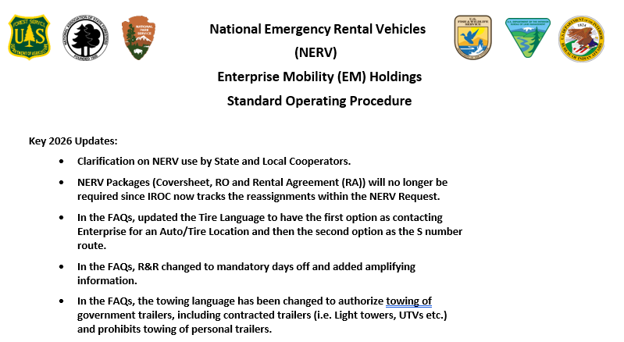
NERV SOP
2026 SOP Available on the NERV website: https://www.wildfire.gov/page/national
-emergency-rental-vehicle-nerv

Slide 3
NERV Facts
The National Emergency Vehicle Rental (NERV) I-BPA is for Emergency Use Rental Cars managed by USFS Equipment Service Branch (ESB) - National Zone (NZ).
Oversite by USFS Fire and Aviation Management (WO FAM).
Enterprise is the vendor. They are not NERV.
Notes:
When you call NERV Support you are talking with USFS! There are no separate NERV Rentals, they are all Enterprise Rentals! We hear, “I have a NERV Vehicle”…you have an Enterprise Rental on the NERV I-BPA.

Slide 4
Scope and Utilization of the I-BPA
The NERV I-BPA is intended to be utilized on incidents by personnel from the NWCG agencies which include:‌
Bureau of Indian Affairs ‌Bureau of Land Management
U.S. Fish & Wildlife Service ‌National Park Service
U.S. Wildland Fire Service
USDA - Forest Service
The National Association of State Foresters
State and Local Cooperators are authorized to use NERV.
AD/Casual Hires are authorized to use NERV.
Contractors (VIPR, EERA, etc.) are prohibited from NERV rental use to include operating NERV vehicles.
Notes:
State and Local governments must be aware of the liability associated with the use of NERV for 3rd party claims. NERV only covers the damage to the Enterprise Rental vehicles when in the performance of their official duties. Contractors: Ground Support needs to make sure they do not hand pool vehicle keys over to Contractors!

Slide 5
NERV Use
NERV must be reserved via IROC by a Dispatch. NERV is not authorized as a counter walk-up and will not be covered!
The NERV program is an acquisition tool for emergency (Incidents, Support, Severity, All Hazard) incident rental vehicles. NERV is not to be used, for example, training (including instructing), preparedness, staff rides, etc. even if on a Resource Order (RO).
NERV is intended for emergency response situations when one or more of the following needs exist:
Standard vehicles for personnel who do not have a Government Travel Card
Incident Pool vehicle requirements
Heavy-Duty (HD) vehicles including:
Trucks requiring higher ground clearance and higher-rated tires such as ¾ and 1 Tons
Large SUVs and ½-ton trucks
Note: These are ordered under “Standard” in IROC. In addition, will most likely not have the higher clearance or higher rated tires.

Slide 6
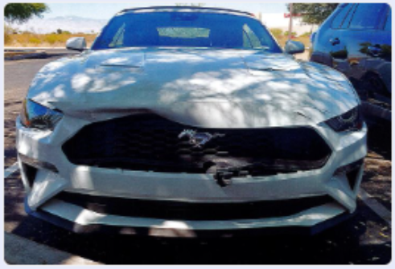
NERV Use (Cont.)
NERV must be on an IROC Request the duration of the rental with no gaps.
Rx’s: NERV is currently only open to single resources in support on
USFS land.
The NERV I-BPA prohibits rentals in Canada or to be driven to Canada!
Cannot be kept beyond 120 days! Around the 90 day mark start the process to turn in and if needed, request a NERV.
Do not reserve or have operator accept a 2-door coupe or a luxury Car. The one below was $4700 in damages!
Notes:
Rx:
Per FY26 FAM Programmatic & Budget Toolbox, project funds must be used to pay for the NERV rental. WFSE, WISXR and NISXR not authorized!
Coupes:
Examples: (i.e. Mustang, Challenger, Camaro etc.), convertible (i.e. Mustang, Camaro etc.) or Luxury Car (i.e. Alfa Romeo, BMW, Mercedes Benz etc.).

Slide 7
Damage/Accident Liability
Please be aware that Operator’s could be held financially responsible for the damage to the NERV Vehicle and to a 3rd party if determined to be gross negligence or non-official use of the vehicle.
NERV is considered a Fleet Vehicle of the Operators agency. Self-Insured (meaning no insurance) and does not have GARS like a vehicle rented from ETS2/Concur! 3rd Party Claims must be submitted to the Operator’s agency. Claims are not handled by the Incident or the NERV Office!
Make sure all accident documentation is turned into sm.fs.nerv@usda.gov . Please keep a copy. Do not leave with Enterprise or Comp/Claims/FSC to process.
Accident/Major Damage: SF-91, SF-94, Photo’s, Police Report. SF-91 needs to be fully filled out and signed!
Damage Only: Statement and Photo’s
Notes:
When the 3rd Party is deemed at fault. NERV will work with Enterprise to have the 3rd party pay damage for the Enterprise Vehicle rented under the NERV BPA.
However, they must have information on the 3rd Party (i.e. Name, address, Phone number, Vehicle/Insurance). Also, need a police report whenever possible. Never admit fault or promise anything. Govt. (Federal/State) Solicitor will make determination. We do pay for brush scratches and hail damage! Please submit statements and photos like you would for other damage! In addition, if you hear/feel anything odd with the vehicle, please stop and inspect to make sure you didn’t hit anything. We get claims frequently where the operator was unaware of any damage. If an Operator, Dispatch or Ground Support receives an Enterprise Damage Claim from Enterprise please forward to sm.fs.nerv@usda.gov.

Slide 8
Categories of Claims
Gross Negligence or Non-Official Use. Operator may be held liable for any damage to the Rental or a 3rd party
Damage not involving another vehicle, Hit/Hit by an Agency Owed Vehicles/GSA or Hit and Run
3rd Party Preliminarily Determined to be at Fault
3rd Party Accident, NERV Operator possibly at Fault

Slide 9
NERV Inspections
Per the 2025 NMAC memo, Vehicle/Heavy Equipment Safety Inspection Checklist (OF-296) are required for all NERV. Local forms are acceptable. NERV Team developed a NERV Inspection Sheet located on the Website.
Main purpose is to document damage so the NERV office can determine whether we should or should not pay a claim based on possible pre-existing damage.
Notes:
Make sure any dents, scratches, windshield crack and missing parts are noted in walk around at the Enterprise Location or at the incident/dispatch if delivered. Please take Photo’s!!! The minimum would be of any pre-existing damage. Make sure any damage is documented by Enterprise also. Inspect the vehicle again when you turn in the vehicle or if you take custody of the vehicle from someone else.

Slide 10
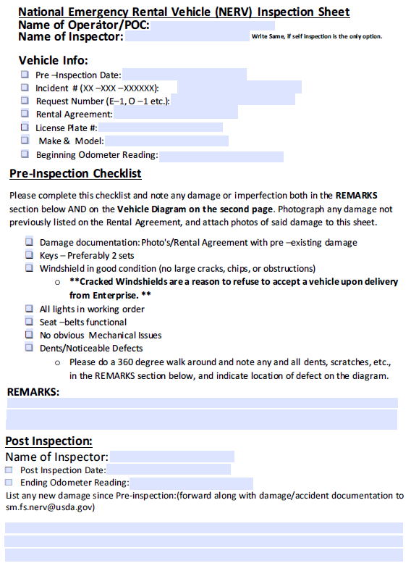
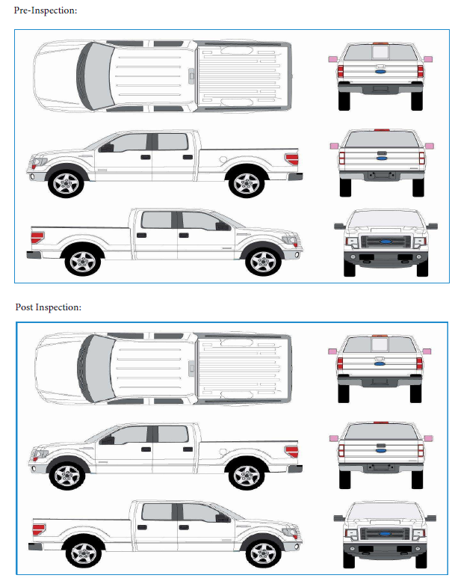

Slide 11
NERV Inspection – Helpful Tips
Helpful tips:
Looking for damage to be documented. If a safety issue (windshield, brakes, light etc.), please contact Enterprise to get a replacement if the rental has already been accepted.
Make sure it is easy to determine which is pre-use/existing and which is release damage if using the OF-296.
3. Fire Extinguishers/Reflectors are not required per the NERV BPA with Enterprise.
Always turn in a clean vehicle. This will help on cleaning charges!
Cleaning can be done while you’re still in travel status.
Notes:
This is different than with VIPR/National Contracts, which are not generally accepted until after they passed an inspection. For NERV, once Operators/Ground Support/Dispatch have the keys and drive off with the Rental, it has been accepted!

Slide 12
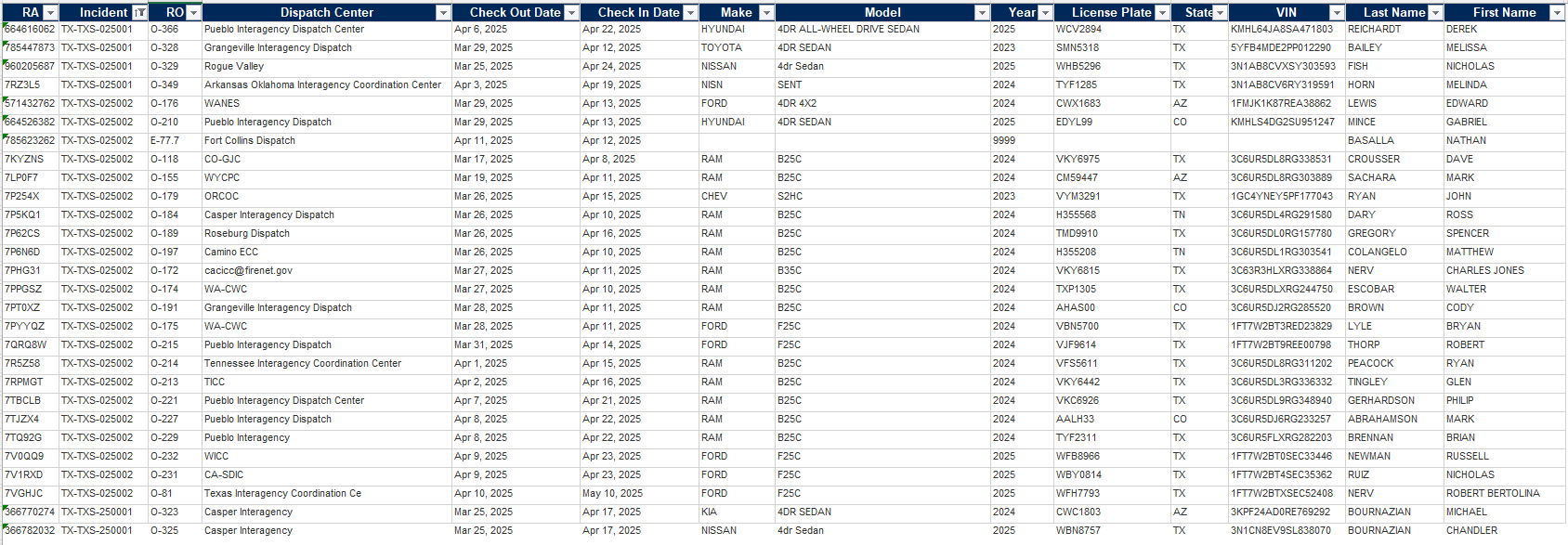
Enterprise Daily Open Ticket Report (OTR)
Daily Report found on https://www.wildfire.gov/page/national-emergency-rental-vehicle-nerv Remember, if the vehicle is listed as what it was originally ordered on.

Slide 13
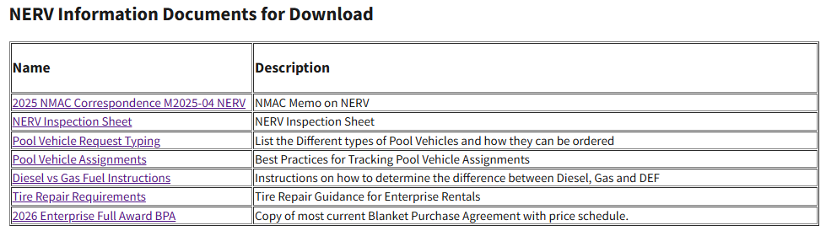
NERV BPA is on the https://www.wildfire.gov/page/national-emergency-rental-vehicle-nerv BPA towards the bottom of the webpage.
Cost Schedule on Page 5!
Example of a charge for an HD Truck:
Weekly rate is 6 times the daily rate and monthly is 24 times the daily rate.
Fee and Surcharges vary by City/County/State.
HD Truck is roughly:
$90 + $30=$120 a day. With fees/surcharges suggest $130 a day for an estimate.

Slide 14
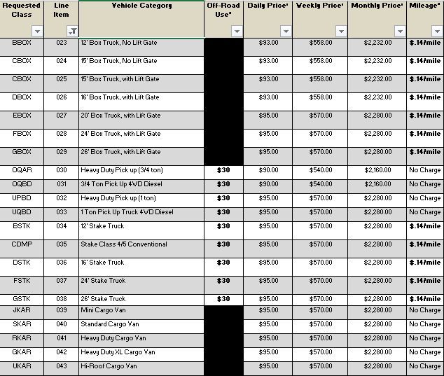
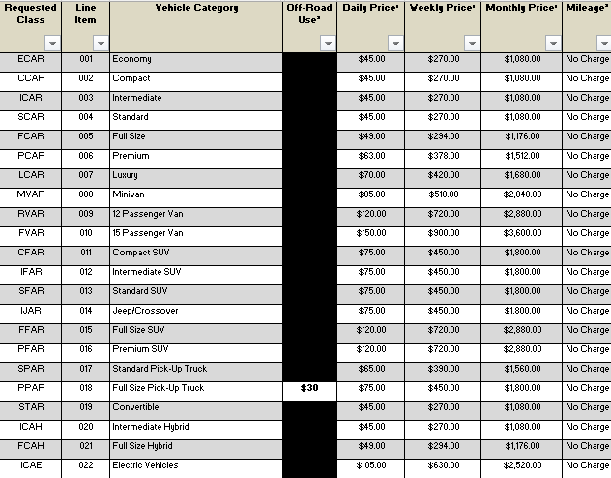
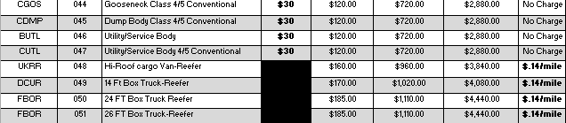

Slide 15
Property Loss and Damage Report (OF-289)
We do see OF 289s and would prefer that they would not be done for NERV Claims.
Don’t want anyone to get a false sense that an approved OF 289 does something.
As you can imagine it doesn’t do anything since it is up to the NERV Contact Specialist.
Only Exception is for Tire’s that need an S#!
Repair of the NERV
If the rental needs repaired (including oil changes and filters) or swapped out, please call the locations that it was picked up or dropped off from and they will guide you. In addition, except for needing to get it off the line, don’t have a Mechanic repair or authorize repairs. Enterprise will need to be contacted and most likely will get the rental swapped out.

Slide 16
Drop Office Location
If there is special circumstance as to why the vehicle cannot be returned to the original location (i.e. Overhead was ordered to another incident in another state, Overhead became ill etc.), a cost analysis will be calculated including the renters M&IE, wages, drop-off fees, fuel, etc. Drop off fee is $1.00 per mile calculated by distance from the pickup location and drop off location.
General rule is standard vehicle to Enterprise Locations, HD Vehicle to Enterprise Truck Locations and Pool Vehicles to the appropriate location. Remember there are fewer Enterprise Truck Locations and they tend to be in bigger areas.
Dropoff Location

Slide 17
Getting the NERV Vehicle Towed
If you have any issues with getting a vehicle towed by Enterprise and it will be delayed or if it’s not in a good location (i.e. on fireline, rugged road etc.), just get it to a secure location.

Slide 18
Tires
Contact the Enterprise branch where the vehicle was picked-up from for an auto/tire retail establishment affiliated with Enterprise.
If this is not an option (distance, small town) you will need to request an S# and pay with a purchase card or have a local micro-purchaser pay for it. Do not put the cost on a travel card.
Notes:
An auto/tire retail establishment affiliated with Enterprise will replace the tire and bill NERV for the tire. See NERV SOP for more Guidance.
Do not take the vehicle to a mechanic or repair facility unless authorized by Enterprise. If it is an emergency, and you are stranded, or are no longer on the incident (traveling home, etc.), please contact Enterprise and they will coordinate a tow or replacement vehicle as necessary.

Slide 19
Who do I contact?
NERV Support | IROC Support | Vendor Support
NERV : 208-390-4868 NERV Email: sm.fs.nerv@usda.gov | Issues with IROC: IIA Help Desk 866-224-7677 | Additional Enterprise Support: enterprisesupport-usfs@em.com Reservations Enterprise Standard Reservations/Cancelations 855-266-9565 HD Vehicle Rental Support Reservations 844-665-4702 (Mon - Fri 8:00 - 17:00 CST) Roadside Assistance Phone Numbers 1/2-ton trucks, SUV's, mini vans and sedans: 1-800-307-6666 HD Pick-up Trucks and Box Trucks: 1-888-736-8287 ext. 3

Slide 20
Questions?

