Slide 1

Dispatcher Training
Equipment Service Branch (ESB) National Zone (NZ)

Slide 2
NERV Process
FS NERV/FAM Monitors BPA
1.
NERV Eligible Rental Need Identified
2. Dispatch
Makes Reservation via IROC
3. Enterprise Provides Rental Vehicle
4. Operational Rental Usage
5. Return to Enterprise
(POST-USE)
6. NERV Invoice/Claim
Payment
(POST-USE)
Notes:
QUICK OVERVIEW OF THE NERV CYCLE

Slide 3
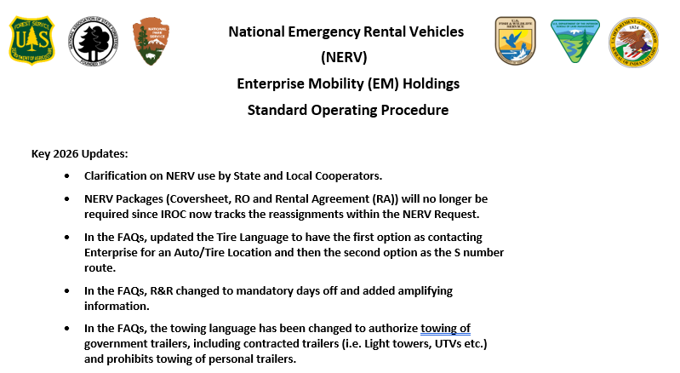
NERV SOP
2026 SOP Available on the NERV website: https://www.wildfire.gov/page/national
-emergency-rental-vehicle-nerv

Slide 4
NERV Facts
The National Emergency Vehicle Rental (NERV) I-BPA is for Emergency Use Rental Cars managed by USFS Equipment Service Branch (ESB) - National Zone (NZ).
Oversite by USFS Fire and Aviation Management (FAM).
Enterprise is the vendor, they are not NERV.
Notes:
When you call NERV Support you are talking with USFS! There are no separate NERV Rentals, they are all Enterprise Rentals! We hear, “I have a NERV Vehicle”…you have an Enterprise Rental on the NERV I-BPA.

Slide 5
Scope and Utilization of the I-BPA
The NERV I-BPA is intended to be utilized on incidents by personnel from the NWCG agencies which include:‌
Bureau of Indian Affairs ‌Bureau of Land Management
U.S. Fish & Wildlife Service ‌National Park Service
U.S. Wildland Fire Service
USDA - Forest Service
The National Association of State Foresters
State and Local Cooperators are authorized to use NERV.
AD/Casual Hires are authorized to use NERV.
Contractors (VIPR, EERA, etc.) are prohibited from NERV rental use to include operating NERV vehicles.
Notes:
State and Local governments must be aware of the liability associated with the use of NERV for 3rd party claims. NERV only covers the damage to the Enterprise Rental vehicles when in the performance of their official duties. Contractors: Ground Support needs to make sure they do not hand pool vehicle keys over to Contractors!

Slide 6
NERV Use
NERV must be reserved via IROC by a Dispatch. NERV is not authorized as a counter walk-up and will not be covered!
The NERV program is an acquisition tool for emergency (Incidents, Support, Severity, All Hazard) incident rental vehicles. NERV is not to be used, for example, training (including instructing), preparedness, staff rides, etc. even if on a Resource Order (RO).
NERV is intended for emergency response situations when one or more of the following needs exist:
Standard vehicles for personnel who do not have a Government Travel Card
Incident Pool vehicle requirements
Heavy-Duty (HD) vehicles including:
Trucks requiring higher ground clearance and higher-rated tires such as ¾ and 1 Tons
Large SUVs and ½-ton trucks
Note: These are ordered under “Standard” in IROC. In addition, will most likely not have the higher clearance or higher rated tires.

Slide 7
NERV Use
NERV must be reserved via IROC by a Dispatch. NERV is not authorized as a counter walk-up and will not be covered!
The NERV program is an acquisition tool for emergency (Incidents, Support, Severity, All Hazard) incident rental vehicles. NERV is not to be used, for example, training (including instructing), preparedness, staff rides, etc. even if on a Resource Order (RO).
NERV is intended for emergency response situations when one or more of the following needs exist:
Standard vehicles for personnel who do not have a Government Travel Card
Incident Pool vehicle requirements
Heavy-Duty (HD) vehicles including:
Trucks requiring higher ground clearance and higher-rated tires such as ¾ and 1 Tons
Large SUVs and ½-ton trucks
Note: These are ordered under “Standard” in IROC. In addition, will most likely not have the higher clearance or higher rated tires.

Slide 8
NERV Reservations
Three Types of Reservation Request:
Standard Request. Instant Reservation.
HD Request. IROC Generated email to Enterprise. Will get a Reservation Email within 2 to 3 Business Hours from Enterprise. Operator do not go to counter until you get the Reservation email.
Pool Request (all types). Will get a Reservation Email within 2 to 3 Business Hours. Don’t send anyone to pickup rental until you get the Reservation email.
Standard and HD Request Vehicles are Non-Pool!
Non-Pool Example as O-1, O-1.1 (Fire Module/IMT), C-1.1, A-1.1, E-1.1
Pool are tied to an Equipment Transportation Resource (E-1). In some case a Crew/Engine/Dozer/Heliatack will want to order as Pool Vehicle if its for more that one assignment and the subordinate’s will be switching out.
In most cases the Filling Dispatch will reserve Standard and HD Truck. Requesting Dispatch will most likely reserve Pool Vehicles since the rentals are for an Incident they are managing.
Can I make the Reservation at the Enterprise Counter or on the phone? No, the only way to get a NERV Reservation is via the reservation system. If you have issues making the Reservation, please look at the IROC help or call the IROC Help Desk.

Slide 9
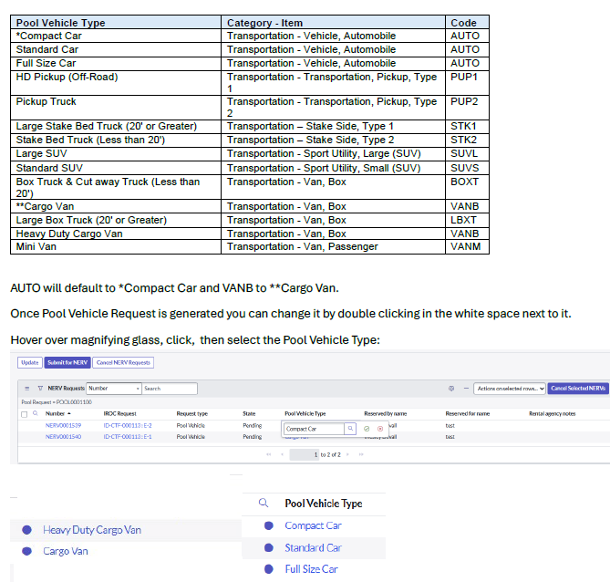
Equipment Transportation Resources

Slide 10
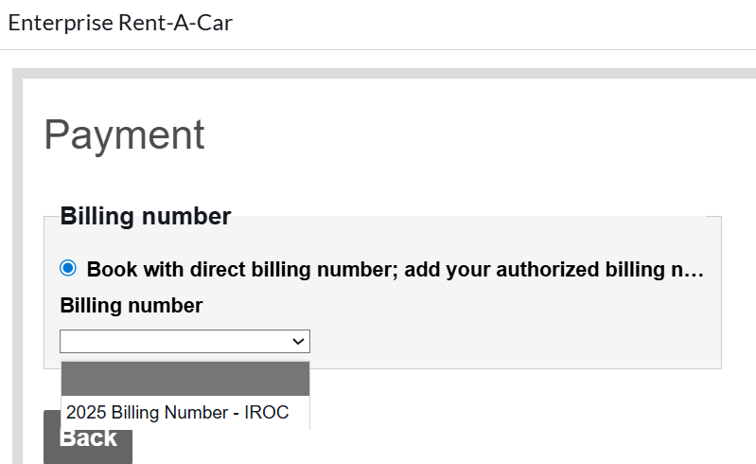
Standard Vehicle Billing Number
Do not submit the Standard NERV request until you see the Billing number populated. If the blank is selected, when the rental is picked up, Enterprise will ask for a credit card!
Note: The current billing number is 2026 Billing Number – IROC. Do not select the blank!

Slide 11
Cancelations/Modification
Standard Request can be canceled in IROC if prior to the pickup date.
For HD/Pool Request and Standard Request after the pickup date, you must contact Enterprise. Once the request has gone out, there is no more communication with Enterprise on Reservations via IROC.
Enterprise Does Not Have Access to IROC. IROC simply takes you to the Enterprise site for the Standard Reservation or sends the email for HD/Pool Vehicles.
Any cancellation/modification of the IROC Request after the reservation has been submitted does not modify the NERV Reservation!
Any comments in the documentation of the NERV Request is internal and not transmitted or seen by Enterprise.
Cancelation of the Standard NERV Request: We still see some issues where the NERV Request will cancel with Enterprise but will not move it to Cancelled in IROC. This normally happens in the Dispatch Portal. If you use the DMT, it will cancel the Reservations with Enterprise and move it to Cancelled in IROC.

Slide 12
NERV Communication IROC and Enterprise
IROC:
Reservation (Standard, HD, Pool)
Cancelations (Standard only and prior to pickup date/time)
Enterprise:
Open Ticket Report (OTR) Loaded into IROC Daily at 9:30 MT
Any OTR Corrections will be made via NERV Support Team

Slide 13
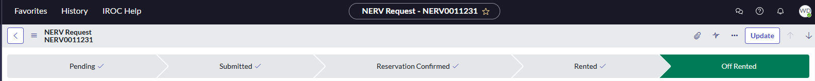
IROC Terms
IROC State:
Pending=NERV Request is still pending and nothing has been sent to Enterprise.
Submitted (HD/Pool)=Reservation has been sent, will receive an email with Reservation information in 2 to 3 business hours.
Reservation Confirmed (Standard)=Instant Reservation
Rented=Once the OTR has been updated and loaded into IROC, the vehicle will move to Rented. This might take one to two days after picked up! For Pool Vehicles, this will also fill the IROC Request.
Off Rented= Once the OTR has been updated and loaded into IROC, the vehicle will move to Off Rented. This might take one to two days after turned in! For Pool Vehicles, this will also release it from IROC.
DMT:

Slide 14

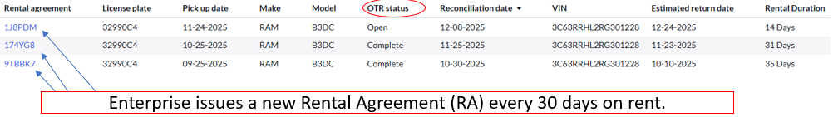
Enterprise Terms
Enterprise Open Ticket Report (OTR) Status:
Open=NERV is still on the OTR
Pend Close=NERV Turned in but not fully processed and still on the OTR
Complete=Fully turned in and no longer on OTR, unless there is a new Rental agreement.
DMT:

Slide 15
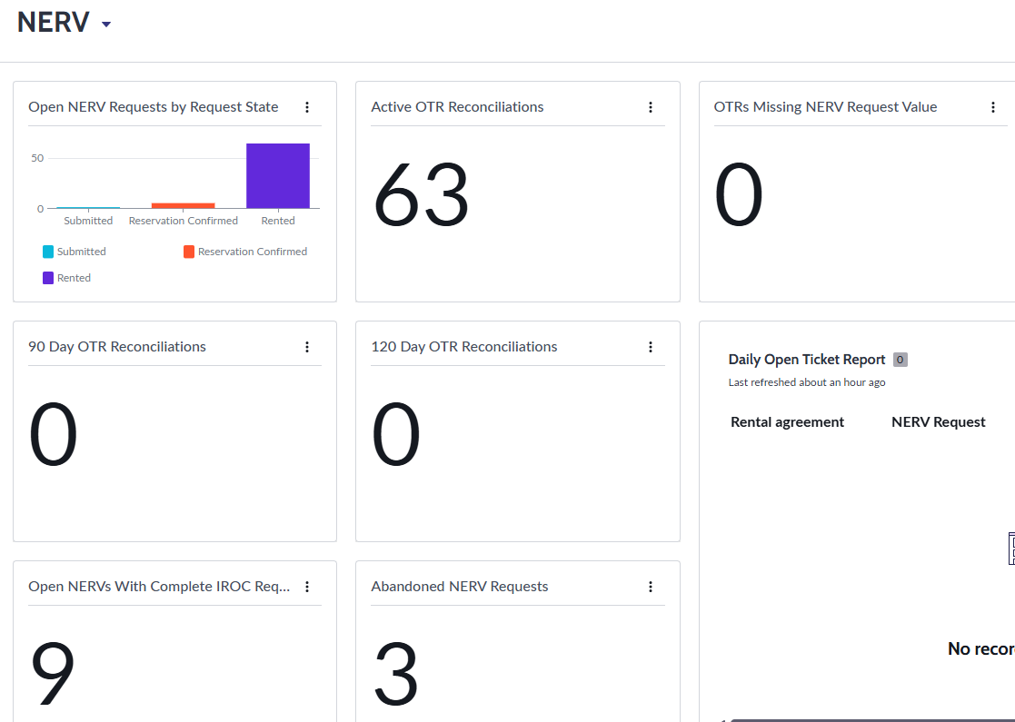
Abandoned NERV
An Abandoned NERV in IROC is when the IROC Request is broke off the NERV Request. This can happen when the IROC Request is unfilled or if the IROC Request has been cancelled. The NERV Team monitors the Abandoned NERV List.
IROC NERV Dashboard:

Slide 16

IROC Request (RO) O, C, A
O# requests
The reservation needs to be made on their O-# and would be a Standard or HD Request. Example O-1 and
O-1.1 for IMTs Positions or Fire Module Positions
C# requests
The reservation needs to be made for the Subordinate who will be responsible for the tracking of NERV and would be a Standard or HD Request. Example – C-1.1
A# requests
The reservation needs to be made for the Subordinate who will be responsible for the tracking of NERV and would be a Standard or HD Request. Example – A-1.1
Be advised that if the A, C, E Engines/Dozers or O Fire Module are going to have the NERV for multiple assignments, please order as a Pool Vehicle, especially if the subordinate it was ordered on will not be on every assignment.
If it is necessary to have more than one NERV ordered on the same IROC Request, you will need to contact the IROC Help Desk to facilitate the request. However, should be an exception and not the rule. Also, if the NERV is turned in/off rented and they are coming back on under the same RO number, a new RO will need to be generated to get the NERV Request Button!
If the NERV is not going to follow on the reassignment then Uncheck “follow Reassign” in the NERV Request prior to reassign the resource.

Slide 17
IROC Request (RO) E
E# requests
For Equipment that are rostered (Engine Crew, Dozer Operator) the reservation needs to be made for the subordinate who will be responsible for tracking of the NERV. Would be a Standard or HD Request. Example - E-1.1
Unless being ordered for multiple assignment. For multiple, order as a Pool Vehicle.
For Equipment Transportation Resources, will be ordered as a Pool Request. Example
E-1. Ground Support would be the Contact. If Ground Support not set up, then the name of who will be managing the pool vehicle.
No generic information like NERV E-1, Smokey Bear, Fire Support E-15 for examples.
On all NERV Request, if you mark the IROC Request Complete, the NERV Request will be closed at that point. If the IROC Request was marked complete in error, but should have been reassigned instead, it needs to be fixed so the NERV will follow to the next assignment.

Slide 18
Best Practices for Tracking Pool Vehicles
See NERV Website for the Best Practices for Tracking Pool Vehicles.

Slide 19
Open NERVs with Complete IROC Request
As mentioned earlier in the training, NERV must be on an IROC Request the duration of the rental with no gaps. IROC has a report under NERV Dashboard the will show all open NERVs with a complete IROC Request. It will be monitored by the NERV Teams. Please respond as soon as possible if you get an email from the NERV Team.

Slide 20
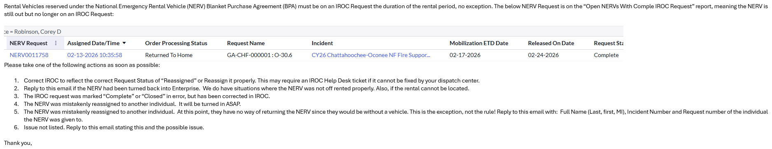
Open NERVs with Complete IROC Request Email Example

Slide 21
NERV Inspections
Per the 2025 NMAC memo, Vehicle/Heavy Equipment Safety Inspection Checklist (OF-296) are required for all NERV. NERV has developed an Inspection Sheet that can be used.
Main purpose is to document damage so the NERV office can determine whether we should or should not pay a claim based on possible pre-existing damage.
Please forward inspections to sm.fs.nerv@usda.gov with license plate or Incident Number ordered on.
Notes:
Make sure any dents, scratches, windshield crack and missing parts are noted in walk around at the Enterprise Location or at the incident/dispatch if delivered. Please take Photo’s!!! The minimum would be of any pre-existing damage. Make sure any damage is documented by Enterprise also. Inspect the vehicle again when you turn in the vehicle or if you take custody of the vehicle from someone else.

Slide 22
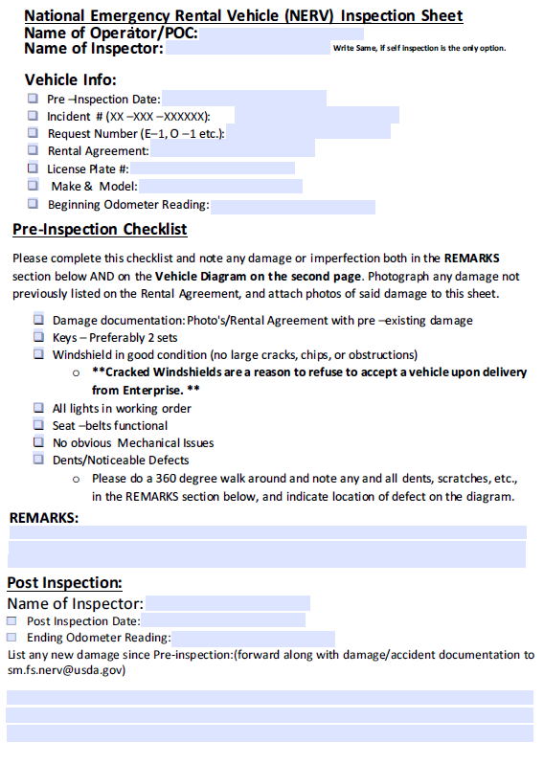
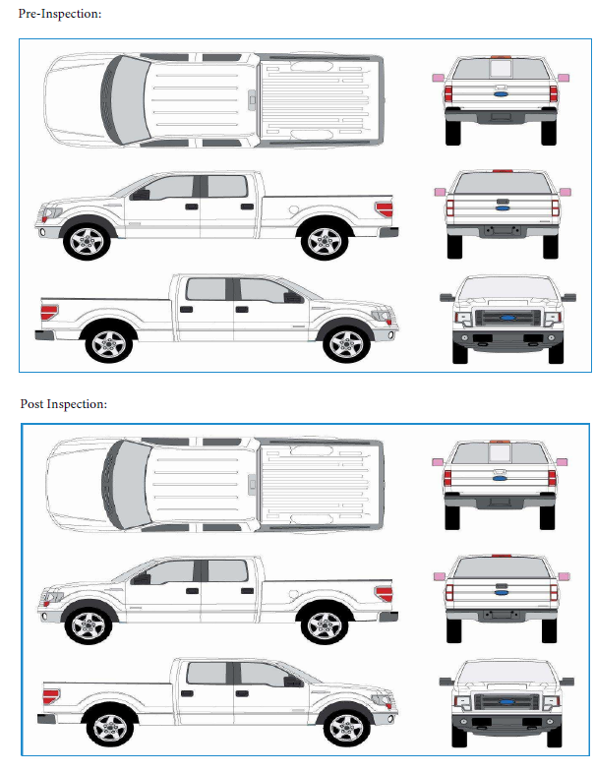

Slide 23
NERV Inspection – Helpful Tips
Helpful tips:
Looking for damage to be documented. If a safety issue (windshield, brakes, light etc.), please contact Enterprise to get a replacement if the rental has already been accepted.
Make sure it is easy to determine which is pre-use/existing and which is release damage.
3. Fire Extinguishers/Reflectors are not required per the NERV agreement with Enterprise.
4. Always turn in a clean vehicle. This will help on cleaning charges!
Notes:
This is different than with VIPR/National Contracts, which are not generally accepted until after they passed an inspection. For NERV, once Operators/Ground Support/Dispatch have the keys and drive off with the Rental, it has been accepted!

Slide 24
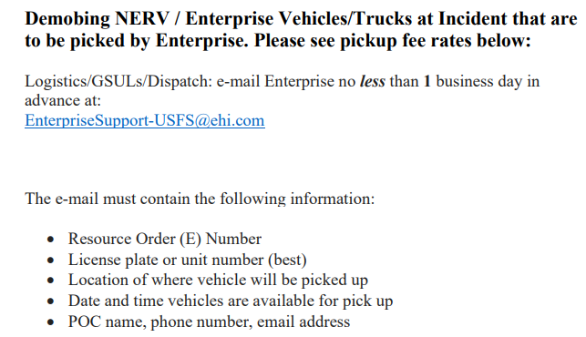
Demob Pickup
Never arrange a Demob pickup via text or phone call. Always send and email with the information listed below
Fee is $1.00 per mile or $2.50 per mile for a transport and will be added to the NERV Invoice.

Slide 25
Towing
Even if the towing was arranged by Roadside Assistance, send an email to enterpriseSupport-USFS@ehi.com with the following information:
Incident Number (example: AB-CDE-000001)
Request Number (example: E-1)
License Plate Number
Date and Time Towed
Tow Company Name/Phone Number
Location Towed to
Govt POC Name, Phone Number and Email address

Slide 26
Drop off at a Enterprise Different Location
If circumstances require a different drop-off location, a drop fee will be incurred.
$1 per mile from pickup to drop location. Example if the difference is 100 miles, a $100 will be added to the NERV Invoice.
The general rule is standard vehicle to Enterprise Locations and HD Vehicle to Enterprise Truck Locations. Remember there are fewer Enterprise Truck Locations, and they tend to be in bigger areas.

Slide 27
Property Loss and Damage Report (OF-289)
We do see OF 289s and would prefer that they would not be done for NERV Claims.
Don’t want anyone to get a false sense that an approved OF 289 does something.
As you can imagine it doesn’t do anything since it is up to the NERV Contact Specialist.
Only Exception is for Tire’s that need an S#!
Repair of the NERV
If the rental needs repaired (including oil changes and filters) or swapped out, please call the locations that it was picked up or dropped off from and they will guide you. In addition, except for needing to get it off the line, don’t have a Mechanic repair or authorize repairs. Enterprise will need to be contacted and most likely will get the rental swapped out.

Slide 28
Tires
Contact the Enterprise branch where the vehicle was picked-up from for an auto/tire retail establishment affiliated with Enterprise.
If this is not an option (distance, small town) you will need to request an S# and pay with a purchase card or have a local micro-purchaser pay for it. Do not put the cost on a travel card.
Notes:
An auto/tire retail establishment affiliated with Enterprise will replace the tire and bill NERV for the tire. See NERV SOP for more Guidance.
Do not take the vehicle to a mechanic or repair facility unless authorized by Enterprise. If it is an emergency, and you are stranded, or are no longer on the incident (traveling home, etc.), please contact Enterprise and they will coordinate a tow or replacement vehicle as necessary.

Slide 29
Reassigning of NERV
Single Resource Overhead, O dot, A dot, C dot numbers (O-1, O-1.1, A-1.1 and C-1.1). No. Person-to-person vehicle reassignments are prohibited and must be returned to the rental provider. If this happens, NERV Support must be contacted immediately.
E dot numbers (E-1.1).
No. Person-to-person reassignments are prohibited and must be returned to the rental provider. If this happens, NERV Support must be contacted immediately.
The operator and vehicle can be reassigned together from incident to incident, but the vehicle must be returned by the original renter to the rental provider after the final assignment is complete. The vehicle must always be on an IROC Request while the vehicle is under rent.
Equipment (E) pool vehicles.
Yes, by ground support or dispatch only. Ground support and dispatch centers are the only facilitators of a pool vehicle reassignment. Only HD vehicles are eligible for reassignment. Ground support and dispatch centers reserve the right not to facilitate reassignment. In addition, please ensure that the Pool Vehicle NERV Request follows the reassignment in IROC.
E pool vehicles on an incident need to use the Pool Vehicle Custody Log every time a new operator is using the pool vehicle. This will ensure the incident is aware of who has possession of the rental and who to contact for damage found during that period.
Transferring from one GSUL to another GSUL is requested by sending a General Message to dispatch.
Additional guidance:
For O, O dot, A dot, C dot, and E dot, the operator and vehicle can be reassigned together from incident to incident, but the vehicle must be returned by the original renter to the rental provider after the final assignment is complete. The vehicle must always be on an IROC Request while the vehicle is under rent.
Notes:
For Standard and HD Vehicles, the NERV are assigned to an individual. If the NERV is given to another individual then the tracking has been lost.

Slide 30
Ground Support
Ground Support Managing Pool Vehicles
Equipment Resource Pool vehicle(s) needed will be managed by a ground support, or dispatch if ground support not established, and will be utilized by multiple resources.
Ground Support Unit Leader (GSUL) requesting the NERV vehicles must be listed as the renter. Please do not use generic information as the renter such as: Big Fire E-15 or Smokey Bear. GSUL will be the renter of and will be responsible for tracking the NERV pool vehicles until such time that the vehicles are either returned to Enterprise or the current GSUL transfers the vehicles to the incoming GSUL.
For GSUL transfer: This will be done via General Message (GM) to dispatch. Dispatch needs to make a note under documentation in the IROC NERV Request since the Enterprise Open Ticket (OTR) will not change. The GM can be attached to the IROC NERV Request.

Slide 31
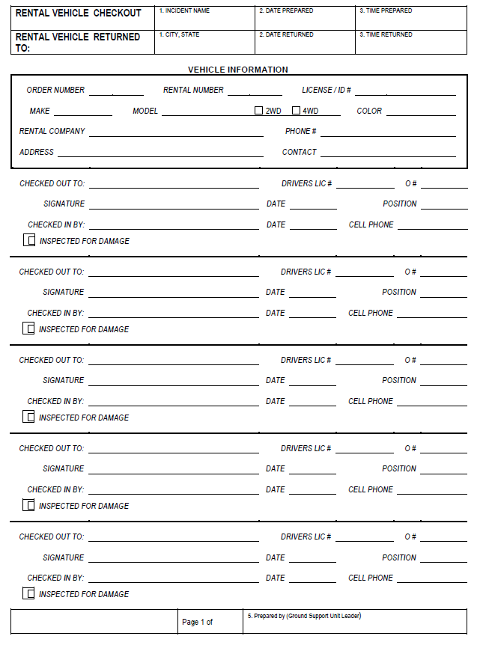
Pool Vehicle Custody Log
Pool Vehicles need to have a Pool Vehicle Custody Log when being used on the same incident with multiple drivers.
This becomes very important when with regards to claims and camera citations.

Slide 32
Who do I contact?
NERV Support | IROC Support | Vendor Support
NERV : 208-390-4868 NERV Email: sm.fs.nerv@usda.gov | Issues with IROC: IIA Help Desk 866-224-7677 | Additional Enterprise Support: enterprisesupport-usfs@em.com Reservations Enterprise Standard Reservations/Cancelations 855-266-9565 HD Vehicle Rental Support Reservations 844-665-4702 (Mon - Fri 8:00 - 17:00 CST) Roadside Assistance Phone Numbers 1/2-ton trucks, SUV's, mini vans and sedans: 1-800-307-6666 HD Pick-up Trucks and Box Trucks: 1-888-736-8287 ext. 3

Slide 33
Questions?

