Slide 1

Equipment Service Branch (ESB)
National Zone (NZ)

Slide 2
NERV Team
PPS/ESB National Zone (NZ) Supervisor/NERV I-BPA Contact Specialist:
Tonya Campbell
WO/FAM:
Sarah Petroff
Lead Contract Coordinator:
Celina Cash
Contract Coordinators:
Wesley DeVall
Lameshia Anderson
Beth Arsenault
Beth Fildes (ESB NZ Purchasing Agent)
Melissa Eldridge-Colgan (Surge Support)

Slide 3
NERV Process
FS NERV/FAM Monitors BPA
1.
NERV Eligible Rental Need Identified
2. Dispatch
Makes Reservation via IROC
3. Enterprise Provides Rental Vehicle
4. Operational Rental Usage
5. Return to Enterprise
(POST-USE)
6. NERV Invoice/Claim
Payment
(POST-USE)
Notes:
QUICK OVERVIEW OF THE NERV CYCLE

Slide 4
NERV Facts
The National Emergency Vehicle Rental (NERV) I-BPA is for Emergency Use Rental Cars managed by USFS Equipment Service Branch (ESB) - National Zone (NZ).
Oversite by USFS Fire and Aviation Management (FAM).
Enterprise is the vendor, they are not NERV.
Notes:
When you call NERV Support you are talking with USFS! There are no separate NERV Rentals, they are all Enterprise Rentals! We hear, “I have a NERV Vehicle”…you have an Enterprise Rental on the NERV I-BPA.

Slide 5
Scope and Utilization of the I-BPA
The NERV BPA is intended to be utilized on incidents by personnel from the NWCG agencies which include:‌
Bureau of Indian Affairs ‌Bureau of Land Management
U.S. Fish & Wildlife Service ‌National Park Service
USDA - Forest Service
The National Association of State Foresters
State and Local Cooperators are authorized to use NERV.
AD/Casual Hires are authorized to use NERV.
Contractors (VIPR, EERA, etc.) are prohibited from NERV rental use to include operating NERV vehicles.
Notes:
State and Local governments must be aware of the liability associated with the use of NERV for 3rd party claims. NERV only covers the damage to the Enterprise Rental vehicles when in the performance of their official duties. Contractors: . Ground Support needs to make sure they do not hand pool vehicle keys over to Contractors!

Slide 6
NERV Use
The NERV program is an acquisition tool for emergency (Incidents, Support, Severity, All Hazard) incident rental vehicles.
NERV is for emergency response meeting one of these needs:
-Standard Vehicles for those without a Gov’t Travel
card
-Truck (including Box, Stakeside etc..) and Large SUV
needs
-Incident Pool vehicle needs

Slide 7
NERV Use (Cont.)
NERV must be on an IROC Request the duration of the rental with no gaps.
NERV is not to be used, for example, training (including instructing), preparedness, staff rides, etc. even if on a Resource Order (RO).
NERV must be reserved via IROC by a Dispatch. NERVs are never authorized as a counter walk-up and will not be covered!
Notes:
IROC Request cancelled after the reservation has been submitted and the NERV was picked up need to have an IROC Request to charge to until the NERV is turned back in. In some cases it might need to be the charged to the cancelled IROC request. This is something that can now be monitored in IROC. If you get contacted, please don’t send IROC Request, we have them! Just like with regular travel, you have to be on an order/authorization.

Slide 8
NERV Use (Cont.)
Rx’s: NERV is currently only open to single resources in support on
USFS land.
The NERV I-BPA prohibits rentals in Canada or to be driven to Canada!
Do not reserve or have operator accept a 2-door coupe or a luxury Car.
Cannot be kept beyond 120 days!
Notes:
Rx:
Per FY26 FAM Programmatic & Budget Toolbox, project funds must be used to pay for the NERV rental. WFSE, WISXR and NISXR not authorized!
Coupes:
Examples: (i.e. Mustang, Challenger, Camaro etc.), convertible (i.e. Mustang, Camaro etc.) or Luxury Car (i.e. Alfa Romeo, BMW, Mercedes Benz etc.).

Slide 9
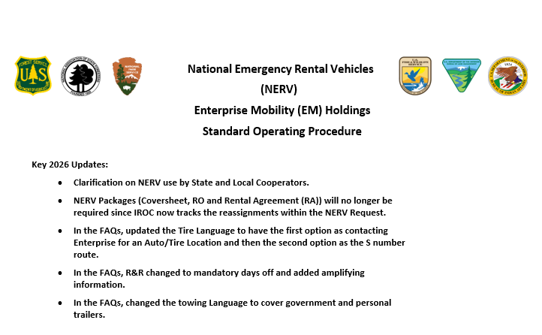
NERV SOP
2026 SOP Available on the NERV website: https://www.wildfire.gov/page/national
-emergency-rental-vehicle-nerv

Slide 10
NERV Inspections
Per the 2025 NMAC memo, Vehicle/Heavy Equipment Safety Inspection Checklist (OF-296) are required for all NERV. Local forms are acceptable.
Main purpose is to document damage so the NERV office can determine whether we should or should not pay a claim based on possible pre-existing damage.
Notes:
Make sure any dents, scratches, windshield crack and missing parts are noted in walk around at the Enterprise Location or at the incident/dispatch if delivered. Please take Photo’s!!! The minimum would be of any pre-existing damage. Make sure any damage is documented by Enterprise also. Inspect the vehicle again when you turn in the vehicle or if you take custody of the vehicle from someone else.

Slide 11
NERV Inspection – Helpful Tips
Helpful tips:
Looking for damage to be documented. If a safety issue (windshield, brakes, light etc.), please contact Enterprise to get a replacement if the rental has already been accepted.
Make sure it is easy to determine which is pre-use/existing and which is release damage.
3. Fire Extinguishers/Reflectors are not required per the NERV agreement with Enterprise.
4. Always turn in a clean vehicle. This will help on cleaning charges!
Notes:
This is different than with VIPR/National Contracts, which are not generally accepted until after they passed an inspection. For NERV, once Operators/Ground Support/Dispatch have the keys and drive off with the Rental, it has been accepted!

Slide 12
Damage/Accident Liability
Please be aware that Operator’s could be held financially responsible for the damage to the NERV Vehicle and to a 3rd party if determined to be gross negligence or non-official use of the vehicle.
NERV is considered a Fleet Vehicle of the Operators agency. Self-Insured (meaning no insurance) and does not have GARS like a vehicle rented from ETS2/Concur! 3rd Party Claims must be submitted to the Operator’s agency. Claims are not handled by the Incident or the NERV Office!
Make sure all accident documentation is turned into sm.fs.nerv@usda.gov . Please keep a copy. Do not leave with Enterprise or Comp/Claims/FSC to process.
Accident/Major Damage: SF-91, SF-94, Photo’s, Police Report. SF-91 needs to be fully filled out and signed!
Damage Only: Statement and Photo’s
Notes:
When the 3rd Party is deemed at fault. NERV will work with Enterprise to have the 3rd party pay damage for the Enterprise Vehicle rented under the NERV BPA.
However, they must have information on the 3rd Party (i.e. Name, address, Phone number, Vehicle/Insurance). Also, need a police report whenever possible. Never admit fault or promise anything. Govt. (Federal/State) Solicitor will make determination. We do pay for brush scratches and hail damage! Please submit statements and photos like you would for other damage! In addition, if you hear/feel anything odd with the vehicle, please stop and inspect to make sure you didn’t hit anything. We get claims frequently where the operator was unaware of any damage. If an Operator, Dispatch or Ground Support receives an Enterprise Damage Claim from Enterprise please forward to sm.fs.nerv@usda.gov.

Slide 13
Tires
Contact the Enterprise branch where the vehicle was picked-up from for an auto/tire retail establishment affiliated with Enterprise.
If this is not an option (distance, small town) you will need to request an S# and pay with a purchase card or have a local micro-purchaser pay for it. Do not put the cost on a travel card.
Notes:
An auto/tire retail establishment affiliated with Enterprise will replace the tire and bill NERV for the tire. See NERV SOP for more Guidance.
Do not take the vehicle to a mechanic or repair facility unless authorized by Enterprise. If it is an emergency, and you are stranded, or are no longer on the incident (traveling home, etc.), please contact Enterprise and they will coordinate a tow or replacement vehicle as necessary.

Slide 14
Fuel - NERV
NERV users are required to refuel their vehicles prior to returning the vehicle back to Enterprise!
NERV users must be cognizant of the type of fuel required for the vehicle they are driving. Not all HD Trucks are Diesel!
Notes:
NERV Receives on average of 10 claims a year for Diesel in Gas/Gas in Diesel/DEF in Fuel tank (DEF has it’s own tank). Repairs are $1200 for a fuel tank drain to $35,000 for a blown engine.

Slide 15
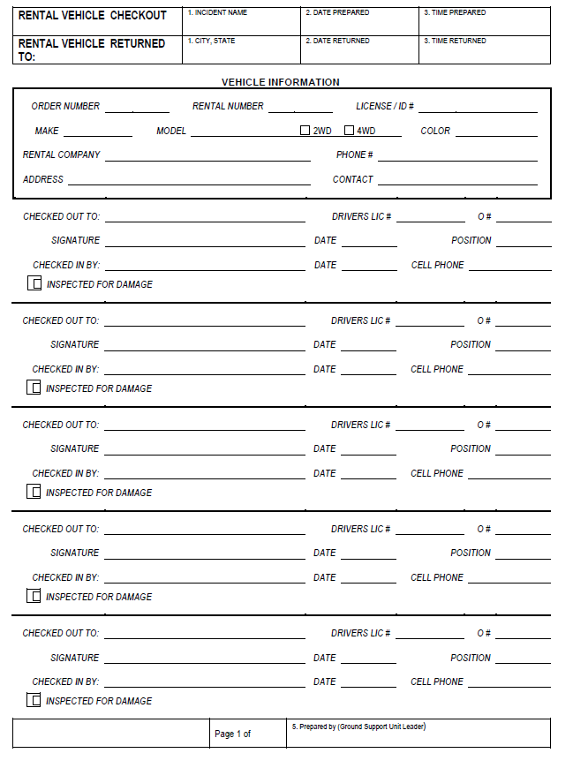
Pool Vehicle Custody Log
Pool Vehicles need to have a Pool Vehicle Custody Log when being used on the same incident with multiple drivers.
This becomes very important when with regards to claims and camera citations.

Slide 16
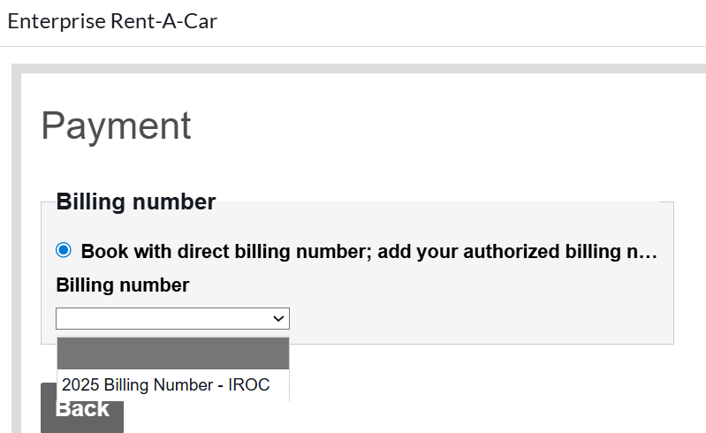
Standard Vehicle Billing Number
Do not submit the Standard NERV request until you see the Billing number populated. If the blank is selected, then Enterprise will ask for a credit card!
Note: The current billing number is 2025 Billing Number – IROC. Most likely will change to 2026 Billing Number – IROC after the NERV BPA has been signed in late February.

Slide 17
Who do I contact?
NERV Support | IROC Support | Vendor Support
NERV : 208-390-4868 NERV Email: sm.fs.nerv@usda.gov | Issues with IROC: IIA Help Desk 866-224-7677 | Additional Enterprise Support: enterprisesupport-usfs@em.com Reservations Enterprise Standard Reservations/Cancelations 855-266-9565 HD Vehicle Rental Support Reservations 844-665-4702 (Mon - Fri 8:00 - 17:00 CST) Roadside Assistance Phone Numbers 1/2-ton trucks, SUV's, mini vans and sedans: 1-800-307-6666 HD Pick-up Trucks and Box Trucks: 1-888-736-8287 ext. 3

