Slide 1
Fire Preparedness Plans and their Relationship to the FDOP
Lesson #15
Notes:
Slide # 1
Lesson #15: Fire Preparedness Plans and their Relationship to the FDOP
Lesson Time: 60 minutes (followed by Task 7)
Facilitator Notes:
Don’t forget to fill in the “Workshop Dates” and “Workshop Location” on the bottom right of this title slide.

Slide 2
Objectives:
Outline the relationship of the FDOP to subordinate fire preparedness plans, including the preparedness, staffing, response, and restriction plans.
Discuss the obstacles which may inhibit successful implementation of these preparedness plans and ways to overcome them.
Notes:
Slide # 2
Lesson Objectives:
Outline the relationship of the FDOP to subordinate fire preparedness plans, including the preparedness, staffing, response, and restriction plans.
Discuss the obstacles which may inhibit successful implementation of these preparedness plans and ways to overcome them.

Slide 3
Objectives (cont’d):
Determine the essential components of each plan as it relates to the specific target groups and associated fire occurrences identified in Task 3.
Notes:
Slide # 3
Lesson Objectives:
Determine the essential components of each plan as it relates to the specific target groups and associated fire occurrences identified in Task 3.

Slide 4
Introduction
The National Fire Danger Rating System (NFDRS) is a decision-support tool incorporating scientific methodology and applied statistics to produce objective outputs. When used appropriately, the NFDRS can counter the subjective influence of personal perspectives, feelings, or opinions entering the decision making process.
Notes:
Slide # 4
INTRODUCTION:
The National Fire Danger Rating System (NFDRS) is a decision-support tool which incorporates scientific methodology and applied statistics to produce objective outputs. When used appropriately, the NFDRS can counter the influence of personal perspectives, feelings, or opinions entering the decision making process (cognitive bias).
KEY POINTS: NFDRS utilizes a structured, analytical process using historical fire and weather data that offers fire managers and agency administrators current fire danger information. The tools and information derived using NFDRS is intended to assist with daily fire danger related decision making.
NFDRS is used to provide a measure of the relative seriousness of burning conditions and threat of fire. This system allows fire managers to estimate today's or tomorrow's fire danger for a given area. NFDRS outputs should be consulted by decision makers because they can provide current information in relation to fuel conditions for a defined area which is described in the local unit’s Fire Danger Operating Plan (FDOP).

Slide 5
.
Response Plan
Staffing Plan
Preparedness Plan
Prevention Plan
Response Level
The number/type of resources dispatched to an initial fire report (engines, crews, aircraft, etc.)
Staffing Level
Daily staffing decisions regarding the “degree of readiness” for initial attack (IA)
Preparedness Level
Weekly or monthly planning decisions based upon seasonal fire danger elements
Adjective Rating Level
Five standard adjective descriptions for public information and signing
Notes:
Slide # 5
The focus of this lesson is on the Plans tiered to the Fire Danger Operating Plan (“subordinate plans”) include:
Response Level
The number/type of resources dispatched to an initial fire report (engines, crews, aircraft, etc.)
Staffing Level
Daily staffing decisions regarding the “degree of readiness” for initial attack (IA)
Preparedness Level
Weekly or monthly planning decisions based upon seasonal fire danger elements
Adjective Rating
Five standard adjective descriptions for public information and signing
The FDOP provides the supporting information to aid in the development of each subordinate plan. The development of the subordinate plans requires a deliberate, collaborative approach. The benefits from investing the time and effort towards this process will be realized as the plans and associated tools are implemented.

Slide 6
Application of NFDRS
Fire managers are provided with fire business thresholds documented in the FDOP and can develop pre-planned actions to be initiated at each decision point. The identified actions to be taken are intended (in some way) to change the behavior of a specific target group previously identified in the fire occurrence workload analysis.
Notes:
Slide # 6
Fire business threshold examples include:
The range of ERC values in an adjective fire danger rating chart that defines the “low”, “moderate”, “high”, “very high”, and “extreme” levels.
The range of IC values that define “low”, “moderate”, and “high” response levels.
The range of ERC values in a preparedness plan that help to determine the level of preparedness for a dispatch zone.
Examples of identified actions may include:
Preparedness Plan - PL 4: “FMO’s will evaluate season severity data (NFDRS indices for the season, fuel loading, fuel moisture, drought indices, long-term forecasts).”
Staffing Plan – Staffing Level 4: “Initial attack resource staffing will increase from 5-day staffing to 7-day staffing.”
Adjective Fire Danger Level – Very High: “Consider implementing restrictions/closure orders for recreational and industrial activities.”

Slide 7
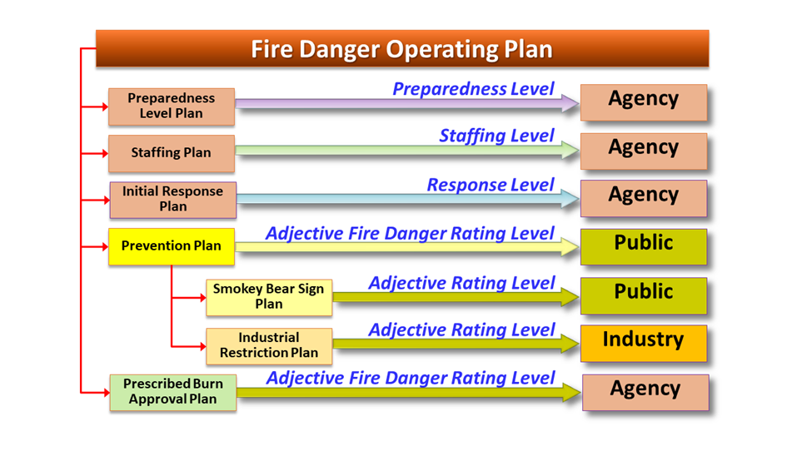
Application of NFDRS
Notes:
Slide # 7
This graphic illustrates the relationship between the Fire Danger Operating Plan, the associated subordinate plans and related target audiences.
The FDOP provides a science-based “tool” for fire managers to incorporate a measure of risk associated with decisions which have the potential to significantly compromise firefighter and public safety and control of wildland fires.
The Staffing Level is used to guide daily internal fire operational decisions at the local level. The Staffing Level specifies appropriate daily staffing for initial response resources, such as when to implement 7-day coverage and adjusted work schedules, and the number of personnel committed to initial attack resources.
Ask workshop participants why a Staffing Plan may be an important tool not only for fire managers but also for crew bosses, module leads, and fire fighters to understand

Slide 8
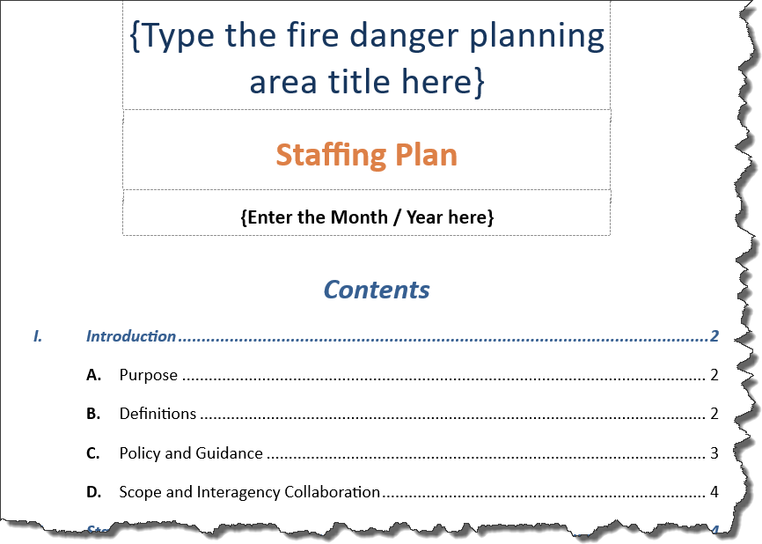
Staffing Plan
Workshop Template
Notes:
Slide # 8

Slide 9
Staffing Levels
Target Group: Agency
Five Staffing Levels
Fire Business Analysis documented in FDOP
Actions documented in Staffing Plan
Supports short-term (daily) staffing decisions
Notes:
Slide # 9
Best Practice: Staffing Levels
The Staffing Level forms the basis for decisions regarding the “degree of readiness” of initial attack (IA) resources and support resources.
Key Points:
Target Group: Agency
Five Staffing Levels
Fire Business Analysis (thresholds) documented in FDOP
Application / Actions documented in Staffing Plan
Each participating agency may choose to develop their own Staffing Plan
Note: experience has demonstrated that interagency staffing plans do not work due to differences in funding and human resource policies and practices.
However, the thresholds at which staffing decision would occur is still valid, regardless of agency jurisdiction.
Bottom Line: all agencies should use the Staffing Levels thresholds documented in the Interagency FDOP; each agency will determine the actions they will take at each Staffing Level
Supports short-term (daily) staffing decisions (ie extra personnel for tomorrow or extensions tonight)

Slide 10
Staffing Plan
The Staffing Plan should consider:
Capacity to fulfill initial attack responses
Dispatch staffing
Potential for extended or after-hours response
Aerial supervision
Funding source(s)
Interagency coordination
Notes:
Slide # 10
The Staffing Plan describes pre-approved escalating responses that may be listed in a Staffing Plan matrix (see example next slide). The Staffing Plan should also include recurring supplemental preparedness actions designed to enhance the unit’s fire management capability during short periods (Fourth of July, or other pre-identified events) where staffing normally needs to be increased to meet initial attack, prevention, or detection needs.

Slide 11
Staffing Plan
Determination of Staffing Levels:
The staffing level forms the basis for decisions regarding the “degree of readiness” of initial attack (IA) resources and support resources.
Staffing Level is intended to provide fire managers with day-to-day decision support regarding staffing of suppression resources.
Notes:
Slide # 11
Staffing Level is intended to provide fire managers with day-to-day decision support regarding staffing of suppression resources. Staffing Level will be used to determine staffing which requires employee overtime associated with working personnel beyond their normal work schedules. In addition, the extended staffing of shared resources such as air tankers, helicopters, Hot Shot crews and other large fire support resources will be a function of the Staffing Level.
Staffing levels can be tied to identified response levels (“Low”, “Moderate”, “High”) that have been determined in the analysis process and the determination of decision thresholds.

Slide 12
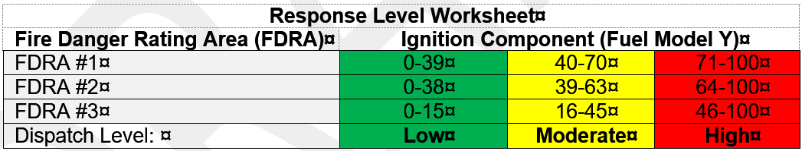
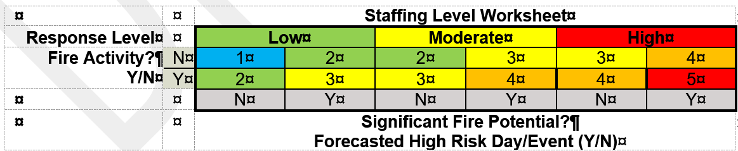
Staffing Plan
Staffing Level Matrix Example
Notes:
Slide # 12
Ask participants to identify and describe the various components of this example matrix and how it works.
Note how the Response Level matrix relates to the Staffing Level matrix (Response Levels will be discussed in the next section.).
The breakpoints (decision thresholds) in the Response Level worksheet were determined for each FDRA using statistical analyses in FireFamilyPlus.
Workshop participants can develop their own style of matrix or worksheet. The important point is that they develop a tool that uses NFDRS inputs and they all understand how it works. The NFDRS inputs in this example is in the Response Level matrix that uses Fuel Model Y and the Ignition Component index.

Slide 13

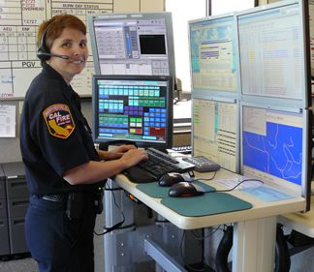
Response Plan
Agency personnel use preplanned response (dispatch) levels to assign initial attack resources to reported wildfires.
Notes:
Slide # 13
Preplanned Response (Dispatch) Levels
Dispatch or response levels are preplanned actions which identify the number and type of resources (engines, crews, aircraft, etc.) initially dispatched to a reported wildland fire can be based upon fire danger criteria.
Key Points:
Target group is the internal agency personnel.
Preplanned Response Levels are often called Dispatch Levels.
The intent is to preplan graduated response levels as the potential containment difficulty increases.
Not knowing the details of a reported fire, response levels based on fire business thresholds provide a fire management application where an appropriate (initial) mix of suppression resources are dispatched to the reported wildfire.

Slide 14
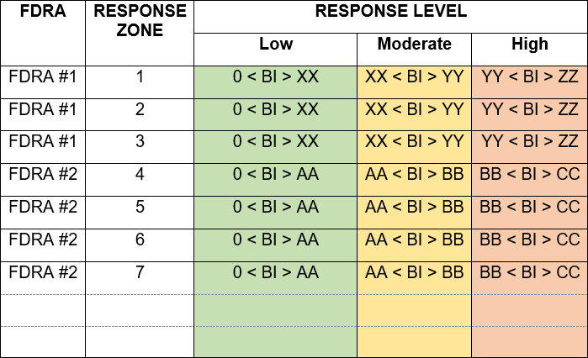
Response Plan
Workshop Template
Notes:
Slide # 14

Slide 15
Response Levels
Target Group: Agency
At least 3, but no more than 5
Response Levels are often called Dispatch Levels
Fire Business Analysis (thresholds) documented in FDOP
Application / Actions documented in Response Plan
Notes:
Slide # 15
Best Practice: Response Levels
Response (or Dispatch) levels are pre-planned actions which identify the number and type of resources (engines, crews, aircraft, etc.) initially dispatched to a reported wildland fire can be based upon fire danger criteria.
Not knowing the details of a reported fire, response levels based on fire business thresholds provide a fire management application where an appropriate (initial) mix of suppression resources are dispatched to the reported wildfire.
Key Points:
Target group is the internal agency personnel.
Preplanned Response Levels are often called Dispatch Levels.
The intent is to preplan graduated response levels as the potential containment difficulty increases (using Fire Danger Rating).
There should be at least 3, but no more than 5, Response Levels. Even some of the most complex fire organizations with many air and ground resources have successfully operated with 3 Response Levels.
Documentation of the Fire Business Analysis (thresholds) of Response Levels belongs in the FDOP.
Documentation of the actions which will be taken at each Response Level

Slide 16
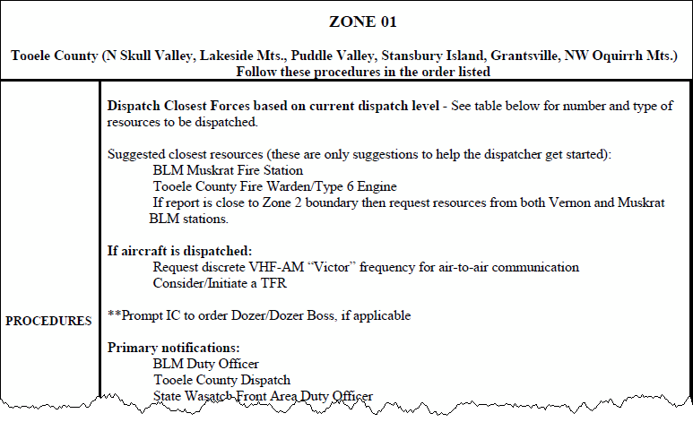
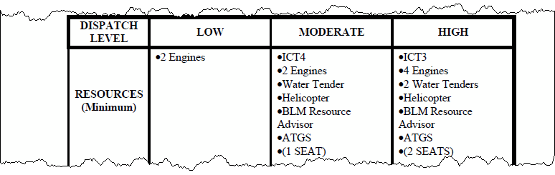
Example of Preplanned Response Levels
Notes:
Slide # 16
Animated Slide Application of Preplanned Response (Dispatch) Levels
Key Points:
Preplanned initial attack responses are common
Have the students remember back to Lesson 5A and the goal of good decision-making using NFDRS (maximize the chances of a “hit” and minimize the chance of a “miss”)
Note that this is an example of a 3 Decision Class system (3 Response Levels: Low, Moderate, High)
Note the increase of initial attack capability from Low=>Moderate=>High.

Slide 17
Response Plan
Application
Response Levels (from the FDOP) are preplanned actions which identify the number and type of resources (engines, crews, aircraft, etc.) initially dispatched to a reported wildland fire based upon fire danger criteria.
Target Group: Agency
Notes:
Slide # 17
Ask workshop participants if they currently utilize an initial response plan. If so, ask them to describe how it works for their unit. Pros vs Cons…
Red Book (2018), Chapter 10: “Fire Management Officers will ensure that Initial Response/Pre-planned Dispatch Plans are in place, utilized, and provide for initial response commensurate with guidance provided in the FMP and/or LRMP.”
Ask workshop participants why a Response Plan may be an important tool not only for fire managers but also for crew bosses, module leads, and fire fighters to understand.

Slide 18
Response Plan
Response Level Examples:
At what level is there an automatic dispatch for aircraft?
How is Staffing Level factored in?
What response level requires multiple resources (engines, dozers, etc.)?
Notes:
Slide # 18
Note: Under circumstances where multiple starts are likely to occur (i.e. forecasted LAL 6) or are occurring and each FDRA is at a Dispatch Level of Moderate or higher consider that the response plan may be suspended and guidance provided by area Duty Officers for initial response to new starts. It would then be desired that the Duty Officers communicate with the dispatch center to provide coordinated guidance to the floor supervisor whenever possible.

Slide 19
Response Plan
Components:
The Response Plan should be based on the analyses completed as part of the unit’s FDOP and the analysis rationale. When selecting an appropriate NFDRS index, consider an index that is sensitive to daily changes in weather and fire conditions (e.g. Burning Index, Ignition Component, Spread Component).
Notes:
Slide # 19
Ask workshop participants which NFDRS indices are the most sensitive to daily changes in weather and fire conditions.
IC: High variability; scaled from 0-100, moderately sensitive to fuel model.
BI: Moderate variability; highly sensitive to choice of fuel model; BI calculations in fuel models with fine fuels can be more influenced by fine fuel moisture and wind than calculations in fuel models with both fine and large fuels.
SC: High variability; very sensitive to fuel model characteristics of surface area, loading, and compaction; good response to green-up in fuel models with live component.

Slide 20
Response Plan
Components:
Identify Response Zones: If response zones need to be identified for the dispatch area, this needs to be completed prior to the development of FDRA’s using a collaborative process. Response zones may be based on various criteria such as: common management objectives, land use, fire load, dispatch locations, estimated response times, WUI locations, topographical features, vegetation communities, etc.
Notes:
Slide # 20
Potential Operational Delineations (PODs) are good examples of response zones.
State agencies may already have their response zones identified (i.e. CalFire response zones).

Slide 21
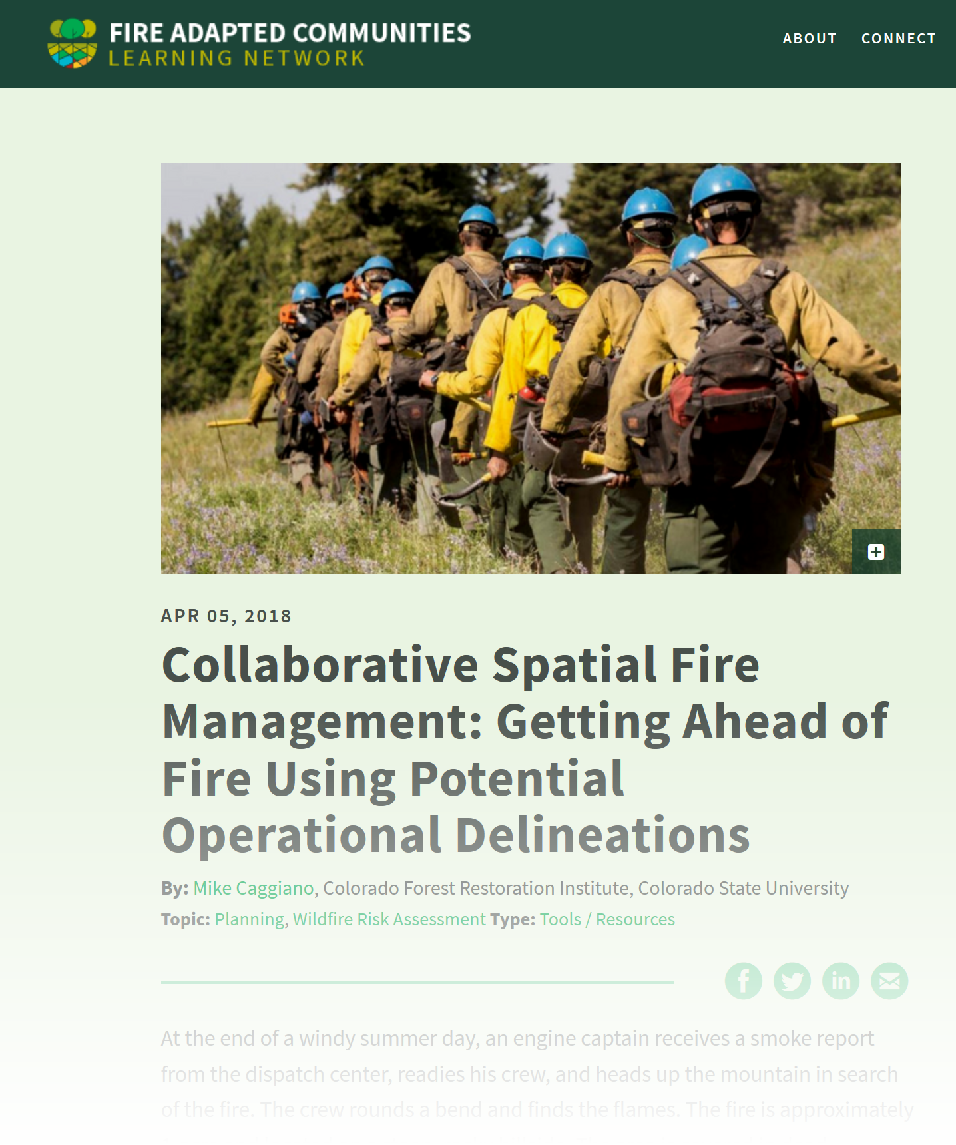
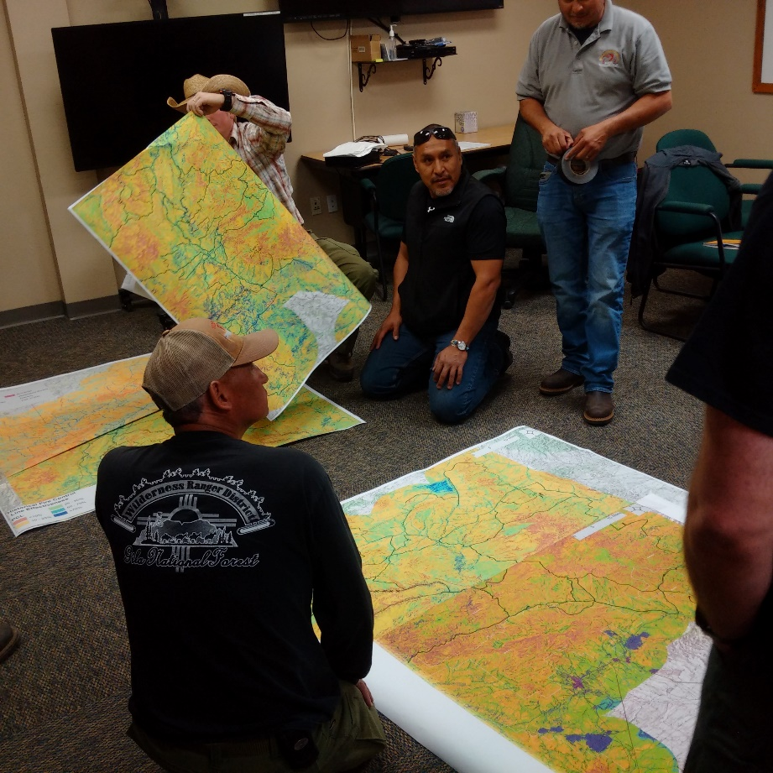
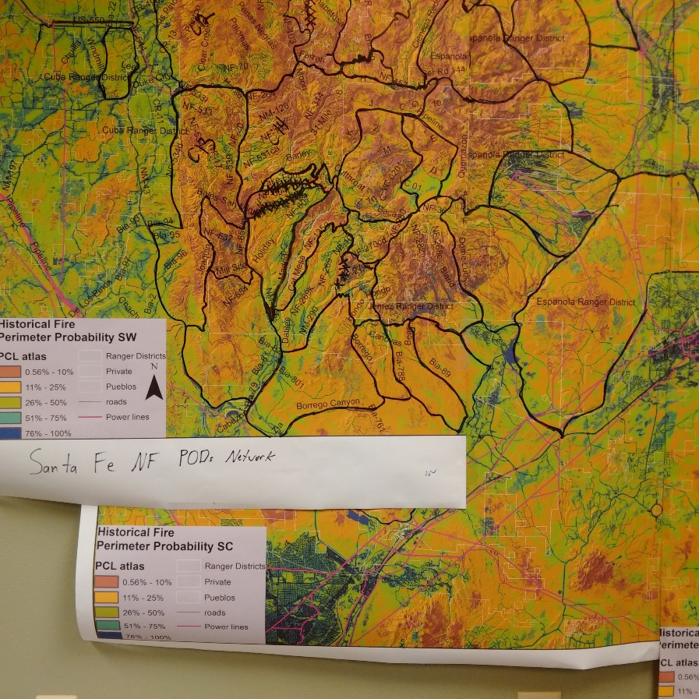
.
Notes:
Slide # 21
Consider using Potential Operational Delineations (PODs) in the response process
Good Resource: https://fireadaptednetwork.org/collaborative-spatial-fire-management-getting-ahead-fire-using-potential-operational-delineations/

Slide 22
Incorporating PCLs, PODs, Risk, and NFDRS2016
Develop, validate, or refine Fire Danger Rating Areas based upon vegetation, climate, and topography.
Simulate a reported wildfire in a response zone during pre-season meetings with partners and cooperators.
Local expertise identifies Potential Control Lines (PCLs) based on ridgetops, lakes, rivers, fuels, roads, non-burnable areas, past and existing containment lines, and previous large fires and behavior.
Develop preplanned responses (run-cards) for each response level.
WFDSS strategic objective shapes can mirror the response zones IF the L/RMP fire management guidance is in alignment with the unit's strategic fire response.
The Rocky Mountain Research Station (RMRS) develops PCLs for the interagency fire unit using the latest inputs and models.
Import response zone and/or strategic response zone boundaries into WFDSS, ensuring that FDRA boundaries are edge-matched.
Fuels planning will focus on response zones and/or POD boundaries.
PCLs are aggregated into Potential wildfire Operational Delineations (PODs) ─ a polygon constructed from linking together PCLs.
PODs will receive an eNVC value based on the net loss or benefit to the assets and resources within the POD.
Create strategic wildfire response zones by combining PODs with similar eNVC.
Notes:
Slide # 22
This example provides a real-world, cutting-edge process which could be incorporated in a Response Plan.
Adapted from Rick Stratton’s “A STRATEGIC FIRE MANAGEMENT APPROACH USING PCLS, PODS, & RISK ASSESSMENT” (OCT. 30, 2018), this illustrates a strategic fire planning procedure which incorporates risk-based decision-support analytics as a methodology for wildfire response. The adaptation is an integration of the National Fire Danger Rating System (v. 2016) to incorporate the capability to systematically alter an initial response to a reported wildfire based upon fire potential.
Develop, validate, or refine Fire Danger Rating Areas based upon vegetation, climate, and topography. If response zones already exist, ensure FDRA boundaries are in alignment with the nearest response zone boundary. Do not split response zones with FDRAs.
Local expertise identifies Potential Control Lines (PCLs) based on ridgetops, lakes, rivers, fuels, roads, non-burnable areas, past and existing containment lines, and previous large fires and behavior.
The Rocky Mountain Research Station (RMRS) develops PCLs for the interagency fire unit using the latest inputs and models. The output is used to further refine or validate the expertise-informed PCLs previously delineated.
PCLs are aggregated into Potential wildfire Operational Delineations (PODs) ─ a polygon constructed from linking together PCLs.
PODs will receive an eNVC value based on the net loss or benefit to the assets and resources within the POD. Data will be utilized from forest, regional, or national quantitative wildfire risk assessment. This net value can be grouped into categories, such as low or moderate benefit, and low, moderate, or high loss.
Create strategic wildfire response zones by combining PODs with similar eNVC.
At this point, two branches emerge (Fuels and Presuppression)
Fuels planning can focus on response zones and/or POD boundaries to increase the probability of success on future wildfires and allow for safer firefighter engagement.
Import response zone and/or strategic response zone boundaries into WFDSS, ensuring that FDRA boundaries are edge-matched.
Develop preplanned responses (run-cards) at each response level based on the changes in eNVC and the probability of containment due to POD and fuels preparation.
WFDSS strategic objective shapes can mirror the response zones IF the L/RMP fire management guidance is in alignment with the unit's strategic fire response.
Simulate (pre-season) a reported wildfire in a response zone during pre-season meetings with partners and cooperators. Utilize response levels (as determined from each FDRA) in conjunction with response zones to send resources. Incorporate SDI and PCL with responding resources to further refine the process.

Slide 23
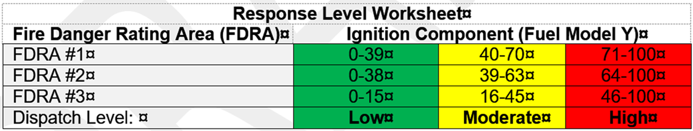
Response Plan
Determine response levels (i.e. “Low”, “Moderate”, “High”) using identified fire business threshold breakpoints.
Notes:
Slide # 23
Note that this matrix uses Ignition Component (IC); this index is highly variable and is the most sensitive of the NFDRS outputs. Decision space with IC is moderate (scaled from 0 to 100). IC has a very short memory as 1-hour fuel moisture dominates the calculations. IC gives a poor characterization of the fire season as daily weather can cause it to range from 0 to 100 from one day to the next.
Also consider Spread Component (SC) or Burning Index (BI) when deciding which NFDRS index may work best for your unit.
Note the different fire business thresholds for each FDRA; these thresholds were determined using FireFamily.
Ask workshop participants if ERC would work for them and explain why.

Slide 24
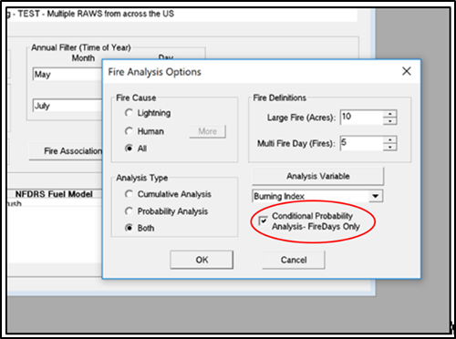
Response Plan
When conducting response plan analyses and setting fire business threshold breakpoints using FireFamily (FFP) remember to check the “Conditional Probability Analysis – Fire Days Only” box in the Fire Analysis Options window.
Notes:
Slide # 24
The Conditional Probability Analysis check box controls the sample size of the large, and multiple fire day analysis. With the box unchecked, all days are included in the large and multiple fire day analysis. Checking the box creates a conditional probability analysis. That is, only weather days with fires are included in the large and multiple fire day analysis probability.

Slide 25
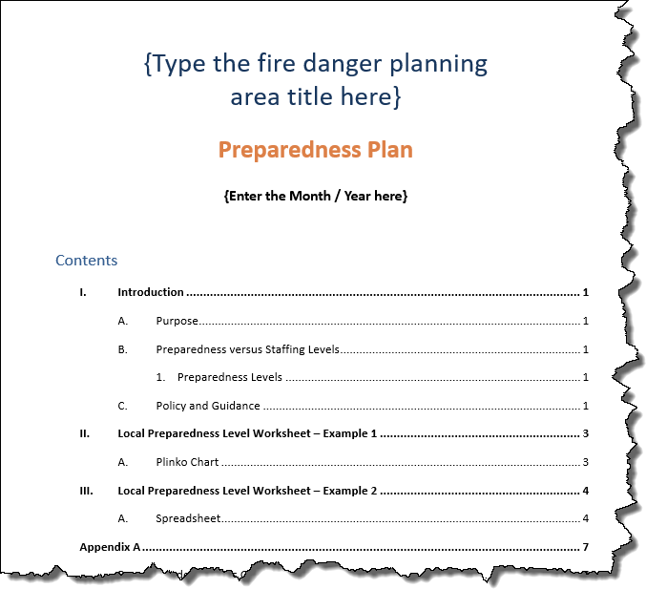
Preparedness Plan
Workshop Template

Slide 26
Preparedness Levels
Target Group: Agency
Five PLs are a function of Fire Danger Rating plus other factors which quantify existing and expected workload
Supports long-term (weekly / monthly) decisions
Actions documented in Preparedness Plan
Notes:
Slide # 26
Best Practice: Preparedness Levels
The preparedness level is a five-tier (1-5) fire danger rating decision tool that is based on NFDRS output(s) and other indicators of fire business (such as projected levels of resource commitment).
Preparedness levels represent planning decisions which typically extend beyond routine daily activities and influence actions on a weekly, monthly, or seasonal basis.
Preparedness levels are developed at the national, regional (geographic), and local levels.
The National Interagency Coordination Center (NICC) and all Geographic Area Coordination Centers (GACCs) currently utilize different methods to establish daily preparedness levels. However, the concept of Preparedness Levels is essential the same, taking into account:
Current Workload (resource availability)
Capability (resource availability)
Predicted Workload (ignition risk + fire danger)
Preparedness plans provide management direction given identified levels of burning conditions, fire activity, and resource commitment, and are required at national, state/regional, and local levels. Preparedness Levels (1-5) are determined by incremental measures of burning conditions, fire activity, and resource commitment.

Slide 27
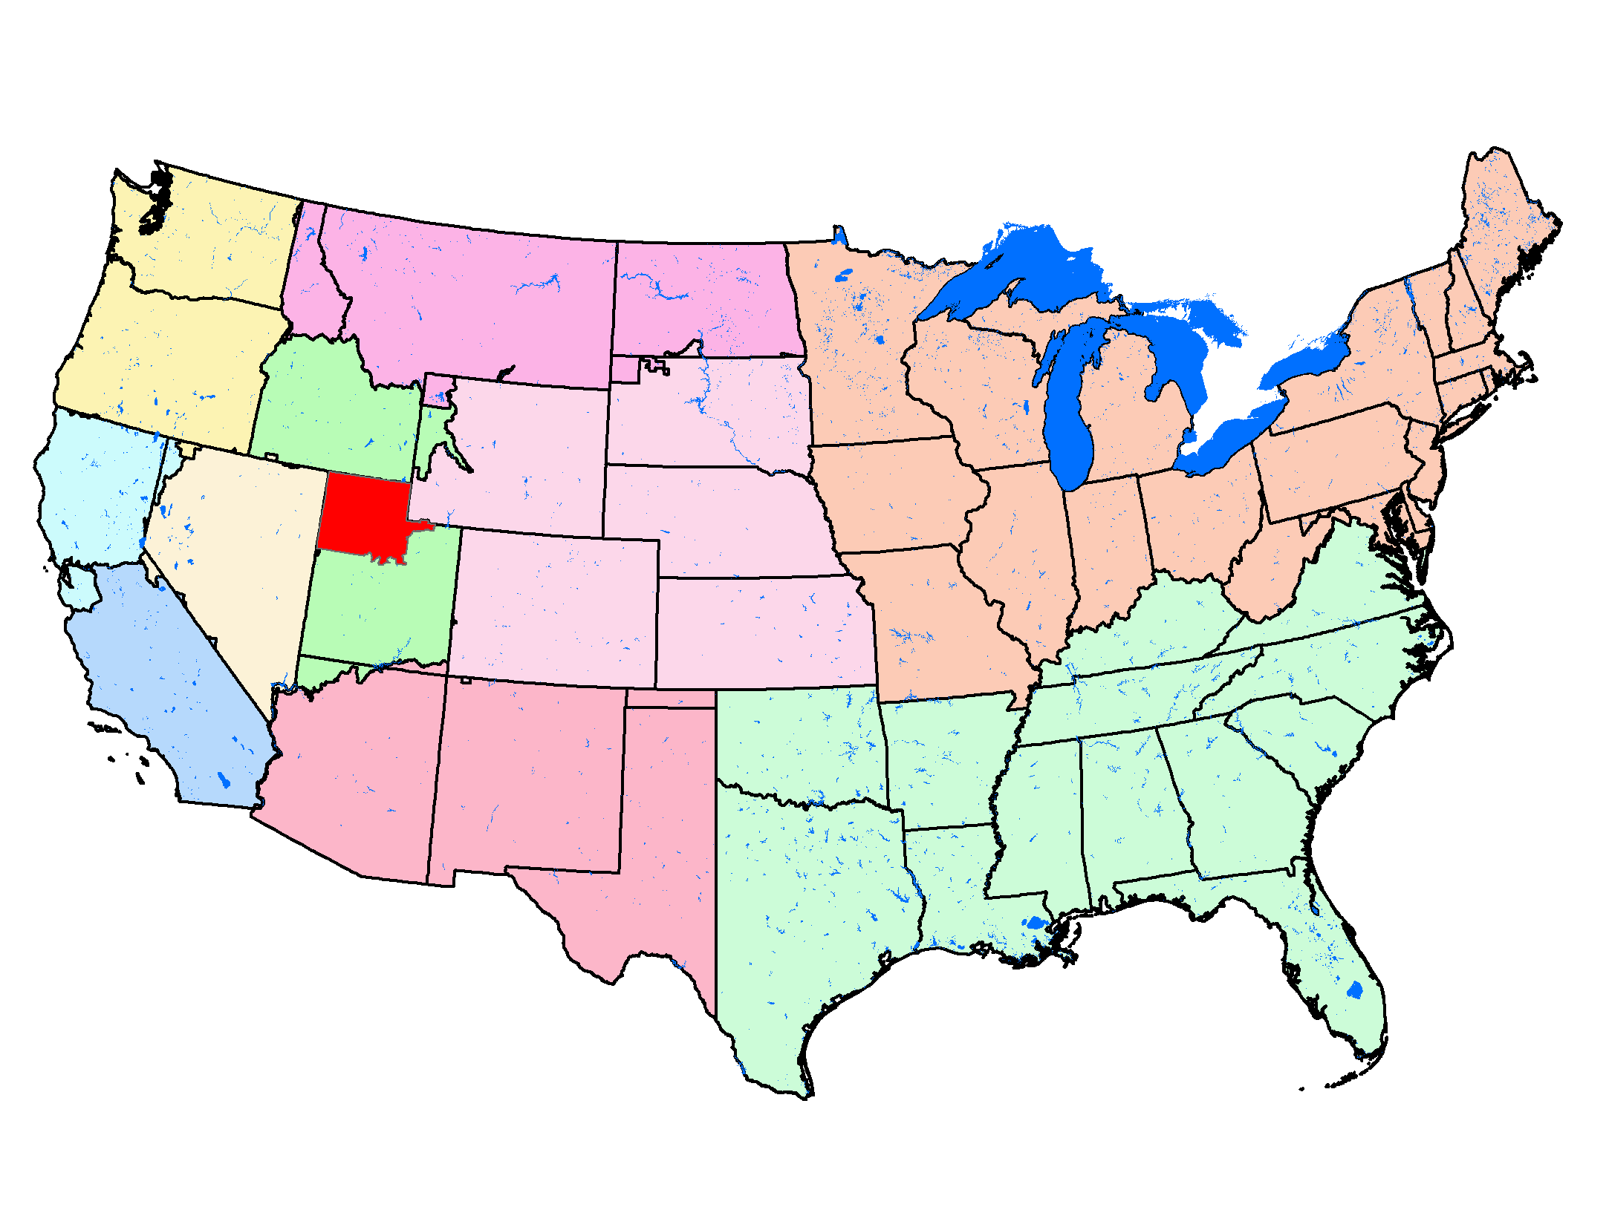
Local Regional National Preparedness Levels
Notes:
Slide # 27
Local Preparedness Level – Northern Utah
Preparedness plans provide management direction given identified levels of burning conditions, fire activity, and resource commitment, and are required at national, state/regional, and local levels. Preparedness Levels (1-5) are determined by incremental measures of burning conditions, fire activity, and resource commitment.

Slide 28
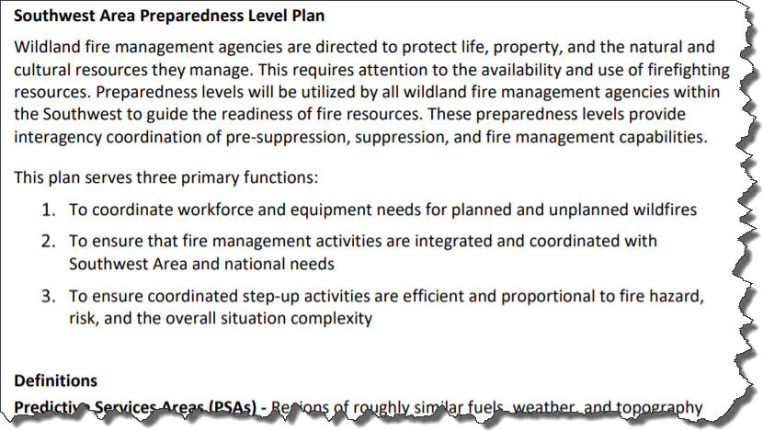
Geographic Area Preparedness Plan
Notes:
Slide # 28

Slide 29
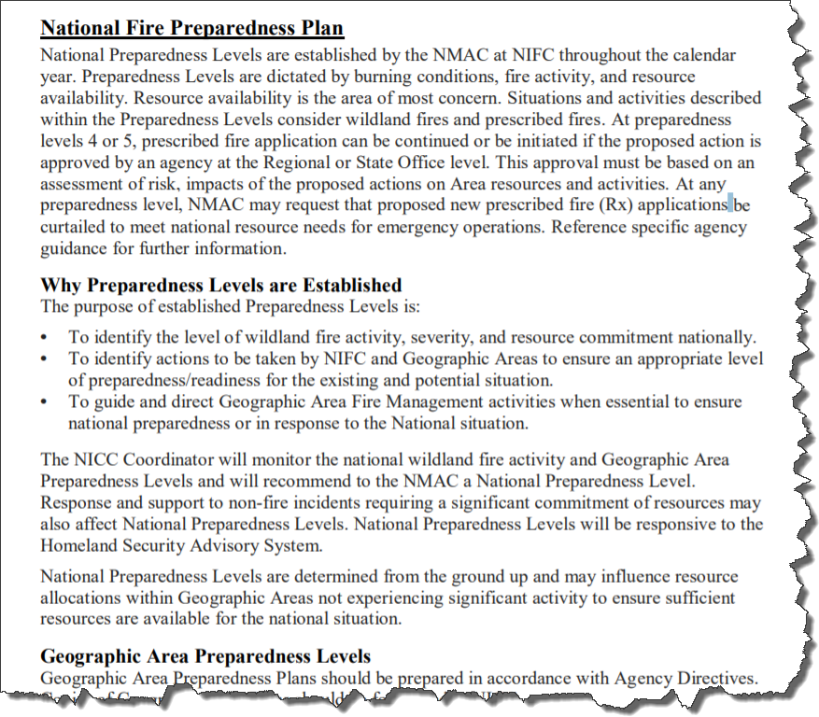
National Preparedness Plan
Notes:
Slide # 29

Slide 30
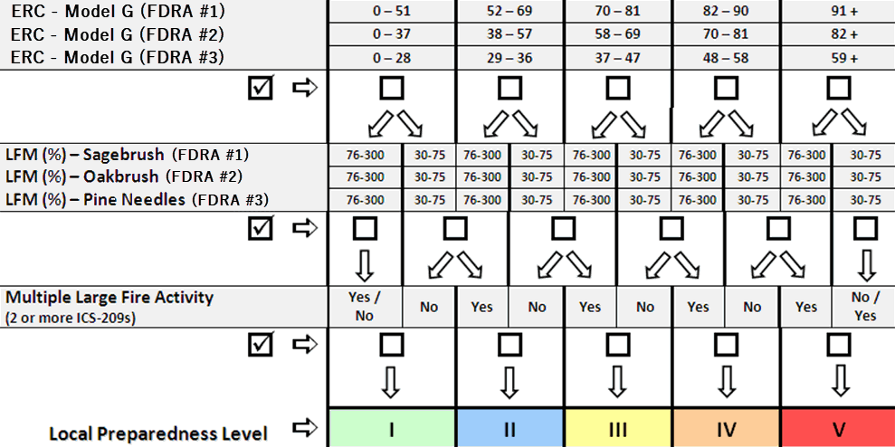
Local Preparedness Level - Example
ERC => 75
FDRA #1
Notes:
Slide # 30
Determining Local Preparedness Level – example
In this example, the Preparedness Level is five (5) levels that are based on fire danger (Energy Release Component) and other indicators of fire business. The fire business indicators used to calculate the preparedness level include a measure of fire activity, draw-down levels, and ignition risk. The thresholds for the preparedness level were set using a historical analysis of fire business and its relationship to 1300 RAWS observations

Slide 31
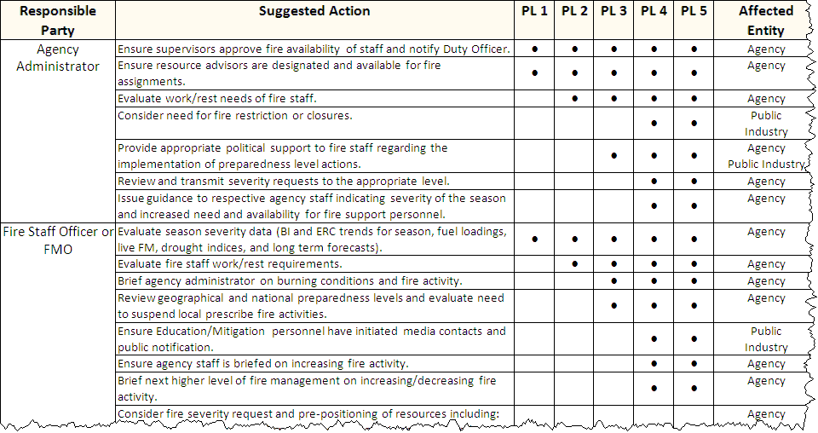
Local Preparedness Level Actions Example
Notes:
Slide # 31
Application of Local Preparedness Levels – Example
Reference: http://www.wildfirelessons.net/documents/FDOP_NUtah_2009.pdf
Key Points:
Several procedures and guidelines are to be followed and/or considered once the preparedness level has been determined.
The formulation of PL is a function of variables which change slowly over the course of several days or weeks.. . .You would not want to be in PL 5 one day and PL 2 the next day (or vice versa).
The ability of fire managers to effectively communicate a decision to industrial and public entities is contingent upon level of control over the respective target group.
It will take days or even weeks for our industrial and public groups to react to our fire management decisions.

Slide 32

Preparedness Plan
Examples of Preparedness Level Applications:
MAC Group activation
Off-unit assignments
Suppress vs Resource Benefit
Rx Approval
Restrictions
Notes:
Slide # 32
Ask workshop participants to provide additional examples on how a Preparedness Plan can assist with decision-making on their unit.
Preparedness Level Examples:
At what level should the MAC (Multi-Agency Coordinating) group be activated?
When should a wildfire be aggressively suppressed rather than actively managed for resource benefit?
At what point can fire managers allow suppression resources go to support off-unit fire activity or detail assignments?
When is the Duty Officer (DO) required to be on-site in the dispatch office?

Slide 33
Preparedness Plan
Supplemental preparedness actions to consider include, but are not limited to, the following items:
Management briefings, direction, and considerations;
Support function: consideration given to expanded dispatch activation and other support needs (procurement, supply, ground support, and communication);
Support staff availability outside of fire organization;
Fire danger/behavior assessment;
Fire information – internal and external;
Multi-agency coordination group/Area command activation; and
Prescribed fire direction and considerations.
Notes:
Slide # 33
These supplemental preparedness actions are listed in the Red Book.

Slide 34
Preparedness Level
Components:
Preparedness Levels often get confused with Staffing Levels. Staffing Levels only consider fire danger, while Preparedness Levels incorporate additional items, such as current level of local fire activity, live fuel moisture, and suppression resources committed.
Preparedness Levels incorporate stable variables (e.g. ERC, Live Fuel Moisture, 100-hr Fuel Moisture, etc.) to help with long-term decisions, such as the need to request severity funding or activation of public-use restrictions.
Notes:
Slide # 34
Preparedness Levels are established to assist fire managers with weekly or monthly planning decisions based upon seasonal fire danger elements. FireFamilyPlus is used to establish the fire business thresholds therefore a statistical analysis of fire occurrence and historical weather needs to be completed.
A Preparedness Level decision tool (i.e. matrix, table, etc.) incorporates additional variables, in conjunction with an NFDRS index, to assist with the determination of a current preparedness level for the unit. These additional variables may include, but are not limited to, current suppression resource commitments, current level of fire activity on the unit, 7-day fire potential, geographic area preparedness level, etc.
There are numerous examples of Preparedness Level worksheets/matrices; participants will need to collaboratively decide what works best for their planning area.
Ask workshop participants which NFDRS index may work best for their planning area and why.

Slide 35
Adjective Fire Danger Rating Levels
Target Group: Public
National standard is five adjectives & colors
Adjective Rating Levels are determined in the Fire Danger Operating Plan.
The application of Adjective Rating Levels is outlined in the Prevention Plan
Notes:
Slide # 35
Best Practice: Adjective Fire Danger Rating Levels
In 1974, the Forest Service, Bureau of Land Management and State Forestry organizations established five standard Adjective Fire Danger Rating Levels descriptions for public information and signing.
As with Staffing Level, the Adjective Fire Danger Rating Level can be obtained as a direct output in WIMS; however, the Adjective Rating from WIMS is strictly based on weather and climatological percentiles (80th / 95th) with no regard to historical fire occurrence.
Another method (preferred), is to determine Adjective Fire Danger Rating thresholds based on statistical correlation of weather observations AND fire occurrence (with a fire business analysis).
Regardless of which method is chosen to determine Fire Danger Rating Adjective Levels, it must be documented in the Fire Danger Operating Plan.
Typical decisions that would be outlined in a Prevention Plan would include the daily adjective level on fire danger signs. In addition, the Prescribed Burn Approval Act of 2016 requires the U.S. Forest Service to get additional approval for prescribed fires at the Regional Forester level if the National Fire Danger Rating System (NFDRS) is indicating an extreme fire danger level.

Slide 36
Prevention Plan
Application
Prevention plans document the wildland fire problems identified by a prevention analysis. Components of the plan include administration of the prevention program, mitigation, prevention, education, and enforcement.
Notes:
Slide # 36
Ask workshop participants why a Prevention Plan may be an important tool not only for fire managers but also for crew bosses, module leads, and fire fighters to understand.
Ask workshop participants how their local unit prevention program interface with the suppression program.
Ask participants how up-to-date their current their prevention plans are. Do they even have a prevention plan? What is the value of having a current, well written prevention plan?

Slide 37
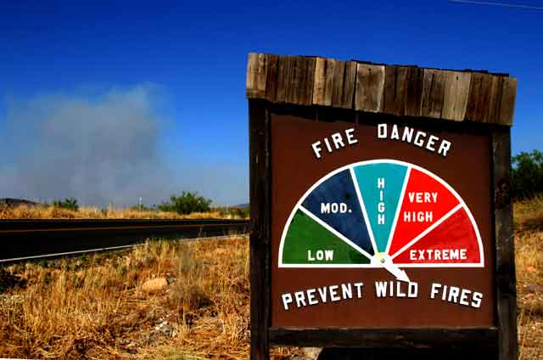
Sign Plan
Notes:
Slide # 37
Now that we have a better understanding of our target groups, we will discuss the application of NFDRS breakpoints and thresholds which are used to communicate to the target groups.

Slide 38
Prevention Plan
Components
Program Administration
Describes how the prevention program for the local unit or zone is to be administrated.
Mitigation
Describe actions to reduce impacts of wildland fire to communities.
Notes:
Slide # 38

Slide 39
Prevention Plan
Prevention
Describe efforts to prevent unwanted human-caused fires
Education
Describe facilitating and promoting awareness and understanding of wildland fire.
Enforcement
Describe actions necessary to establish and carry out regulations, restrictions, and closures.
Notes:
Slide # 39

Slide 40
Public Fire Prevention Plan
Target Group: Public
Restrictions. The public’s activities can be regulated through the implementation of restrictions. NFDRS can be used to determine critical thresholds when these restrictions should be considered.
Notes:
Slide # 40
Ask workshop participants what criteria their unit(s) utilize to decide when they implement restrictions or closure orders.
Do they utilize a “Restrictions/Closure” template or some other form of standardized procedures?

Slide 41
Public Fire Prevention Plan
Examples:
When should local/state agencies stop issuing burn permits?
When should camp fire/smoking restrictions go into effect?
When should restricted access or closures go into effect?
When is firewood cutting allowed?
Notes:
Slide # 41

Slide 42
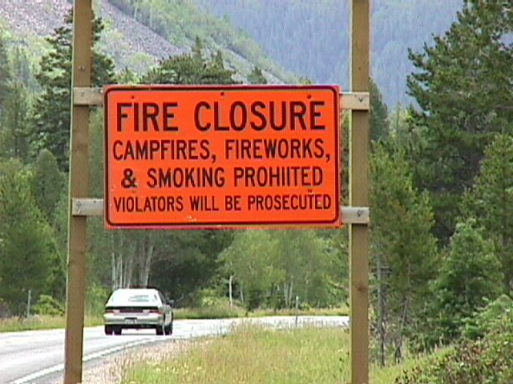
Public Use Restrictions
Notes:
Slide # 42
Public Use Restrictions
Public-use restrictions are intended to limit activities on Federal or State land during periods of high fire danger.
Prevention activities are intended to reduce the occurrence of unwanted human-caused fires and include, but are not limited to:
Education (signage, school programs, radio and news releases, recreation contacts, local business contacts, exhibits);
Enforcement monitoring (patrol, restrictions, area closures);
Administration (patrol, communication, FDOP, sign and other plans and planning activities).
Ask workshop participants how they decide when and how frequently fire danger signs are updated.

Slide 43
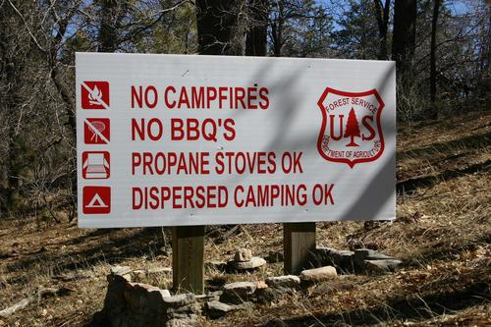
Public Use Restrictions
Regulated Use
Burn Bans
Closures
Notes:
Slide # 43
Public Use Restrictions
Regulated Use
Different land managing agencies establish their fire restrictions for their lands in different ways. Some use National Forest or district boundaries, county lines or their agency-based administrative areas. To minimize confusion to the public, fire restrictions and closures should be issued and enforced on a coordinated, interagency basis.
Restrictions may include:
Smoking
Campfires, charcoal fires, cooking fires and warming fires
Chain saw use
Vehicles
Fireworks
Burn Bans
During burn bans, all open fires are prohibited.
Closed Entry Areas: Land designated as closed to entry is only open to local residents and woods workers carrying out industrial jobs there. All other land uses, including recreation, are restricted.
Closure
Permit Closure: Permit closures require people, including landowners, to obtain permits before entering wildland areas of an agency's protection district.
Absolute Closure: This closure prohibits all forms of use within a designated area. All forms of travel and all recreational activities are prohibited. These closures, which are very rare, may even restrict local residents from returning home if the fire danger warrants it.
As an example => Idaho Fire Restrictions Plan:
http://www.idahofireinfo.blm.gov/southwest/documents/IdahoFireRestrictionsPlan_2008.pdf

Slide 44
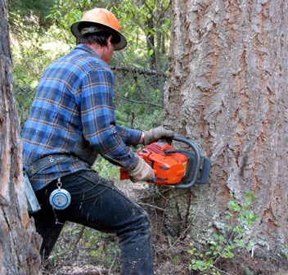
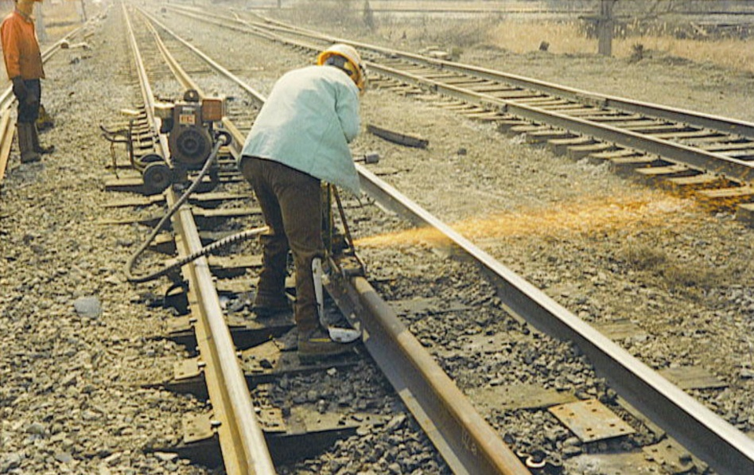
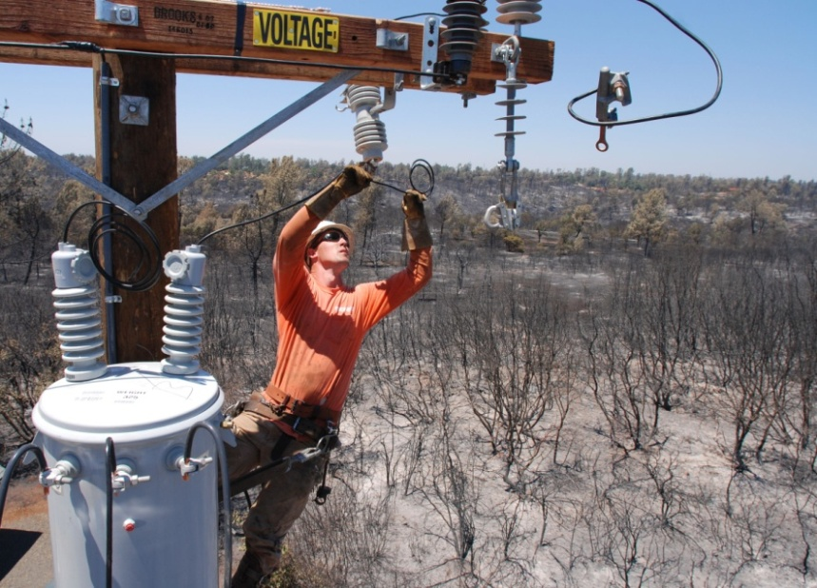
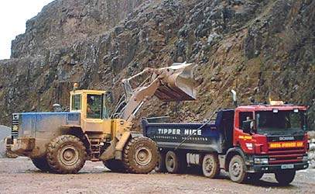
Industrial Activity Restrictions
Notes:
Slide # 44
Industrial Restrictions
Different units may have different levels of industrial use that they work with.
Ask workshop participants what their level of industrial use is on their unit and how they implement fire danger restrictions with industrial entities.
How do agencies consider the economic impacts to industrial cooperators?
These management decisions are handled differently throughout the US.
Two examples of industrial restrictions are calculated for Forest Service Region 5 (California) and Region 6 (Oregon and Washington).
Region 5 => Project Activity Level (PAL)
Region 6 => Industrial Fire Precaution Level (IFPL)
In Region 5: the Project Activity Level (PAL) considers the relationship between the ER, IC and fires less than 10 acres, fires 10 to 99 acres, fires 100 to 999 acres, and fires greater than 1000 acres.
Decision points were established that allowed for a reasonable degree of risk at each of the 4 levels of regulation.
Contractors have a case-by-case opportunity to take extra mitigating actions at the lower PAL levels to continue to operate.
In Region 6: the Industrial Fire Precaution Levels (IFPL) has been implemented in the pacific northwest to regulate industrial operations such as logging and road construction/maintenance.
By plotting each industrial-related fire against the IC and ERC for the day corresponding to the start of a fire, and by recording the ultimate size class, a relationship was established between the observed NFDRS components and final fire size.
IFPL is a graduated scale of restrictions used by most agencies in the pacific northwest to regulate industrial operations.
During the period of time that the IFPL system has been in use, there has been a significant reduction in industrial related fires in all jurisdictions.

Slide 45
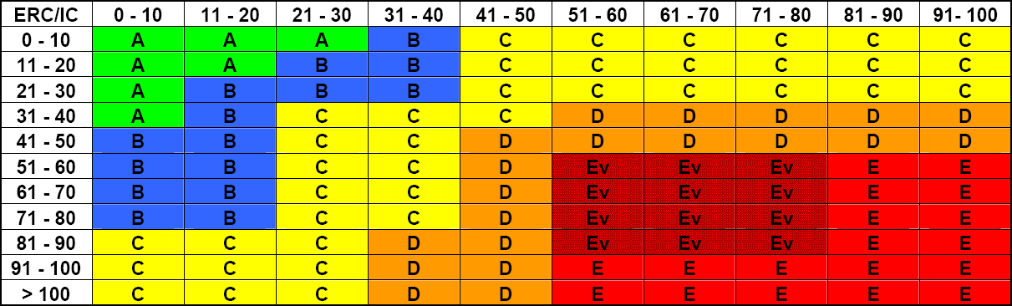
Project Activity Level (PAL) – Example
http://www.fs.usda.gov/detail/r5/fire-aviation/management/?cid=stelprdb5372656
Notes:
Slide # 45
Project Activity Levels -PAL for USFS Region 5
PAL is the Region 5 Forest Service method of regulating Industrial Operations. It is derived from a matrix using the Energy Release Component (ERC) and Ignition Component (IC) outputs run on a fuel model G. The matrix is based on the analysis of equipment fire occurrence on the national forests in California and is divided into 6 levels
The location on the matrix allows manager to make informed decisions on establishing the PAL for the next day.
The PAL Value Chart button when selected will open a window with a master copy of the matrix => http://fam.nwcg.gov/fam-web/wims/jsp/R5PalValues.jsp
PAL - Project Activity Level
A - Minimum Restriction.
B - Furnish Fire Patrol and tank truck.
C - After 1:00 PM no blasting or hot saw technology operations.
D - Additional operations prohibited after 1:00 pm unless a Fire Patrol is available until sunset.
Ev - Most operations prohibited after 9:00 am except loading trucks in landings, servicing equipment in landings, and dust abatement if a Fire Patrol is available.
E - Shut down except loading trucks in landings, servicing equipment in landings, and dust abatement if a Fire Patrol and a tank truck are available.

Slide 46
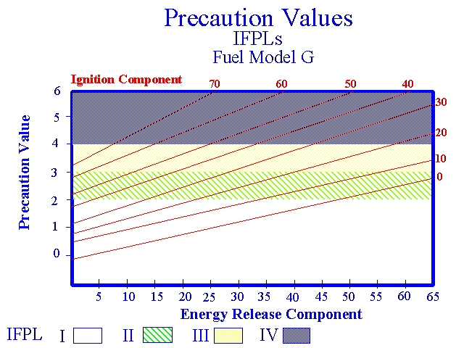
Industrial Fire Precaution Levels - Example
Notes:
Slide # 46
In Region 6: the Industrial Fire Precaution Levels (IFPL) has been implemented in the pacific northwest to regulate industrial operations such as logging and road construction/maintenance.
By plotting each industrial-related fire against the Ignition Component (IC) and Energy Release Component (ERC) for the day corresponding to the start of a fire, and by recording the ultimate size class, a relationship was established between the observed NFDRS components and final fire size. The higher the Ignition Component, the more frequent the fire starts; and the higher the Energy Release Component, the larger the fires. These relationships were converted into mathematical equations and are used today to calculate the daily Industrial Fire Precaution Level, a graduated scale of restrictions used by most agencies in the Pacific Northwest to regulate industrial operations. In the 20 years that the IFPL system has been in use, there has been a significant reduction in industrial related fires in all jurisdictions.

Slide 47
Industrial Fire Prevention Plan
Examples:
When are contractors restricted from harvest operations?
Implementation of “hoot owl” restrictions for:
Power saws, Cable Yarding, Blasting, Welding or cutting metal
When is commercial firewood cutting allowed/not allowed?
Implementation of Industrial Fire Precaution Levels (IFPL).
Notes:
Slide # 47

Slide 48
Industrial Fire Prevention Plan
Prevention activities are intended to reduce the occurrence of unwanted human-caused fires and include, but are not limited to:
Enacting Industrial Fire Precaution Levels.
Engineering (public utility company, government agency/cooperator coordination)
Enforcement/industrial program monitoring (patrol, permitting, inspections including firewood cutting, logging, mining, power line maintenance, and area closures).
Administration (patrol, communication, fire danger signage, and other plans and planning activities).
Notes:
Slide # 48

Slide 49

Implementation Challenges
Implementation Challenges
Notes:
Slide # 49
ANIMATED SLIDE
These five obstacles are common implementation challenges.
The following slides provide some suggestions to remove these obstacles.
Funding
Expertise
Cognitive Bias
Time
Support

Slide 50
Implementation Challenges
Cognitive Bias
Funding
Time
Support
Expertise
Implementation Challenges
Notes:
Slide # 50
ANIMATED SLIDE
These five obstacles are common implementation challenges.
The following slides provide some suggestions to remove these obstacles.
Funding
Expertise
Cognitive Bias
Time
Support

Slide 51
Implementation Challenges — Funding
Issue:
No money for additional / extended staffing (per Staffing Plan)
Possible Mitigation:
Check on discretionary short-term severity funding (often held at regional / State level)
It may be possible to leverage “short-term” funds held at regional or State levels to implement Staffing Plan decisions that meet the intent of “short-term” severity needs.
Notes:
Slide # 51
Funding
Issue:
Insufficient budget for FDOP development/updates and implementation
No money for additional / extended staffing (per Staffing Plan)
Possible Mitigation:
Check on discretionary short-term severity funding (often held at regional / State level)
State/Regional-Level Fire Severity Funding
Each fiscal year the national office will provide each state/region with funding and a severity cost code for state/regional short-term severity needs (e.g., wind events, cold dry front passage, lightning events, and unexpected events such as off road rallies, cultural events) that are expected to last less than one week.
Expenditure of these funds is authorized by the State/Regional Directors at the written request of the Agency Administrator. State/Regional Directors are
responsible and accountable for ensuring that these funds are used only to meet severity funding objectives and that amounts are not exceeded. The national
office will notify the State/Regional Director, State/Regional Budget Officer, and the State/Regional FMO when the severity cost code is provided.
BLM – Refer to Chapter 2 and the BLM Fire Operations Website (http://web.blm.gov/internal/fire/fire_ops/index.html) for additional short-term severity guidance.
NPS – Parks have the authority to approve “Step-up” actions only, as defined in their fire management plan. Regional offices approve severity long term – up to 30 days) for parks up to $100,000 per severity event.
FWS – Refer to the Fire Management Handbook Chapter 10 for additional short-term severity guidance.
FS – Severity funding direction is found in FSM 5130 and current FY Program Direction.
BIA – Regional Offices will establish procedures for approval and monitoring short-term severity usage/funds within their respective regions.
Question: Can workshop participants offer any additional potential solutions?

Slide 52
Implementation Challenges — Expertise
Issue:
The expertise to complete the FDOP does not exist
Specialized skills (such as GIS) are not readily accessible.
Possible Mitigation:
Training / workshops to educate and provide skills
Contact SMEs
Utilize reference material posted on the web
Notes:
Slide # 52
Expertise:
Issue:
The expertise to complete the FDOP does not exist
Specialized skills (such as GIS) are not readily accessible.
Possible Mitigation:
Training / workshops to educate and provide skills
Contact SMEs
Utilize reference material posted on the web
Can workshop participants offer any additional potential solutions?

Slide 53
Implementation Challenges — Cognitive Bias
Issue:
A multitude of personal biases affect reasoning & evaluating because of preferences, experience, and beliefs (contrary to factual information).
Possible Mitigation:
Education and awareness
Utilize decision-support tools to avoid decision traps
Notes:
Slide # 53
Cognitive Bias:
A cognitive bias is a mistake in reasoning, evaluating, remembering, or other cognitive process, often occurring as a result of holding onto one's preferences and beliefs regardless of contrary information.
There are several types of cognitive bias. Some examples include the following: Bandwagon effect: This is the tendency for people to do or think things because other people do or think them.
Ask participants to give examples of cognitive bias from a fire manager’s perspective.
Can workshop participants offer any additional potential solutions?

Slide 54
Implementation Challenges — Time
Issue:
Limitations on time affect the completion, implementation, and maintenance of fire danger products.
Possible Mitigation:
Time limitations are usually the result of prioritization.
Advocate for higher priority of decision-support effort
Notes:
Slide # 54
Time:
Issue:
Limitations on time affect the completion, implementation, and maintenance of fire danger products.
Possible Mitigation:
Time limitations are usually the result of prioritization.
Advocate for higher priority of decision-support effort
Can workshop participants offer any additional potential solutions?

Slide 55
Implementation Challenges — Support
Issue:
Supervisors / Managers do not recognize NFDRS as a decision-support tool, and subsequently, fail to support efforts to utilize and train for its use.
Possible Mitigation:
Persistence; look for opportunities to teach supervisors & managers who do not understand NFDRS decision-support.
Notes:
Slide # 55
Support:
Issue:
Supervisors / Managers do not recognize NFDRS as a decision-support tool, and subsequently, fail to support efforts to utilize and train for its use.
Possible Mitigation:
Persistence; look for opportunities to teach supervisors & managers who do not understand NFDRS decision-support.
Can workshop participants offer any additional potential solutions?

Slide 56
Summary
Wildland fire operations have inherent risks that are difficult to mitigate. The use of NFDRS tools and information can optimize the outcome of the decision-making process which ultimately impacts the public, industry, and agency personnel.
Notes:
Slide # 56
The FDOP and associated plans are intended to be used on a regular basis to assist with wildland fire related decision-making.
The FDOP and associated subordinate planning documents provide systemic procedures for implementation.
These systematic procedures offer decision support for fire managers, agency administrators, and firefighters.

Slide 57
Summary
Decision‐support tools may be able to leverage how managers respond to risk information to mitigate some cognitive biases and decision heuristics (Thompson, Calkin, Scott, & Hand, 2016).
Notes:
Slide # 57
A heuristic is a rule or method that helps you solve problems faster than you would if you did all the computing. It sounds fancy, but you might know a heuristic as a "rule of thumb.“
“Heuristic” describes a rule or a method that comes from experience and helps you think through things, like the process of elimination, or the process of trial and error. You can think of a heuristic as a shortcut.

Slide 58
Summary
The FDOP and associated subordinate planning documents provide systemic procedures for implementation that are not dependent upon the subjective influences of people.
Systematic practices offer support for fire managers by assisting with planning and operational decisions, preparedness, resource needs, requesting severity funding, personnel briefings, increased situational awareness, and when considering implementing fire restrictions or closures.
Notes:
Slide # 58

Slide 59
Conclusion
It is important that NFDRS information and associated planning documents/tools are understood and utilized by upper-level decision makers (i.e. fire managers, agency administrators).
It is equally critical that all firefighters understand why NFDRS information is essential and can assist with vital, risk-based decision making.
Notes:
Slide # 59
It is extremely important to clearly articulate how and why the use of NFDRS information/outputs can influence firefighter decision making – increased situational awareness.
The FDOP and associated subordinate plans are intended to assist every person involved with wildland fire management (firefighters, crew bosses, module leads, fire managers, prevention/mitigation personnel, agency administrators, etc.).

Slide 60
Review Objectives:
Outline the relationship of the FDOP to subordinate fire preparedness plans, including the preparedness, staffing, response, and restriction plans.
Discuss the obstacles which may inhibit successful implementation of these preparedness plans and ways to overcome them.
Notes:
Slide # 60
Lesson Objectives:
Outline the relationship of the FDOP to subordinate fire preparedness plans, including the preparedness, staffing, response, and restriction plans.
Discuss the obstacles which may inhibit successful implementation of these preparedness plans and ways to overcome them.

Slide 61
Review Objectives (cont’d):
Determine the essential components of each plan as it relates to the specific target groups and associated fire occurrences identified in Task 3.
Notes:
Slide # 61
Lesson Objectives:
Determine the essential components of each plan as it relates to the specific target groups and associated fire occurrences identified in Task 3.

Slide 62

.
Notes:
Slide # 62
Questions?

