Slide 1
Defining Breakpoints and Thresholds
Lesson 14
Notes:
Slide # 1
Lesson #14: Weather Stations
Lesson Time: 45 minutes (followed by a 15 minute break)
Facilitator Notes:
Don’t forget to fill in the “Workshop Dates” and “Workshop Location” on the bottom right of this title slide.

Slide 2
Objectives:
Describe which management decisions are most appropriately supported by either climatological breakpoints or fire business thresholds.
Using FireFamilyPlus, discuss a process which can identify the best "fire business" relationships by examining multiple combinations of fuel models and NFDRS outputs.
Notes:
Slide # 2
Lesson Objectives:
Describe which management decisions are most appropriately supported by either climatological breakpoints or fire business thresholds.
Using FireFamilyPlus, discuss a process which can identify the best "fire business" relationships by examining multiple combinations of fuel models and NFDRS outputs.

Slide 3
Objectives (cont’d):
Using FireFamilyPlus, discuss a process using statistical tools to identify appropriate decision points for staffing levels, adjective rating levels, dispatch levels, and public fire restrictions)
Notes:
Slide # 3
Lesson Objectives (cont’d):
Using FireFamilyPlus, discuss a process using statistical tools to identify appropriate decision points for staffing levels, adjective rating levels, dispatch levels, and public fire restrictions)

Slide 4
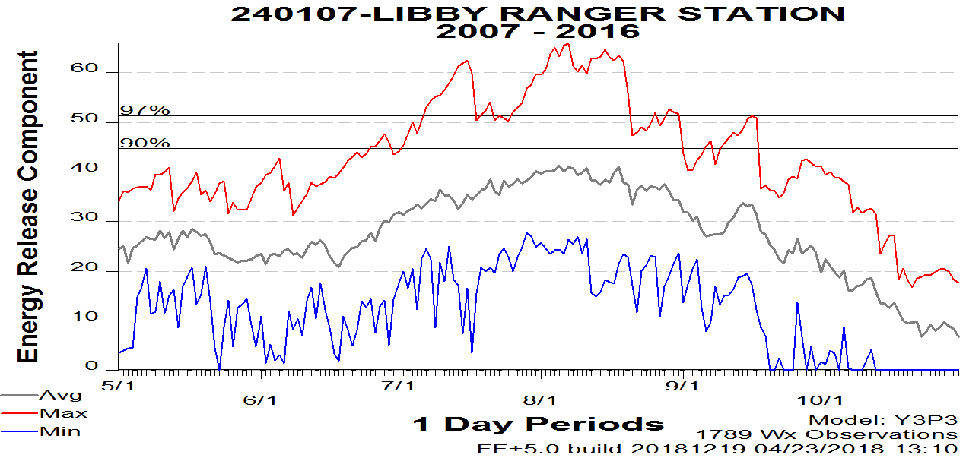
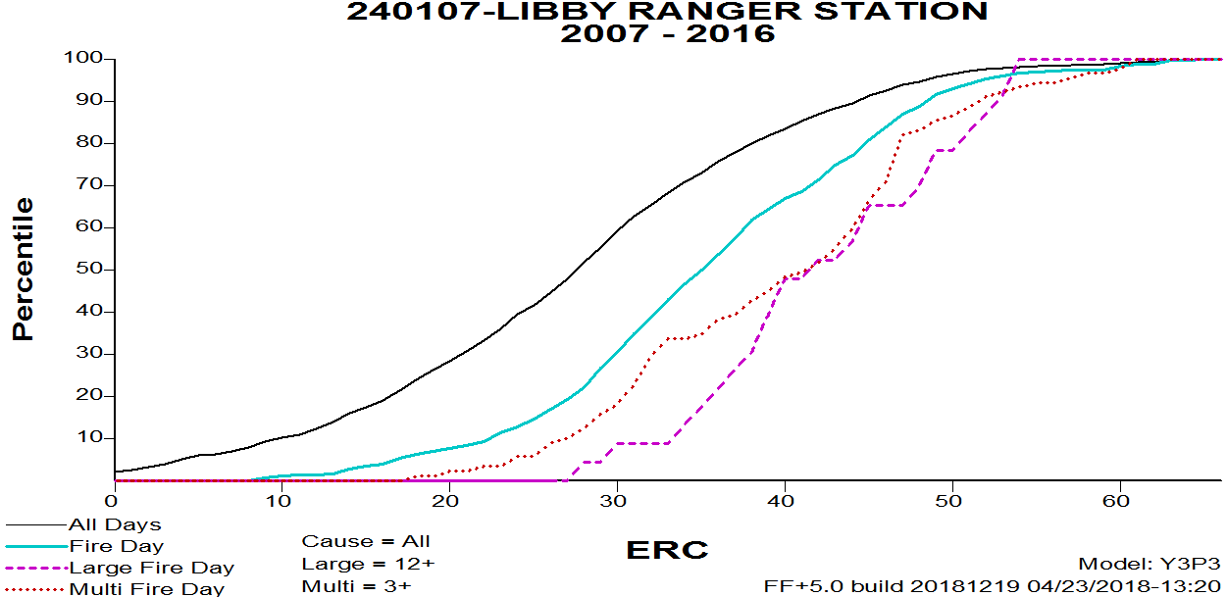
Climatology Breakpoints / Fire Business Thresholds
Climatological Breakpoints
Fire Business Thresholds
Based solely on weather
Statistical breakpoints calculated from climatology
Determined through statistical relationship between weather and fire
Notes:
Slide # 4
Climatological Breakpoints only include weather and typically use set values such as the 90th and 97th percentile. When the 97th percentile is selected, only 3% of days in the record are worse than that. These climatological breakpoints were originally developed because there was very little fire data available. At the time, managers needed a way to determine what a “bad” day looked like. It was arbitrarily decided to use the 90th and 97th percentiles in the USFS and 80th and 95th percentiles in the BLM. Very little, if any, analysis was done to determine what these values should be.
Fire Business Thresholds are determined by analyzing the statistical relationship between weather and fire, which you learned about in a previous lesson. Using this information, we can analyze any number of NFDRS fuel models and outputs to see which combinations explain this relationship the best. Further analysis allows you to divide the index into the number of classes needed.

Slide 5
When/Why to Use Climatological Breakpoints
Look at the “big picture” (national level)
Useful to compare different dispatch centers, states, or regions with each other
Typically used at national and geographic levels (e.g., Predictive Services)
Notes:
Slide # 5
While we suggest using fire business thresholds at the local level, there is still a place for climatology. Climatological breakpoints are used nationally to compare different regions, GACCs, states, or even dispatch centers with each other using the same fuel model and index/component (e.g., ERC for fuel model Y).
NFDRS is relative. A value of 35 does not necessarily mean the same thing in Montana that it means in Texas. It doesn’t mean the same thing for Fuel Model X that it means for Fuel Model Y. Climatological breakpoints account for that. Knowing that the local fire danger is at the 30th or the 99th percentile does tell you something.

Slide 6
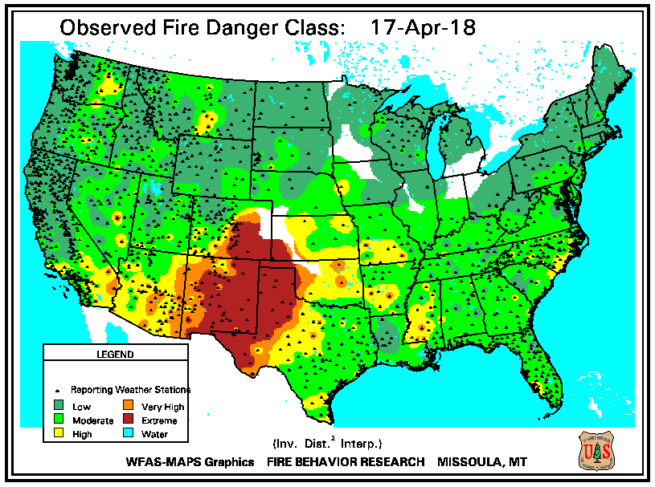
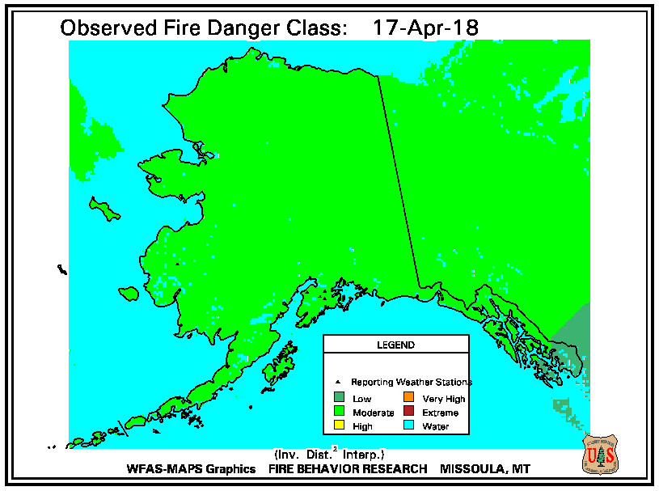
When/Why to Use Climatological Breakpoints
Notes:
Slide # 6
The Wildland Fire Assessment System (WFAS, www.wfas.net) uses climatological breakpoints in mapping. At a glance, you can see how the fire danger in your area relates to the fire danger in other areas of the U.S.
Note: These graphs show the 1978 system, fuel model G.

Slide 7
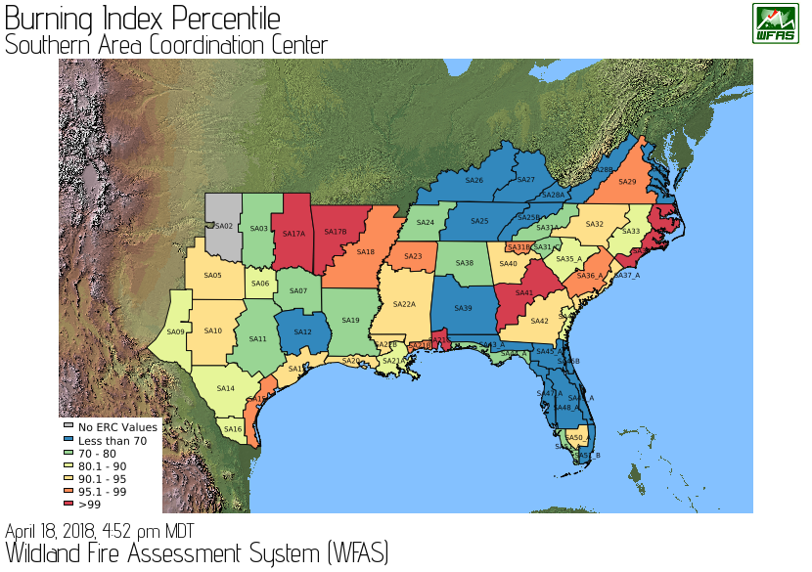
When/Why to Use Climatological Breakpoints
Notes:
Slide # 7
A number of Predictive Service Centers have created their own regional products, such as this one from the Southern Area. Such graphs show how current weather compares with historical BI for each Predictive Service Area (PSA). While this provides valuable information about climate around the region, there is no direct correlation to fire activity.
Note: This graph shows the 1978 system, fuel model G.

Slide 8
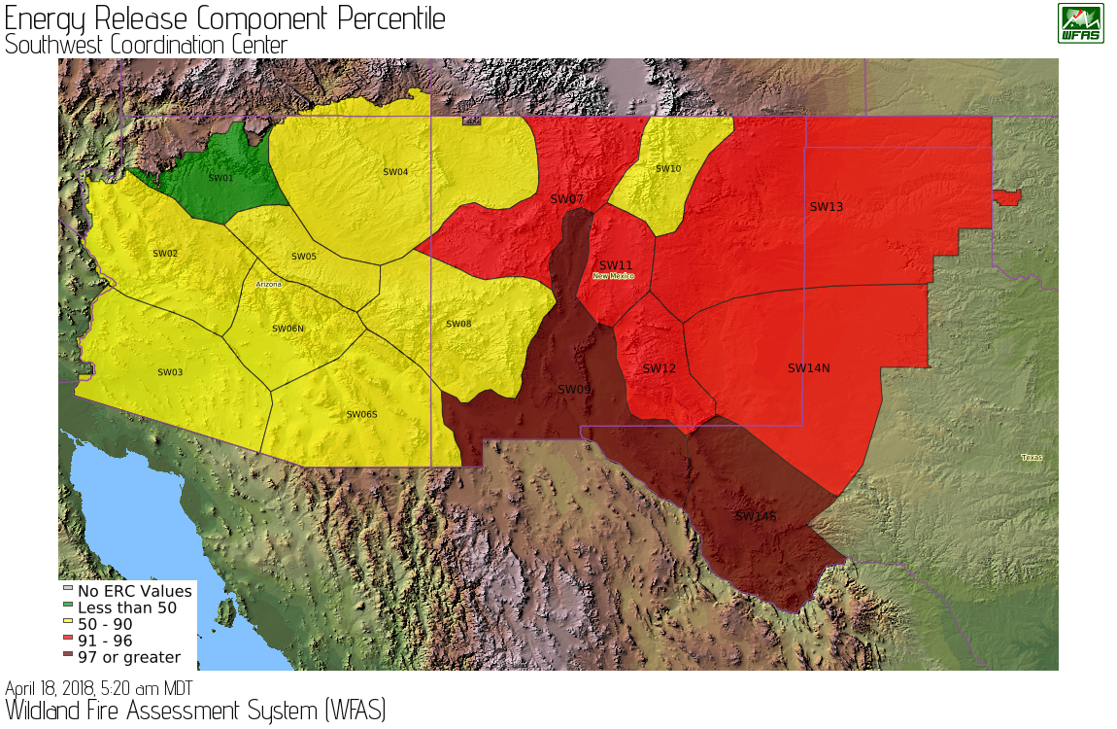
When/Why to Use Climatological Breakpoints
Notes:
Slide # 8
Each Predictive Service Center creates maps of climatological breakpoints specific to their area. Here is one from the Southwest for their PSAs.
Note: This graph shows the 1978 system, fuel model G.

Slide 9
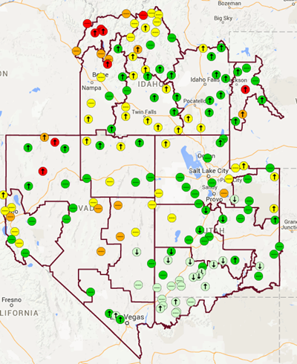
When/Why to Use Climatological Breakpoints
Notes:
Slide # 9
This map from the Great Basin shows the values at each RAWS rather than by PSA or FDRA.
Note: This graph shows the 1978 system, fuel model G.

Slide 10
When/Why to Use Fire Business Thresholds
Local application and interpretation
More refined thresholds that relate to actual fire activity
Thresholds may be too high/low if based only on climatology
Notes:
Slide # 10
Using fire business allows you to apply decisions locally by interpreting the relationship between weather and fire activity. Climatological breakpoints may be too high. Fires occur well before conditions become “high” or “very high”. Conversely, they may be too low. A particular index may be “high.” but there may never be any fires at that value of the index/component.
By adding fire activity to the analysis, we can ask several questions: As there is an increase in fire danger, at what level (value) do fires occur? When do large fires occur? When would you expect multiple fires in a single day? When does the local situation “change”? When would you make a different decision?

Slide 11
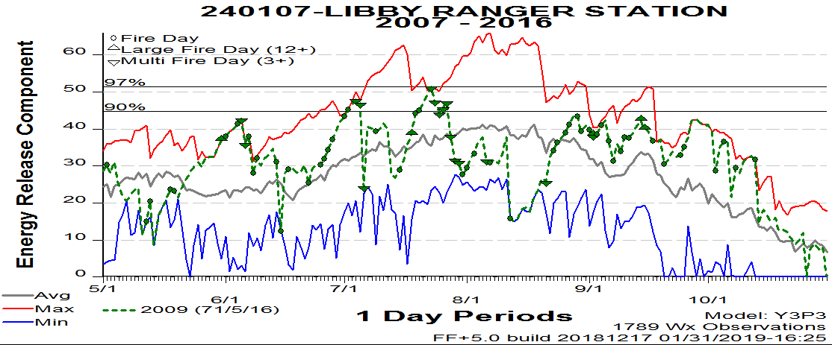
When/Why to Use Fire Business
Fire activity may occur below Climatological Breakpoints
Notes:
Slide # 11
In this example from the Libby RAWS and Kootenai National Forest, we plotted the Climatological Breakpoints. Most of the fires occur below the 90th percentile, including the large and multiple fire days. Additional breakpoints were created by arbitrarily dividing the NFDRS value at its 90th percentile in half, and then in half again. This provided the 5 classes that they wanted to use for decisions. Most of the fires, including large and multiple fire day fires are in the middle category.
How would this information help you effectively manage risk?

Slide 12
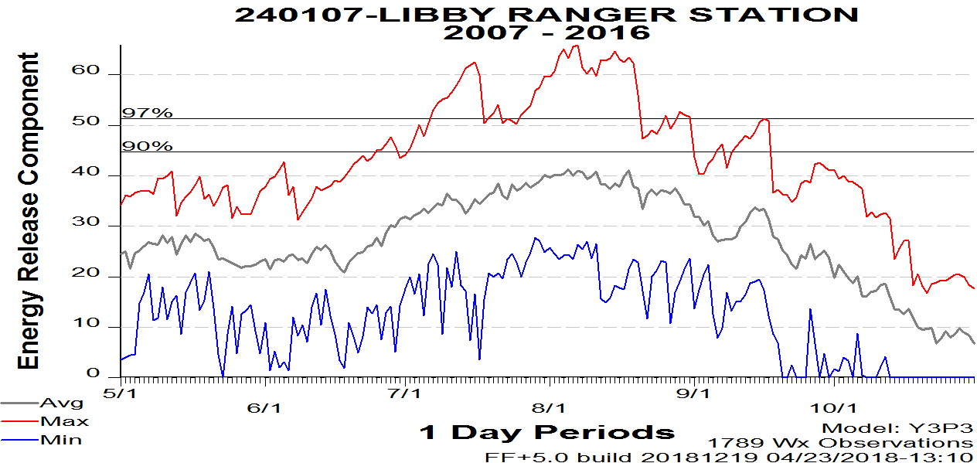
When/Why to Use Fire Business
Fire activity may occur below Climatological Breakpoints
Notes:
Slide # 12
Animated Slide
Here is the seasonal example from the Libby RAWS again without any fires. The gray lines show the climatological breakpoints from earlier. Let’s look at where things are now. The top two classes didn’t change much for Libby. The benefit in this example is that much more of the time is spent in Classes 1 and 2, and fires don’t start until Class 3.
Note, you can use this for Adjective Fire Danger Rating, but this is different from WIMS. WIMS includes the IC to determine the actual Adjective Fire Danger Rating. Just remember the difference so that you know locally what you intend to do.

Slide 13
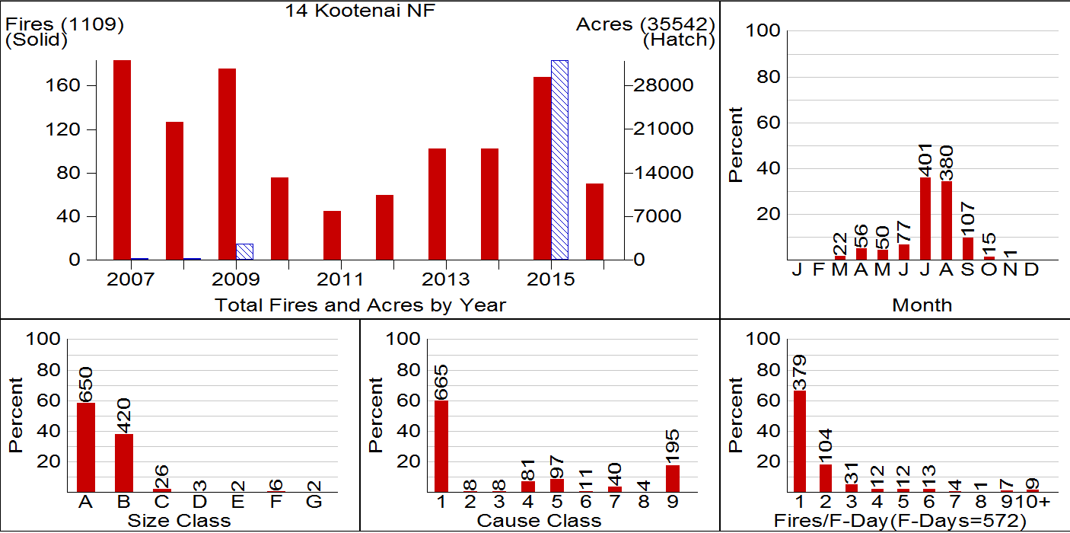
Elements of Fire Business: Fire Summary Chart
Notes:
Slide # 13
You saw this graph before when you looked at when framing the fire occurrence. This shows the season, cause, size – the fire workload. FireFamilyPlus measures fire business by the number of fire days, large fire days, and multi fire days. You define what a large or multiple fire day looks like based on fires and local capacity.

Slide 14
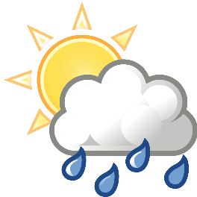
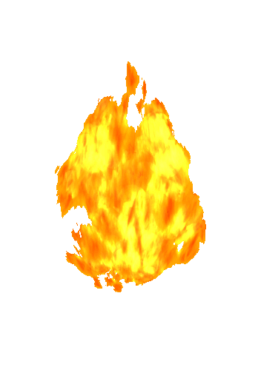
Measures of Fire Business
Weather Day: a day on which weather was recorded at the RAWS (aka All Days)
Fire day: a day on which a fire was reported
Large Fire Day: a day on which a fire above a defined size was reported
Multiple Fire Day: a day on which more than a specified number of fires was reported
Notes:
Slide # 14
When you are examining fire business, there are a few definitions that you need to know as shown on the slide. If weather are not reported on a given day, any fire that occurs on that day may not be included in the analysis. Therefore, consistent, quality weather data are needed during the fire season. You determine, as mentioned in earlier lessons, what a large fire is. You also define how many fires constitute a multiple fire day.

Slide 15
How Many Decision Classes?
Depends on the management action
For example…
Management Tool | # Decision Classes
Staffing Levels | 3-5
Response Levels | 3-5
Preparedness Levels | 5
Adjective Fire Danger Rating Levels | 5
Notes:
The number of decision classes (thresholds or breakpoints) should reflect the associated management action. To simplify the process, consider that some management tools have pre-defined numbers of decisions classes. Several examples are shown in the table above.

Slide 16
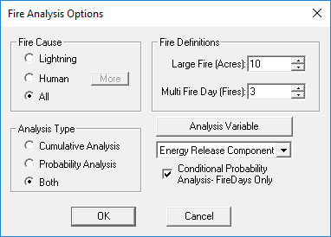
Fires Analysis
Part 1
Selecting fuel model/index combinations
This was Task 4
Part 2: Decision Points
Fires > Fire Analysis
Task 5
Notes:
Slide # 16
Once you know which management action you are analyzing and how many decision classes that action requires, you can continue the fires analysis. We covered the first part of a fires analysis yesterday during Lesson 11 and task 4. Today, we will look at setting decision points. The fires analysis is where you can look at decision thresholds. This cannot be done in Interactive Batch. Click on Fires > Fires Analysis. Select the appropriate Fire Cause option button, often All. Select the Both Analysis Type option button.
Hint: Once you get the feel for what you are looking for, you may find viewing only the Cumulative Analysis graphs to be a much faster way to “screen” indexes. Then perform the Probability Analysis on the most representative indexes.
Complete the Fire Definitions fields. You should do this based on either local experience or from the results of your fire summary graphic. What constitutes a large fire in each FDRA? Here we use 12 acres to define a large fire-day. How many fires, per fire-day, tax the fire management resources? Here we use 3 fires per day as the threshold for a multiple fire-day.
In the Analysis Variable list, click the arrow to the right and scroll to see all the variables you can select from for an analysis. We have selected Energy Release Component.
If you check the box to the left of Conditional Probability Analysis, it uses fire-days only for large and multiple fire-day probability analysis. (not All Days) Note: Conditional probability gives the probability of a large or multiple fire day as a function of the index given that there is a fire already. If you are not looking at conditional probability, it is the risk of any large fire or multiple fire day only as a function of the index.

Slide 17
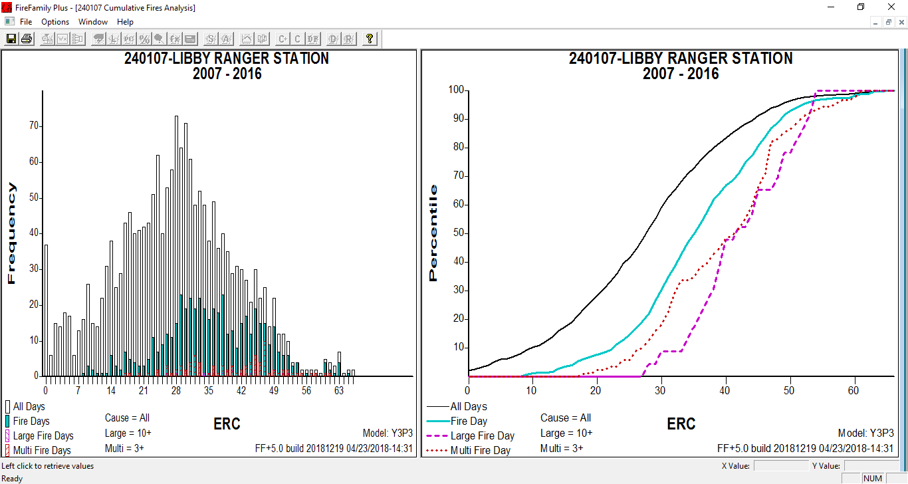
Cumulative Fires Analysis
Notes:
Slide # 17
The Cumulative Fires Analysis window displays frequency distributions of four groups of “weather days” in two ways. The left panel shows frequencies as histograms, the right panel as cumulative distributions. Both contain similar information, displayed differently. The weather groups are:
a. All weather days regardless of fire activity (black).
b. Only weather days with a reported fire (teal).
c. Only weather days with large-fires (purple).
d. Only weather days with multiple-fires (red).
The histograms are based on number of days (frequency) and the cumulative distributions are based on percent. They both have the same decision space (ERC values)

Slide 18
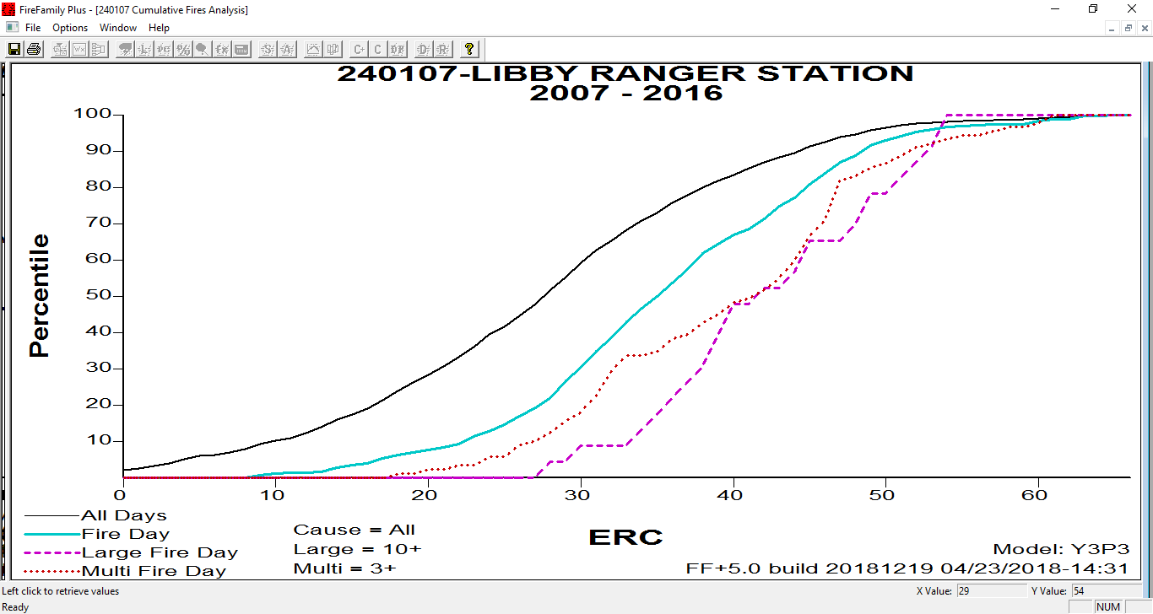
Fire Business
Notes:
Slide # 18
This is the cumulative distributions graph; the histogram contains the same data. Some people find it easier to look where the thresholds might be, points of inflection where the line changes slope; change in fire activity.
Animated slide
This is an open discussion for students. Discuss what they think might be some trigger points before continuing with the animation of the arrows. The arrows are there to show some possible trigger points.
If you have determined that you have an index that contains some good information about fire business in your analysis area, it makes sense that you would want to set some sort of thresholds based, in part, on the index.
Ask students: Thinking about fire business thresholds, where along the cumulative percentiles graph might there be some decision points or thresholds? For example, a local unit wants to establish a graduated continuum of responses to a reported fire. They will look at the correlation with weather and fire occurrence to help set a low, moderate, high and extreme dispatch level. Where would you set some thresholds or points for this using the graph or histogram? You want to look at the points where things start to change.

Slide 19
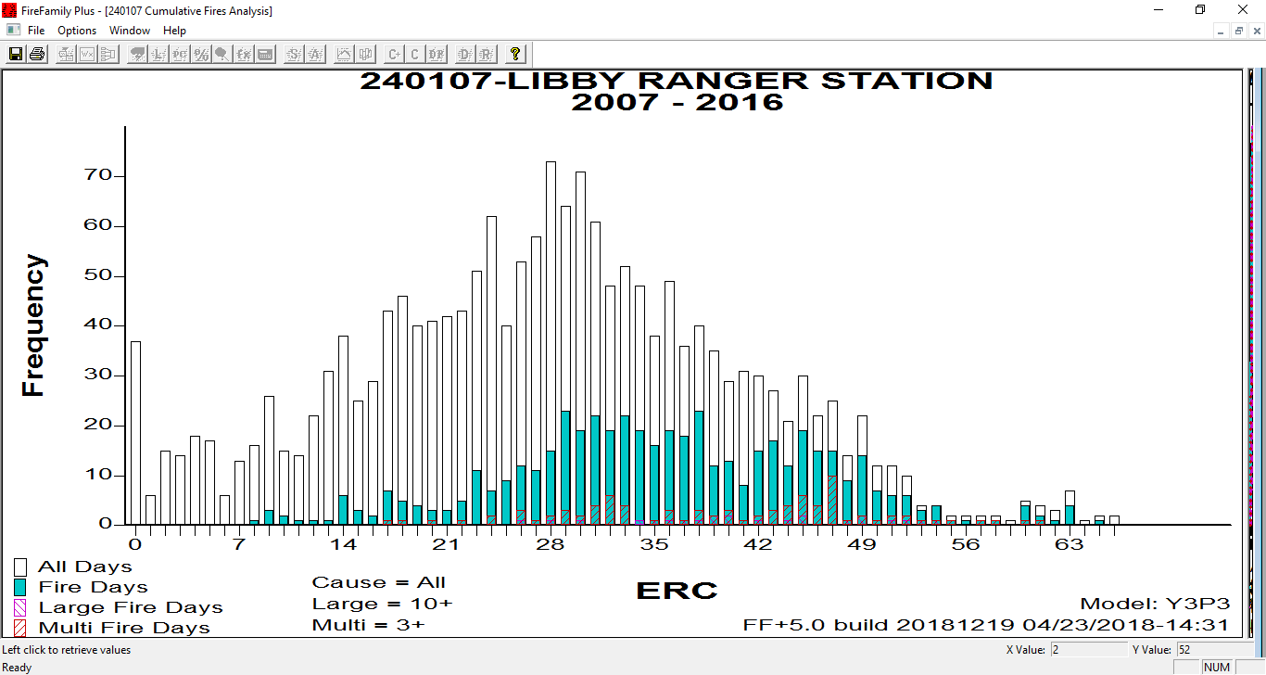
Fire Business
Notes:
Slide # 19
Here is how those data look as a histogram.
If you have determined that you have an index that contains some good information about fire business in your analysis area, it makes sense that you would want to set some sort of thresholds based, in part, on the index.
Ask students: Thinking about fire business thresholds, where along the cumulative percentiles graph might there be some decision points or thresholds? For example, a local unit wants to establish a graduated continuum of responses to a reported fire. They will look at the correlation with weather and fire occurrence to help set a low, moderate, high and extreme dispatch level. Where would you set some thresholds or points for this using the graph or histogram? You want to look at the points where things start to change.
These are subjective; what we call the “art” of NFDRS, with the climatic breakpoints being the science.

Slide 20
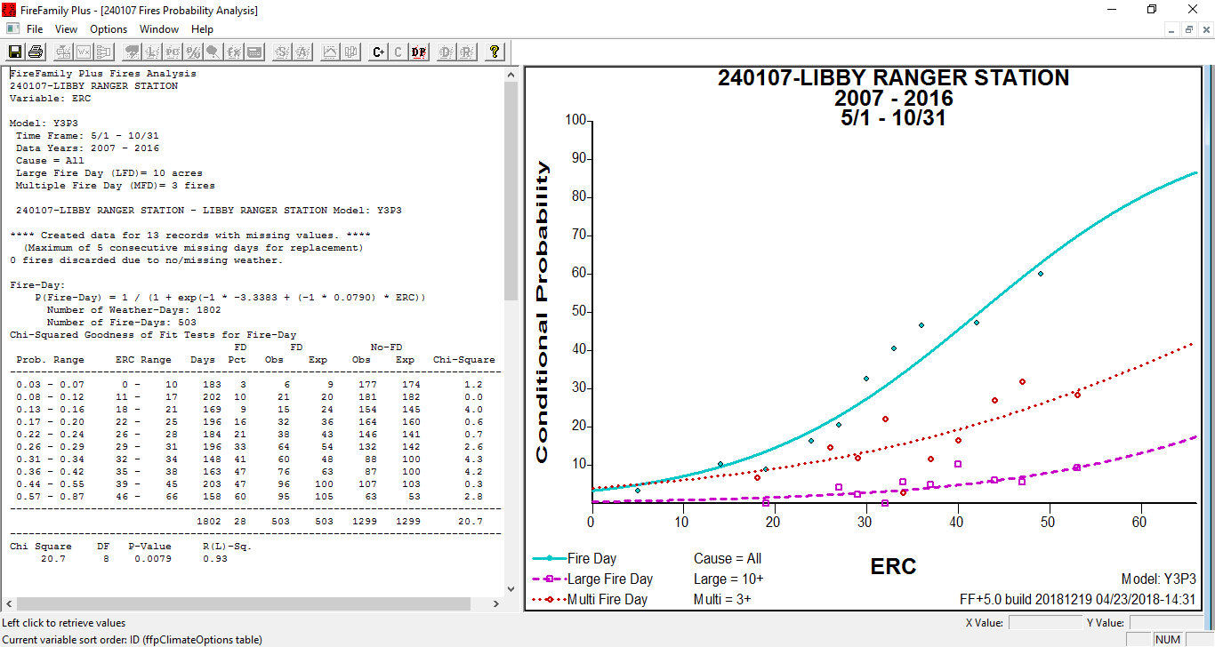
Fires Probability Analysis
Notes:
Slide # 20
You have already seen this graph (or something similar from Interactive Batch) because we looked at it a lot in Lesson 11. This graph must be active so that you can access the Decision Points feature (DP button).

Slide 21
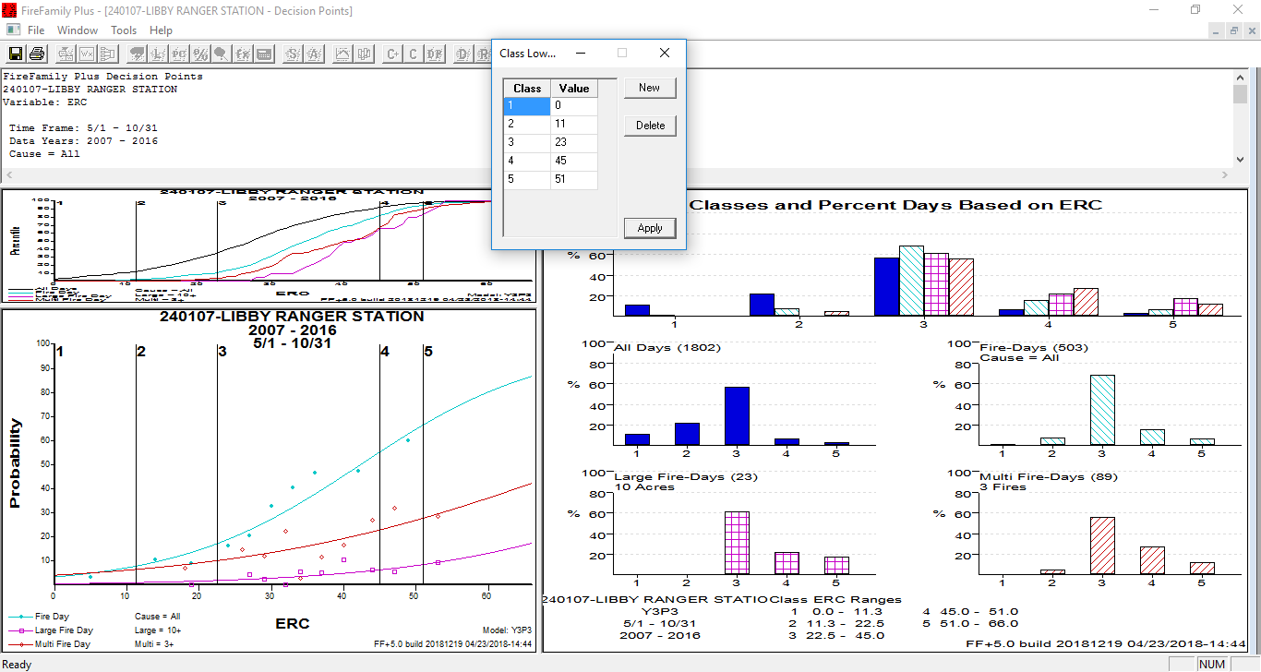
.
Notes:
Slide # 21
***See handout.***
This is the decision point screen in FFP. There are up to 9 thresholds; the default is 5. The lowest threshold is 0. You move from class 1 to class 2, in this example, at an ERC of 16.
How many thresholds you have will depend on how many decisions you need to make for a given management tool. How much time (All Days) should you spend (all year or seasonally) in each level? This is year-round data in Montana, so most days are spent in Classes 1 and 2. For fire days, most of your time is in 3 and 4. For large and multi fire days, most is in 4 or 5 (Note: this may not work for human-caused fires or areas with few fires). The All Days curve varies depending on your fire season. A year-round fire season could have a different shape.
With 3 decision thresholds (i.e. campfire restrictions, debris burning), reduce the number of lines. How much time do you spend in each group (i.e. 30% in each or most in 1 and 2)? Remember if you are restricting, set it a little higher so it isn’t constantly changing, especially if you are talking to non-agency folks.
You will determine how many decision points you need for each management tool. Then, set decision points for each tool for each FDRA – staffing, preparedness, response/dispatch, adjective rating, restrictions; levels of escalating fire danger. Each tool can use a different fuel model/index combination and a different number of decision points, although that can also be a lot to maintain during the busiest times of year.

Slide 22
Fire Business Thresholds vs Climatological Breakpoints
Thresholds determined through a Fire Business analysis are preferred to Climatological Breakpoints when applying preparedness, response, and staffing decisions.
Notes:
Slide # 22
Best Practice: Climatological Breakpoints versus Fire Business Thresholds
Thresholds determined through a Fire Business analysis (correlation of weather observations and fire occurrence data) are preferred to Climatological breakpoints (percentiles based strictly on weather data) when applying preparedness, response, and staffing decisions.
Fire Business thresholds are based upon the statistical correlation of weather data AND historical fire occurrence.
With a statistical correlation of weather and fire occurrence, decision points will be based upon the appropriate fire danger threshold at which a new action (decision) should be implemented.
FireFamilyPlus provides the tool with which the statistical correlation can be accomplished.
Climatological breakpoints only consider weather data.
Climatological breakpoints are points on the cumulative distribution curve of one fire weather/danger index computed from climatology (weather) without regard for associated fire occurrence/business.
For example, the value at the 90th percentile ERC is the climatological breakpoint (for that period of record) at which only 10 percent of the ERC values are greater in value.
Climatological breakpoints are valuable for comparisons of NFDRS values (such as an ERC value at the 90th percentile in one location versus another).
HOWEVER . . . caution should be used in using annual data, unless an area has year-round fire activity. The ‘Very High’ and ‘Extreme’ danger rating thresholds may be lower than warranted when including non-fire season months with low fire danger index values.
If annual data are used, annual data should be available for every year in the selected date range to avoid hidden biases. In addition, use of fire season data can be biased without a consistent definition of the ‘fire season.’
Additionally, the length of the fire season may be increasing; the definition of a ‘fire season’ should be sensitive to such changes.¹
¹Heinsch, F. A. (2009, January). Implications of Using Percentiles to Define Fire Danger Levels. Proceedings of 8th symposium on fire and forest meteorology. Kalispell, Montana: American Meteorological Society. Retrieved from https://ams.confex.com/ams/8Fire/webprogram/Paper156081.html

Slide 23
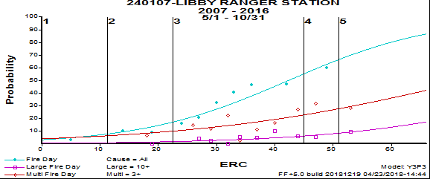
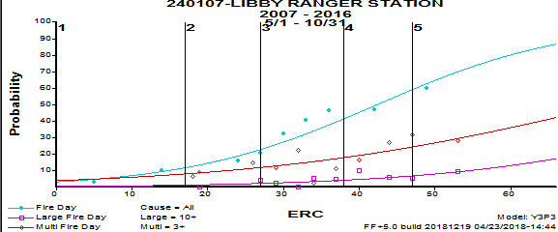
Decision Points
Default
User-Defined
Notes:
Slide # 23
Animated Slide
In the probability graph, you can determine thresholds/decision points. FireFamilyPlus automatically brings in 5 lines with the 1st line at 0, the 4th line at the 90th percentile, and the fifth line at the 97th percentile. You can add or delete lines as desired to get the appropriate number of classes.
The lines are how well the index fit. The dots represent the median value where the fires (groups of them) occur.
If we were using preparedness level with 5 decisions: The chart on the top is how it came in automatically. It doesn’t really show where things start to ramp up. When would you want to gear up or bring in more resources before line 4? The chart (updated) on bottom is an example of how you might adjust the values to reflect fire danger thresholds (instead of climatological breakpoints).

Slide 24
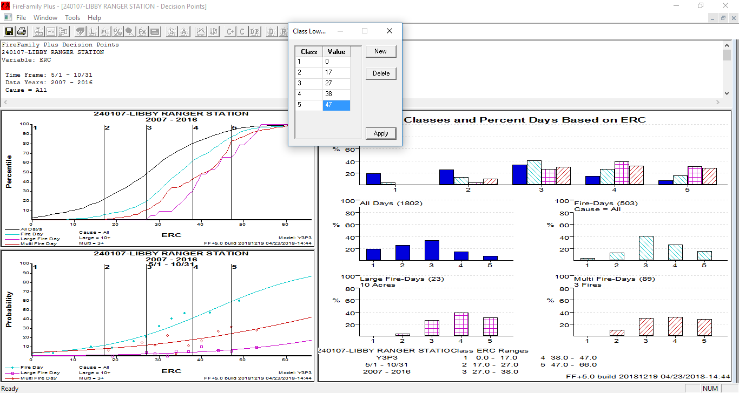
.
Notes:
Slide # 24
***See handout.***
This is the decision point screen in FFP. There are up to 9 thresholds; the default is 5. The lowest threshold is 0. You move from class 1 to class 2, in this example, at an ERC of 16. You may have learned in other classes about looking at a number of different bar graphs on this page. In reality, you get the most information from all days and fire days. Large and multiple fire days are good for determining when to change decision class, but the bar charts are not as meaningful.
How many thresholds you have will depend on how many decisions you need to make for a given management tool. The lines over the bar charts reflect what the distribution should look like.
How much time (All Days) should you spend (all year or seasonally) in each level? These are seasonal data from northwest Montana, so most days are spent in Classes 2 and 3. For fire days, most of the days are in 3 and 4. For large and multi fire days, most are in 4 or 5 (Note: this may not work for human-caused fires or areas with few fires). The All Days curve varies depending on your fire season. A year-round fire season could have a different shape.
With 3 decision thresholds (i.e. campfire restrictions, debris burning), reduce the number of lines. How much time do you spend in each group (i.e. 30% in each or most in 1 and 2)? Remember if you are restricting, set it a little higher so it isn’t constantly changing, especially if you are talking to non-agency folks.
You will determine how many decision points you need for each management tool. Then, set decision points for each tool for each FDRA – staffing, preparedness, response/dispatch, adjective rating, restrictions; levels of escalating fire danger. Each tool can use a different fuel model/index combination and a different number of decision points, although that can also be a lot to maintain during the busiest times of year.

Slide 25
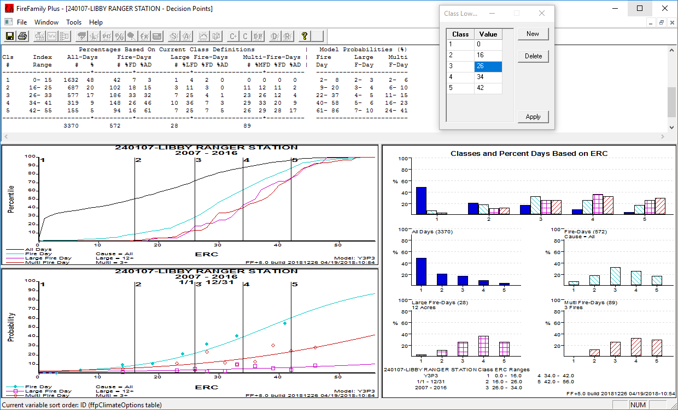
.
Notes:
Slide # 25
***See handout.***
The previous slide showed an analysis for the Libby RAWS and Kootenai NF when analyzing only the fire season. That would apply to a fire season analysis such as this or an area that has a year-round fire season.
However, if you are analyzing the entire year, and you do not have a year-round fire season, you would end up with an All Days (Weather Days) graph that looks different. Most days would not be fire days at Libby, for example, so rather than a bell-shaped curve, you would end up up with most days in class 1 or 2 (no fires, class 1). In an area with a year-round fire season, on the other hand, you would expect to see a similar curve in both All Days and Fire Days.

Slide 26
A Couple of Thoughts…
In an ideal world:
Determine the appropriate number of classes needed to support each decision or management action.
Define classes so that fire business is different for the class above and below it.
Have an increase of fire potential with each class.
E.g., no fires to fires; fires to large fires; some large fires to a lot of large fires
Use large and multiple fire days to inform fire business thresholds
Notes:
Slide # 26
If you need help getting started, here are a couple of thoughts to keep in mind. You want to define your classes such that fire business is different for the class above and the class below. There should be a large increase in fire potential with each class (e.g., large fire day). You also need a minimum number of classes to support each decision or action. You determine what that is locally.

Slide 27
Review Objectives:
Describe which management decisions are most appropriately supported by either climatological breakpoints or fire business thresholds.
Using FireFamilyPlus, discuss a process which can identify the best "fire business" relationships by examining multiple combinations of fuel models and NFDRS outputs.
Notes:
Slide # 27
Review Lesson Objectives:
Describe which management decisions are most appropriately supported by either climatological breakpoints or fire business thresholds.
Using FireFamilyPlus, discuss a process which can identify the best "fire business" relationships by examining multiple combinations of fuel models and NFDRS outputs.

Slide 28
Review Objectives (cont’d):
Using FireFamilyPlus, discuss a process using statistical tools to identify appropriate decision points for staffing levels, adjective rating levels, dispatch levels, and public fire restrictions)
Notes:
Slide # 28
Review Lesson Objectives:
Using FireFamilyPlus, discuss a process using statistical tools to identify appropriate decision points for staffing levels, adjective rating levels, dispatch levels, and public fire restrictions)

Slide 29

Questions?
Notes:
Slide # 29
Questions

