Slide 1
Applied Statistics for FireFamilyPlus
Lesson 12
Notes:
Slide # 1
Lesson #12: Applied Statistics for FireFamilyPlus
Lesson Time: 60 minutes (followed lunch)
Facilitator Notes:
Don’t forget to fill in the “Workshop Dates” and “Workshop Location” on the bottom right of this title slide.
Students will need their computers for this lesson.

Slide 2
Objectives:
Describe the statistics used in FireFamilyPlus to analyze NFDRS indices
Use FireFamilyPlus to analyze NFDRS indices to select a final fuel model
Notes:
Slide # 2
Lesson Objectives:
Describe the statistics used in FireFamilyPlus to analyze NFDRS indices
Use FireFamilyPlus to analyze NFDRS indices to select a final fuel model

Slide 3
Assumptions for Weather Data
Quality data!
Future weather patterns similar to the past
Archived data adequately samples past variability
Results monitored over sufficient period of time
Notes:
Slide # 3
Before we talk about methods, we need to establish assumptions of the analysis, including weather data from the local RAWS and fire data. We need to ensure it is accurate.
Quality data! Good data quality cannot be achieved solely through the push of a button or implementation of an instant solution. Develop a protocol to examine the data in WIMS at least weekly. Remember, you should look at all 24-hours of data, not only the “daily ob”.
Future weather patterns are similar to the past We rely on past weather patterns to predict future. Changes in climate have also changed trends in fire danger, so scientists suggest we limit the analysis to about 10 (no more than 15) years of data. NFDRS2016 requires solar radiation data, which may limit your analysis further. The model also requires a snow flag to be entered. You turn it on and off in response to snow. You do not need to enter it daily.
Archived data adequately samples past variability Ensure the analysis includes scenarios important to the local area (wet/dry; El Niño/La Niña; early/late start/end of fire season). The 10-15 years of data often includes a “extremely busy” year, a “normal” year, and a “slow” year. Consider adjusting the data years if the data don’t cover all of those scenarios. Be careful of confirmation bias. Trends in fire danger may mean that a “normal” year now is not the same as a “normal” year in the 1990s.
Results are monitored over sufficient period of time Examine how well this system would have worked in previous fire seasons. If we had this system in, say, 2013, would it have reflected the number of fires that we had? The severity? The number and type of resources we needed to dispatch? You can gain confidence in the analysis before the season even starts. Then, run it side-by-side with the current analysis for a season to ensure that it predicts fire business.

Slide 4
Determining Fire Activity
Quality fire data are also required!
Fire activity is determined locally
How many days have a fire?
How many days do we have more than 1 fire?
How large do these fires become?
When does fire activity become a burden to local fire management resources?
What other activities are occurring on the local unit?
Notes:
Slide # 4
We also need to know something about fire in the area. You have already looked at how to define the fire season length by fire activity. Fire activity can be described as the total number of fires, the number of acres burned, the number of days you have more than 1 fire, or how many long-duration fires a unit typically gets in a year.
Currently, we use fire occurrence data, but this has limitations. Days of large fire growth do not necessarily correspond to discovery date. Scientists are looking at methods to generate data that better reflects fire growth.
In addition to the fires, we need to know, at least generally, about our resources and their availability. When does fire activity become a burden to local fire management resources? When do we need to call our partners? When are our partners likely to be busy or unavailable? Are there other activities occurring on the local unit that may reduce the available resources (e.g., last few weeks of a busy fire season when local resources are exhausted)?

Slide 5
Data Quality
Good data quality cannot be achieved through
Pushing a button
Implementing instant solution
Data quality requires people and processes as much as technology
Notes:
Slide # 5
If your data isn’t accurate, complete and consistent it can lead to major missteps when making fire business decisions. It cannot be over-emphasized the importance of good fire and weather data. The integrity of the data is essential to gain reliability and trust in information; if people can’t trust the NFDRS2016, our efforts here are pointless.
Data quality requires the right combination of people, processes and technologies all with the common goal of improving the measures of data quality that matter most to us.

Slide 6

When is your birthday?
Notes:
Slide # 6
Image from PowerPoint search of creative commons.
Tell participants how many people are in the room (students + coaches + instructors).
Ask students: What is the probability that two of us have the same birthday? Get a few answers.
Activity: Tell participants to stand up if their birthday is, for example, in November (it works with any month). Ask students for the day of their birthday. Keep track of how many students have been asked. Repeat for each months until two people have the same birthday (It shouldn’t take long). Add up all the people who stood up during the exercise. Note: You could start on any day of the year and work either forwards or backwards. The probability remains the same.
In a room with 23 people, there is a 50-50 chance that two people have the same birthday. The probability only increases from there. This is called the birthday paradox. We are a bit biased, and we tend to look at things more personally. Therefore, we think of the 22 people whose birthday is compares to ours. We do not think of the 231 other comparisons (in a room of 23 people) being made when someone who is NOT me is being checked against someone else who is NOT me. This is where probability comes into play.

Slide 7
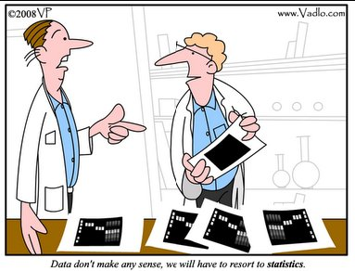
.
“Data don’t make any sense,
we will have to resort to statistics.”
Notes:
Slide # 7
Image: http://vadlo.com/cartoons.php?id=71
Statistics: Statistics helps us avoid the decision biases that creep in. We can use statistics to validate and challenge our assumptions about fire business on our unit. If it challenges our assumptions, we should pay attention to that: Are there data missing? Are there problems with data quality? Am I missing something that the analysis picked up?
If you have been on a unit awhile, you may know when to make a different decision. Using fire danger indices helps ensure that we base our decisions on current and expected fire business. We then use it to determine where to set the thresholds using a documented analysis that supports decisions. Do we need to ramp up? Are things slowing down?

Slide 8
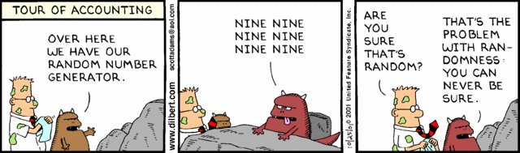
Random Event
Any occurrence for which
the outcome is
UNCERTAIN
Notes:
Slide # 8
Cartoon: http://dilbert.com/strips/comic/2001-10-25/
By its definition, a random event is something unpredictable. Knowing about a lot of random events, we can start to look for patterns.

Slide 9
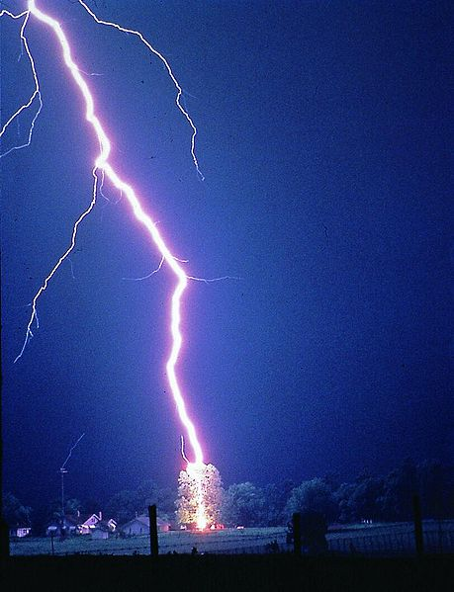
Probability
Numerical chance
that a
RANDOM event
will occur.
Notes:
Slide # 9
Images: Microsoft Clip Art; lightning from PowerPoint search of Creative Commons
To try and predict if a random event will happen, we look to probability. When we talk about probability, many people think of gambling. If the cards aren’t stacked against you, and the dice aren’t loaded, then you can calculate the probability of winning.
In fire, we don’t know, for example, exactly when and where lightning is going to strike. We do know the conditions under which it is likely. And, we know certain things are more likely to be struck by lightning (Golden Gate Bridge, Washington Monument, Statue of Liberty, Eiffel Tower, Great Pyramid of Giza, Burj Khalifa in Dubai, the large tree in a clearing). We can take the data that we have and develop a probability of that random event occurring.
While this event is not truly random, it can still be assumed to be random for this statistical exercise.

Slide 10
NFDRS – Fire Business Relationships
Given weather conditions on any given day,
what is the probability (0-100%)
that we will have a fire?
Notes:
Slide # 10
Ultimately, the question that we are trying to answer is, “Given fire danger on any given day, what is the probability (0-100%) that we will have a fire?”
That fire danger includes information about both the weather and the fuel (fuel model). We correlate that information with the fire data to calculate this probability.

Slide 11
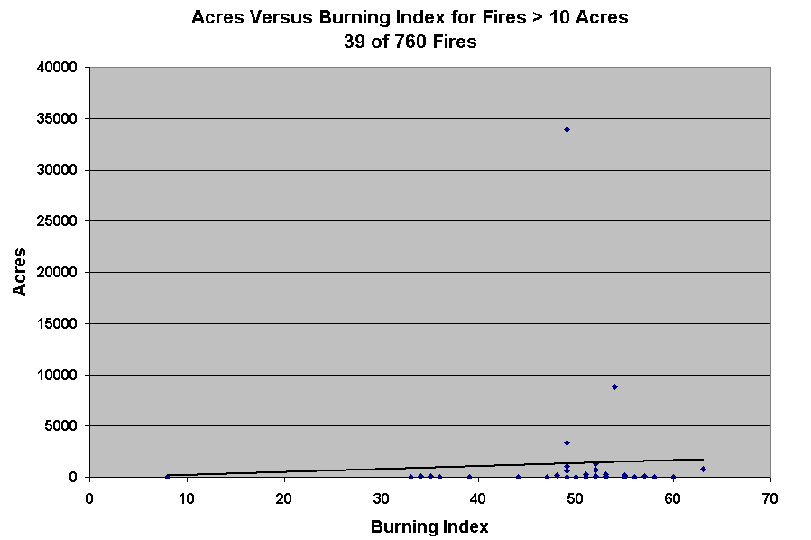
Linear Regression
Notes:
Slide # 11
Regression is commonly used to develop predictive equations. Linear regression takes the data and tries to fit a straight line to it. This works well if your data are normally distributed. However, fire data are not typically normally distributed. There are occasional very large fires that could skew the data. They aren’t outliers, however; it is really important to include them in the data.

Slide 12

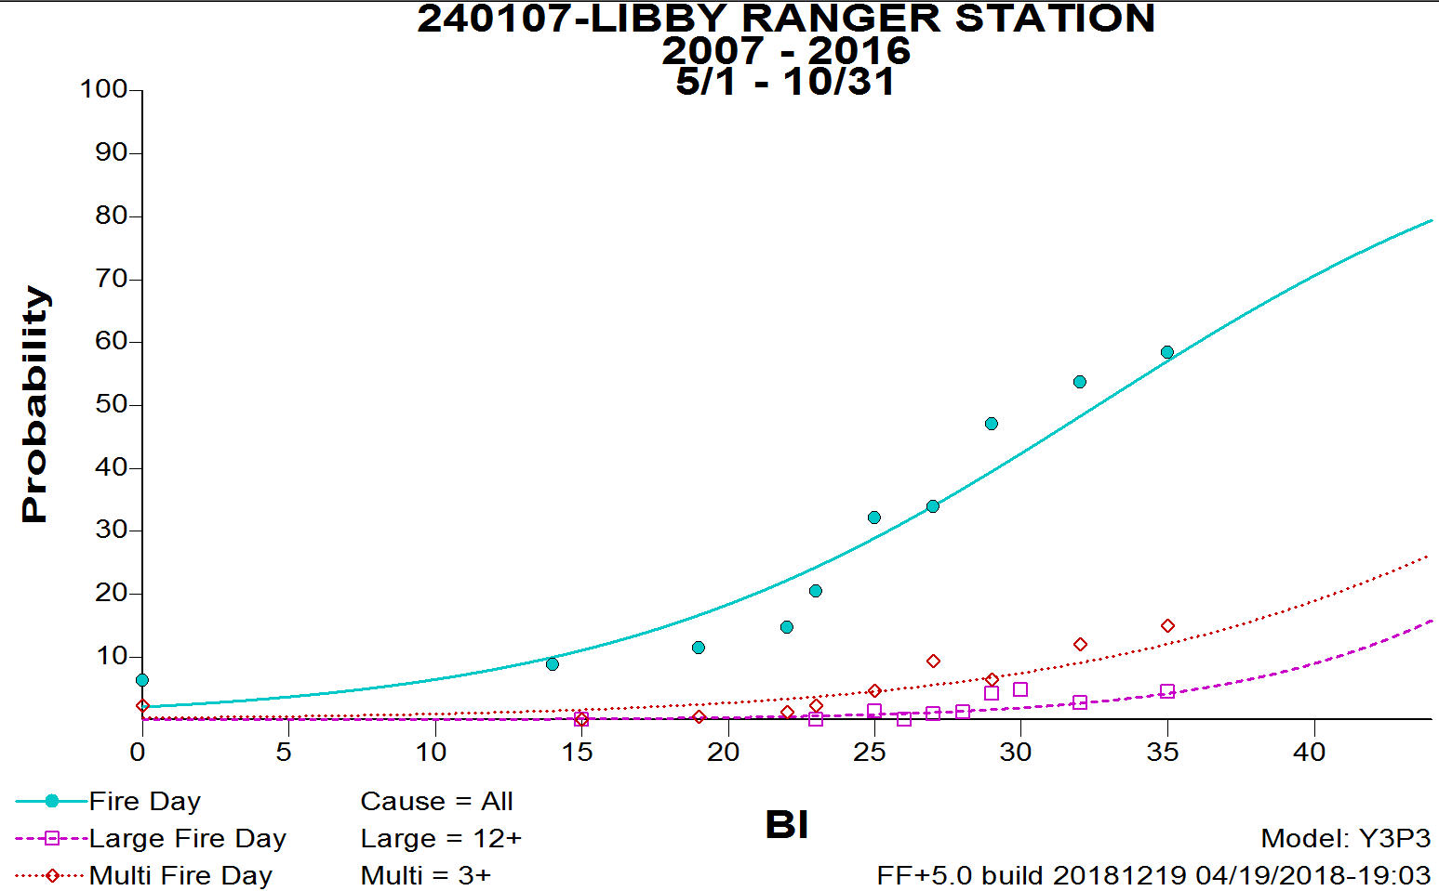
Logistic Regression
P(Fire-Day) = 1 / (1 + exp(-1 * -3.8594 + (-1 * 0.1184) * BI))
Notes:
Slide # 12
Image: PowerPoint Creative Commons search
Therefore, researchers looked at logistic regression. Logistic Regression is used to analyze the relationship between weather and fire. It is based on a “yes/no” answer: Yes, there was a fire today and the BI was 26. No, there was not a fire today and the BI was 26. FireFamilyPlus uses this information to predict the relationship between an NFDRS index/component and fire discovery day. A regression is only as good as the input data.
Outputs from logistical regression allow us to answer the following questions.
What is the probability that there will be a fire today, given this condition (e.g., BI of 27)?
What is the probability that this fire will be a large fire?
What is the probability of having multiple fires in a day? You specify what constitutes a large or multiple fire day.
Let’s look at the fire day regression. In FireFamilyPlus, each fire is associated with a day of weather. If there are no weather data, there is no fire in the analysis (with some caveats). The program looks at values and determines if it was or was not a fire day. The data are binned for display purposed.
The graph that FFP generates shows bins of data. The bin for a BI range of 10-16, there were 26 days in that range that had fires and 308 days that did not, or an 8 percent probability of having a fire when the BI was between 10 and 16. The dots are NOT fires.

Slide 13
Conditional Probability
Probability of a random event
GIVEN
that some other event
HAS already occurred
Notes:
Slide # 13
Conditional probability means that you already have some information. In this case, you know there is a fire. We now want to know, “What is the probability that the fire will get large? Or, what is the probability that there are have multiple fires today?” We use the same statistics, but the inputs differ slightly. Rather than compare large fires to all weather days, we only compare fires to days that we know had fires (fire days).
If we are responding to an incident, there is already a fire. We know that, or we wouldn’t be responding. So, the response is based on knowing there is a fire. In other words, the response is conditional on having a fire – you want to use conditional formatting for that.
However, if we are setting Adjective Fire Danger Rating, we are often concerned with the probability of a fire occurring. We want to prevent those if we can. The same can be said for Preparedness and staffing. We don’t have a condition as there is no fire yet.

Slide 14
Statistical Fit – The Short Answer, Part 1
Goodness-of-Fit
More fires = better (within reason).
Statistics may not be valid for large fire days or multiple fire days!
If <20 fires, beware of statistics!
Focus on Fire Days; others if you can
Do NOT change definition of large or multiple fire day to improve the statistics! (local capacity)
Notes:
Slide # 14
Having more fires is better. Statistics may not be valid for large or multiple fire days. There may not be enough fires to analyze that. Focus on Fire Days. Look at the others if possible. Don’t try to make it fit by changing your definition of multiple or large fire day – that is a decision bias.
Our goal is to rate models (indexes) by reviewing the following:
Goodness of Fit
Chi-Square
Probability Range
Predictor Variable Range
Note: We used to look at the R2 for logistic regression, but it is actually not very useful at determining the best metrics to use.

Slide 15
Statistical Fit – The Short Answer, Part 2
Goodness-of-Fit: How well does this equation predict observed data?
Currently in FFP, Chi Square is the best metric
In Chi Square, lower is better. In a Fires Analysis,
0 is a perfect fit (with 8 DF),
Less than 13 is excellent,
Less than 20 is good, and
Greater than 26 is not so good.
Notes:
Slide # 15
Our goal is to rate models (indexes) by reviewing several metrics, the first of which is the Goodness-of-Fit. How well does the equation (line) predict the observed data (points)? If the points are close to the line, then the fit is good. If the points are far away from the line, then the fit is not as good.
But, how good is it?
Goodness of fit is currently measured using the Chi-Square in FFP. A value of 0 represents a perfect fit.
Note: It is pronounced with a strong “K” sound (/kaɪ/ or /kiː/). Chai is a delicious tea. ☺☺
Optional (if students ask): There are 8 Degrees of Freedom (DF) in a FireFamilyPlus fires analysis. The actual Chi Square value that is considered excellent, good, and less than that depends on how many degrees of freedom exist in a given regression analysis. FireFamilyPlus Fires Analysis will always have 8 DF if you have more than 20 fires, so these values hold across all fire business analyses.

Slide 16
Statistical Fit – The Short Answer, Part 3
Probability and Predictor Variable Ranges
Probability Range (0-1): Larger range
Predictor Variables: Larger range
Statistics are not the only factors:
Other information is also important!
Notes:
Slide # 16
A large Probability Range A large probability range indicates that the predictor variables (ERC) do a good job of estimating the outcome (“Fire Day” versus “Not a Fire Day”). Thus, most possible outcomes (the probability) are included in the predictor model. If a probability range is small (e.g., 0.2 to 0.3), the predictor variable does not estimate the outcome well. You can use a
A large range for a Predictor Variable allows flexibility in setting fire business thresholds. The range of the predictor variable is determined by the inputs and fuel model selected. A range of 0-45 allows more flexibility than a range of 0-5.
If we had perfect data, perfect statistical methods, and perfect understanding of fire, we could consider statistics alone. However, we don’t. Therefore, consider other information as well. Do not consider only the statistics. However, do not ignore the statistics either.

Slide 17
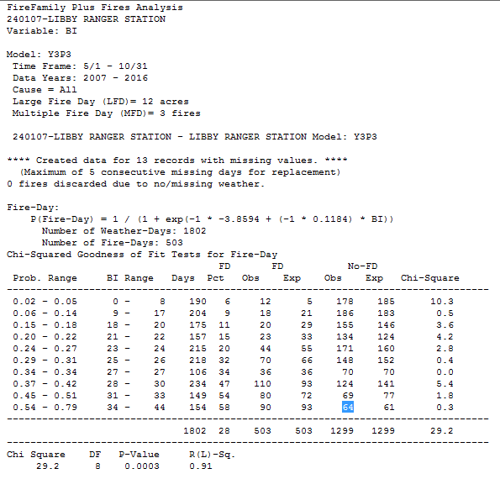
Logistic Regression: Fire Day
Fire-Day
Notes:
Slide # 17
ANIMATED SLIDE
This table provides the same information as the previous slide. First, look at the probability analysis for Fire Days. FireFamilyPlus calculates a BI for every day that has weather data. In this example, there were 1,802 days with weather data. With fires, there are only 2 possibilities: a day with fires and a day with no fires. There are 503 fire days.
Chi Square = 29.2 (not great good); Notice, however, that most of the error is in the first class. Why are there so many BI values of 0? When it rains, the BI, SC, and IC are all set to 0. When do a lot of natural ignitions start? During thunderstorms, which may also bring rain. So, we can ignore this error FOR BI because of this anomaly. How does the Chi Square look now? Pretty good, actually
Probability Range is 0 – 0.79 (really good; this equation accurately predicts that a day will be a fire day 79% of the time. Of course, that means it cannot predict it 21% of the time.)
Predictor Variable (BI) Range is 0-44 (good). With decimals, we can use much smaller ranges than before. So, do not necessarily through out a predictor variable with a small range, but think about how you need to describe it to others. You can use percentiles to get around that issue. Percentiles are actually better to describe fire danger because they mean the same thing everywhere. Everyone has a sense for what an ERC-Y at the 87th percentile means; They may not know what an ERC-Y of 27 means. For some areas, those are extreme conditions; for others, it is an ordinary day.

Slide 18
Statistics is not the only consideration
In addition to Statistics, think about
Fire occurrence: What questions are you trying to answer? Will these outputs help with that?
NFDRS Outputs: How quickly do they respond to changes? How well do they relate to fire occurrence?
Responsiveness: How quickly does the candidate (fuel model + output) respond to change?
Notes:
Slide # 18
NFDRS analysis is an art and a science; both are important. Other lectures contain information to help guide your selection(s). Consider everything you know about your area and the questions you are trying to answer.
You do want the best possible statistics, but not necessarily the absolutely best numbers. If you want staffing levels that can respond rapidly, a great statistical relationship between ERC and a slash model may not help you. Perhaps a BI will provide better response times.
What is the range of the selected index? Say that the index with the best statistical relationship (e.g., BI) has a decision space ranging from 1-10. Is that helpful in making a given decision?
These are all hypothetical questions. You need to consider the vegetation, weather, NFDRS indices, and statistical relationships for your area.
The lesson plan contains this information as well as a table for easier reference.

Slide 19
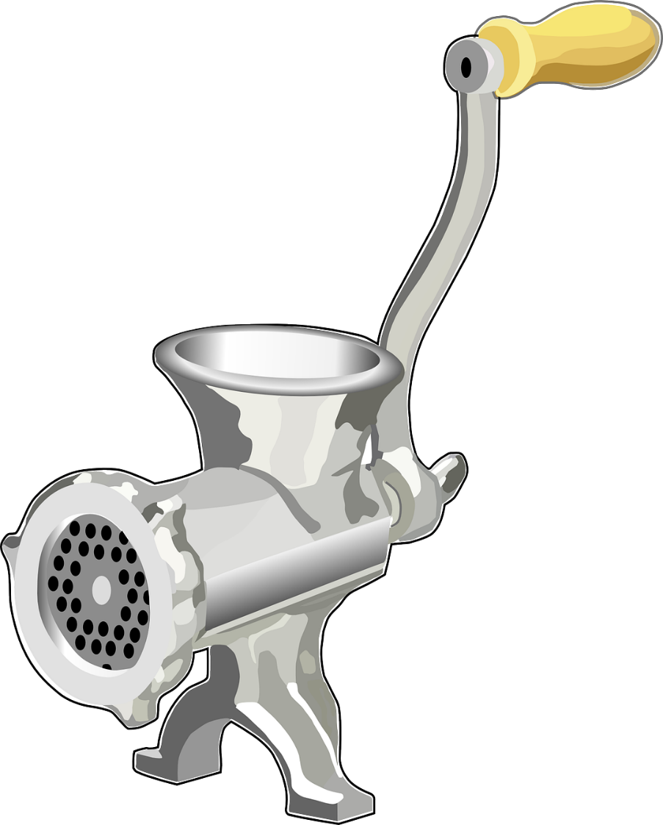
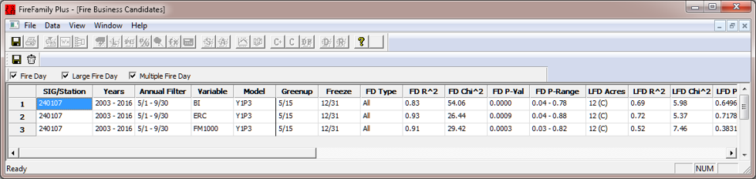

Task 5
FIRE OCCURRENCE
FUEL MODEL S
WEATHER DATA
KBDI?
SC?
DMC?
ERC?
BI?
BUI?
FWI?
FireFamilyPlus
1000-hr?
Notes:
Slide # 19
Image: CCO Creative Commons, https://pixabay.com/en/mincer-meat-grinder-grinder-147531/
Now, it is time to do an analysis by entering all of the information into the FireFamilyPlus sausage grinder. You will do a Fires Analysis for all 5 fuel models for a number of NFDRS variables, including ERC, BI, SC, and IC. Also look at variables that do not depend on fuel models, such as KBDI, CFFDRS outputs, fuel moisture, etc.
As part of Task 5, examine statistical fit, probability range, and decision space. If it is a viable option, add it to the Candidates Table. by clicking on the C+ button. You must be on either Fires Analysis Report or Fires Analysis Graph for the C+ button to be active. You can view the Candidates list at any time by clicking on the C button.
Do not attempt to select the single best option in this step. As mentioned earlier in the lecture, you may choose different combinations for different reasons. You may want a variable (or fuel model) that changes slowly or quickly, and this may change for every decision you are trying to make. You will learn more about that that this afternoon. In the meantime, look for viable candidates to consider further.

Slide 20
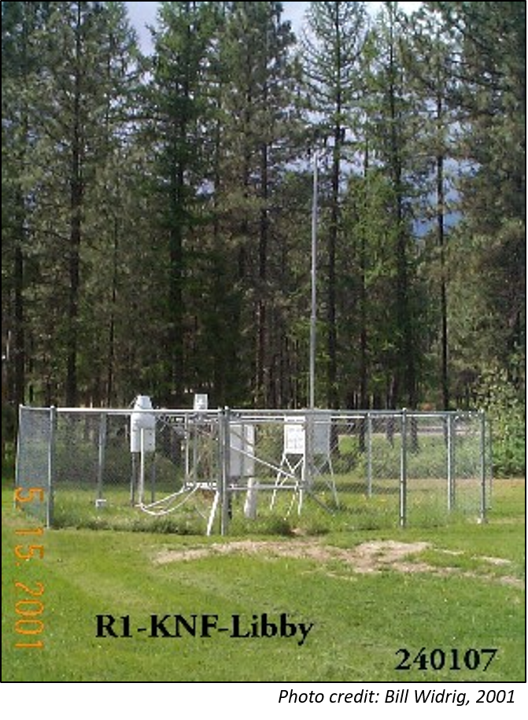
Setting up a Fires Analysis
Sample analysis uses the Libby RAWS and fires from the Kootenai NF
First, set up the Working Set.
Then, use Interactive Batch.
Notes:
Slide # 20
Photo of Libby RAWS from WRCC RAWS Photo Archive (http://www.wrcc.dri.edu/wraws/pictures/mlib/200105/mlib.ST1.jpg).
Tech Tips 5a, 5b, and 5c will help you with the process of doing a fires analysis.
Lets take a quick look at the graphs and reports you will look at in your analysis using the Libby RAWS on the Kootenai National Forest.
Remind students it is easier to set up the Working Set before you open Interactive Batch.
Use the following slides since they are easier to see on the screen than windows from FireFamilyPlus.

Slide 21
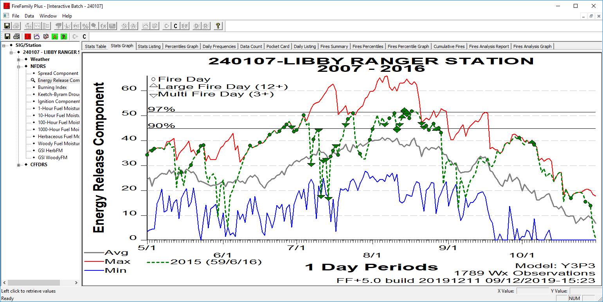
View Fires on Stats Graphs (Overlay)
Fire Days / Large Fire Days / Multiple Fire Days
Notes:
Slide # 21
You can view the fires for any given year in the Stats Graph as shown on the slide. You can only look at fires for specific years. 2015 was an extremely busy year on the Kootenai National Forest. Occasionally, when you add fires, they don’t appear. If that happens, repeat the steps and try again. Each point on the graph represents a day that had at least one fire. If the day had a large fire, it is noted as an upward facing triangle. A multiple fire day is noted as a downward facing triangle. At the bottom of the graph next to the year, you can see how many fire days, large fire days, and multiple fire days there were. In this example, there are 59 fire days, 6 large fire days, and 16 multiple fire days.
Ask participants:
Do most fires start when the ERC is average, above-average or below-average? Answer: Above average
Based only on this graph, do you think ERC is a good indicator of fire danger? Answer: Yes, most fires occur when ERC is high.
While this graph shows ERC, you will look at a number of variables to avoid decision bias.

Slide 22
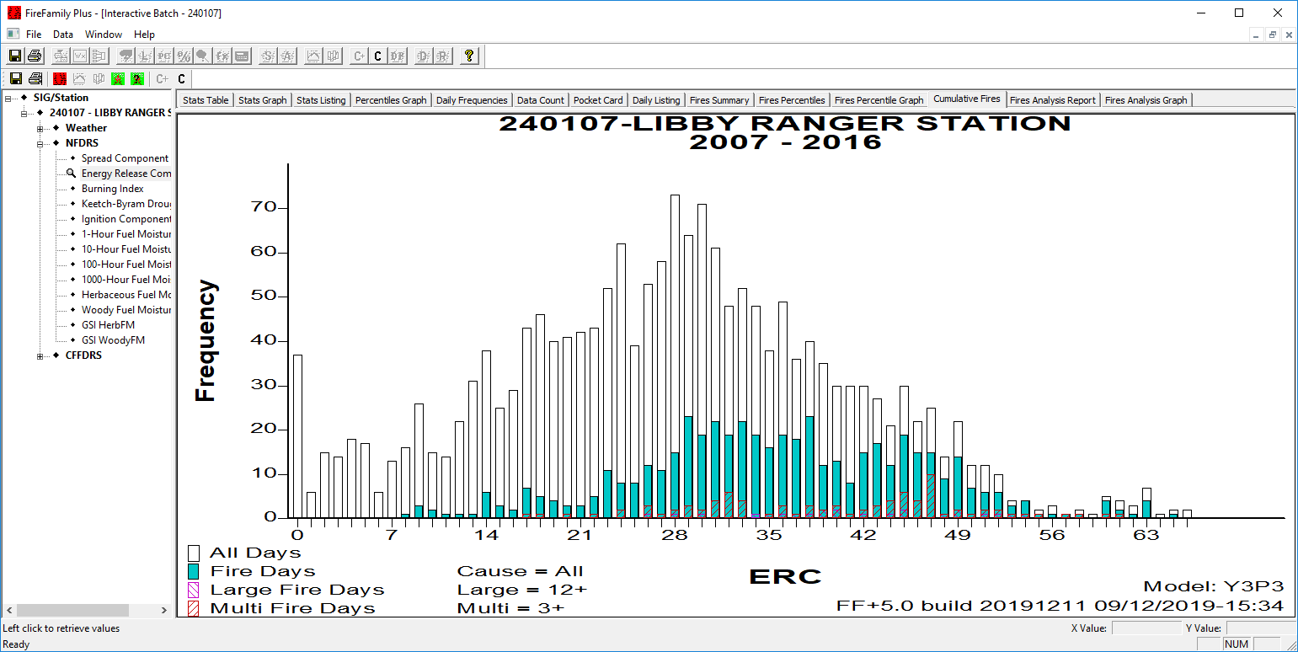
Cumulative Fires Graph
Notes:
Slide # 22
Take a look at the Cumulative Fires graph. This graph is a histogram of the fires analysis. Criteria defined for Cause Class (All, Lightning, or Human), Large Fire Day, and Multiple Fire Day are all printed on the graph. The frequency is the number of days at each ERC value.
Cumulative fires analysis graphs include
Black line or bin: all weather days regardless of fire activity (called All Days on this graph)
Teal: weather days with a reported fire
Purple: weather days with a reported large fire (e.g., 12 acres or larger in this graph).
Red: weather days with multiple fires reported (e.g., 3 or more fires per day in this graph).
This graph, unlike the Stats Graph, includes fires for all years. Generally, you expect to see more fires as the fire danger increases, or more of the teal and less of the white. It can be difficult to see large and multiple fire day bars as there are so few in most areas.
Note: If you analyze fuel moisture or relative humidity, bars are revered since low values indicate higher fire danger.

Slide 23
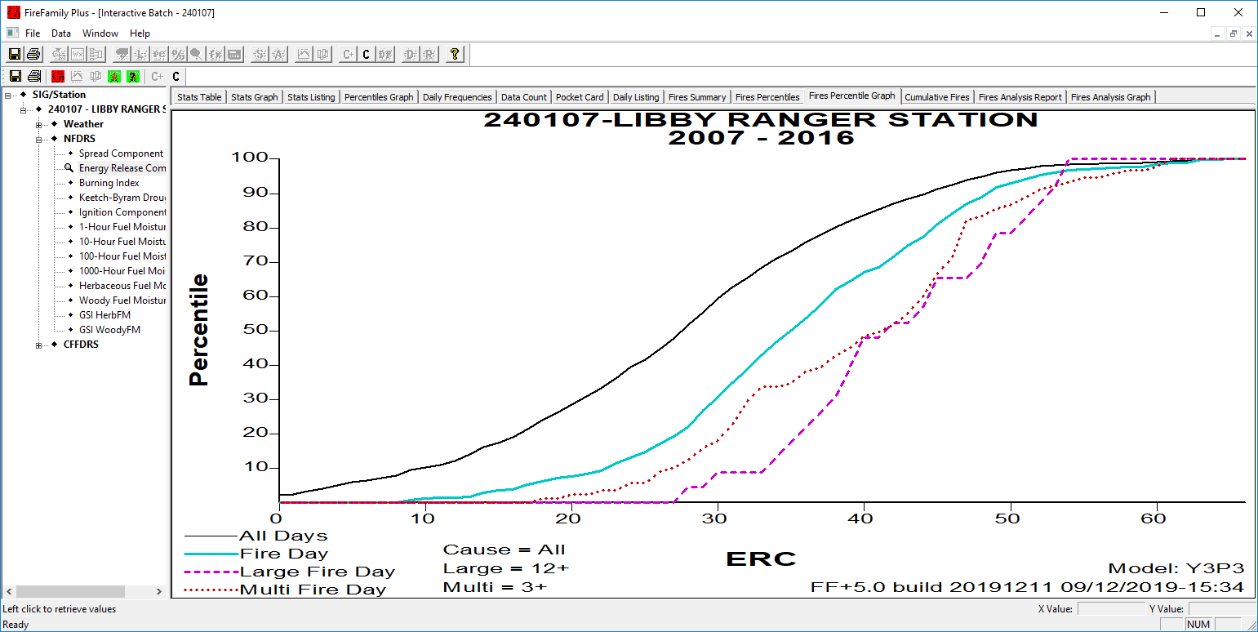
Fire Percentiles Graph
This is the “All Days” line
aka Weather Days
aka Percentiles Graph used to identify Climatological Breakpoints
Notes:
Slide # 23
Next is the Fires Percentile Graph. There are four lines on this graph. These lines will change with fuel model/NFDRS output combination.
The black line is the All Days line. It shows all weather days in the dataset. This is the exact same line used in the Percentiles Graph. The remaining lines show fire days, large fire days, and multiple fire days.
This graph shows how well the predictor variable (ERC) predicts fire occurrence. There should be separation between the lines. All Days (Weather Days) should increase first and be higher than Fire Days. Fire Days should increase before both Large and Multiple Fire Days. Lines should not max out too early (e.g., All Days reaches 100% when ERC is 25, and the maximum ERC is 50).
This graph contains the same information as the Cumulative Fires graph we just looked at; it is just in a different format. Use whichever graph works best for you.
Note: Sometimes the lines reverse as the output increases. This generally occurs because there are not enough fires in the dataset or the analysis is done for the entire year. Do not worry about this for S491.

Slide 24
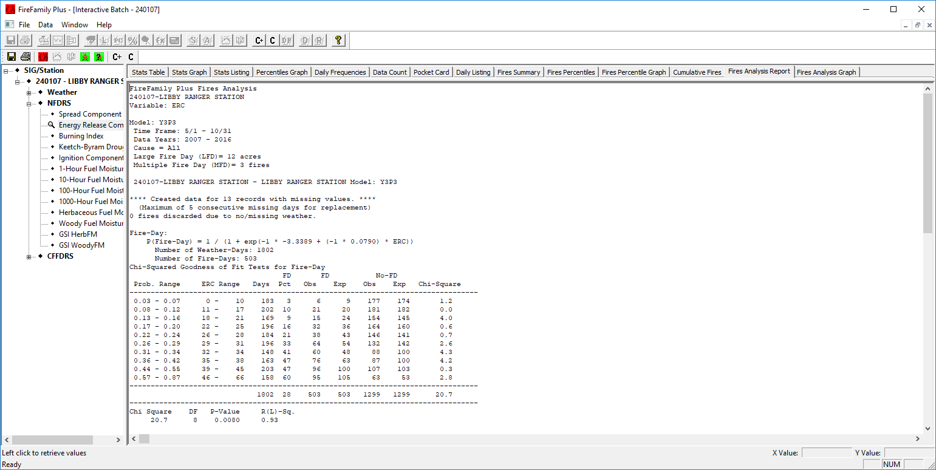
Fires Analysis Report
Notes:
Slide # 24
Let’s look at the Fires Analysis Report.
We saw this table earlier in the presentation. There will be three tables in this report: Fire Days, Large Fire Days, and Multiple Fire Days. An analysis has been done for each one.
Look at the Chi-Squared, located in the lower left-hand corner of the table (green box).

Slide 25
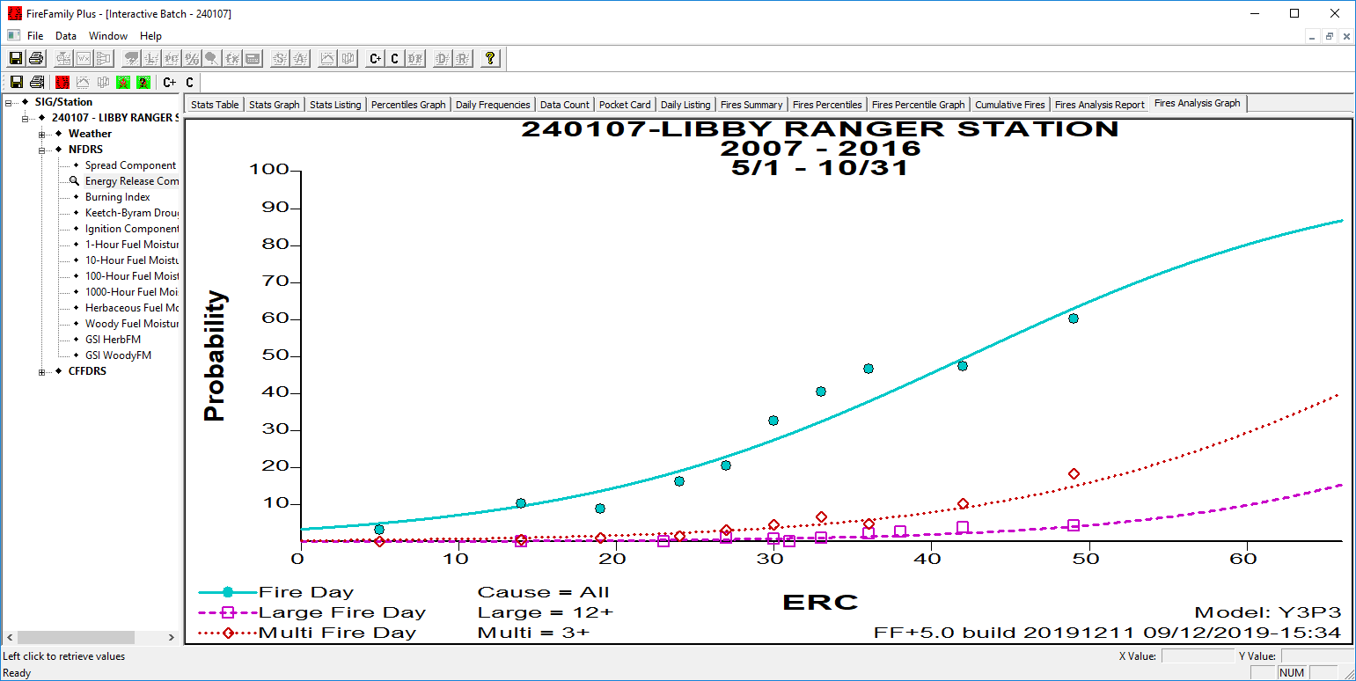
Fires Analysis Graph: Adding Candidates
Notes:
You saw this graph, the Fires Analysis Graph, earlier. When you find a selection you want to consider further, add it to the Candidates Table by clicking on the C+ button.
Add this candidate to Candidates Table by clicking on the C+ button. You must be on either the Fires Analysis Report or Fires Analysis Graph for it to be active. You can view the candidates at any time by clicking on the C button.

Slide 26
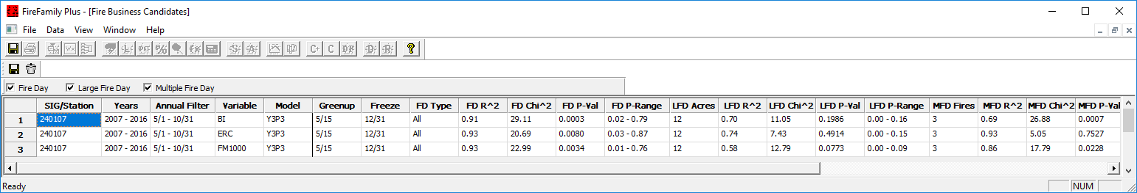

Save Your Fires Analysis: Candidates Table
Add potential candidates to the Candidates Table (C+)
View the Candidates Table (C)
Document your selections (Exercise 4)
Notes:
Open the Candidates Table (C) and review the results. Your results will likely differ from those shown above. Point out the variable, fuel model, and Fire Da (FD) statistics. Focus on the Chi-Squared. Reinforce how tough it can be to read the table; students should not add all possible candidates and sort it out later. It is much easier to add only candidates they want to consider.
Tips
View the Candidates Table by clicking on the C button, which is always available.
Click on the floppy disk to Save the Candidates Table. Click to add oval. Make sure to use the floppy disk closest to the table. Click to add CSV box. If done correctly, it will be saved as a Comma Separated Values File (*.csv) that can be opened in Excel, Google Sheets, or other spreadsheets.

Slide 27
Review Objectives:
Describe the statistics used in FireFamilyPlus to analyze NFDRS indices
Use FireFamilyPlus to analyze NFDRS indices to select a final fuel model
Notes:
Slide # 27
Review Lesson Objectives:
Describe the statistics used in FireFamilyPlus to analyze NFDRS indices
Use FireFamilyPlus to analyze NFDRS indices to select a final fuel model

Slide 28

Questions?
Notes:
Slide # 28
Are there any questions? If not, you are ready to do Task 5.

