Slide 1
Fire Danger Operating Procedures, Decision Classes, and Management Actions
Lesson #11
Notes:
Slide # 1
Lesson #11: Fire Danger Operating Procedures, Decision Classes, and Management Actions
Lesson Time: 60 minutes (followed by Lunch/Lesson 12)
Facilitator Notes:
Don’t forget to fill in the “Workshop Dates” and “Workshop Location” on the bottom right of this title slide.

Slide 2
Objectives
Determine which correlation of fuel model and NFDRS output is appropriate for a fire response plan.
Determine which correlation of fuel model and NFDRS output is appropriate for a staffing plan with 5 decision points.
Notes:
Slide # 2
Lesson Objectives:
Determine which correlation of fuel model and NFDRS output is appropriate for a fire response plan.
Determine which correlation of fuel model and NFDRS output is appropriate for a staffing plan with 5 decision points.

Slide 3
Objectives (cont’d)
Determine which correlation of fuel model and NFDRS output is appropriate for communication with our internal agency personnel affecting weekly, monthly, or seasonal fire preparedness decisions.
Notes:
Slide # 3
Lesson Objectives:
Determine which correlation of fuel model and NFDRS output is appropriate for communication with our internal agency personnel affecting weekly, monthly, or seasonal fire preparedness decisions.

Slide 4
Operational Considerations
Fire Danger Operating Plan
Remote Automated Weather Stations (RAWS)
Weather Information Management System (WIMS)
Roles and Responsibilities
PocketCards
Seasonal Trend Analysis
Notes:
Slide # 4
Key Points:
A good fire danger analysis and plan can quickly become a waste of personnel time and resources if it does not consider the operational elements to implement and support it.
For example:
RAWS => What happens if a RAWS used in the analysis malfunctions during the fire season? What if a station owner retires or leaves the unit for a new job?
WIMS => Who determines the climatological breakpoints for each RAWS? 90th/97th , 80th/95th , or something else? Climatology based upon a full year, or fire season?
Roles/Responsibilities => Who is delegated the authority to make decisions based upon the Staffing or Preparedness Plans?
PocketCards => Who is responsible for developing PocketCards? Are they interagency cards?
Seasonal Trend Analysis => How do we incorporate fine fuel loading and live fuel moisture sampling in our fire danger-based decisions?

Slide 5

Operational Considerations
Remote Automated Weather Stations (RAWS)
Maintenance
Planned - Annual (Required)
Unplanned - Emergency
Noncompliance Report
Ownership
Notes:
Slide # 5
Key Points:
Maintenance
RAWS need to receive annual maintenance as per PMS 426-3
Plan for the unexpected equipment failure or other issues which necessitate repair.
Consider either:
contractual agreement with the Remote Sensing / Fire Weather Support Unit (RSFWSU) or
agency personnel that have completed RSFWSU RAWS maintenance training.
Additional information regarding RSFWSU maintenance services, including service contract fees can be found at https://raws.nifc.gov/remote-sensing-fire-weather-support-unit-statement-services.
Weekly Noncompliance Report (https://raws.nifc.gov/standards-guidelines)
A weekly report from Wildland Fire Management Information (WFMI) weather module displays RAWS that are more than 1 year and 45 days past their annual maintenance date.
The report is widely distributed by email and available at https://famit.nwcg.gov/applications/RAWS.
If a RAWS is on the report, it has either not had annual maintenance, or the documentation for annual maintenance has not been completed in WFMI.
Data from these RAWS should not be used or used with caution.
Interagency RAWS Network
RAWS within any given analysis area may be purchased and/or owned by multiple agencies.
Interagency coordination is essential to leverage scarce resources (personnel, expertise, equipment, funding)
The FDOP should account for the agency and owner of each RAWS for the purposes of coordination and weather station management.

Slide 6
Fuel Models
NFDRS2016 Name | Description | Source
16V | Grass | Scott/Burgan GR2
16W | Grass/Shrub | Scott/Burgan S2
16X | Brush | Scott/Burgan SH9
16Y | Timber Litter | Scott/Burgan TL1
16Z | Slash | Scott/Burgan SB1
Notes:
Slide # 6
Key Points:
NFDRS2016 Fuel Models
The fuel models have generic names and are derived from the established Fire Behavior Prediction System models. They are denoted by the prefix “16.”
Interagency RAWS Network

Slide 7
Characterization of NFDRS Outputs (Staffing Idx)
BI ─ Burning Index
EC ─ Energy Release Component
IC ─ Ignition Component
SC ─ Spread Component
KB ─ Keetch-Byram Drought Index
Notes:
Slide # 7
Key Points:
Characterization of Staffing Indices (or Analysis Variable):
More than one index may be selected for use at a station, but each requires a complete line entry on the "Create Default NFDRS Parameters" form.
Valid entries are as follows:
BI BURNING INDEX Very high sensitivity to the fuel model. Low to moderate memory. Moderate variability. Low predictability. Fair to good characterization of the fire season.
EC ENERGY RELEASE COMPONENT Very high sensitivity to the fuel model. Moderate to good memory. Low variability as it is not affected by the wind. Good predictability. Fair to good characterization of the fire season.
IC IGNITION COMPONENT Moderate sensitivity to fuel models. Very short memory as it is dominated by the 1-hour time lag fuel moisture. Highly variable due to effects of relative humidity and wind speed. Very low predictability. Very poor characterization of the fire season.
SC SPREAD COMPONENT Very high sensitivity to fuel models. Very short memory dominated by surface area weighting and the 1-hour TLFM. High variability due to relative humidity, wind, and live fuel moisture. Low predictability. Very poor characterization of the fire season.
KB KEETCH-BYRAM DROUGHT INDEX No sensitivity to fuel models. Good memory, moderate variability, good predictability and characterization of the fire season. NFDRS Forecasts

Slide 8
FDOP Roles and Responsibilities
Agency Administrator
Fire Program Manager
Dispatch/Communication Center Manager
Station Owner (RAWS)
Station Owner (WIMS)
Model Manager (WIMS)
Duty Officer
Education / Mitigation / Prevention Specialist
Fire Danger Technical Group
GACC / Predictive Services Meteorologist
Notes:
Slide # 8
Key Points:
To minimize possible confusion regarding specific roles and responsibilities, it’s important to define them in the plan.
At a minimum, consider the following positions:
Agency Administrator
The Agency Administrators have delegated authority within their organizations to make decisions affecting their respective jurisdictions.
For Federal Agencies, these are likely to be Forest Supervisors (USFS), District Managers (BLM), Park Superintendents (NPS), Regional Fire Management Coordinators (USFWS), and Agency Superintendents or Regional Directors (BIA).
State organizations will vary.
Fire Program Manager (or Fire Management Officer)
Fire Program Managers (or Fire Management Officers) are delegated decision authority for FDOP actions which makes them essential for successful implementation.
If the Program Manager / FMO for each affected agency is not sitting at the table during the development of the FDOP, it is essential that someone ensure the Program Manager is familiar with the relationship of the Land-Use Plan(s), Fire Management Plan(s), FDOP, and the Response, Staffing, Preparedness, and Prevention plans.
Dispatch / Communication Center Manager
The dispatcher has traditionally assumed the essential role to run the WIMS processor to obtain NFDRS indices/components.
This position should be identified and targeted for WIMS and NFDRS training (Minimally, S-491. ANFDRS is highly recommended).
WIMS Model Manager
WIMS has added a new user role called Model Manager.
Those assigned to this role will have additional tabs (in the ENFDR screen) to actively manage the live and dead fuel moisture models.
RAWS Station Owner
Station owners have specific responsibilities as per PMS-426-3 and will need access to the weather section of Wildland Fire Information Management (WFMI) to ensure maintenance is documented as per policy.
They must ensure RAWS used for NFDRS calculations have annual maintenance to ensure outputs can be trusted.
It is very important that Station Owners delegate the appropriate access (Access Control List in WIMS) to those who will need edit access.
Duty Officer
The Duty Officer’s role may vary from agency to agency; common operational protocols should be discussed to avoid inconsistent implementation of the staffing, preparedness, or response plans.
It is recommended that specific delegated responsibility be assigned to Duty Officers to interpret and modify the daily staffing, preparedness and dispatch levels due to extenuating factors not addressed in the plan. Otherwise, the expectation is that Duty Officers will utilize and implement the FDOP subordinate plans for decision support.
For Interagency FDOPs with multiple Duty Officers, it is critical that the cooperating agencies agree on the operational roles and responsibilities of their respective Duty Officer.
Education/Mitigation (Prevention) Specialist
The role of the fire education/mitigation specialist has often been overlooked with respect to the FDOP
This is a key position with primary responsibilities directly related to the tasks targeted at public prevention programs.
Fire Danger Technical Group
Consider designating a group of interagency interdisciplinary specialists with responsibility to focus of the technical aspects of analysis, planning, and implementation of the FDOP.
The tasks given this technical group should be identified in the Fire Danger Operating Plan.
Geographic Area Coordination Center (Predictive Services) Meteorologist
Each Geographic Area Coordination Center (GACC) employs meteorologists with responsibilities that include fire danger rating.
Predictive Service Areas (PSA) were delineated using similar criteria as FDRAs
PSAs are intended to support longer-term prediction and strategic planning decisions.
GACC meteorologists are also responsible for coordination between the local dispatch units and the National Weather Service who provide forecasted NFDRS indicies

Slide 9
Operational Considerations
PocketCards
Who is responsible?
What will be included?
When do they need to be updated?
Where can they be accessed?
Why are they important?
How are they expected to be used?
Notes:
Slide # 9
Key Points:
The role and responsibilities of PocketCard developers should be included in the FDOP to ensure content and currency of each card is maintained. Coordination and collaboration amongst all affected agencies is essential to ensure consistency; the goal should be to produce one card per FDRA that all agencies would use. Once completed, the PocketCard should be posted on the National Wildfire Coordinating Group website for others to access. Additional PocketCard resources are located on the FAM-IT Portal.

Slide 10
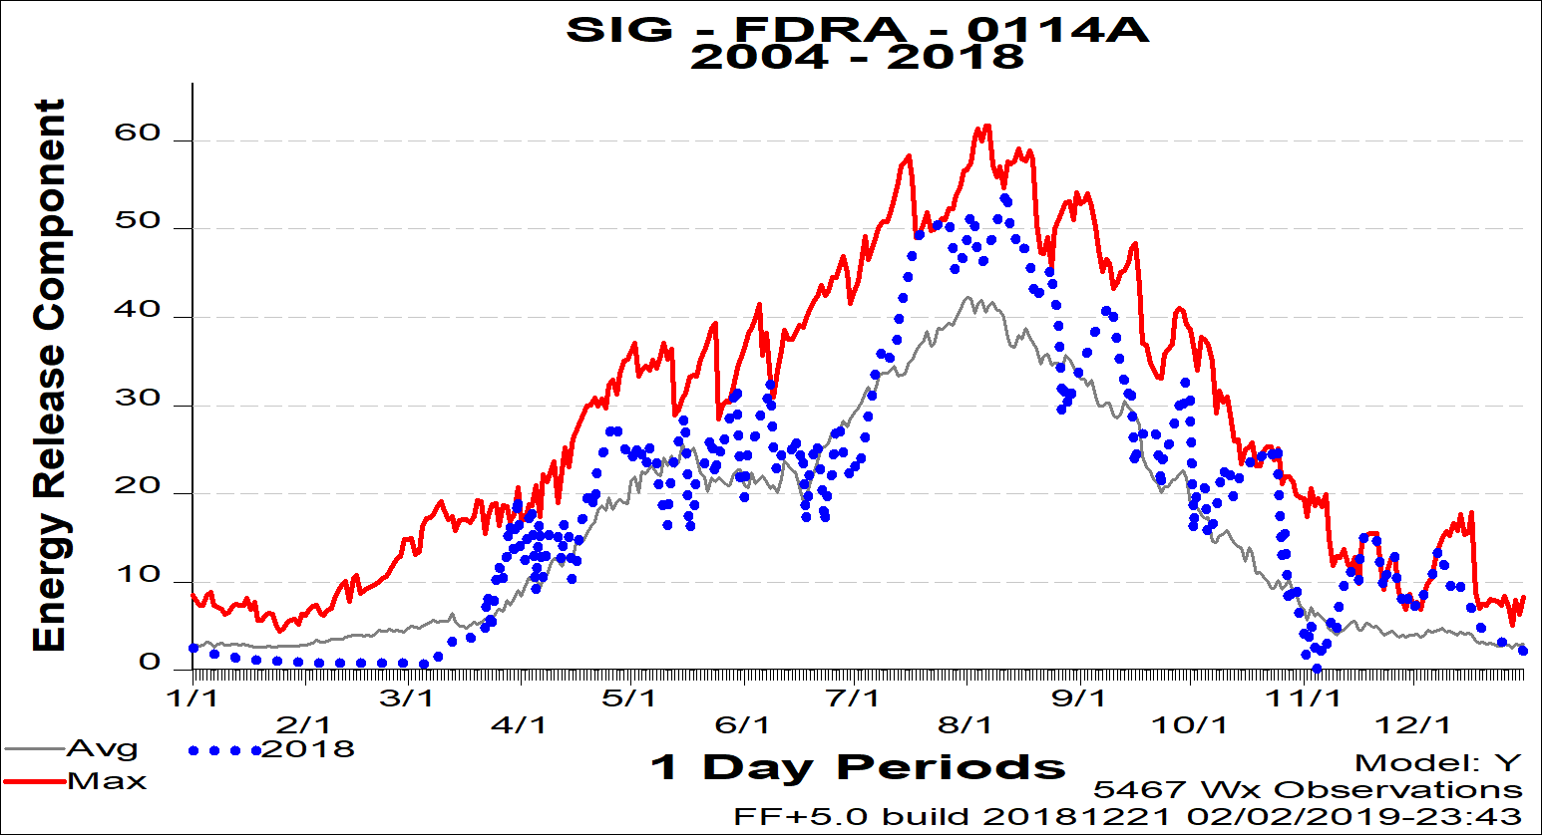
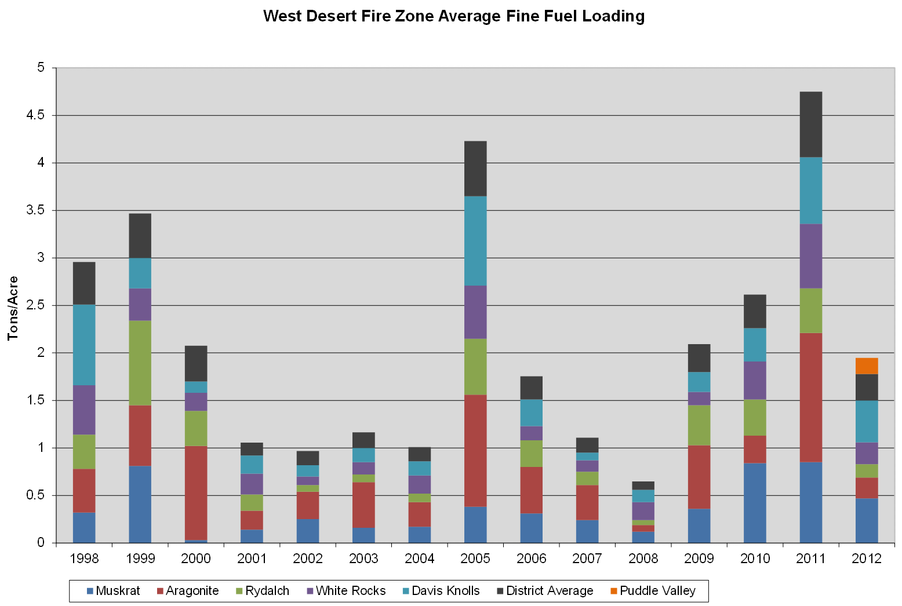
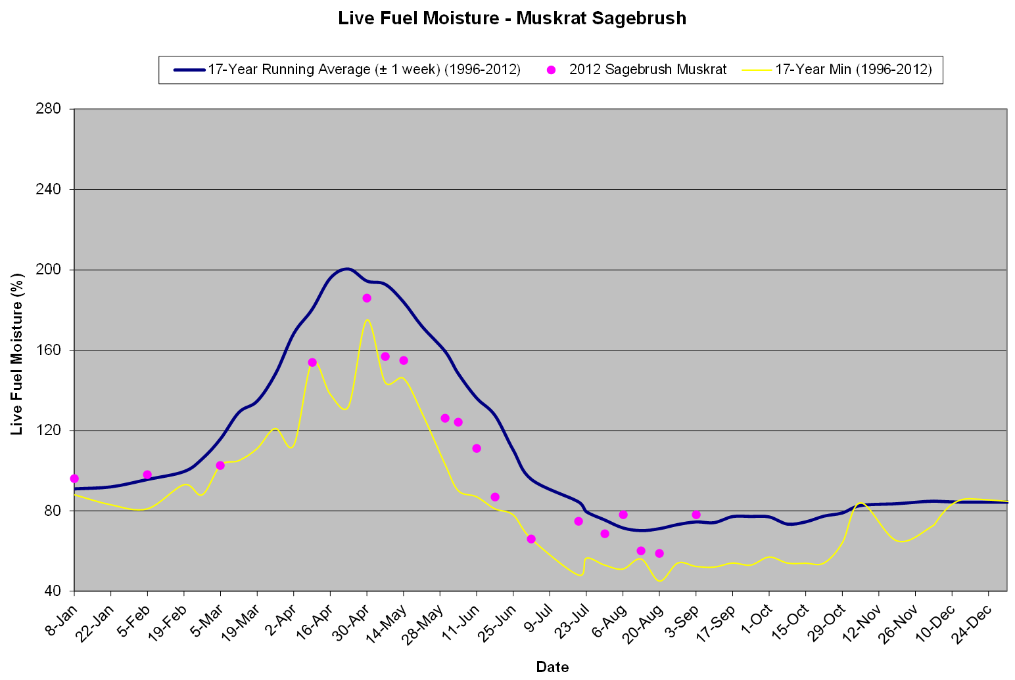
Operational Considerations
Seasonal Trends
NFDRS
1-Hr Fuel Loading
Live Fuel Moisture
Notes:
Slide # 10
Key Points:
Some elements of fire danger change from year-to-year or month-to-month . . . And are monitored / sampled locally:
1-hr fuel loading
live dead fuel moisture
FFP and WIMS do not account for some local fire danger factors, but can be included in Fire Danger Management Tools to account for annual/seasonal variations (Reference Preparedness Level Example on next Click)
Seasonal Trends:
The seasonal trend of each selected indicator is graphically compared to normal and all-time worst (for the historical period analyzed).
updated regularly and posted in dispatch and crew areas.
It’s recommended that seasonal trends are compared to PocketCard and/or fire danger seasonal graphs intended to inform and educate firefighters on local conditions.
PocketCards and seasonal fire danger graphs should use the same index and fuel model to display information so that the two can be easily compared.
Seasonal trends pertaining to fuel loading and live fuel moisture should augment NFDRS indices/components for a more comprehensive assessment of the fire season potential.
Trends should be monitored throughout the fire season and communication should be on-going, particularly when significant changes in key indicators occur.
BLM – FA IM-2018-022 describes BLM required criteria for a Seasonal Trend Analysis.

Slide 11
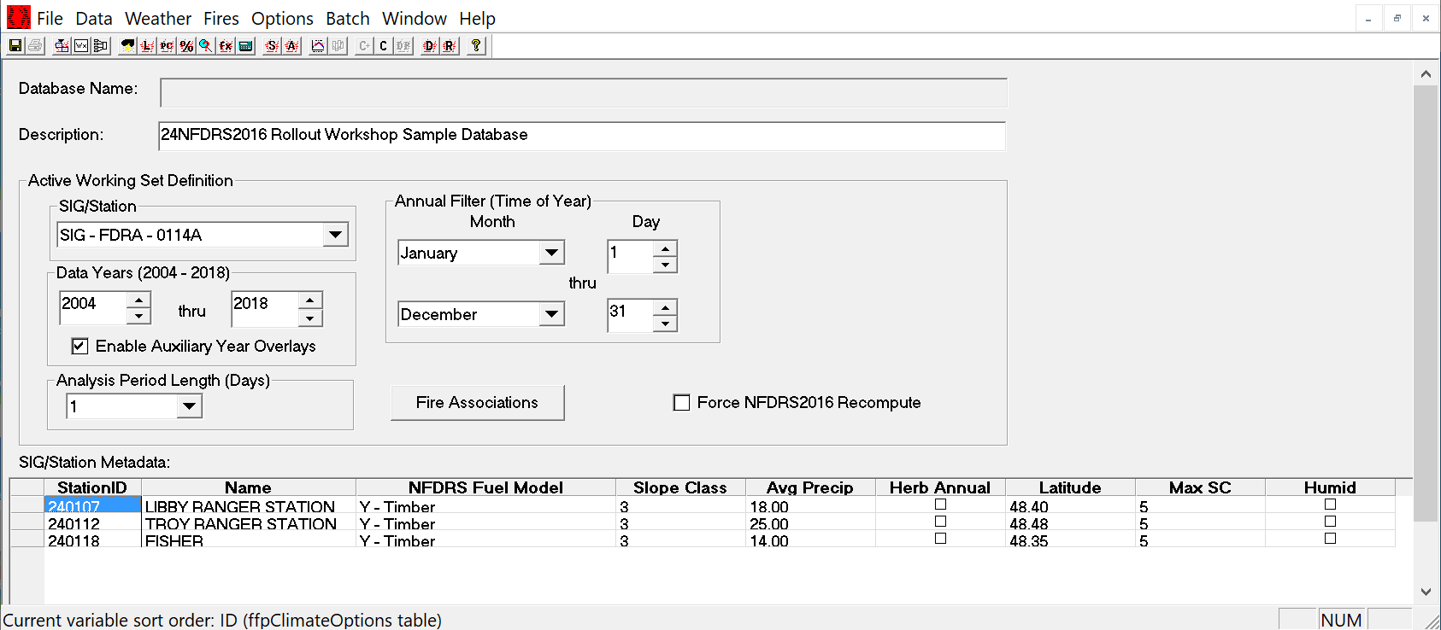
Fires Analysis
Notes:
Slide # 11
Key Points:
The logistic regression tool in FireFamilyPlus creates a model that relates an “Analysis Variable” to a target binary variable that has only two possible values (yes/no) to obtain the estimated probability for each of two possible responses for the target variable.
In other words, we can select an NFDRS2016 Fuel Model and an “Analysis Variable” (such as BI, IC, ERC, SC, or KBDI) and run a FireFamilyPlus Fires Analysis which will derive probability equations (models) for Fire-Day, Large-Fire-Day, and Multiple-Fire-Day.
The FireFamilyPlus working set filters the characteristics of the FDRA in terms of topography, climate, and vegetation.

Slide 12

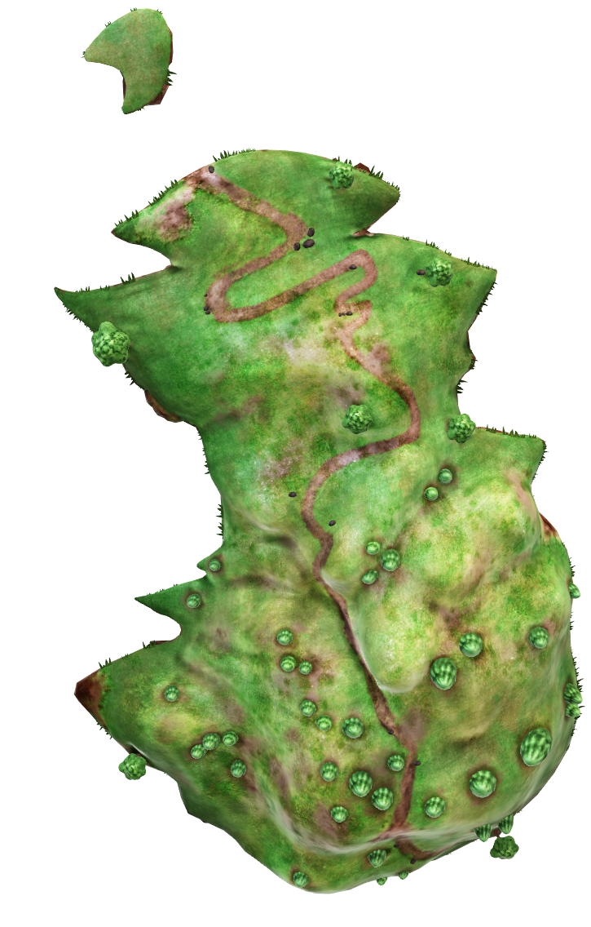
Fires Analysis - Considerations
Fire Environment Homogeneity
FDRA #2
FDRA #1
Notes:
Slide # 12
ANIMATED SLIDE (1st in a series of 2 slides) CLICK to start animation
by default, this slide will run by itself . . . automatically transitioning (Morph) to the next slide
if you wish to have control over the timing, please change the transition settings as desired (Transitions > Timing > Advance Slide > On Mouse Click)
Key Points:
Remember that we assume the fire environment to be relatively homogenous.
We delineate Fire Danger Rating Areas (FDRAs) for the purposes of analyzing the correlation of an NFDRS value with historical fire occurrence (given the same conditions).
Mixing the attributes of one FDRA with another FDRA violates the assumption that the fire environment (vegetation, climate, topography) has remained similar.
For these reasons, a separate Fires Analysis must be run for each FDRA.

Slide 13
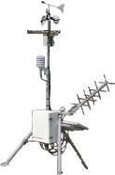


Fires Analysis - Considerations
Run a separate Fires Analysis for each FDRA
FDRA #1
FDRA #2
Notes:
Slide # 13
ANIMATED SLIDE (this slide will run by itself without clicking)
ANIMATED SLIDE (2nd in a series of 2 slides)
Key Points:
Remember that we assume the fire environment to be relatively homogenous.
We delineate Fire Danger Rating Areas (FDRAs) for the purposes of analyzing the correlation of an NFDRS value with historical fire occurrence (given the same conditions).
Mixing the attributes of one FDRA with another FDRA violates the assumption that the fire environment (vegetation, climate, topography) has remained similar.
For these reasons, a separate Fires Analysis must be run for each FDRA.
We are going to begin the process of conducting a Fires Analysis.
The end-product will be a combination of model variables which will tell us the probability that a fire will occur . . . And, the probability that a large fire will occur . . . And, the probability that multiple fires will occur. . . on days with similar conditions as the model variables.
Again, the NFDRS is a system of algorithms which are driven by computer processors. In this case, we will be using FireFamilyPlus as our processor since it incorporates both weather and fire data.
This is important => To the modeling algorithm, the samples of data we feed it are all that the model knows about the world.

Slide 14
Special Interest Groups (SIGs)
Data years must be the same.
Fuel Model and Slope Class must be the same.
Having more than one RAWS per FDRA can be advantageous.
Notes:
Slide # 14
Key Points:
Data years must be the same. RAWS with the fewest years of data becomes the limiting station.
Fuel Model and Slope Class must be the same for each station.
More than one station to represent a FDRA can be advantageous, especially when one station fails to report, another station can fill the gap (temporarily).

Slide 15
Special Interest Groups (SIGs)
Weighting
Setting weights to each station in a SIG will adjust the relative importance of each station in the SIG.
The NFDRS processor will calculate a weighted average.
The final FFP analysis and WIMS must be weighted the same.
Notes:
Slide # 15
Key Points:
Weight factors are relative in FireFamilyPlus. Initially, every station in the SIG is assigned a Weight Factor of 1.0, denoting equal weight for all stations. To increase a station’s weight for analysis, increase its weight.
In WIMS, the Weight Factor is a percentage. By default, each station is set to an equal weighting with all other stations in the SIG. WIMS must be set to match the final FFP analysis.

Slide 16
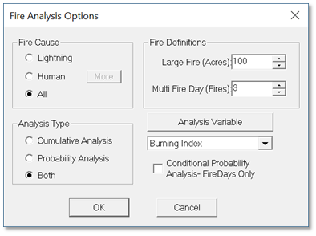
Fires Analysis Options
Notes:
Slide # 16
Key Points:
Upon clicking the Fires Analysis button, the Fire Analysis Options dialog box appears.
This dialog box is important, as it will filter the fire occurrence data available for analysis.
Remember, the analysis is specific to a FDRA. Only those fires in the FDRA should be included.

Slide 17
Fires Analysis Options
Fire Cause:
Usually concerned about “All” fire days, regardless of fire cause.
This option may have the most affect on Multiple-Fire days
Notes:
Slide # 17
Key Points:
Fire Cause =>
In most cases, we would want to include both Lightning and Human caused fires in our analysis. Usually, we are concerned about the fire danger conditions which result in large or multiple fires – regardless of the cause.
In addition, by clipping fire occurrence to Fire Danger Rating Areas, the proportion of lightning-caused to human-caused fires in any given FDRA is resolved.
There are legitimate reasons for excluding lightning or human-caused fires in the analysis if our resulting decisions and actions will be focused solely on fires caused by either lightning or humans, but not both.
If either lightning or human-caused fires would be unrepresentative of the target group, the results could be subject to selection bias.
In the Western U.S., multiple-fire days are probably due to lightning-caused fires. Filtering for Lightning fires only, may improve statistical correlation.

Slide 18
Fires Analysis Options
Fire Definitions:
Large Fire Day– size at which a fire exceeds local IA capability.
Multiple Fire Day – number of fires in a single day which exceed local IA capability
Notes:
Slide # 18
Key Points:
Fire Definitions =>
Values for these definitions are based on local experience and results from using the fire occurrence summary statistics.
Task 3 - values for large and multiple-fire days.
Each Fire Danger Rating Area (FDRA) should be considered independently of each other.
Large Fire (# of acres) – typically, this would be the acreage that would exceed the capability of the local unit to contain the fire during initial attack.
CAUTION: Overconfidence is one of the largest and most ubiquitous of the many biases to which human judgment is vulnerable. For example, 93 percent of American drivers claim to be better than the median (Svenson, 1981), which is statistically impossible (Steen, 2004). Keep this in mind when determining Large and Multi-Fire values.
Multi-Fire Day (# of fires) – typically, this would be the number of fires occurring in a single day that would exceed the capability of the local unit to contain each fire during initial attack.
CAUTION: Do not manipulate Large Fire or Multi Fire Day values to obtain better statistical correlation. Before conducting the analysis, decide what range of values would be acceptable based upon local experience and the fire occurrence summary statistics.

Slide 19
Fires Analysis Options
Analysis Type:
Cumulative
Probability
Notes:
Slide # 19
Key Points:
Analysis Type =>
Typically, Both are selected to include the Cumulative Analysis and Probability Analysis.
Probability Analysis must be selected to proceed with the Fires Analysis.
Cumulative Analysis:
Selecting the Cumulative Analysis will display two panels.
The left panel will show frequencies as stacked histograms (absolute frequencies).
The right panel will show a cumulative frequency distribution curve (percentiles).
Both charts can provide meaningful visual insight to the chosen Analysis Variable.
Probability Analysis:
FireFamilyPlus will create a mathematical model that relates the Analysis Variable (such as BI, IC, ERC, SC, or KBDI) to a target binary variable. The binary variable has only two possible values (in this case, yes/no) to obtain the estimated probability for each of the two possible responses of the target variable (Fire-Day, Large-Fire-Day, or Multiple-Fire-Day).
• Was this day a Fire-day? (yes/no)
• Was this day a Large Fire-Day? (yes/no)
• Was this day a Multiple Fire-Day? (yes/no)

Slide 20
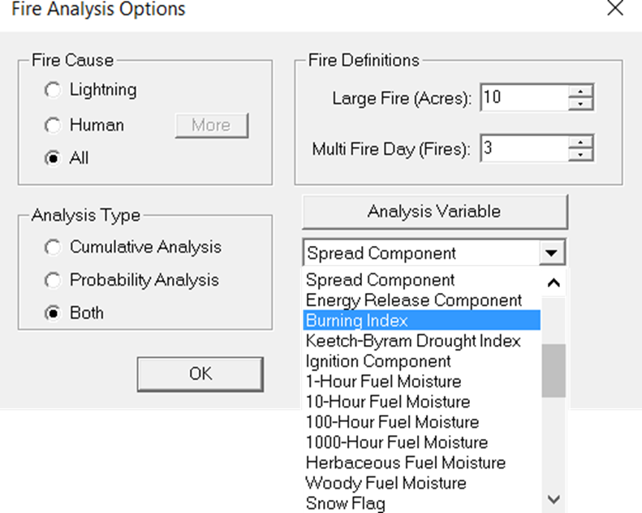
Fires Analysis Options
Analysis Variable:
Notes:
Slide # 20
Key Points:
Analysis Variable =>
A dropdown menu provides options available to select as an analysis variable. When choosing an Analysis Variable, it is important to consider the sensitivity and intended meaning as it relates to the associated Target Group(s).
The determination of the analysis variable is going to depend upon the desired sensitivity which is appropriate for the Target Group and the statistical correlation of a fuel model and the analysis variable.

Slide 21
Fires Analysis Options
Conditional Probability:
Notes:
Slide # 21
Key Points:
Conditional Probability =>
The checkbox controls the sample size of the large, and multiple fire day analysis.
If the box is unchecked, all days are included in the large and multiple fire day analysis.
If the box is checked, a conditional probability analysis is created where only weather days with fires are included in the large and multiple fire day analysis probability.
In most cases, we will be interested in a statistical correlation for all weather days – with the box unchecked – for preparedness decisions which focus primarily on the probability of a fire-day (such as Preparedness, Staffing, and Adjective Fire Danger Rating Levels).
Response Level decisions are typically based on a reported wildfire and focus primarily on the probability of a large fire. Therefore, it makes sense that Response Level decisions are based upon the condition that a fire-day has already occurred – and the box would be checked.

Slide 22
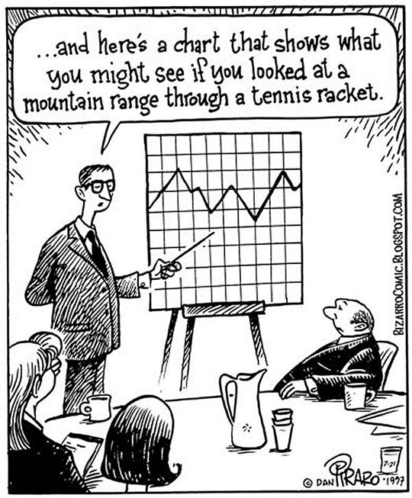
Fires Analysis
Notes:
Slide # 22
Key Points:
The Fires Analysis graphs, tables, and statistics [has been, or will be] covered in another lesson [depending upon the order of lessons presented.

Slide 23
Characterization of Target Groups
Lesson 9 / Task 3
Notes:
Slide # 23
Key Points:
This was covered in Lesson 9 / Task 3

Slide 24
Matching NFDRS Outputs to Target Groups
Notes:
Slide # 24
Key Points:

Slide 25
Response Plan
Which combination of fuel model and NFDRS output is appropriate for a fire response plan?
Notes:
Slide # 25
Key Points:

Slide 26
Staffing Plan
Which combination of fuel model and NFDRS output is appropriate for a staffing plan with 5 decision points?
Notes:
Slide # 26
Key Points:

Slide 27
Preparedness Plan
Which combination of fuel model and NFDRS output is appropriate for communication with our internal agency personnel affecting weekly, monthly, or seasonal fire preparedness decisions?
Notes:
Slide # 27
Key Points:

Slide 28
Public Fire Restriction or Prevention Plan
Which correlation of fuel model and NFDRS output is appropriate to base decisions which restrict the public’s activities or elevate the public’s awareness of critical fire danger conditions?
Notes:
Slide # 28
Key Points:

Slide 29
Industrial Fire Restriction Plan
Which combination of fuel model and NFDRS output is appropriate to base decisions which restrict industrial activities?
Notes:
Slide # 29
Key Points:

Slide 30
Review Objectives:
Determine which correlation of fuel model and NFDRS output is appropriate for a fire response plan.
Determine which correlation of fuel model and NFDRS output is appropriate for a staffing plan with 5 decision points.
Determine which correlation of fuel model and NFDRS output is appropriate for communication with our internal agency personnel affecting weekly, monthly, or seasonal fire preparedness decisions.
Notes:
Slide # 30
Lesson Objectives:
Determine which correlation of fuel model and NFDRS output is appropriate for a fire response plan.
Determine which correlation of fuel model and NFDRS output is appropriate for a staffing plan with 5 decision points.

Slide 31

Questions?
Notes:
Slide # 31
Questions?

