Slide 1
Weather Stations
Lesson #10
Notes:
Slide # 1
Lesson #1: Weather Stations
Lesson Time: 60 minutes (followed by a 15-minute break)
Facilitator Notes:
Don’t forget to fill in the “Workshop Dates” and “Workshop Location” on the bottom right of this title slide.

Slide 2
Objective:
Learn how to interpret graphical weather data for delineating Fire Danger Rating Areas.
Notes:
Slide # 2
Lesson Objectives:
Learn how to interpret graphical weather data for delineating Fire Danger Rating Areas (FDRA).
Interpreting graphical weather data means using applications such as FireFamilyPlus, Excel (pivot tables), and/or the SIG Selector Tool to view data for the purpose of comparing trends and statistical similarities.

Slide 3
In this lesson, you will learn to . . .
Recognize the general factors to consider when selecting weather stations that will represent the climatology of a Fire Danger Rating Area (FDRA).
Use the RAWS SIG Selector Tool as a statistical analysis application to provide rationale for weather station grouping.
Notes:
Slide # 3
Through application of knowledge gained in this lesson, you will be able to:
Discuss the general factors which should be considered when selecting weather stations to include in a Special Interest Group (SIG) to represent the climatology of a Fire Danger Rating Area (FDRA). (Qualitative Factors)
Demonstrate the application of the RAWS SIG Selector Tool to provide visual and statistical analysis to provide rationale for weather station grouping. (Quantitative Factors)

Slide 4
Special Interest Group (SIG)
A SIG is a group of weather stations selected for the purpose of representing the climatology of a given Fire Danger Rating Area (FDRA).
Notes:
Slide # 4
A Special Interest Group (SIG) is a group of weather stations selected for the purpose of representing the climatology of a given Fire Danger Rating Area (FDRA).

Slide 5
General Considerations for FDRA Station Selection
Data Quantity and Quality
Representativeness
Management objectives
Past station selection
Location relative to FDRA
Single station or multiple stations (SIGs)
Notes:
Slide # 5
General Considerations for FDRA Station Selection
Data Quantity and Quality
Representativeness
Management objectives
Past station selection
Location relative to FDRA
Single station or multiple stations (SIGs)
Each of these considerations will be discussed in further detail.

Slide 6
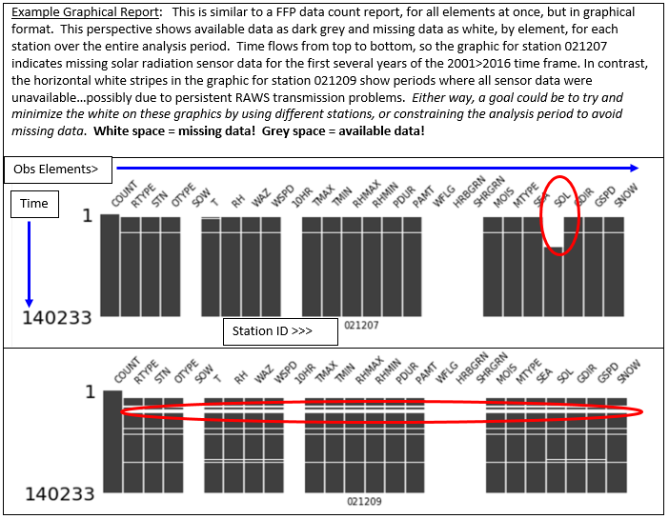
Data-Based Considerations for FDRA Station Selection
Data Quantity
Seeking an analysis period of 10+ years with complete station data
FFP Data Count report can help
Notes:
Slide # 6
This data period of record and completeness perspective was produced outside of FireFamilyPlus, but is similar to the FFP data count report for all elements simultaneously. In this example, data look quite complete for the two stations shown…though station 021207 is missing a few years of necessary solar rad data and 021209 had some extended period of missing data during the first few years.

Slide 7
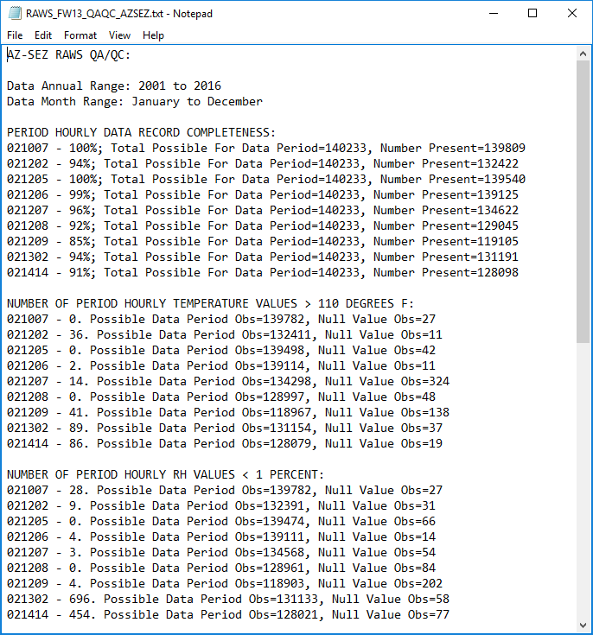
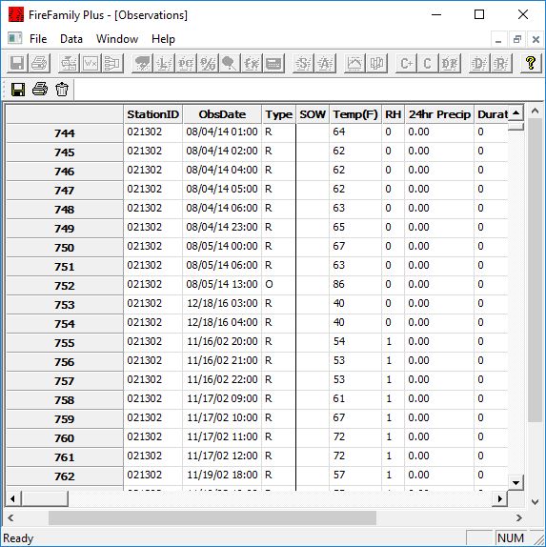
Data-Based Considerations for FDRA Station Selection
Data Quality
A lengthy and complete data set with bad data isn’t helpful
Notes:
Slide # 7
Data quality can be assessed both within and outside of FFP in various ways. In this case, station 021302 showed a high number of hourly RH values < 1%...which is impossible. Within FFP, you can only screen one station and element at a time….while other applications might enable mass station data QA/QC screening.
Important: There’s no real strategy right now for correcting poor quality hourly data, because it is so vast. For now, it’s best to delete poor data or set an analysis period which avoids it.

Slide 8
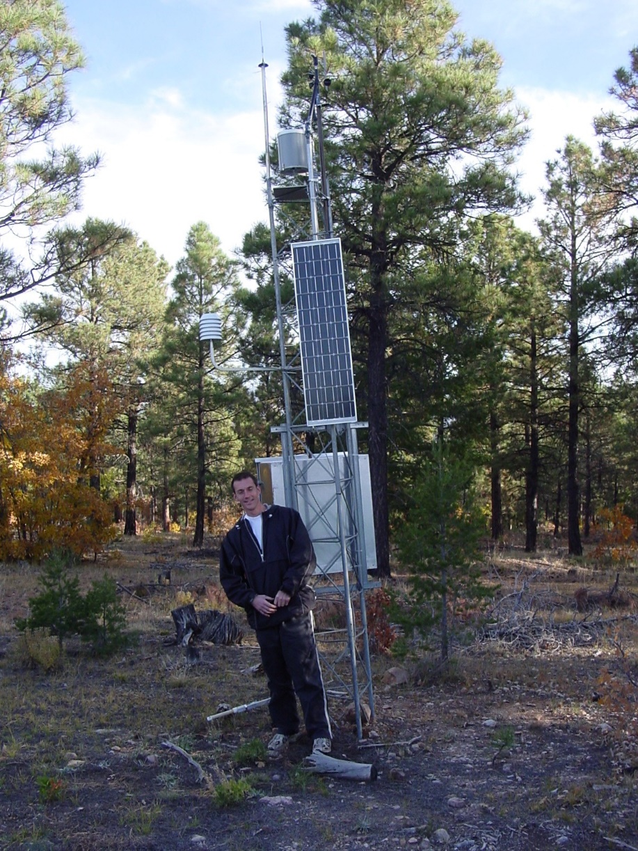
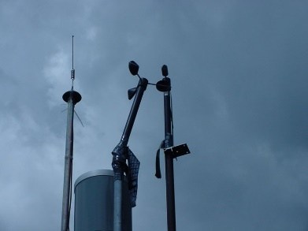
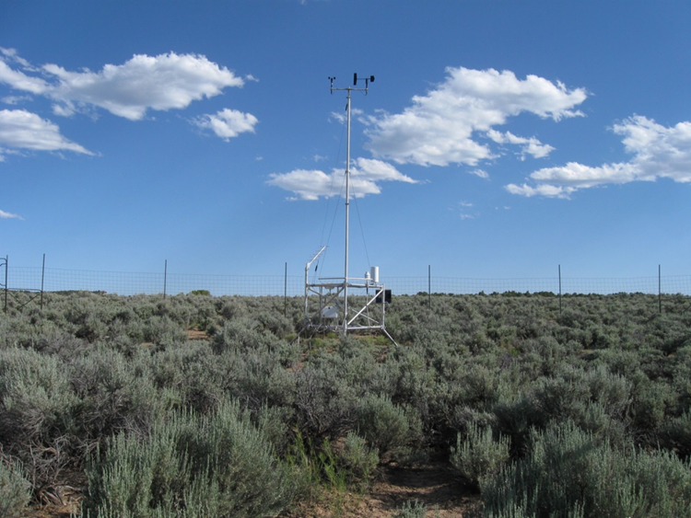
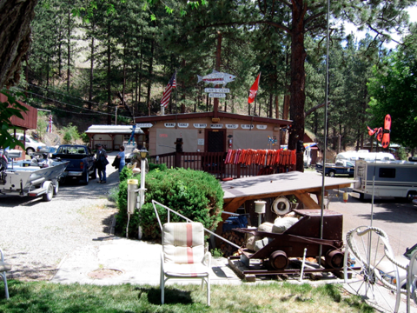
General Considerations for FDRA Station Selection
Representativeness
All RAWS represent something…
Notes:
Slide # 8
Common sense is a good first step in considering weather station representativeness. You don’t need data analysis to tell you that one of these stations is likely much more representative of the fire environment than the others!

Slide 9
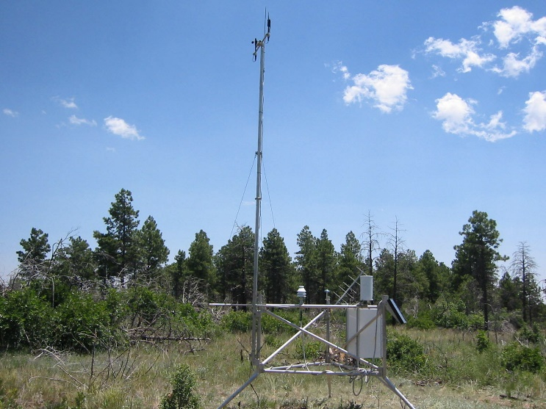
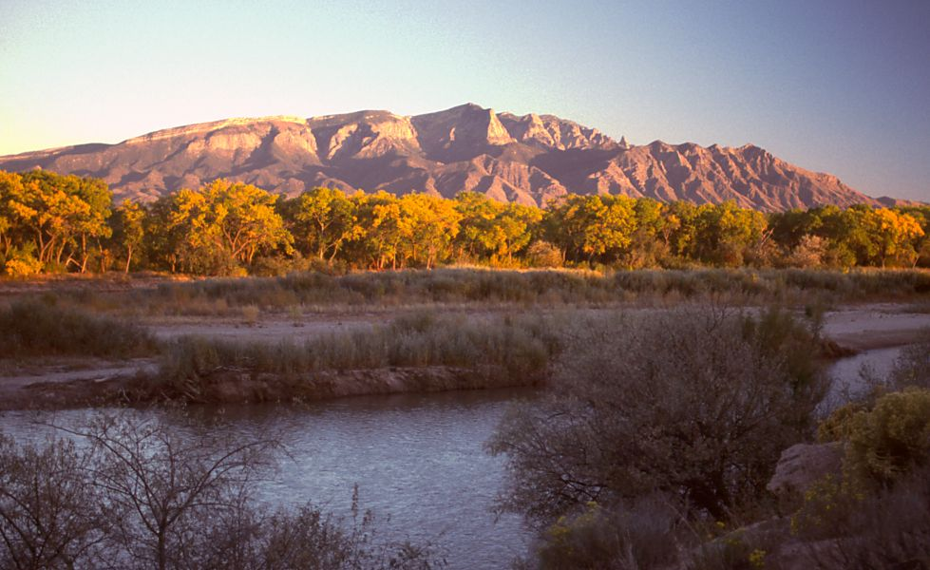
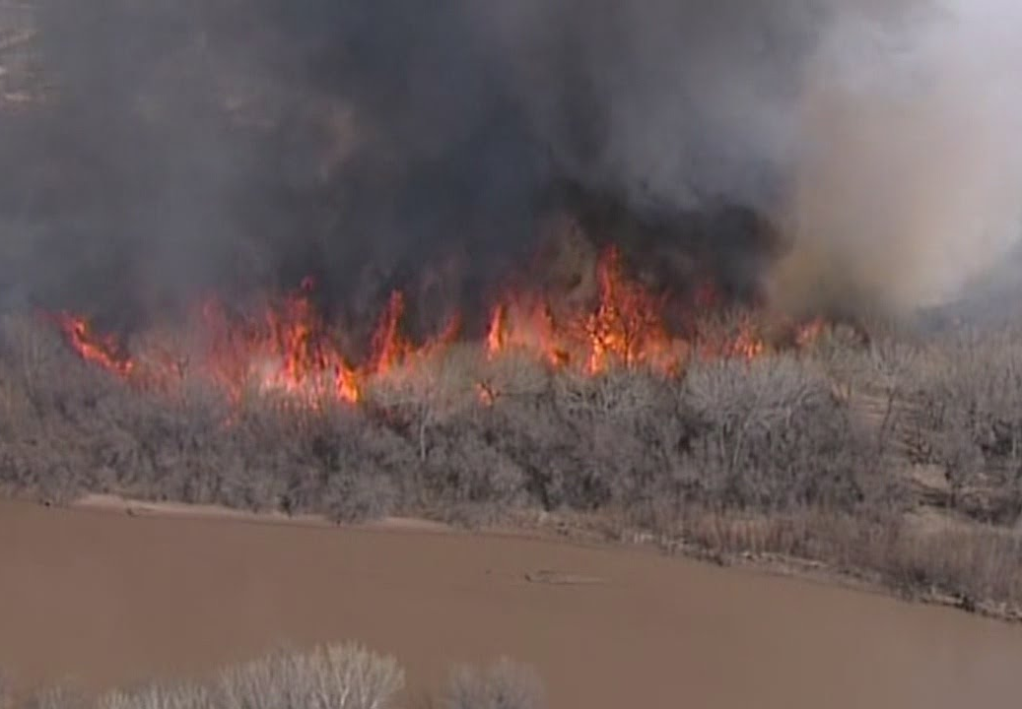
General Considerations for FDRA Station Selection
Management Objectives
Are RAWS locations reflective of your management issues and objectives?
Notes:
Slide # 9
More common sense. If you’re charged with managing unwanted human caused fires along the Rio Grande, would you use the nearest RAWS atop an adjacent mountain?

Slide 10
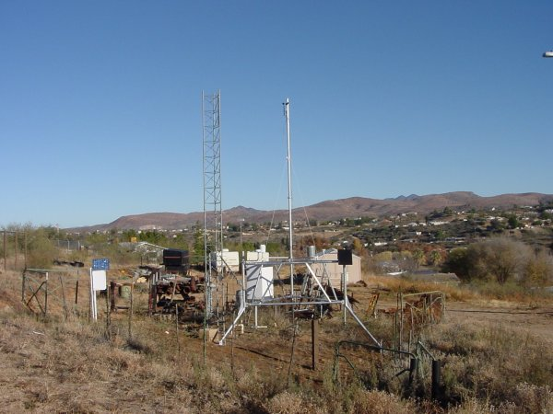
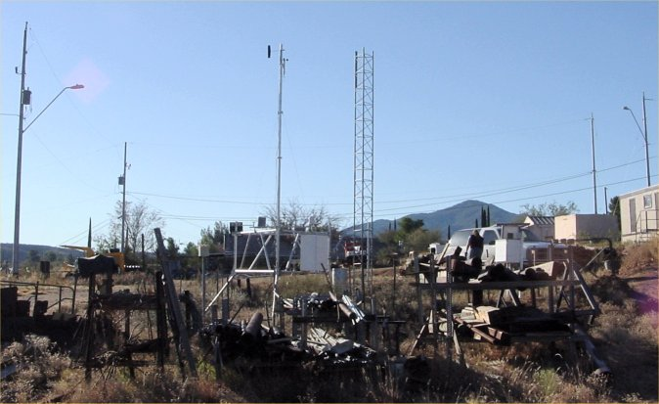
General Considerations for FDRA Station Selection
Past Station Selection
Avoid Decision Traps
Notes:
Slide # 10
It’s a good practice to not assume that stations which have been used are the right or best stations. You might not know why they were chosen in the first place! This is an example of one of the twelve stations used to represent regional fire danger for USFS in the Southwest. (it has since been re-sited to a nearby hill)
Be aware of these decision traps:
Bandwagon Effect: uptake of beliefs and ideas increases the more that they have already been adopted by others.
“It seems that everybody in the group wants to move that RAWS, I guess I can support that decision too?”
Status Quo Bias: preferring the current state-of-affairs over change.
“We’ve had that station in that location for 10 years, why would we want to move it now?”
Information Bias: The tendency to seek information even when it cannot affect action.
“If we add more weather stations to the SIG, won’t more weather observations give us better results?”

Slide 11
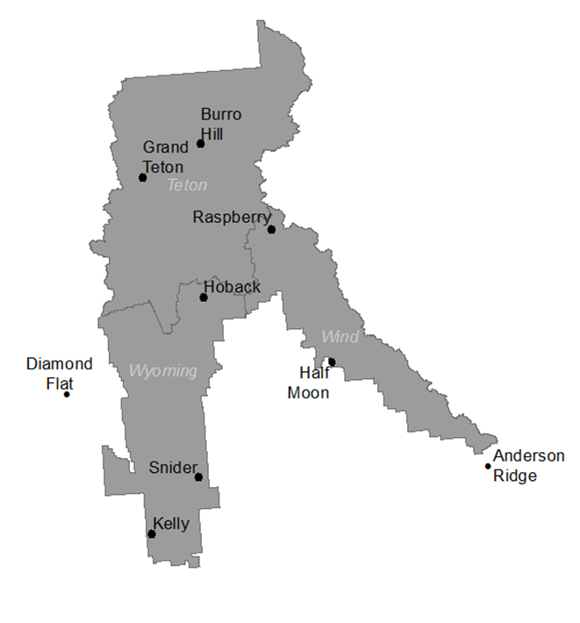
General Considerations for FDRA Station Selection
Location Relative to FDRA
Stations don’t have to be strictly within FDRA boundaries
Individual stations can be used in more than one FDRA
Teton Interagency Dispatch
Notes:
Slide # 11
It’s okay to use stations that are close to, but not within the FDRA or even project area, if they are representative. The same station can also be used in different SIGs. It’s important to validate with data!

Slide 12
RAWS SIG Selector Tool
An online tool was developed to help units assess their RAWS for the purpose of creating fire weather networks, or Special Interest Groups (SIGs).
https://gacc.nifc.gov/gbcc/predictive/rawsSelector/
The tool uses statistical methods to group weather stations based on how well they correlate with each other.
Notes:
Slide # 12
https://gacc.nifc.gov/gbcc/predictive/rawsSelector/

Slide 13
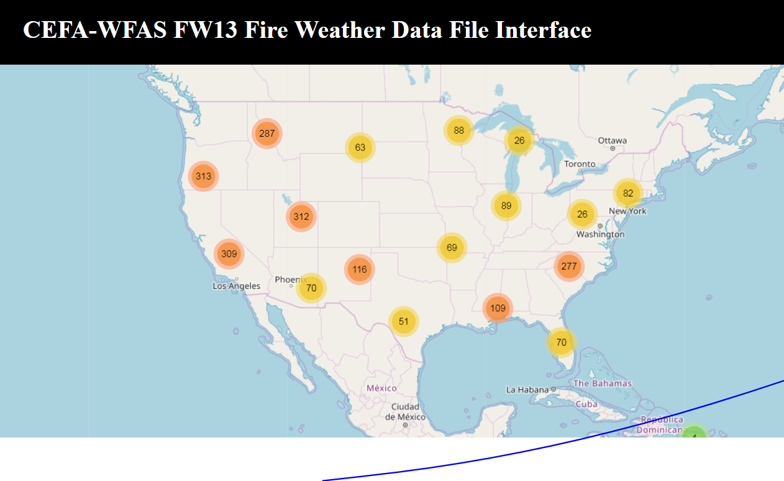
RAWS SIG Selector Tool – Data
Hourly data from the CEFA website was used for all stations
ERC-Y was used for all stations
Notes:
Slide # 13

Slide 14
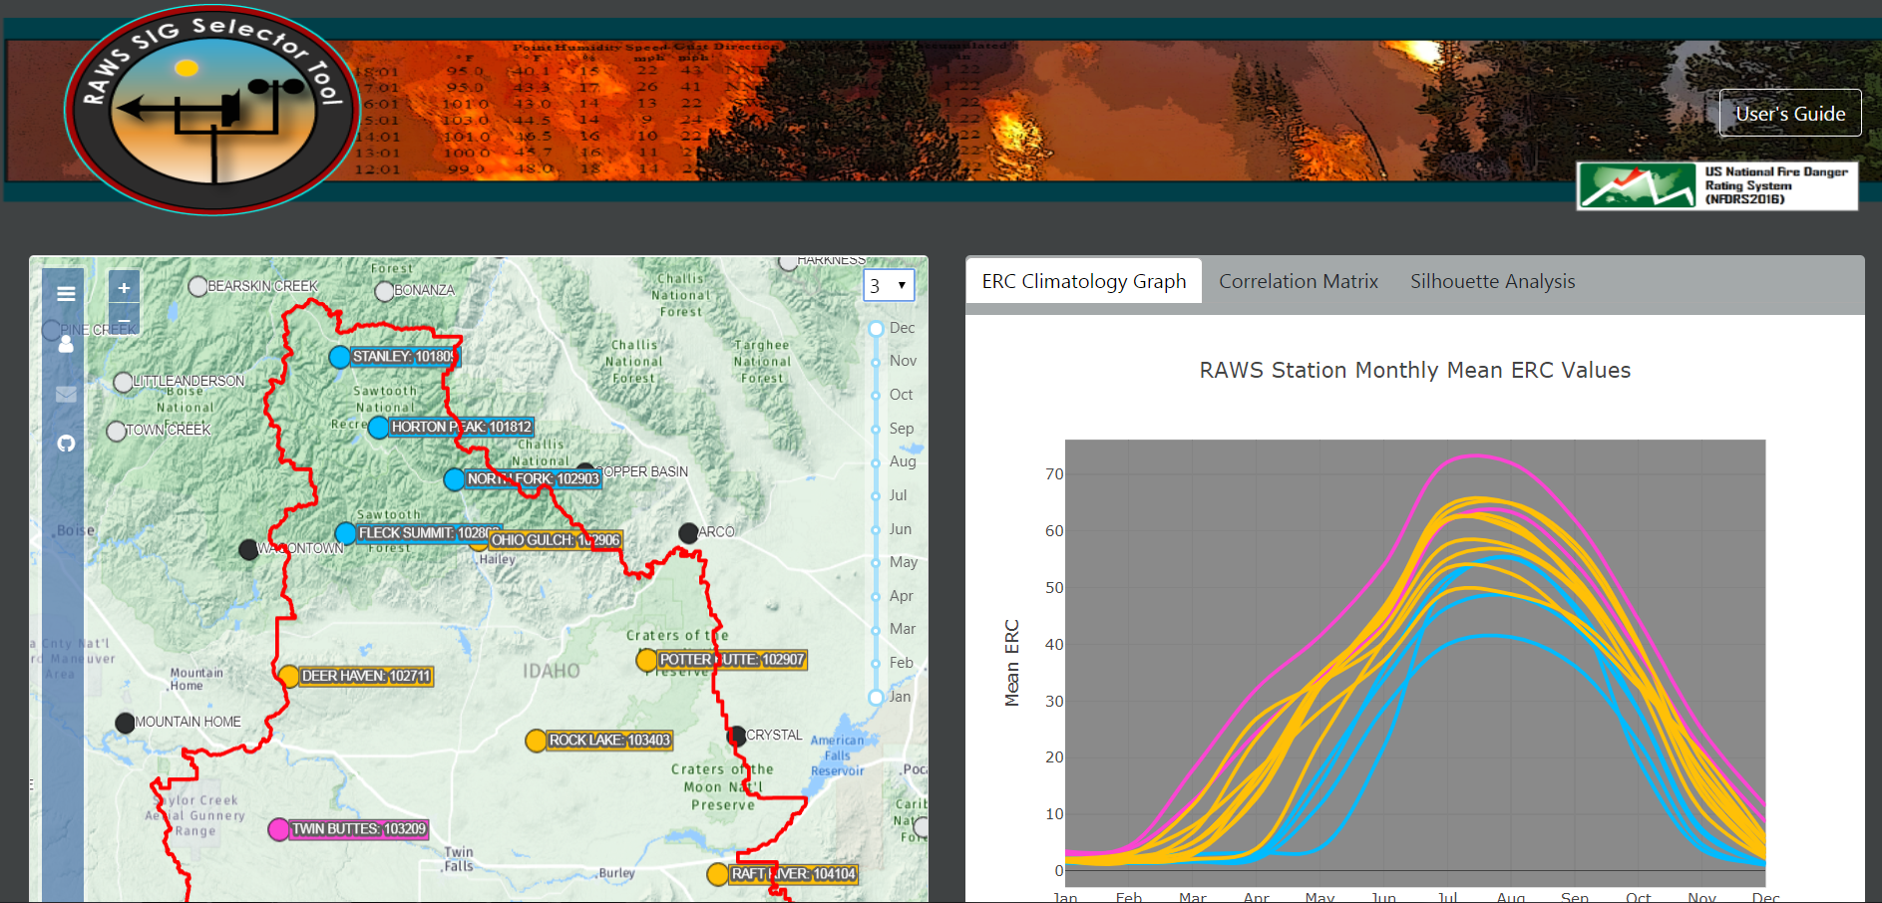
RAWS SIG Selector Tool – 4 windows
RAWS Map
Climatology Graph
Correlation Matrix
Silhouette Analysis
Notes:
Slide # 14

Slide 15
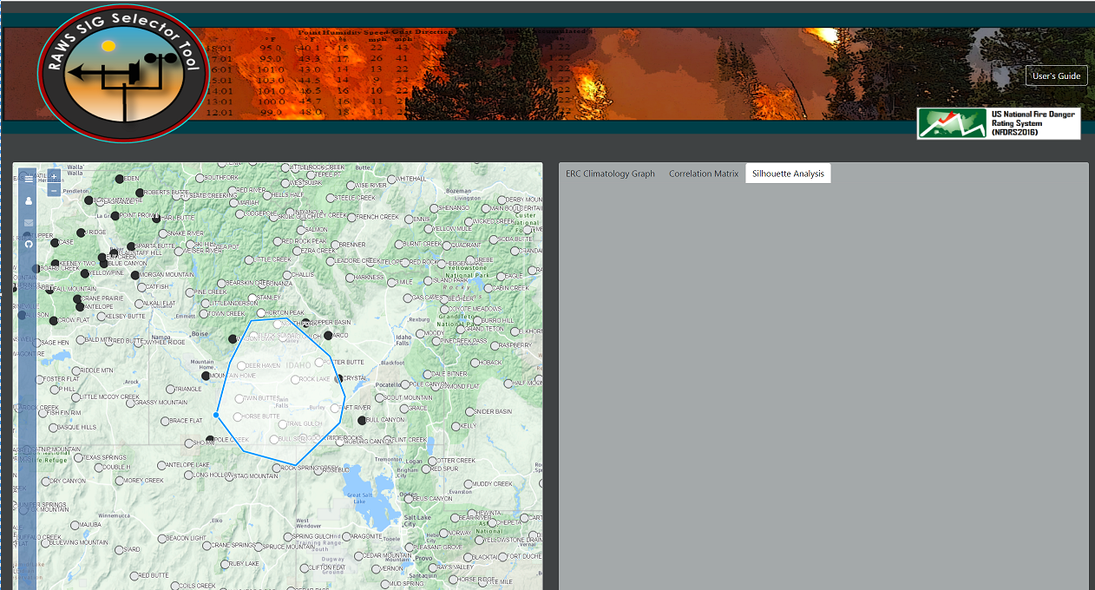
Station Selection
Users will first draw a polygon around the desired stations for the whole area of interest, not just one FDRA.
Notes:
Slide # 15

Slide 16
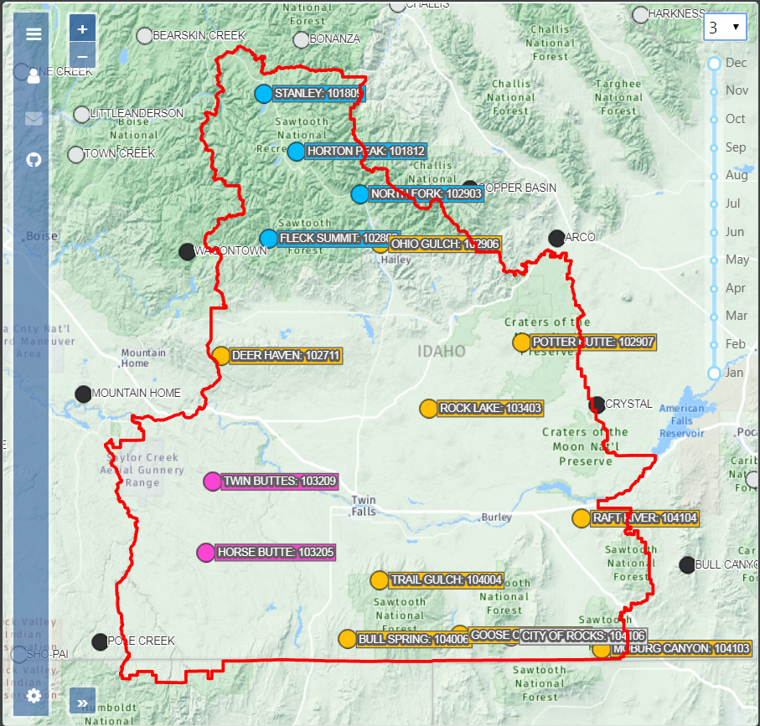
Map
Number of Groupings – the user selects the number of RAWS groupings
Month Range – the user selects which months to include in the analysis
The map shows the locations of the RAWS
The stations are color coded according to their grouping
Notes:
Slide # 16
ANIMATED SLIDE:
1ST Click: Number of Groupings – the user selects the number of RAWS groupings
2nd Click: Month Range – the user selects which months to include in the analysis
3rd Click:
The map shows the locations of the RAWS
The stations are color coded according to their grouping

Slide 17
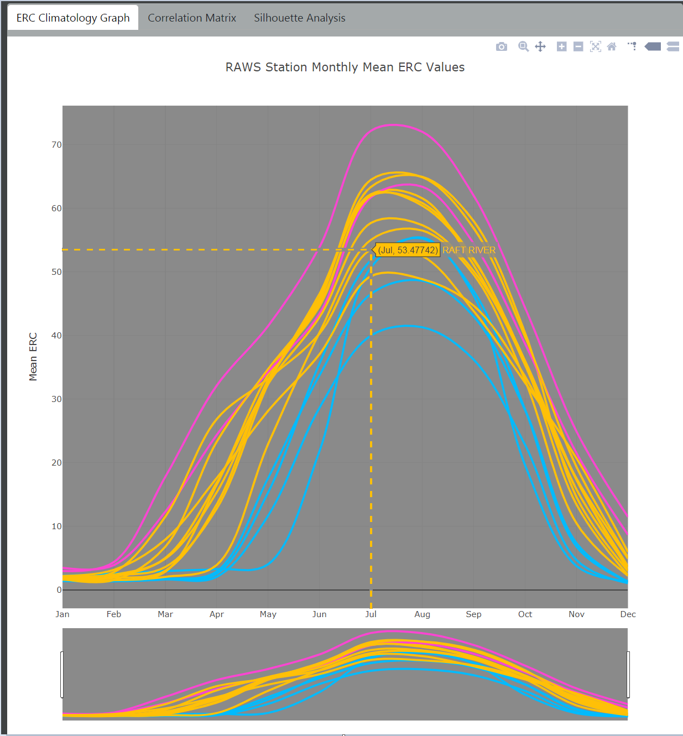
ERC Climatology Graph
The averaged monthly ERCs are plotted on this graph for all stations in the selected area.
The stations are colored coded according to their groupings
Users can hover over any ERC line to see the station name and ERC value.
If users change the month range or number of groupings on the map, it will be reflected on this graph.
Notes:
Slide # 17
ANIMATED SLIDE:
Click #1: The averaged monthly ERCs are plotted on this graph for all stations in the selected area.
Click #2: The stations are colored coded according to their groupings
Click #3: Users can hover over any ERC line to see the station name and ERC value.
Click #4: If users change the month range or number of groupings on the map, it will be reflected on this graph.
Click #5: A variety of graphing tools are available on the top right corner of the graph for more detailed analysis or printing, etc.

Slide 18
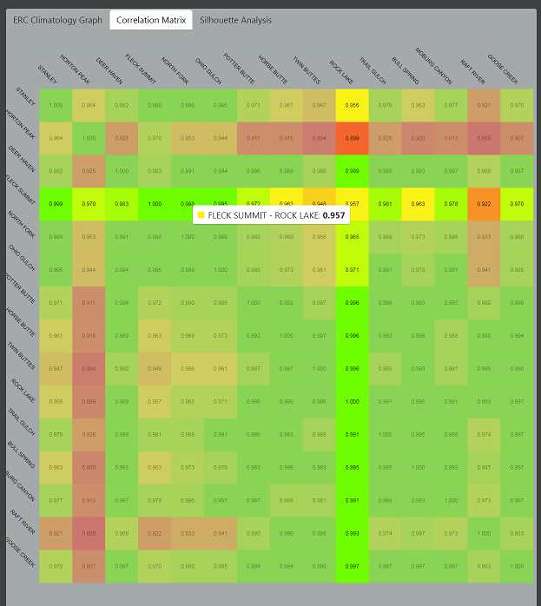
Correlation Matrix
This matrix displays the calculated r-squared correlation between all the stations in the selected area.
The boxes are color coded according to the strength of correlation (r-squared value)
Users can hover over any box in the matrix and see the r-squared values for those two stations.
Notes:
Slide # 18
R-squared is the proportion of the variance in the dependent variable that is predictable from the independent variable(s). ‘How closely correlated are the two stations?’
R-squared ranges from 0-1 where values closer to 1 show a higher correlation between the two stations.

Slide 19
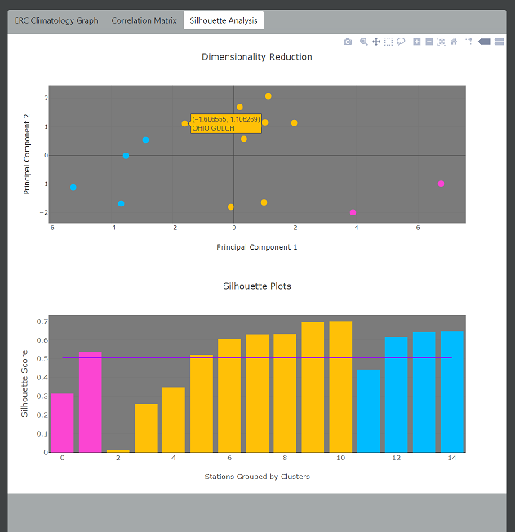
Silhouette Analysis
The Silhouette Analysis is designed to help users determine the natural number of SIGs
Dimensionality Reduction – this plot shows each station represented by one dot through a Principal Component Analysis.
Silhouette Plots – this plot shows the Silhouette Score of each station based on the number of groupings the user selects.
Notes:
Slide # 19
The Principal Components values for each station are used to determine the Silhouette Score.
Dimensionality Reduction
The graphical location of each dot shows how different the data from each station is in relation to the other stations.
Stations are grouped together based on their proximity to other stations on this plot.
Click to reveal => Silhouette Plots
The Silhouette Score represents the value of each grouping. The higher the silhouette score the more valuable the grouping.
If the Silhouette Scores becomes negative the user may have broken the stations into more groups than the data support

Slide 20
The Art of SIG Selection
Users will use the tools available as well as local knowledge to determine which stations best represent fire danger for each FDRA
Notes:
Slide # 20

Slide 21
Review Objective(s):
Learn how to interpret graphical weather data for delineating Fire Danger Rating Areas (FDRA).
Notes:
Slide # 21
Review Lesson Objective(s):
Learn how to interpret graphical weather data for delineating Fire Danger Rating Areas (FDRA).

Slide 22

Questions?
Notes:
Slide # 22
Questions?

