Slide 1
Fire Danger Rating Areas
Lesson #7
Notes:
Slide # 1
Lesson #7: Fire Danger Rating Areas
Lesson Time: 45 minutes (followed by Lesson 8 – No Break)
Facilitator Notes:
Don’t forget to fill in the “Workshop Dates” and “Workshop Location” on the bottom right of this title slide.

Slide 2
Objectives
Explain what a Fire Danger Rating Area (FDRA) is.
Identify the role of FDRAs in NFDRS (planning, analysis, application, actions).
Identify and apply "best practices" relating to the development and implementation of FDRAs.
Notes:
Slide # 2
Lesson Objectives:
Explain what a Fire Danger Rating Area (FDRA) is.
Identify the role of FDRAs in NFDRS (planning, analysis, application, actions).
Identify and apply "best practices" relating to the development and implementation of FDRAs.

Slide 3
Fire Danger Rating Areas (FDRAs)
Characteristics:
Geographic areas (spatial; polygons)
Similar fire danger conditions throughout FDRA
Unique (vs other FDRAs)
Meaningful for management (decisions, actions)
Role in NFDRS:
Basic unit for planning and analysis
Area for which outputs (e.g. WIMS) are generated
Area to which decisions (e.g. response) apply
Notes:
Slide # 3
Fire Danger Rating Areas
Slide provides the basic definition and role pertaining to FDRAs (fulfilling objectives #1 & #2). Given the skills and experience of most workshop attendees and its focus on developing an FDOP, the remainder of the lesson will focus on WHY we create FDRAs and best practices.

Slide 4

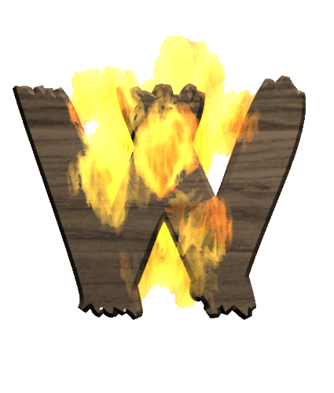
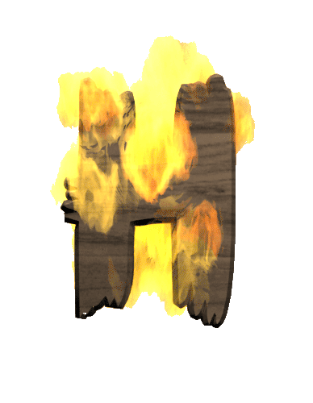
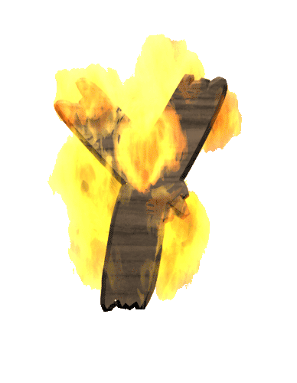
Let’s focus on . . .
Notes:
Slide # 4
WHY?
Many workshop attendees are seasoned NFDRS practitioners and graduates of S-491 and ANFDRS, so they should already understand the basic concepts (e.g. Objectives #1 and #2) relating to FDRAs. Those concepts can be reinforced and applied most effectively if the participants understand WHY we create FDRAs. Challenge participants with existing FDRAs to reassess their validity and make adjustments if needed (avoid potential decision trap/bias).

Slide 5
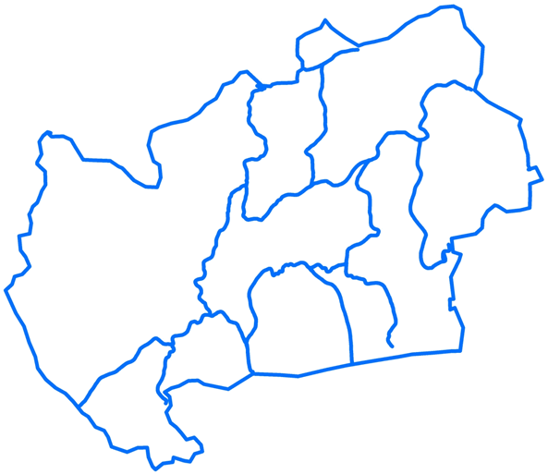
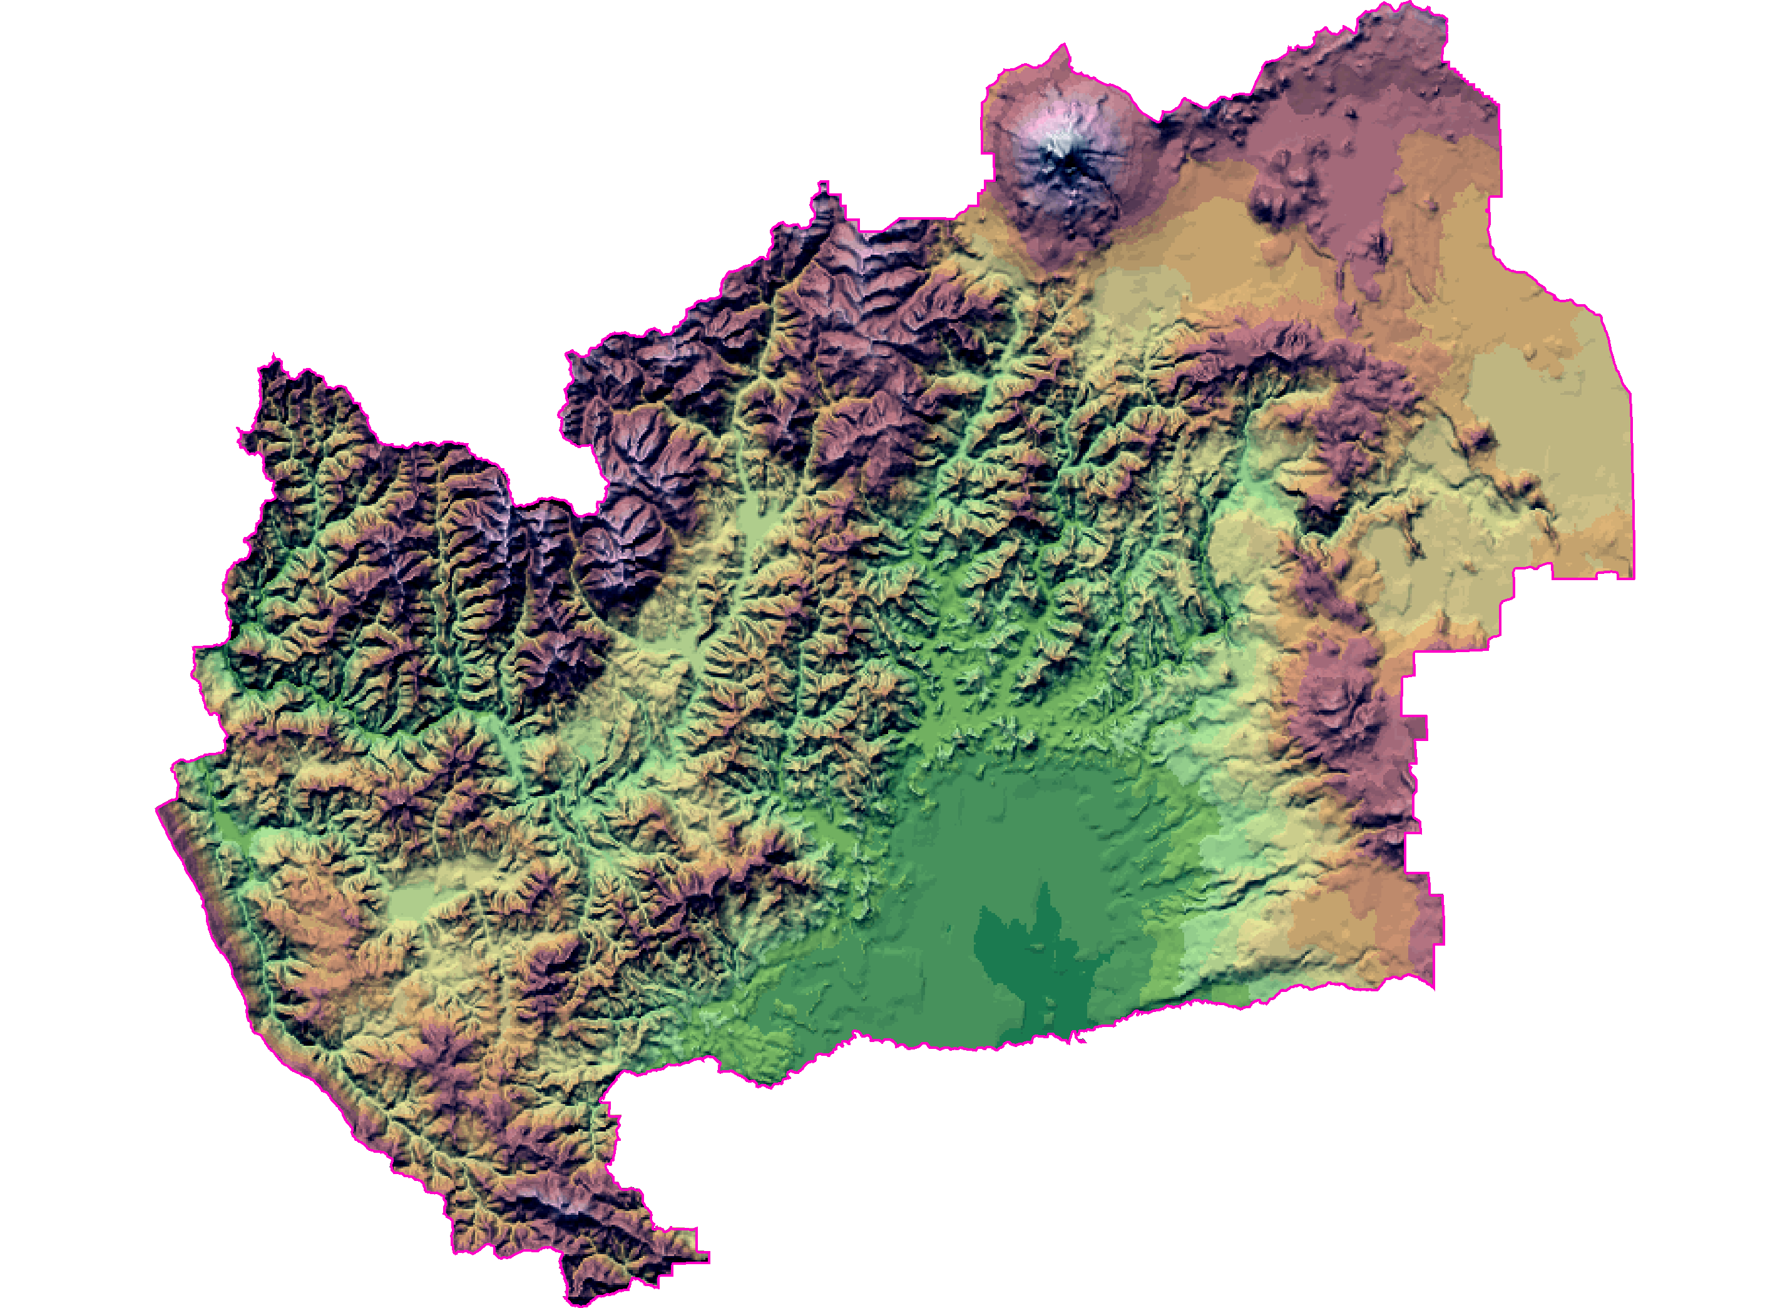
WHY do we delineate Fire Danger Rating Areas?
Elemental Units for Analysis & Planning
Connect NFDRS to landscape featuring
similar fire environmental characteristics
Decision Support
(reliable predictions, appropriate scale)
Notes:
Slide # 5
ANIMATED SLIDE (NO clicking necessary)
Fire Danger Rating Areas (FDRAs) provide a mechanism to connect large geographic areas with similar fire potential to the NFDRS2016 model. By doing this, we are able to support decisions based upon the current and forecasted fire danger potential. This affects the behavior of public and industrial entities, as well as the efficiency, effectiveness, and safety of our agency personnel who respond to wildland fires.
The FDRAs are the elemental units (nothing smaller) that are used for analysis and defined in Fire Danger-related plans.
Ultimately, we want to use NFDRS2016 to provide good decision support, based on reliable predictions and at an appropriate scale. Accordingly, the FDRAs must be defined so that they produce unique, accurate, and meaningful NFDRS outputs, but at a scale that is neither too nuanced nor too general for response decisions and other management activities.

Slide 6
Fire Danger Rating Areas
Large geographic area
Relatively homogeneous with respect to:
Vegetation
Climate
Topography
Initial FDRA delineation based upon environmental factors (NOT administrative or political)
Notes:
Slide # 6
Best Practice: Fire Danger Rating Area
Fire Danger Rating Area (FDRA) is defined as a large geographic area relatively homogeneous with respect to climate, vegetation and topography. Fire Danger Rating Areas are delineated based upon an analysis of these three factors: climate, vegetation, and topography.
Why this large scale and these 3 factors (vegetation, climate, topography)?
Large geographic area because the spatial scale for the weather inputs to NFDRS is large (coarse scale).
Because of these similarities, it can be assumed that the fire danger within a FDRA is relatively uniform.
The initial delineation of FDRAs should not include any consideration of administrative/political boundaries, Land-Use Plan (LUP) and Fire Management Plan (FMP) objectives, operational efficiencies, and risk management factors.
The Land-use Plan (LUP) is the over-arching document with has received extensive analysis and input from subject-matter experts and the public which gives guidance and direction to a federal agency regarding the management of the public land they administer.
The Fire Management Plan (FMP) is tiered from the LUP and provides guidance and direction to the fire management component of the respective agency.
Why?
FDRAs represent the fire environment and related concepts, such as potential containment difficulty, for a given geographic area, which are influenced by physical factors.
Fires do not stop at any political or administrative boundary, nor is the fire danger or fire behavior any different a wilderness or some other designated area (unless the designation has indeed affected the physical factors – e.g. fuels buildup or significantly fewer human ignitions).
Similarly, LUP Objectives, agreements, and operational efficiencies are not a consideration (Fires don’t respect these factors).
Terminology: to maintain the meaning for FDRA, it is important that we have a consistent understanding of its meaning and intent.

Slide 7
Response Zones
Response Zones:
Used to pre-plan initial attack response to areas with pre-identified administrative, jurisdictional, land/fire management objectives/constraints, operational efficiency, and risk management considerations.
Used to send appropriate type/quantity of resources . . . Until a qualified IC arrives at fire.
Notes:
Slide # 7
Fire Danger Rating Areas
Best Practice: Response Zones
Used to pre-plan initial attack response to areas with pre-identified administrative, jurisdictional, land/fire management objectives/constraints, operational efficiency, and risk management considerations.
Used to send appropriate type/quantity of resources . . . Until a qualified IC arrives at fire.
A basic principle of risk management is to get ahead of problems one may face down the road. Doing so can help reduce time pressure, reduce uncertainty, and expand options – ultimately facilitating safer and more effective response. The primary purpose for delineating response zones is to achieve this principle which attains efficiency, effectiveness, and mitigates risk.

Slide 8
Edge-match FDRAs with Response Zones
Edge-match FDRA with Response Zones
Do not allow a single Response Zone to span multiple FDRAs. If necessary,
Move the FDRA boundary to the Response Zone boundary, or
Make two Response Zones
Notes:
Slide # 8
Best Practice: Edge-match FDRAs with Response Zones
Delineated as subsets of FDRAs; never spanning multiple FDRAs
FDRAs are Edge-matched FDRA with Response Zones
Do not allow a single Response Zone to span multiple FDRAs. If necessary (two options):
Move the FDRA boundary to the Response Zone boundary, or
Make two Response Zones

Slide 9
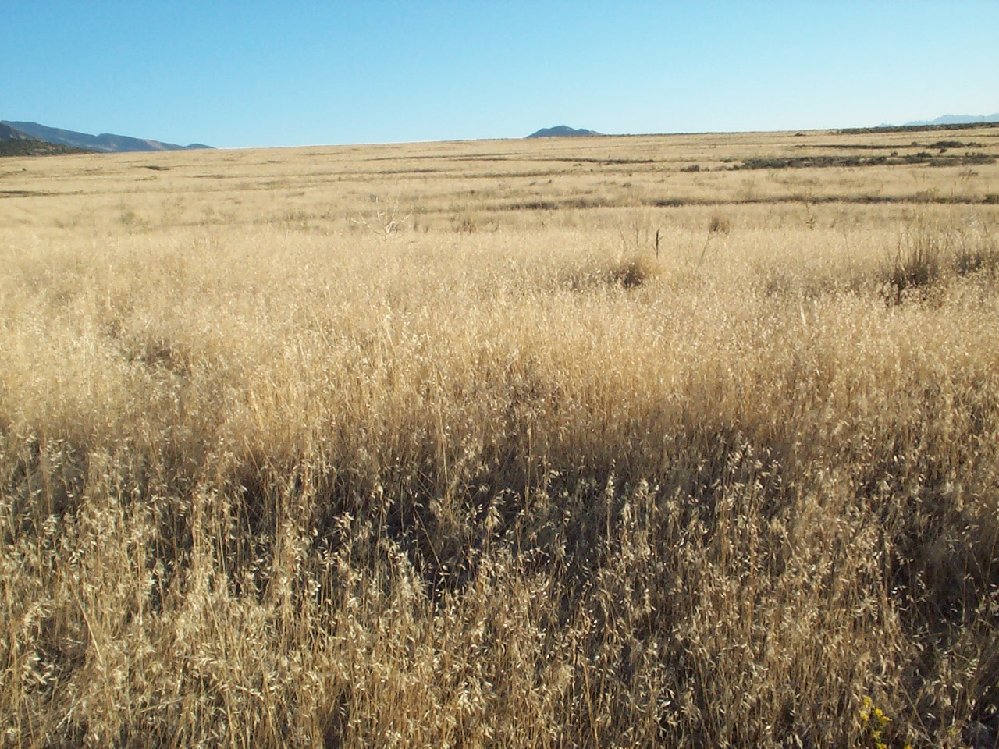

Why do we avoid the “Split Decision” ?
High Fire Danger
Federal Jurisdiction
Private Jurisdiction
Notes:
Slide # 9
Fire Danger Rating Areas
Best Practice: DO NOT split Response Zones . . . WHY?
Keep in mind that Response Areas are the most basic footprint we use to make dispatch resources to an initial attack fire. If the FDRA divides a Response Zone, the Fire Danger Rating for Response Zone Operationally, you do not want to have 2 or more Fire Danger Ratings affecting a single Response Area.

Slide 10
Factors that Influence Response Zone Boundaries:
Administrative Boundaries
Land-Use / FMP Objectives
State / County Boundaries
Municipalities
Land Ownership
Fire Management Units
Wilderness Areas
Areas of Critical Environmental Concern
Operational Efficiencies
Risk
Agreements
Accessibility
Response Time
Retardant Avoidance Areas
Risk Assessment
Potential wildland fire Operational Delineations (PODs)
Notes:
Slide # 10
Fire Danger Rating Areas
Factors that Influence Response Zone Boundaries:
Administrative Boundaries
State / County Boundaries
Municipalities
Land Ownership
Land-Use / FMP Objectives
Fire Management Units
Wilderness Areas
Areas of Critical Environmental Concern
Operational Efficiencies
Agreements
Accessibility
Response Time
Retardant Avoidance Areas
Risk
Risk Assessment
PODs

Slide 11
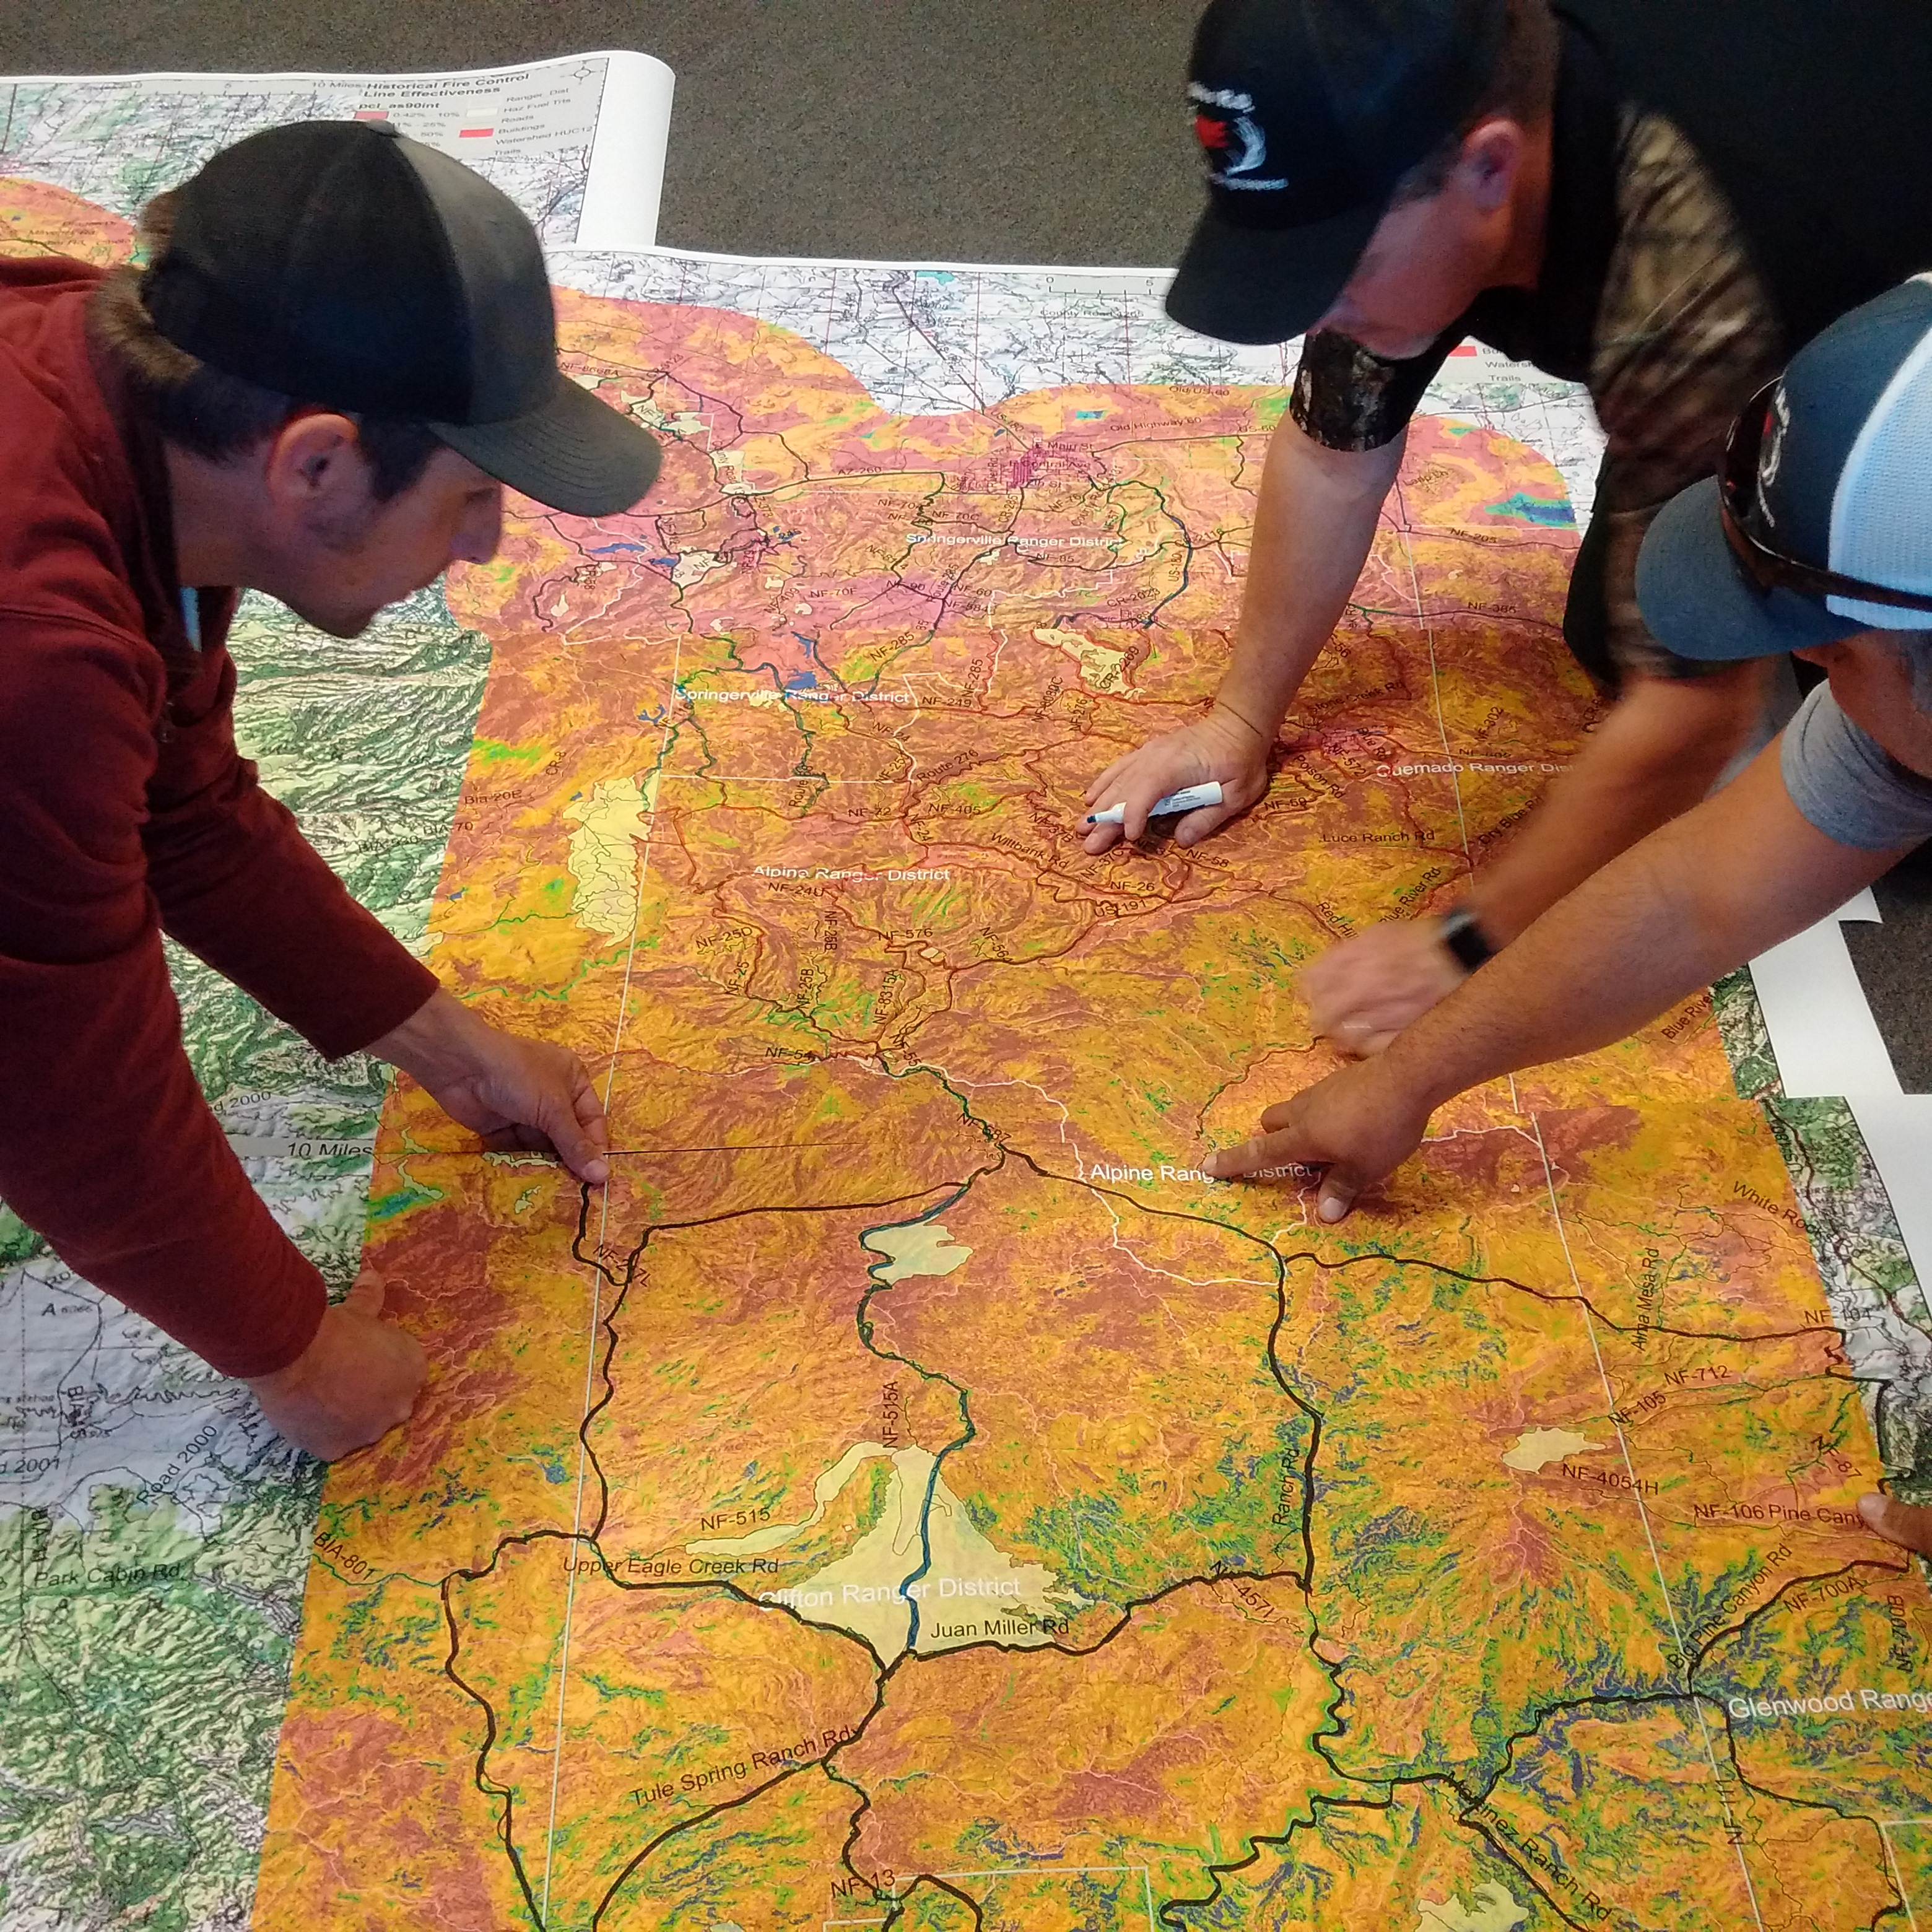
Potential Wildfire Operational Delineations (PODs)
What are PODs?
PODs are polygons drawn by local fire experts
PODs are delineated on maps highlighting potential control locations likely to be successful.
The maps are developed using analytical tools accounting for the fire environment (pyromes).
Notes:
Slide # 11
What are Potential Wildfire Operational Delineations (PODs)?
PODs are polygons whose boundary features are relevant to fire control operations (e.g., roads, ridgetops, and water bodies).
PODs are created by local fire experts with the help of analytical tools that highlight landscape features with control potential and provide information on their likely effectiveness.
PODs are useful for summarizing wildfire risk and planning strategic response to unplanned ignitions accordingly.
In an operational response context, POD boundaries can be used to guide and communicate choices of where to construct or hold fire line as well as where to conduct burnout operations.
PODs may also prove useful for strategic fuels planning, with potential applications for designing controlled burn units, reinforcing existing POD boundaries, or prioritizing treatment opportunities within PODs.
Vetting and mapping POD boundaries essentially formalizes and institutionalizes the knowledge of fire management experts.
The basic idea of delineating “boxes” within which to manage fire has long been around; the POD concept uses risk-based analytics, ground-truthing, and expert consensus to take that concept much farther, and moves it into the pre-fire planning world to buy more time.

Slide 12
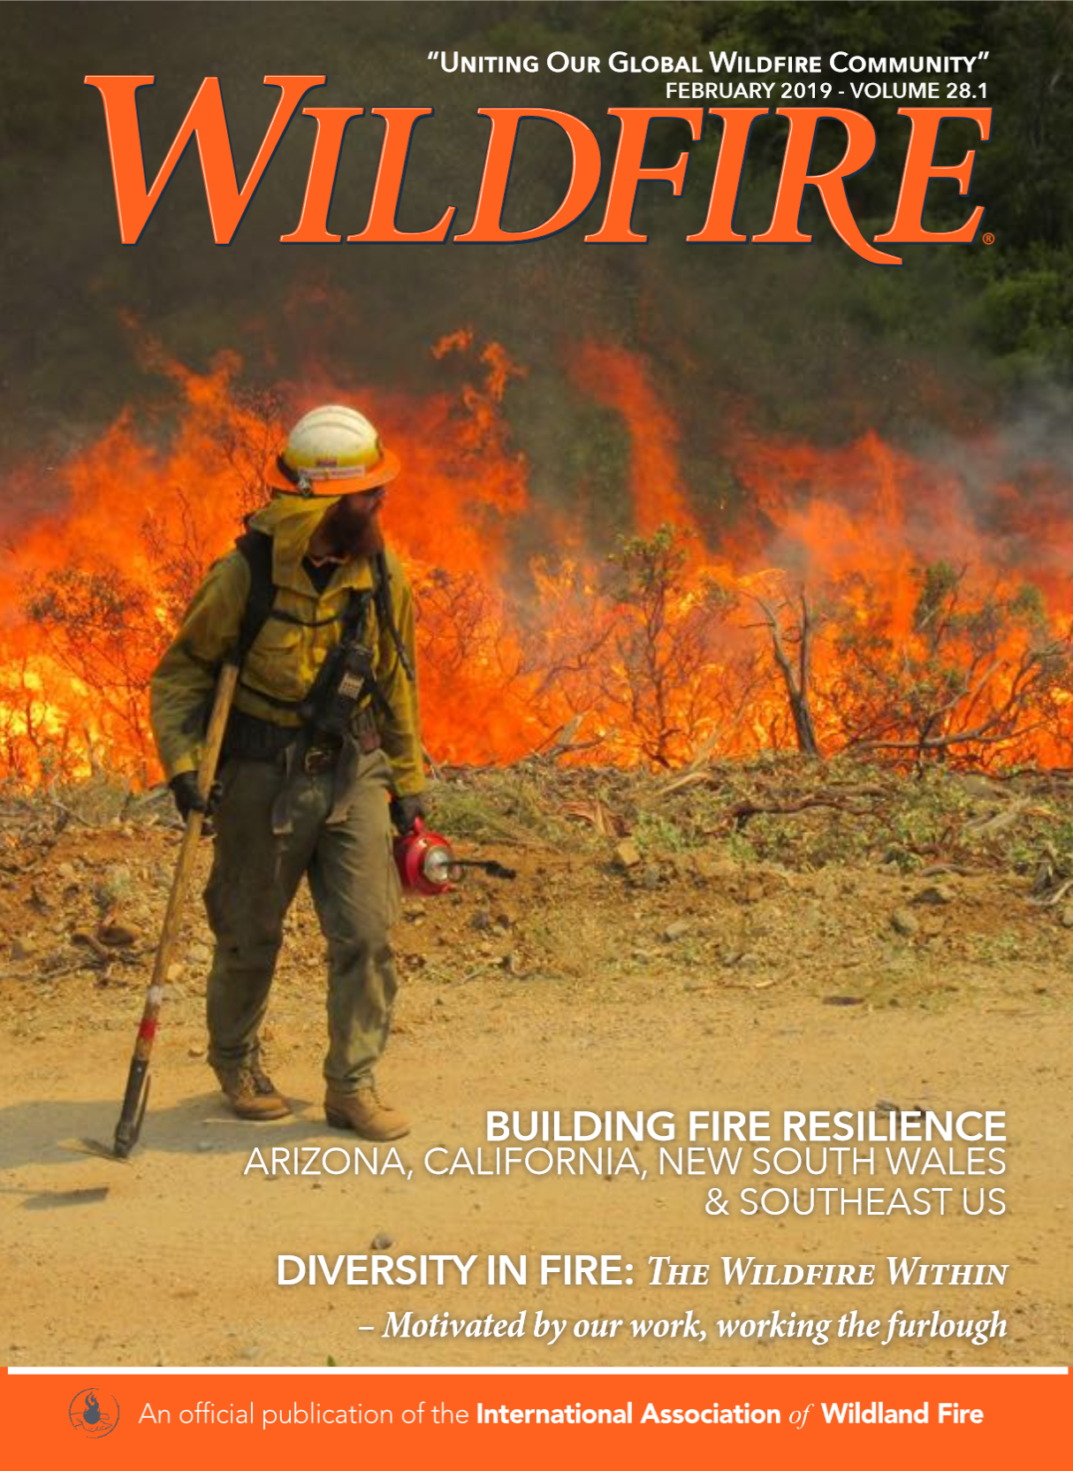
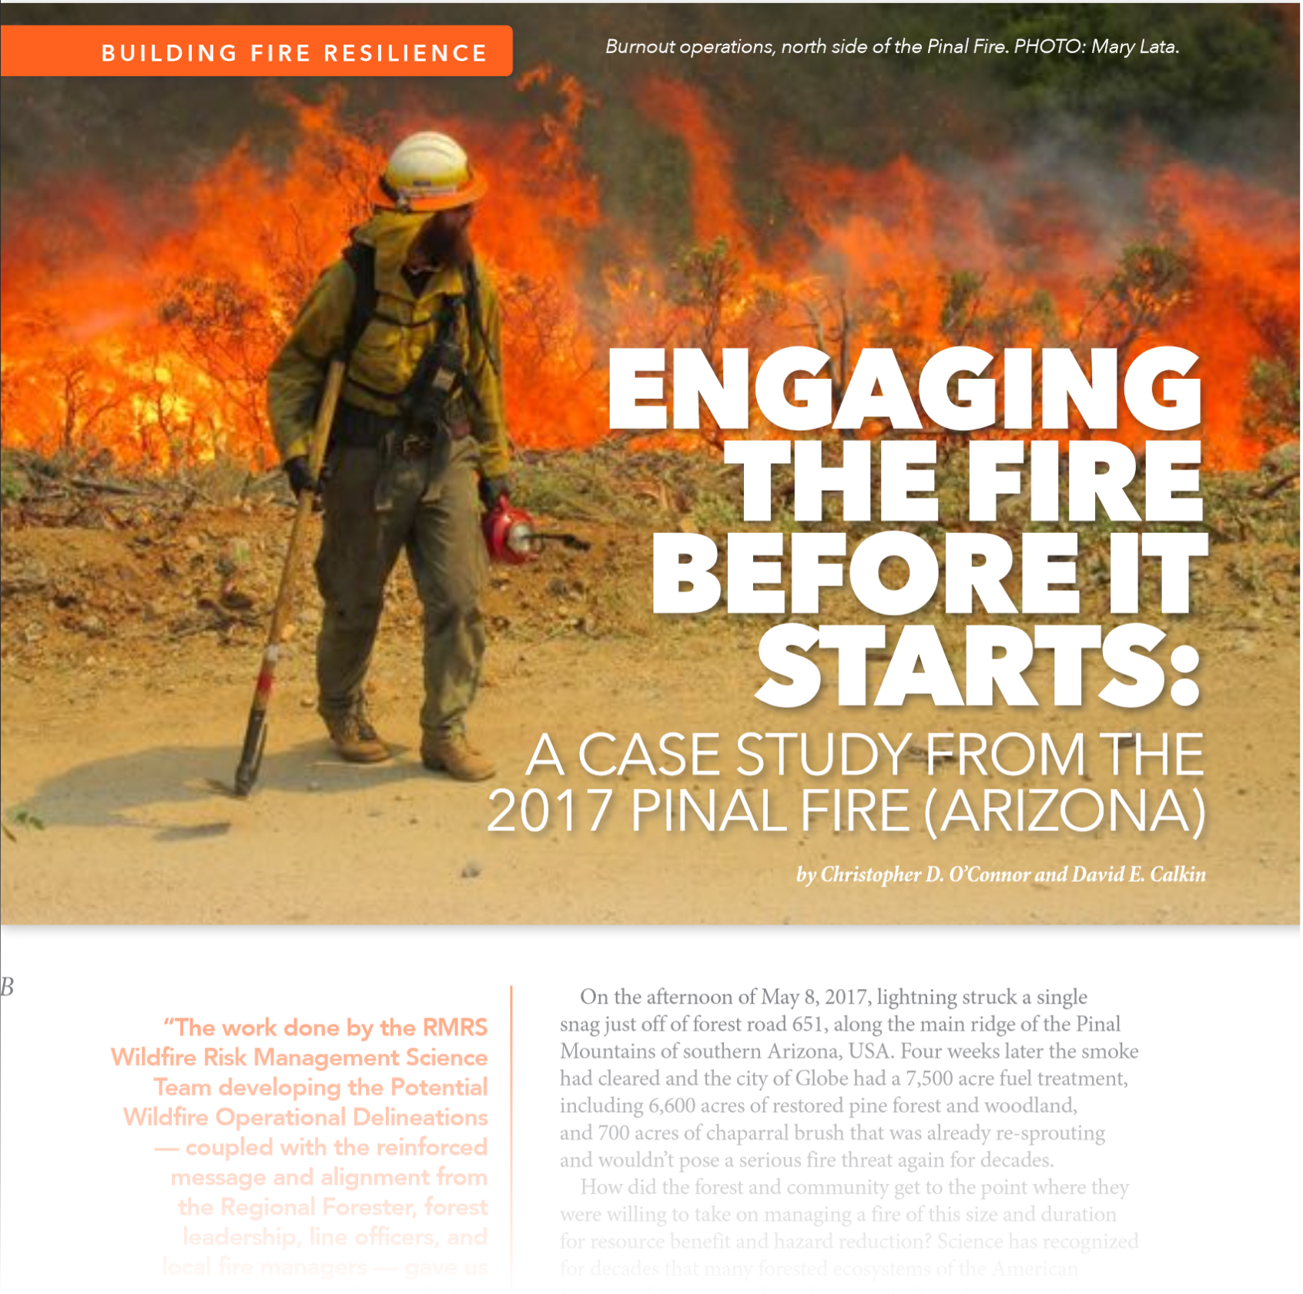
Potential Wildfire Operational Delineations (PODs)
PODs as Response Zones
PODs represent risk factors associated with fire response and suppression.
When FDRA boundaries are edge-matched to POD boundaries for response actions, risk-based decision-making can be enhanced.
Notes:
Slide # 12
Using recently developed analytical tools to map potential control locations, fire suppression specialists delineate the best locations to operationally engage wildfires under various levels of fire danger.
References:
https://www.iawfonline.org/wp-content/uploads/2019/02/28.1-February-2019-Wildfire-Magazine-Web.pdf
https://www.fs.fed.us/rm/pubs_journals/2019/rmrs_2019_oconnor_c001.pdf

Slide 13
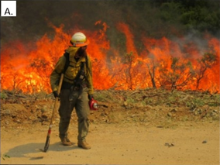
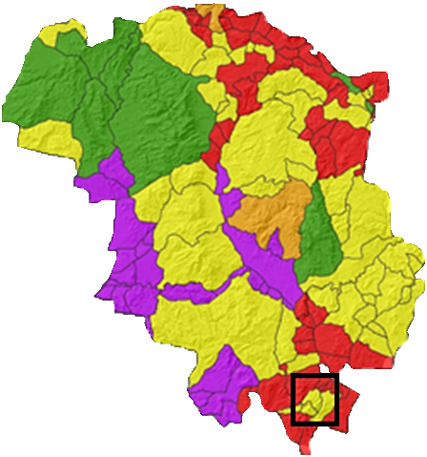
Potential Wildfire Operational Delineations (PODs)
Notes:
Slide # 13
Although several examples now exist, the Tonto National Forest was the first to develop their POD layers with the assistance of Rocky Mountain Research Station scientists.

Slide 14
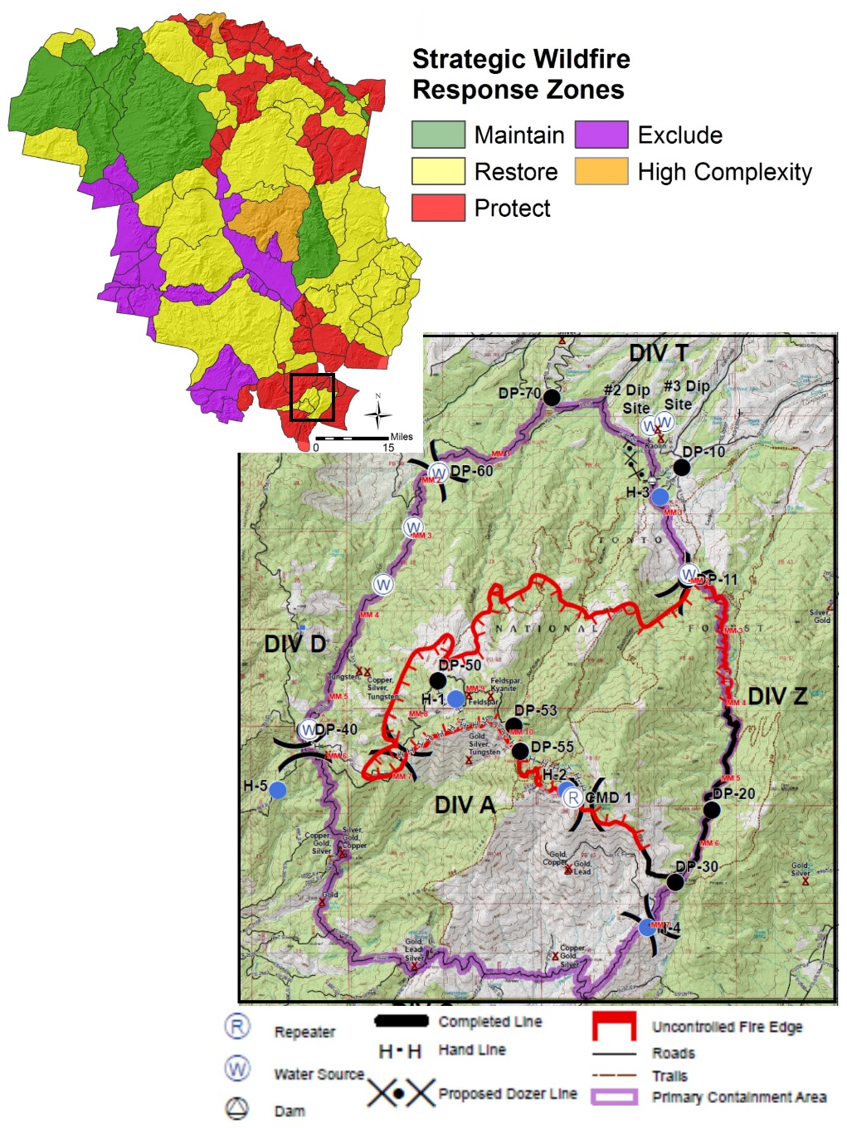
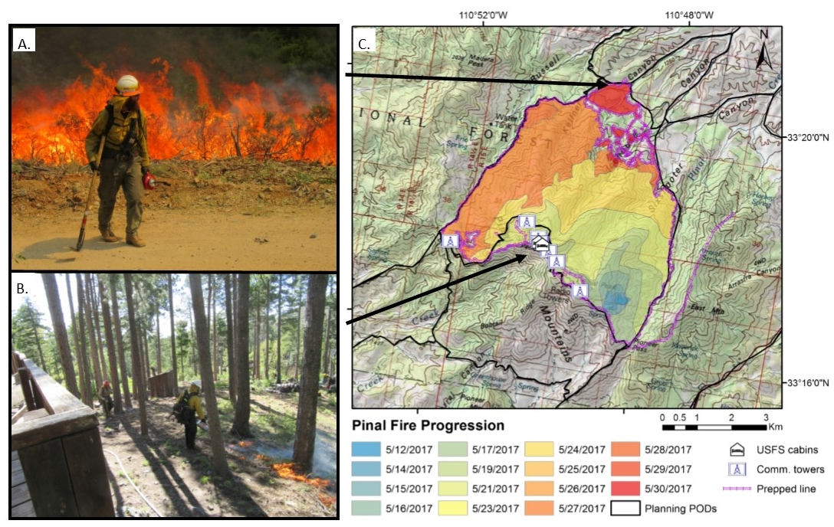
.
Pinal Fire
Tonto National Forest
Started on May 12, 2017
Notes:
Slide # 14
The Pinal Fire was an early season wildfire (starting on 5/12/2017) with significant potential to manage for resource objectives.
Reference the graphic in the upper left corner: The Pinal Fire started within a POD boundary (yellow) pre-identified to achieve restoration objectives by reducing surface fuel loading and minimizing the potential for future crown fire behavior.
The Pinal Fire grew in size and complexity as the community of Globe, AZ was threatened as illustrated by the area in Red (protection)
Pinal Fire provides an example where a preparedness planning effort (delineating PODs) provided meaningful strategic response zones and effective operational engagement.
Potential Operational Delineations will be discussed again in lesson 15.

Slide 15
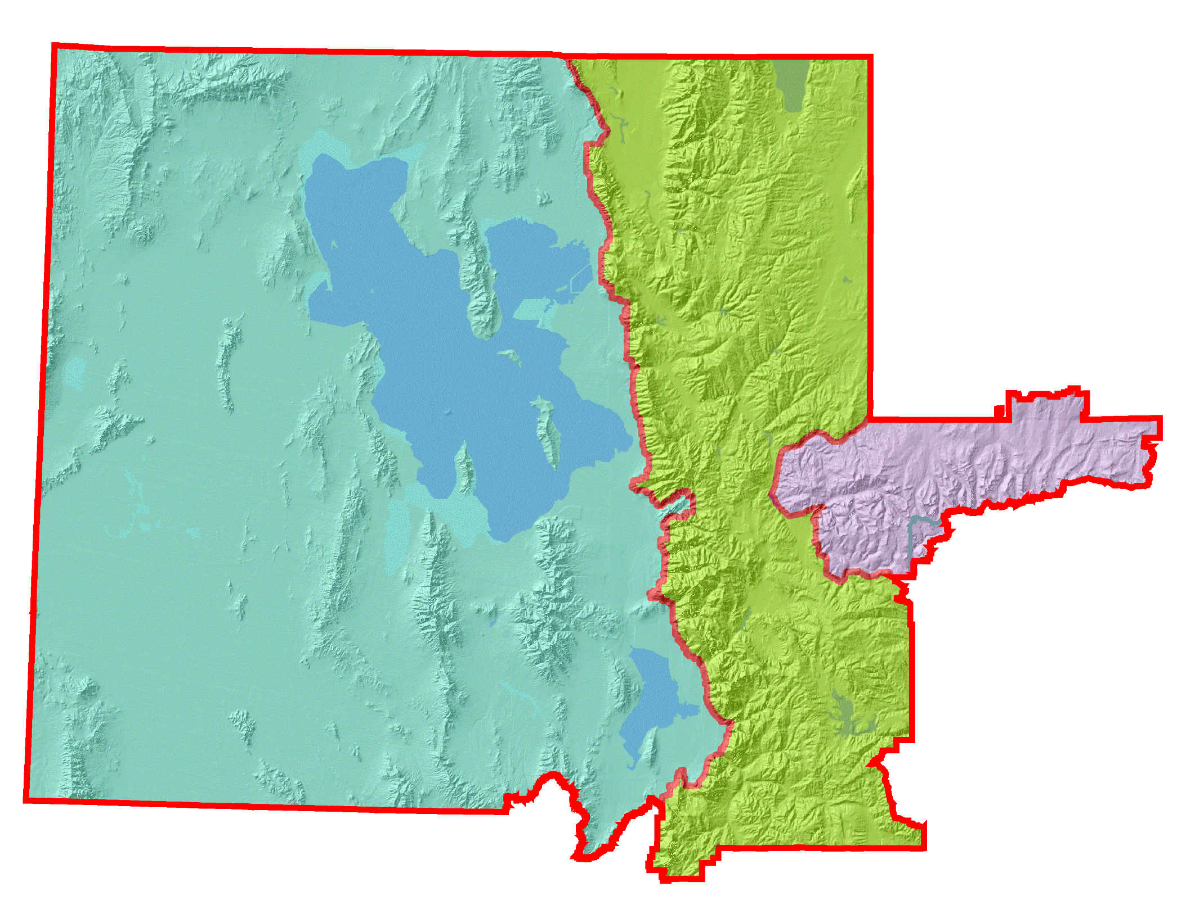
Each FDRA represents a large geographic area where fire danger can be considered relatively similar.
Wasatch Mountain FDRA
Salt Lake Desert FDRA
Uinta Mtns FDRA
Notes:
Slide # 15
Fire Danger Rating Areas – Northern Utah Example (or substitute with a local example)
Fire Danger Rating Areas are based purely upon the fire environment, without consideration of social, political, or managerial factors.

Slide 16
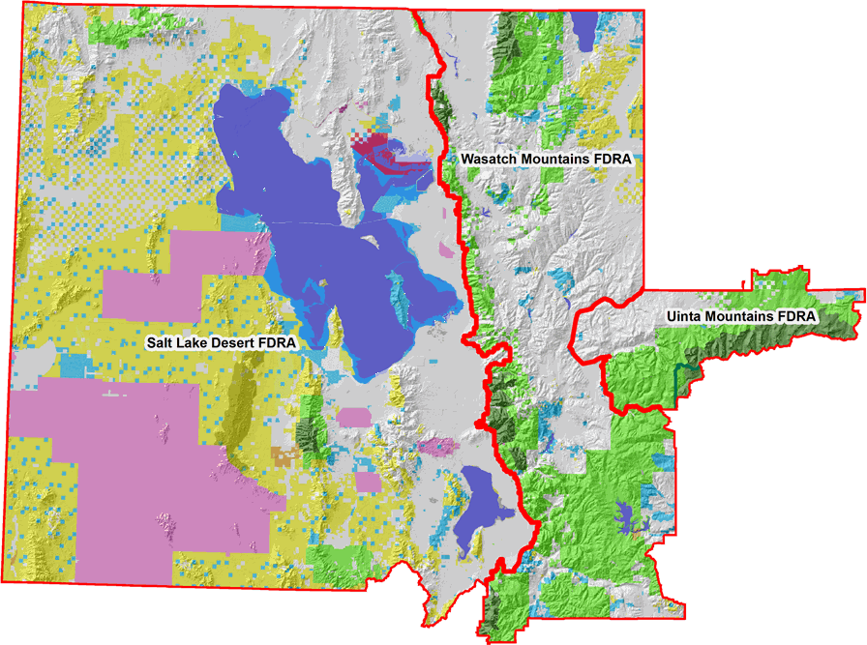
The Fire Danger within a FDRA is expected to be similar, regardless of jurisdictional boundaries.
Notes:
Slide # 16
Fire Danger Rating Areas
Once again, we emphasize the fact that regardless of jurisdictional, administrative, and political boundaries that underly Fire Danger Rating Areas, the fire environment is considered to be similar.
Fires do not respect administrative boundaries.

Slide 17
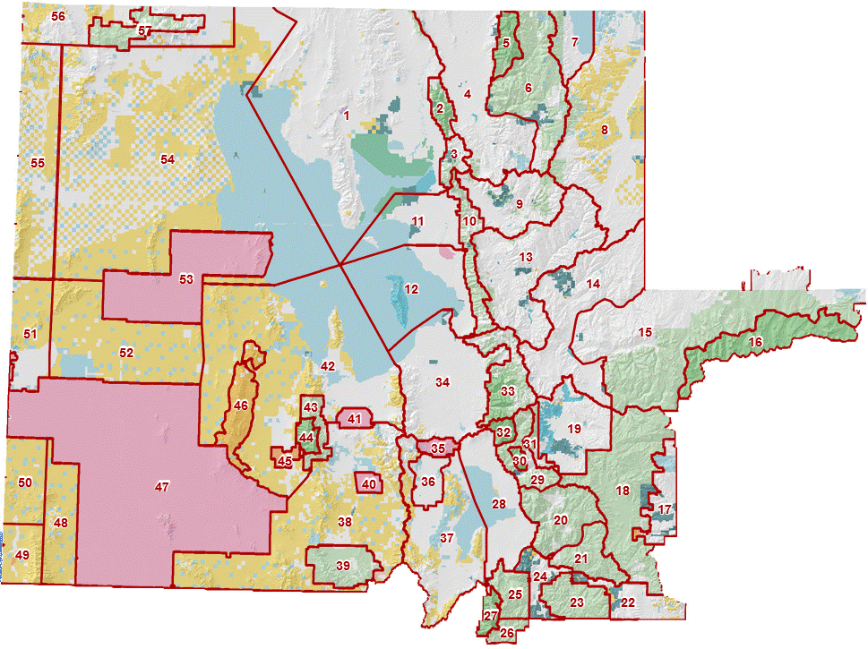
Although the Fire Danger Rating within a FDRA remains similar . . .
. . . administrative subdivisions do influence our actions.
Notes:
Slide # 17
Response Zones
It is important to remember that the fire danger will remain relatively similar within each FDRA (without regard to the social/political factors).
Administrative, jurisdictional, political, and managerial agreements and considerations do influence our response actions.

Slide 18
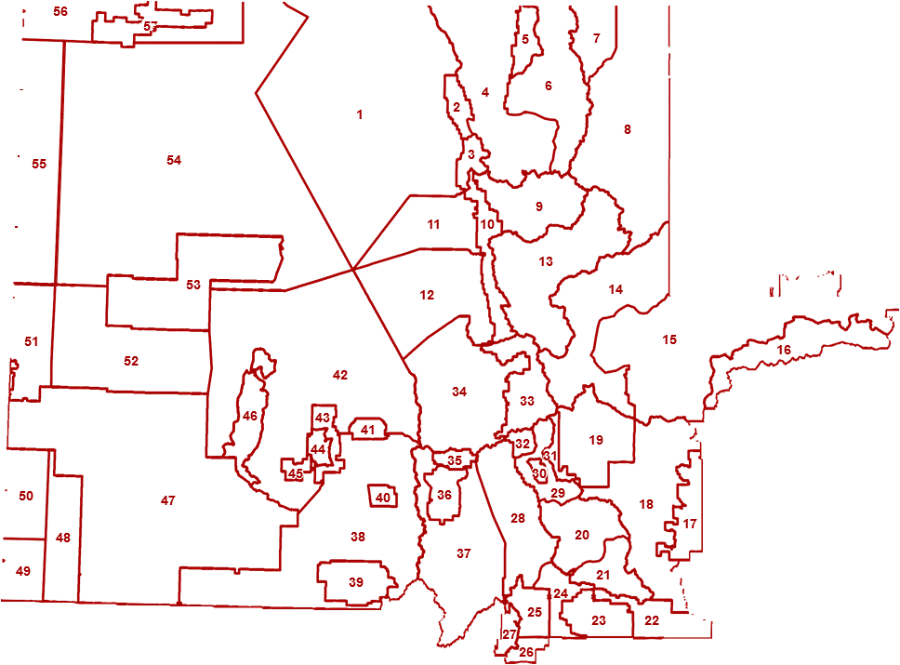
Response Zones
Notes:
Slide # 18
Response Zones
Response Zones are the footprint for response decisions; they are based upon administrative, jurisdictional, political, and managerial agreements and considerations. By laying Fire Danger Rating Areas over the Response Zones, we can integrate Fire Danger Rating in our response decisions.
It is important to understand that FDRAs can be subdivided into smaller Response Zones to account for the social and political considerations; AT THE SAME TIME, we will expect the fire danger within the FDRA to remain similar.

Slide 19
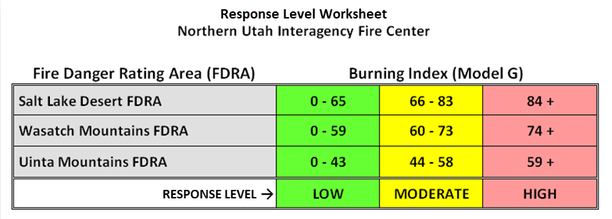
Response Level
Agency personnel use preplanned response (dispatch) levels to assign initial attack resources to reported wildfires.
Notes:
Slide # 19
Preplanned Response (Dispatch) Levels (EXAMPLE)
Key Points:
Target group is the internal agency personnel.
Preplanned Response Levels are often called Dispatch Levels.
The intent is to preplan graduated response levels as the potential containment difficulty increases.
Not knowing the details of a reported fire, response levels based on fire business thresholds provide a fire management application where an appropriate (initial) mix of suppression resources are dispatched to the reported wildfire.

Slide 20
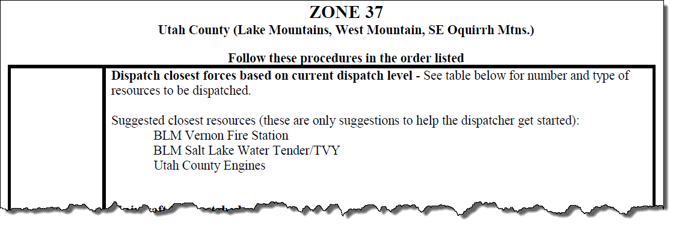
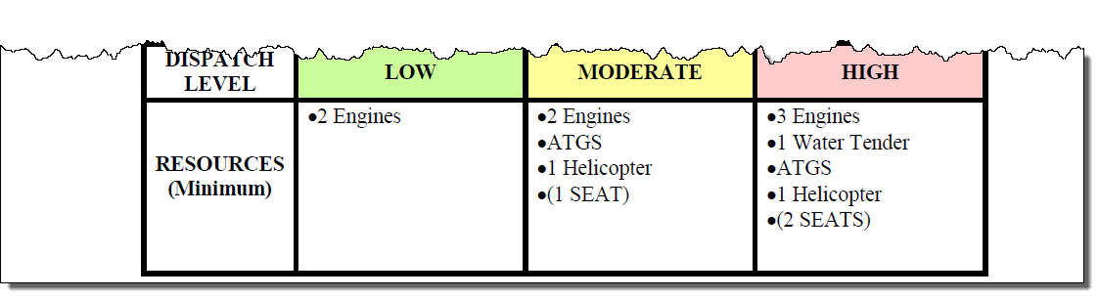
Application of Response Levels Example
Notes:
Slide # 20
ANIMATED SLIDE -- Application of Preplanned Response (Dispatch) Levels (EXAMPLE)
Key Points:
Preplanned initial attack responses are common
This is intended to attain the goal of good decision-making by mitigating cognitive bias by using NFDRS
Note that this is an example of a 3 Decision Class system (3 Response Levels: Low, Moderate, High)
Note the increase of initial attack capability from Low=>Moderate=>High.

Slide 21
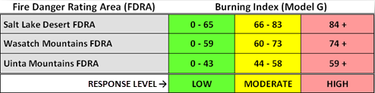
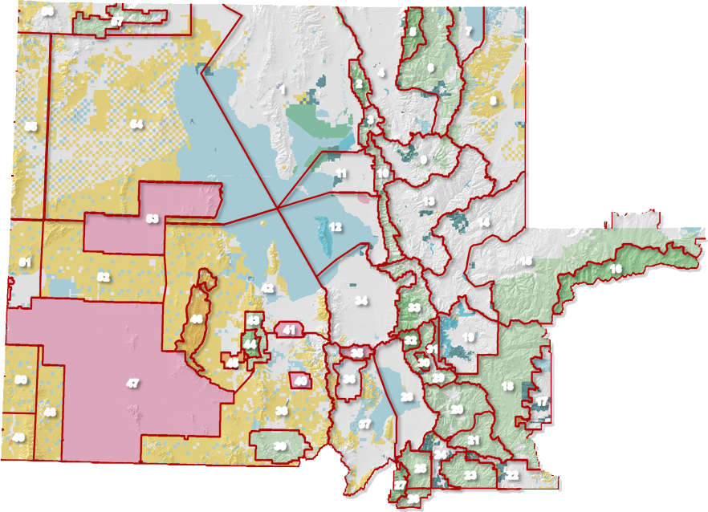


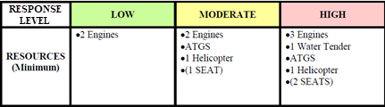
.
56
57
Burning Index = 73
5
7
4
6
1
2
8
Response Zone #52
55
54
3
9
11
10
13
53
12
14
Two Fire Reports
(in the same FDRA)
51
15
16
52
42
34
33
46
43
41
44
32
31
30
19
45
35
50
47
40
36
29
18
Response Zone #37
28
17
48
38
20
49
37
39
21
24
25
23
22
27
26
Notes:
Slide # 21
ANIMATED SLIDE (NORTHERN UTAH EXAMPLE – Use a local example if one is available)
In this example:
A fire is reported in Response Zone #52
At the same time, a second fire is reported in Response Zone #37
KEY POINT => both fires are in the same FDRA
This means that the Fire Danger Rating is at the same level (BI => 73 => MODERATE RESPONSE LEVEL), but the response will be different due to other factors such as values-at-risk, accessibility, county jurisdiction, barriers to fire spread, and other possible considerations.
“Run Cards” for each Response Zone (#52 & #37) are dispatched to each fire
If the resources are not available within the local dispatch area, resources are sought after in neighboring dispatch units to fill the “Run Card”
The dispatched resources will continue to the fire until a qualified Incident Commander arrives to determine whether to cancel or augment the “Run Card” response.

Slide 22


Summary
Characterize:
Vegetation
Climate
Topography
Edge-Match:
Predictive Service Areas ?
Response Zones
Delineate (or Validate):
Fire Danger Rating Areas
Notes:
Slide # 22
In the first Task (#1), it is important to evaluate the fire danger environment without the influence administrative, political, and operational factors.
In the second Task (#2), the administrative, political, and operational factors are incorporated by edge-matching the draft FDRAs with “Response Zones”
The recommended geospatial tools include ArcMap and AGOL. AGOL will be discussed in the next lesson.

Slide 23
Review Objectives
Explain what a Fire Danger Rating Area (FDRA) is.
Identify the role of FDRAs in NFDRS (planning, analysis, application, actions).
Identify and apply "best practices" relating to the development and implementation of FDRAs.
Notes:
Slide # 23
Review Lesson Objectives:
Explain what a Fire Danger Rating Area (FDRA) is.
Identify the role of FDRAs in NFDRS (planning, analysis, application, actions).
Identify and apply "best practices" relating to the development and implementation of FDRAs.

Slide 24

Questions?
Notes:
Slide # 24
Questions?

