Slide 1
FDOP Case Study
Lesson 5
FMO Perspective - Local Application
“It’s all about decision making and informing decision makers.”
Geographic Area
Fire Danger Operating Plan Workshop
Notes:
Slide # 1
Title Slide for Lesson # 05
Lesson Title: FDOP Case Study: FMO Perspective – Local Application
Time: 45 minutes (immediately followed by Lesson 06)
Note: This is intended to be an instructional case study; not a project report. It should be decisional and analytical. It should challenge participants to move to higher orders of learning by prompting them to ask “how” the issues are related to one another and “why” things happen the way they do. Please read the following instructor notes.
Facilitation Method:
Before you introduce the case study, clarify that you want the participants to be thinking about the process of developing the Fire Danger Operating Plan (FDOP) versus the Staffing, Preparedness, and Response Plans.
Briefly review the “Best Practices” that have been presented so far. Inform the students that they should be ready to discuss two questions after the Case Study has been presented:
Which “Best Practice” seemed to have the greatest influence leading to decisions supported by the Fire Danger Operating Plan?
Which “Best Practice” will be most difficult to implement at your home unit, and why?
Introduce the facts related to the case in 20-30 minutes; reserve a minimum of 15 minutes for discussion and questions.
Avoid interjecting personal bias, opinions, and conjecture about the case study.
The facilitator should be able to engage the group with questions to stimulate focused discussion.
Set the Goals/Objectives:
Objective: Demonstrate the importance of adhering to the recommended “best practices”
Goals:
Ask thoughtful, non-judgmental questions to generate healthy discussion leading to a lesson learned or potential solution.
Stay focused on how Fire Danger has been meaningful in this case.
The discussion must center around the recommended “best practices” . . . Particularly the following:
Fire Danger Operating Plan
Response Plan
Staffing Plan
Preparedness Plan
Prevention Plan
End the discussion at roughly 35-45 minutes to allow enough time to summarize the discussion, answer pending questions, and bring closure to the lesson
Recommendation for Asking Questions:
The first question is important for setting the right tone for the rest of the discussion.
Start with an open-ended inquiry. If you start with a question that is too obtuse, too formidable, or looks like a trick question, no one will answer… The best opening questions are open ended, where there are multiple reasonable answers, or where the question is neutral and simple to answer.
Hold back from engaging in controversial or emotional material until all the facts have been established and put into context. If you start off on a fighting issue, there is a good chance that the facts will get lost in the barrage of attacks and counterattacks that ensue.
Possible Questions:
Which “Best Practice” seemed to have the greatest influence leading to decisions supported by the Fire Danger Operating Plan?
Which “Best Practice” will be most difficult to implement at your home unit, and why?

Slide 2
Objectives
Demonstrate the importance of adhering to the recommended “best practices” as discussed in Lesson 3.
Relate a local view of the interagency planning and implementation of a fire danger operating plan.
List several fire management decisions based on NFDRS outputs.
Discuss the Southeast Zone (SEZ) Fire Danger Operating Plan (FDOP) connection between local fire occurrence issues and decisions based on fire danger products.
Notes:
Slide # 2
Lesson Objectives:
Demonstrate the importance of adhering to the recommended “best practices” as discussed in Lesson 3.
Relate a local view of the interagency planning and implementation of a fire danger operating plan.
List several fire management decisions based on NFDRS outputs.
Discuss the Southeast Zone (SEZ) Fire Danger Operating Plan (FDOP) connection between local fire occurrence issues and decisions based on fire danger products.

Slide 3
Introduction
Southeast Zone (SEZ) Interagency Fire Danger Operating Plan (FDOP) was initially developed in 2012.
Has been revised several times. Currently operating under the 2017 version.
A 2018 version has been developed using the NFDRS 2016 model.
The SEZ FDOP working group continues to solicit advice and input towards improving the plan to meet fire managers needs and expectations.
Notes:
Slide # 3
This case study is intended to present how the Southeastern Arizona (SEZ) Fire Danger Operating Plan (FDOP) is utilized to provide fire danger information to line officers, fire management officers, duty officers, dispatch centers, firefighters, industrial cooperators, and the public.
The SEZ FDOP example also shows that the plan and subordinate plans are evaluated on a regular basis to ensure continuity of information and to maintain accurate and current data.
Maintaining a consistent level of currency is intended to promote a product that the end-user can trust and be willing to continue to utilize to answer questions related to fire danger and fire potential.

Slide 4
Interagency FDOP Agency Partners
National Park Service
Coronado National Forest
Arizona BLM Gila District
US Fish and Wildlife Service
Tohono O’odham Nation/BIA Papago Agency
Arizona Department of Forestry and Fire Management, Southeast District
Notes:
Slide # 4
An interagency FDOP requires active participation from all partners. Each cooperating agency may be able to provide varying levels of expertise to the development and review of the plan.
The interagency FDOP is an opportunity to improve understanding to those cooperators with limited knowledge or experience with the tools and subordinate plans.
At every scale, fire danger rating is a key consideration for staffing and prepositioning preparedness resources, regulating industrial activity, or placing restrictions on public lands.
These assessments are used by and affect a wide variety of stake holders including federal and state agencies, local governments, industrial and other private entities, as well as the general public.
Participation in a recognized fire danger system and careful management of weather and fire data is vital to ensure accurate assessments and the consistent application of fire danger rating, especially for broader scale assessments.

Slide 5
Preparedness Information
Current Information
Provides managers and decision makers with current fire danger and fire behavior potential information.
Forecast Information
Predictive Services can provide the most applicable and current forecast information to aid decision makers in gauging potential fire danger conditions over an identified forecast period.
Notes:
Slide # 5
Available fire danger and fire weather information can be categorized into two groups:
Current Information: Current information can provide decision makers with current conditions in regard to fire danger and fire behavior potential. National Fire Danger Rating System daily outputs are readily available and should be incorporated into the decision-making process.
Forecast Information: Forecast information is available in many forms. Each geographic area employs Predictive Services personnel who can provide the most applicable and current forecast information to aid decision makers as they try to gauge potential fire impacts over the next few days or weeks.
When briefing decision makers on the current level of fire danger during fire season, it is important to provide line officers with current, appropriate information to assist them with the decision-making process.

Slide 6
Preparedness Information for Agency Personnel
Fire Danger Operating Plan development process blends:
Science
Historical Data
Established Processes
Local Knowledge
Notes:
Slide # 6
The FDOP process blends science, historical data, established processes, and local knowledge to provide a unified framework for local interagency unit managers and administrators to make informed decisions that result in safe, efficient, and effective responses to fire situations.
The FDOP is intended to offer decision-making support combining historical fire and weather information, evaluating this information using science-based processes to reinforce local fire knowledge.

Slide 7
Preparedness Information for Agency Personnel
Fire Danger Operating Plan provides:
Unified framework for local interagency fire managers and agency administrators.
Provides tools to assist in decision making
Provides information that can lead to safe, efficient, and effective fire responses.
Notes:
Slide # 7
The FDOP can provide consistent information using a unified format that fire personnel and non-fire personnel can understand.
A variety of charts/graphs can help to describe various levels of fire danger (i.e. ERC, BI, Fuel Moisture, etc.).
Fire managers can use these tools to help explain fire danger potential during critical periods throughout the course of the fire season.

Slide 8
Preparedness Information to Aid Decision Makers
Current Information (WIMS data, NFDRS outputs, current weather information, etc.)
NFDRS outputs provide information on current conditions related to fire danger and fire behavior potential.
Forecast Information
Available in a variety of formats (daily fire weather forecasts, spot weather forecasts, seasonal outlooks, etc.)
Predictive Services can help to provide applicable and accurate forecast information.
Notes:
Slide # 8
Ask participants where they may be able to locate various forms of current and forecast information.
How often do participants seek out these types of information during fire season?
How do they use these types of information? Who do they tend to convey this information to (who is their target audience)?

Slide 9
NFDRS Information
Aids Fire Management Officers in providing daily fire preparedness direction based on:
Current Fire Danger
Current Fire Activity
Current Local Suppression Resource Availability or Commitment
Notes:
Slide # 9
Ask participants if FMO’s utilize NFDRS information as they assess daily fire preparedness situations for their unit?
If so, what kind of information do they utilize and how do they obtain the information?

Slide 10
NFDRS Information
The Dispatch Center helps to provide daily fire danger information to local units:
Daily adjective fire danger rating
Staffing Level
Response Level
Preparedness Level for the Zone
Notes:
Slide # 10
Dispatch Centers provide current NFDRS information on a daily basis.
The SEZ FDOP provides tools to determine the above-listed ratings/levels. These tools use fire business thresholds as opposed to climatological breakpoints. Do the participants understand the difference?
Thresholds are based on both historical weather (climatology) and fire occurrence (fire business). Fire business thresholds are developed using FireFamily Plus. Examples of climatological thresholds are the 90th and 97th percentiles. Thresholds, or breakpoints, are used to define fire danger input for management decisions in each fire danger rating area. Activities, events, and fire operations affected by fire danger are identified, and appropriate NFDRS components or indices are selected as decision guides. Historical analysis of fire weather data is used to identify thresholds for staffing class, adjective rating, and preparedness level.
Ask participants how their respective dispatch centers determine the daily adjective fire danger rating, staffing level, response level, and/or preparedness level.

Slide 11
NFDRS Information for Agency Administrators
The FDOP provides continuity of information for leadership personnel.
FMO’s can provide agency administrators with an accurate depiction of the daily fire danger situation.
Current fire danger level
Current fire weather forecast information
Agency Administrators can support justification for fire preparedness decisions:
Availability of support staff outside of the fire organization
Restrictions or Closure Order considerations
Severity requests to augment local suppression resources
Notes:
Provide Agency Administrators with current, appropriate information that presents an accurate depiction of the daily fire danger situation.
FMO’s provide the appropriate fire danger and fire weather information to ensure that the Agency Administrator is aware of the current fire danger and preparedness levels for the zone.
This information helps Agency Administrators understand the current fire danger assessment and helps to justify decisions (i.e. availability for support staff outside of the fire organization; consideration of restrictions or closure orders; and justification severity requests to augment local suppression resource capabilities.

Slide 12
NFDRS Information for Agency Administrators
Decision documentation (WFDSS requirements on large, extended wildland fires):
Initial decisions need to provide the Agency Administrator’s overall direction
Fire program managers provide current fire danger and fire weather information to Agency Administrators to assist in the decision documentation process.
This information aids the Agency Administrator, FMO, and resource staff in the development incident specific objectives and requirements, a clear course of action for the management of the incident, and a rationale statement that supports the decision document.
Notes:
On large, extended fires where decision documentation is required (i.e. WFDSS) decision makers need to be provided with current, appropriate information to assist them with their decision-making process.
Initial decision documents are often created under hasty conditions where a decision is needed that provides the Agency Administrator’s overall direction on how the incident is to be managed.
Fire Management Officers (i.e. Fire Staff, District FMO, NPS FMO, etc.) in the SEZ do utilize NFDRS information to provide current fire danger and fire weather information to their respective Agency Administrators to assist in their decision documentation process.

Slide 13
NFDRS Information for Agency Administrators
Fire managers can use graphical NFDRS information to display trending fire danger conditions.
Notes:
Ask participants how they present fire danger information to their Agency Administrators.
SEZ Fire Managers utilize graphical NFDRS outputs to display trending fire danger conditions to Agency Administrators.
Agency Administrators may not always understand the significance of the various NFDRS variables (i.e. ERC, 1000-Hr Fuel Moisture).
Graphical displays help Fire Managers present current fire danger conditions in a format that is easier for non-fire personnel to understand.
Ask participants which NFDRS variables they utilize and ask them to explain why.

Slide 14
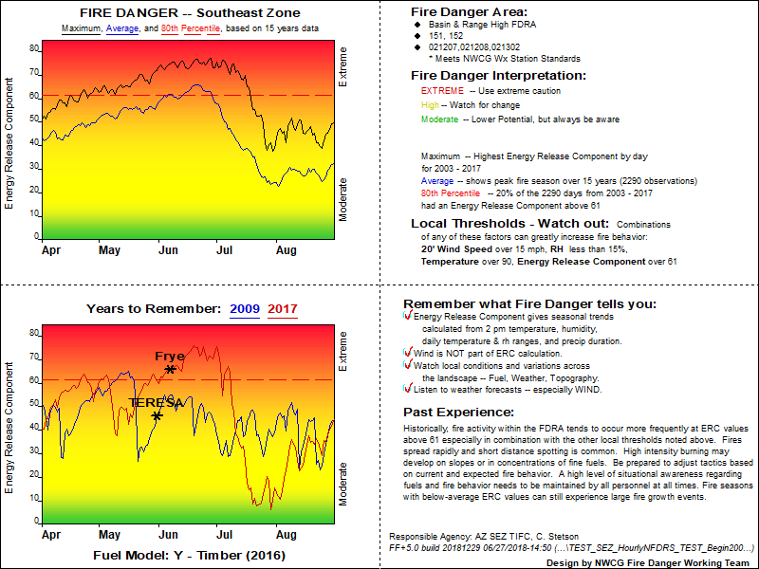
Local Unit – Fire and Non-Fire Personnel
FMO’s at the local level utilize NFDRS information in daily briefings for suppression personnel
Local unit FMO’s are responsible for ensuring that firefighters understand the value of the daily NFDRS outputs (i.e. ERC, BI, etc.) in conjunction with daily fire weather forecasts.
Local unit FMO’s need to ensure that firefighters and local unit leadership understand what the daily NFDRS outputs indicate with regard to daily preparedness planning and potential fire danger.
Notes:
Slide # 14
Ask participants whether they or their local unit FMO’s or AFMO’s utilize NFDRS information during daily briefings.
Do they provide pocket cards to their firefighters and incoming severity resources?
Do they find pocket cards useful? If not, ask why… What might work better?

Slide 15
Local Unit Decisions
NFDRS information can be used to aid in deciding:
Daily staffing
Restrictions for local industrial cooperators.
Prescribed Fire Go/No-Go decisions.
Allow fire to be managed to meet resource benefit objectives or implement suppression actions.
Availability of resources for scheduled project work.
Availability of non-fire personnel to support fire suppression activities.
Notes:
Slide # 15
NFDRS information is also considered when determining the availability of suppression resources for project work or the need to pre-position suppression resources during periods of elevated fire danger levels. Local FMO’s use NFDRS information when considering whether prescribed fire projects can either proceed or need to be delayed.
Duty Officers utilize the Staffing Level tool to guide daily internal fire operational decisions at the local level. The Staffing Level specifies appropriate daily staffing for initial response resources, such as when to implement 7-day coverage and adjusted work schedules, and the number of personnel committed to initial attack resources.
Ask participants whether they utilize NFDRS information to guide them in their daily decision-making process.
Do the local FMO’s understand the FDOP tools?
Is there acceptance to utilize the available tools to aid in their decision-making processes or do they prefer to rely on their “gut feeling”?
How can the value of using NFDRS outputs be better explained to local FMO’s, AFMO’s, or DO’s?

Slide 16
Industrial Cooperators
NFDRS-based benchmarks (i.e. Adjective Fire Danger Rating, Preparedness Level) assist FMO’s and agency administrators when evaluating restrictions or limitations on industrial activities.
FMO’s, COR’s, and agency staff ensure that industrial cooperators understand which activities are allowed at the different levels of fire danger and why it is important to adhere to the identified BMP’s.
Notes:
Slide # 16
NFDRS tools within the FDOP help FMO’s and Agency Administrators in the decision-making process when considering restrictions or limitations on industrial activities on public lands during periods of elevated fire danger.
Ask participants whether they utilize NFDRS tools/outputs as they may consider implementing restrictions or limitations on industrial activities in their Zones.
What are some of the challenges in working with industrial cooperators?
How do these challenges affect their decision-making process and how do they mitigate some of these challenges?

Slide 17
Public Information
FMO’s work with Public Information Officers (PIO’s) to effectively communicate fire danger information to the public.
It is important for the public and the media to understand why certain restrictions or closures are being considered or implemented.
NFDRS outputs are just as important when considering rescinding restrictions or closure orders.
Fire program mangers for all cooperating agencies within the SEZ utilize the Adjective Fire Danger Rating tool to convey current fire danger conditions to the public
Notes:
NFDRS tools within the FDOP help FMO’s and Agency Administrators work with PIO’s when considering restrictions or closures on public lands during periods of elevated fire danger.
It is important for the public and the media to understand why certain restrictions or closures are being considered or implemented.
NFDRS outputs are just as important when considering the removal of restrictions or closure orders to allow public recreational use to resume on public lands.
Fire Program Managers for all cooperating agencies within the SEZ utilize the Adjective Fire Danger Rating tool to convey current fire danger conditions to the public.

Slide 18
Adjective Fire Danger Rating
WIMS will automatically calculate the adjective class rating.
TDC manually determines Adjective Fire Danger Rating for each FDRA based on fire business thresholds developed using FFP.
The actual determination is based on the current or forecasted value of a selected staffing index (ERC) and ignition component (IC) using the tables in the FDOP.
Notes:
Slide # 18
Fire danger is a broad scale assessment while fire behavior is site specific.
Fire danger ratings describe conditions that reflect the potential, over a large area, for a fire to ignite, spread and require suppression action.
SEZ Fire Managers use this information to communicate potential fire danger conditions to Agency Administrators, agency personnel, the public, and industrial cooperators in a manner that is easily understood.

Slide 19
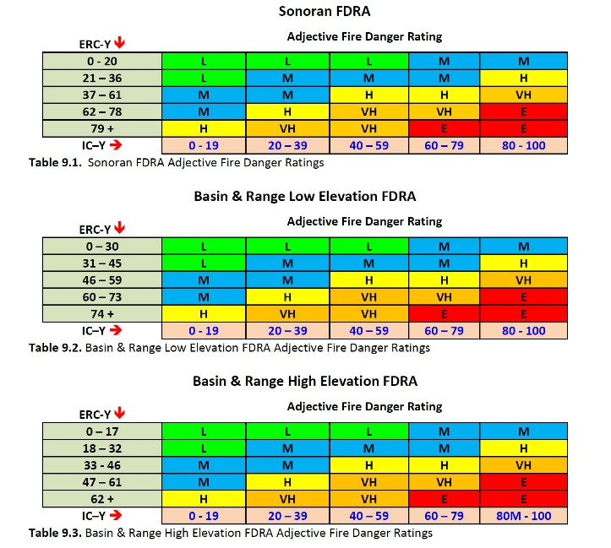
Adjective Fire Danger Rating
Tucson Dispatch displays the daily Adjective Fire Danger Rating on the Tucson Dispatch Center website. This information is available to all agency personnel.
Prevention Specialists and FMO’s can coordinate the proper adjective rating to be displayed on the fire danger signs for the public.
At elevated fire danger levels the FMO’s coordinate with PIO’s on the appropriate communication through various media outlets (web-based, local news outlets, press releases, etc.)
Notes:
Slide # 19
Ask participants who determines the daily adjective fire danger level in their Zone and how this is calculated.
Do they determine the adjective rating for their Zone or for each FDRA?

Slide 20
Preparedness Levels
Preparedness Level (PL) plans are required at the national, state/regional, and local levels.
The SEZ PL plan uses NFDRS inputs to help provide management direction based on:
5-day Southeast Zone ERC average
Southeast Zone Resource Commitment
Southeast Zone Fire Activity
Southwest Area (SWA) Preparedness Level
7-day Fire Potential for SW06S (SWA Predictive Services)
Notes:
Slide # 20
The Preparedness Level is a five-tier (1-5) fire danger rating decision tool that is based on NFDRS output(s) and other indicators of fire business (such as projected levels of resource commitment). Preparedness Levels will assist fire managers with more long-term (seasonal) decisions with respect to fire danger.
The SEZ created an MSExcel worksheet to guide personnel through the PL determination process . Directions on how to use the spreadsheet are described in the SEZ FDOP. Tucson Dispatch personnel utilize the spreadsheet to help determine the PL for the Zone.

Slide 21
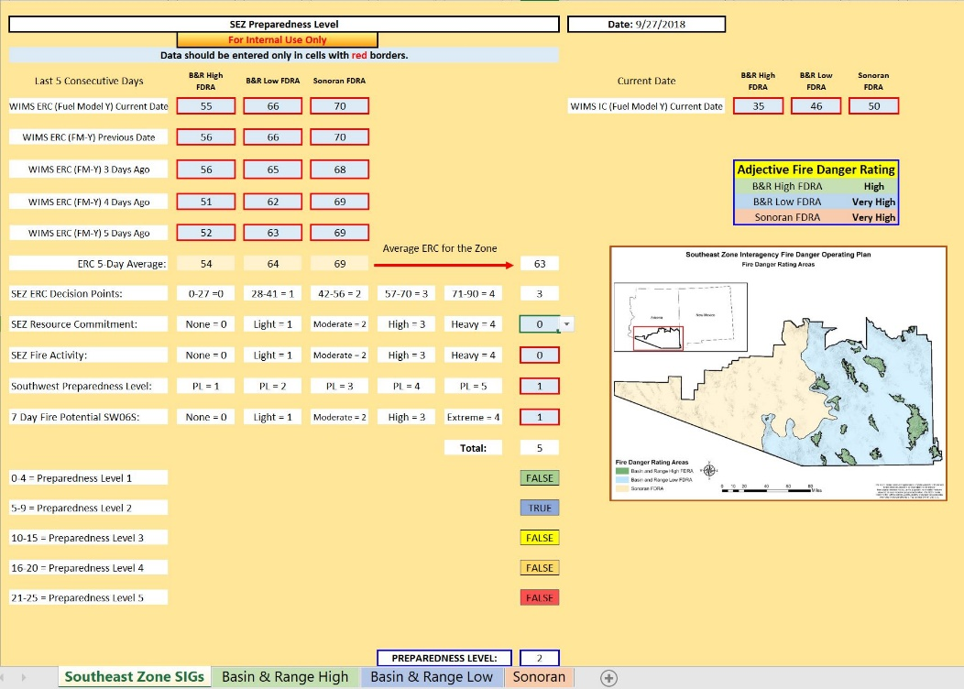
Preparedness Levels
The SEZ uses an MSExcel worksheet to help determine the PL for the Zone.
Guidance for using the worksheet is in the SEZ Interagency FDOP.
Tucson Dispatch personnel posts the daily PL for the Zone on the TDC website.
Notes:
Slide # 21
This example displays the proposed DRAFT Southeast Zone FDOP using fuel model Y. Directions for using the spreadsheet are described in the draft FDOP.
Ask participants how their Zone determines their preparedness level.
What is the value of determining the preparedness level for the zone?

Slide 22
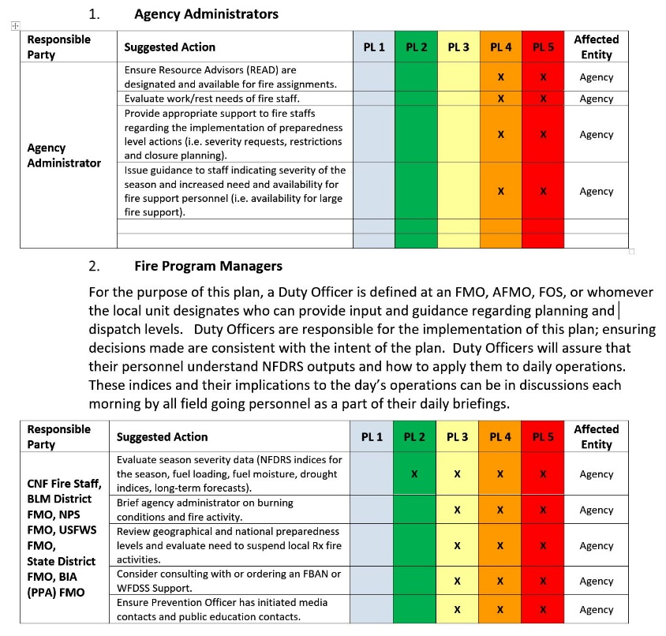
Preparedness Levels
Several procedures and guidelines are to be followed once the preparedness level has been determined.
Procedures and guidelines have been developed for:
Agency Administrators
Fire Program Managers
Duty Officers
Tucson Dispatch Center
Prevention Specialists
National Weather Service - Tucson
Notes:
Slide # 22
Each preparedness level has recommended guidelines/procedures for Agency Administrators, Fire Program Managers, Duty Officers, Dispatch Center, Prevention Specialists, etc.
Ask participants whether they have similar preparedness level guidelines or procedures defined for their zones.
Do they follow their guidelines/procedures?
What is the value of having guidelines and procedures for identified personnel at the various preparedness levels?

Slide 23
Dispatch Centers
Tucson Dispatch Center (TDC) is a significant partner in the use and timely dissemination of NFDRS information for the SEZ.
TDC personnel provides NFDRS information for the SEZ on a daily basis:
Preparedness Level
Adjective Rating
Staffing Level
Response Level
Critical fire weather situations (i.e. Red Flag Warning)
TDC and Fire staff work with the NWS Tucson office personnel during periods of elevated fire danger and provide critical information to the local units.
Notes:
Slide # 23
Tucson Dispatch Center is a significant partner in the use and timely dissemination of NFDRS information for the SEZ.
Ask participants whether they understand the important role dispatch centers play in the daily summarizing and dissemination of NFDRS information.
Ask participants how their respective dispatch centers determine these ratings?
Do participants understand the role dispatch centers play in maintaining RAWS stations?
How may poor RAWS station maintenance affect NFDRS outputs?

Slide 24
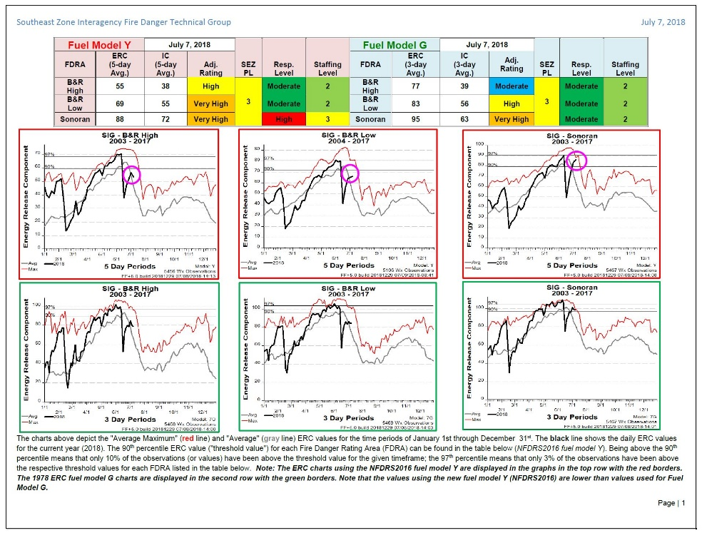
Seasonal Local Unit Tracking
FMO’s utilize NFDRS information provided through week seasonal tracking reports to inform:
Agency Administrators
Local Units
Severity Resources
Agency Partners
These weekly reports are especially useful as the Zone approaches peak fire season.
NFDRS information is also used to raise situational awareness and emphasize firefighter and public safety.
Notes:
Slide # 24
The intent is to provide accurate NFDRS information to maintain current level of awareness with regard to fire danger information within the SEZ.
This information is used by fire managers and the Tucson Dispatch Center to inform agency administrators and local unit personnel on trending fire danger conditions within each of the three FDRA’s within the zone.
The National Weather Service (NWS), Tucson Office also uses this information to assist them in producing a weekly Southeast Arizona Fire Weather Outlook.
The weekly NFDRS report in combination with the weekly NWS forecast informs both fire managers and agency administrators on current fire danger and fire weather conditions which can assist management in the decision-making process.
Ask participants if their zone conducts seasonal NFDRS tracking.
What is the value in tracking seasonal NFDRS information?

Slide 25
Summary
The FDOP, based on NFDRS information, has provided SEZ fire program managers with decision support tools to help inform agency partners, the public, and industrial cooperators with current information on fire danger conditions within the zone.
NFDRS information is included in daily fire preparedness briefings as well as agency management briefings to help provide management direction based on fire danger, fire activity, and resource commitment and availability.
Most importantly, NFDRS information is used to help maintain a high level of safety awareness for suppression personnel.
Notes:
Slide # 25
Conclusion or Summary:
It is important to bring closure to the presentation; however, this doesn’t mean all of the questions need to be answered.
Provide a short synopsis of the case to reiterate the main issues, or even to raise new questions.
Despite any personal emotion or bias, end the presentation neutrally.
Don’t provide any analysis, or “lessons learned” in the case.
Let students decide about the merits of any particular argument based on their understanding of the facts provided in the case.

Slide 26
Review Objectives
Demonstrate the importance of adhering to the recommended “best practices” as discussed in Lesson 3.
Relate a local view of the interagency planning and implementation of a fire danger operating plan.
List several fire management decisions based on NFDRS outputs.
Discuss the Southeast Zone (SEZ) Fire Danger Operating Plan (FDOP) connection between local fire occurrence issues and decisions based on fire danger products.
Notes:
Slide # 26

Slide 27

.
Notes:
Slide # 27
Questions?

