Slide 1
Using Fire Danger Products to Manage Readiness, Risk, and Response Decisions
Lesson #2
Notes:
Slide # 1
Lesson #: 2 – Using Fire Danger Products to Manage Readiness, Risk, and Response Decisions
Lesson Time: 45 minutes (immediately followed by Lesson #3)
Facilitator Notes:
Don’t forget to fill in the “Workshop Dates” and “Workshop Location” on the bottom right of this title slide.

Slide 2
Objectives
Understand basic principles of decision-making and risk.
Provide examples of how the fire danger management tools can optimize the potential outcome of a decision by minimizing the associated risk.
Describe how the fire danger management tools support risk management.
Notes:
Slide # 2
Lesson Objectives:
Understand basic principles of decision-making and risk.
We’ve all have our own perception of “risk” as it relates to making decisions. However, it’s important that we have some common understanding of the challenges we face to make safe, effective, efficient risk-based wildfire management decisions.
Provide examples of how the fire danger management tools can optimize the potential outcome of a decision by minimizing the associated risk.
We will discuss several examples where NFDRS can be incorporated as a fire management decision-support tool to hedge the risk in our favor.
Describe how the fire danger management tools support risk management.
We will discuss how NFDRS is a viable management and operational decision-support tool intended to mitigate risk.

Slide 3

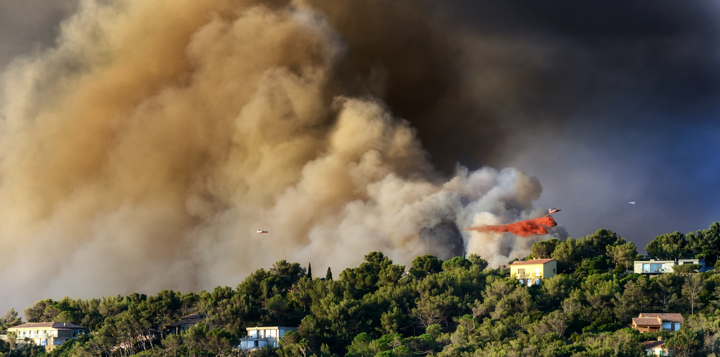
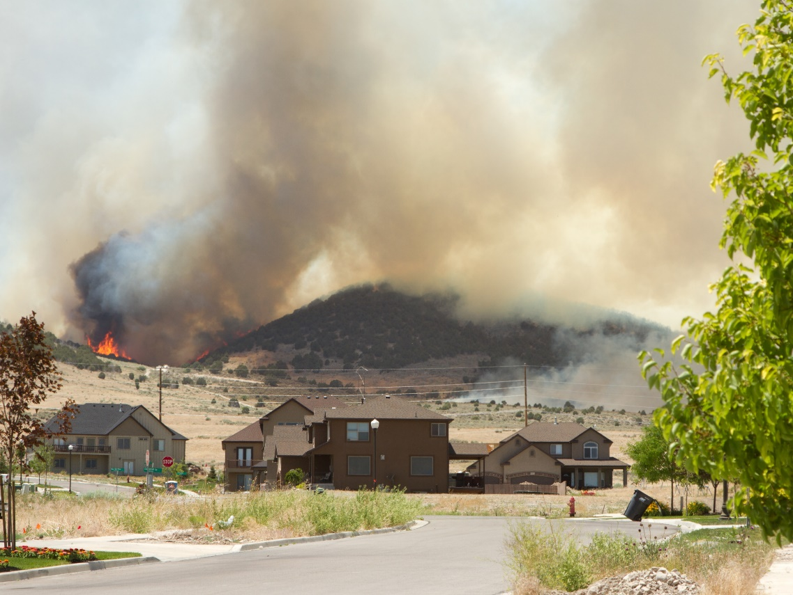
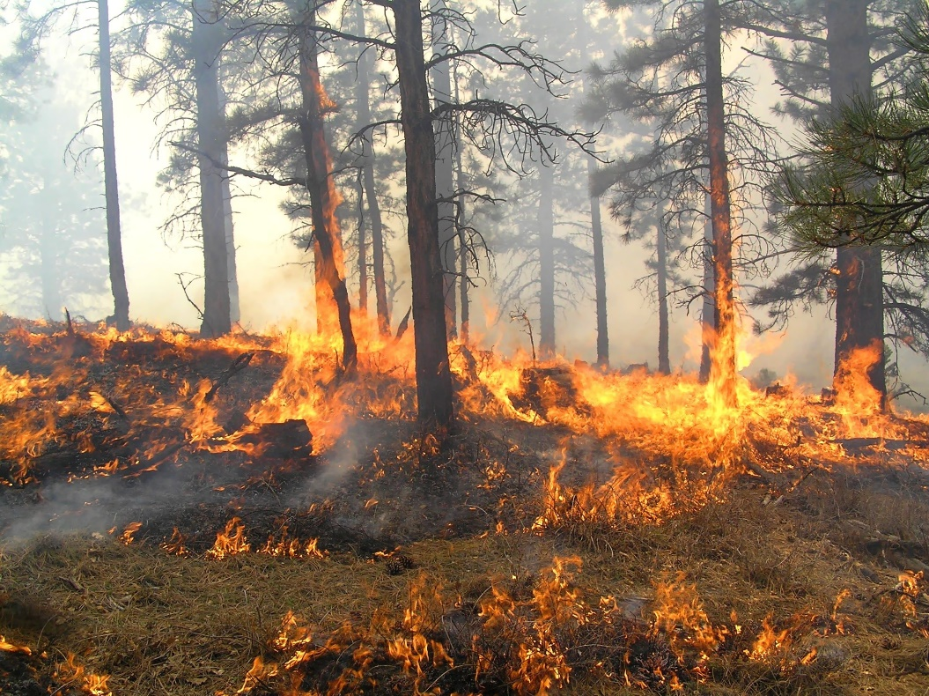
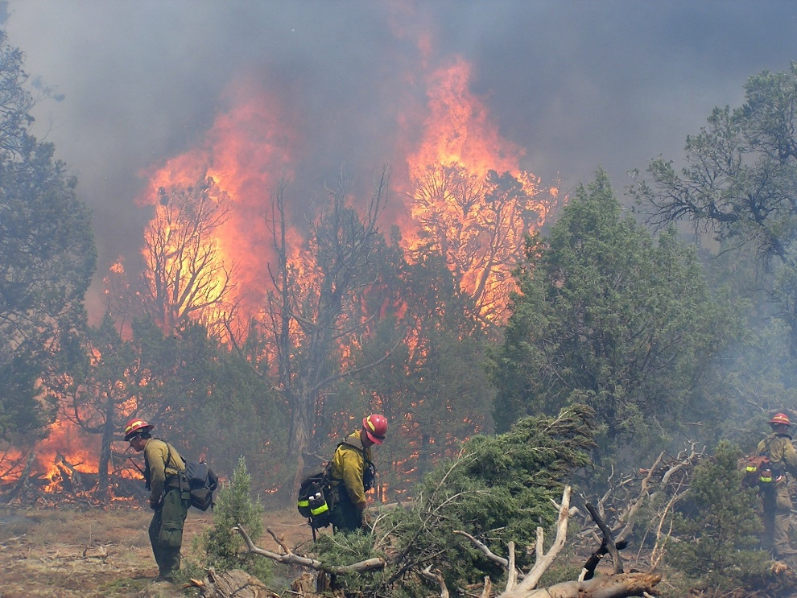
Managing the Land
People
Protecting Communities
Notes:
Slide # 3
Animated Slide
What influences our decisions?
It really boils down to three primary values which affect our decisions:
Protecting communities
Wildland fire is dynamic and respects no jurisdictional boundaries. No one agency can manage and respond to all wildland fire threats. In order to protect our cities, towns and villages, we must work together across all levels of our organizations to respond to wildfire ignitions. Utilizing NFDRS to implement informed decisions in responding to wildland fire enables us to be more effective in our response and leverage resources with our partners.
Long term gains can be made in reducing wildfire risk to communities. One part of reducing long term risk is allowing good fire to reduce hazardous fuels and help create a resilient landscape.
Managing the land
Fulfilling objectives in land management plans calls for making mindful decisions on the time, place and environmental conditions to allow fire to move across the landscape. This will lead to restoring ecosystems while managing short term risk to communities and reducing long term risks.
People
Understanding fuel moisture and weather conditions enable firefighters to make strategic decisions on engaging the fire. A constant awareness if your window is opening or closing as the day and season progress will allow firefighters to make mindful decisions on the fire line.

Slide 4

NFDRS as a Decision-support Tool
Notes:
Slide # 4
What Factors Influence our Fire Management Decisions? –
Discussion

Slide 5
Recalling Lessons Learned about Fire Danger
What have we experienced?
What have we learned from these tragedy fires:
Mann Gulch
South Canyon
Thirty-Mile
Cramer
Yarnell
Notes:
Slide # 5
ANIMATED – no clicks are necessary until ready to advance to the next slide.
What have we experienced in the past 60 years with respect to Fire Danger. Specifically, what tragedy fires have we taught us lessons about Fire Danger?
We will review some tragedy fires:
Mann Gulch
South Canyon
Thirty-Mile
Cramer
Yarnell
As we refresh our memories about the following tragedy fires, ask yourselves these two questions:
With respect to the decision-making cycle, do you think fire danger was a consideration at any level?
where can fire danger influence your decision making?”

Slide 6

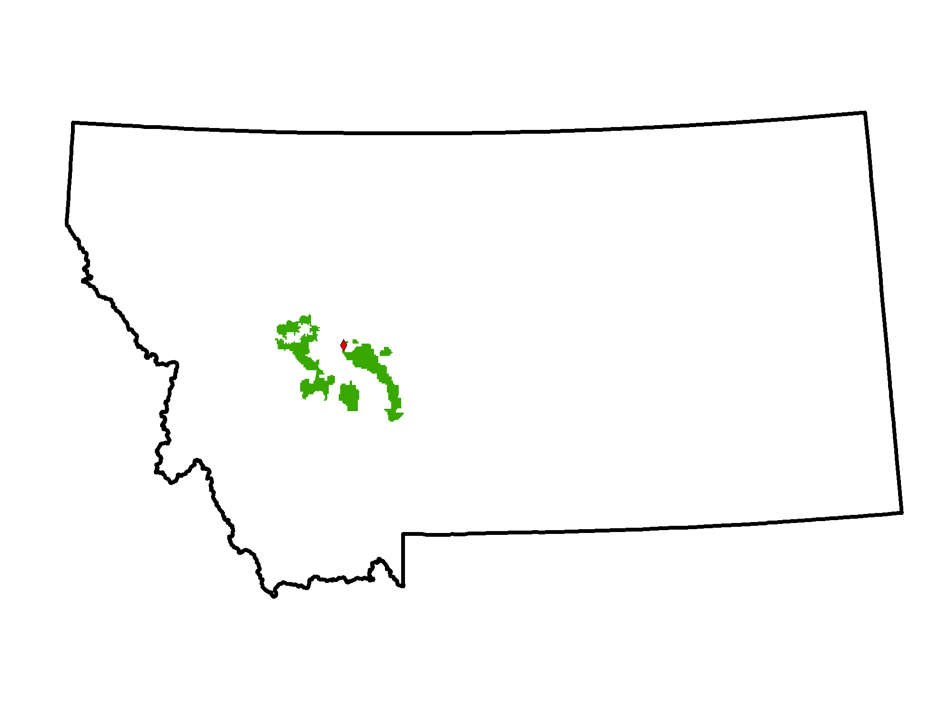
Conditions on
August 5, 1949
Montana
Helena National Forest
Gates of the Mountains Wilderness
High Temp (97° F)
20 – 30 mph winds with gusts to 40 mph
Fine dead fuel moisture at 3-4%
Notes:
Slide # 6
Mann Gulch Fire (13 Fatalities)
August 5, 1949
BACKGROUND INFORMATION:
Reference: GTR INT-299 Mann Gulch Fire: A Race That Couldn’t Be Won
Temperatures that day reached 97° F in Helena (Mann Gulch was 20 miles north of Helena)
In Helena, the wind had been blowing from the north and east at 6 to 8 mi/h that afternoon. At 3:30 p.m. the wind switched to the south, increased to 24 mi/h, and continued to blow strongly from the south at 14 to 22 mi/h.
At about 5 p.m. Canyon Ferry District Ranger Robert Jansson had reached the mouth of Mann Gulch by boat and was attempting to walk up the gulch to reach the smokejumpers. He estimated the wind at Mann Gulch to be between 20 and 30 mi/h with gusts to 40 mi/h.
The moisture content of fine dead fuels during the hottest part of the day was calculated from the temperature and humidity to have been about 3.5 percent.

Slide 7
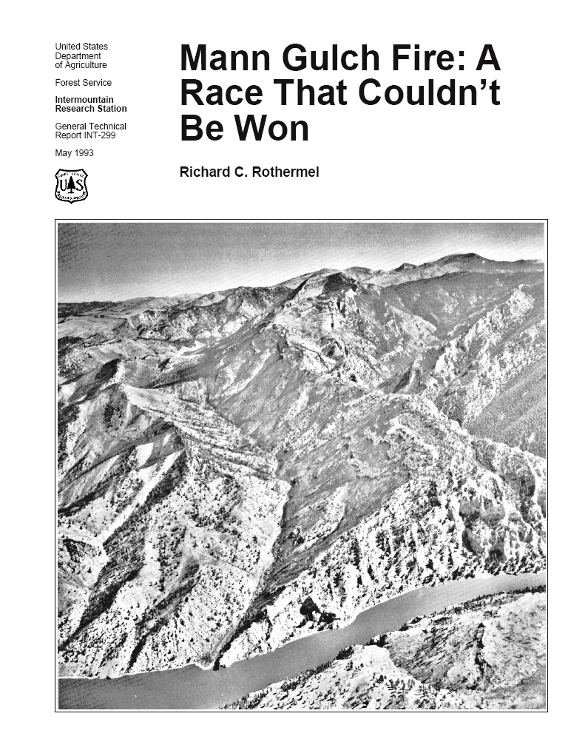
Action Items
“. . . intensify efforts in the study of fire behavior. . .“
“. . . furnish more dependable basis for anticipating and predicting blow-ups . . . “
Mann Gulch(1949)
13 Fatalities
Notes:
Slide # 7
Mann Gulch Fire (13 Fatalities)
August 4, 1949
BACKGROUND INFORMATION:
Recommended Action Items were taken from the Report of Board of Review, Mann Gulch Fire, Helena National Forest, Missoula, MT, Sept 29, 1949.
“. . . intensify efforts in the study of fire behavior . . . “
“. . . furnish more dependable basis for anticipating and predicting blow-ups . . . “
On November 9, 1949, a Forest Service fire researcher, Harry Gisborne, became Mann Gulch's 14th victim when he suffered a fatal heart attack while researching fire behavior in the gulch.

Slide 8
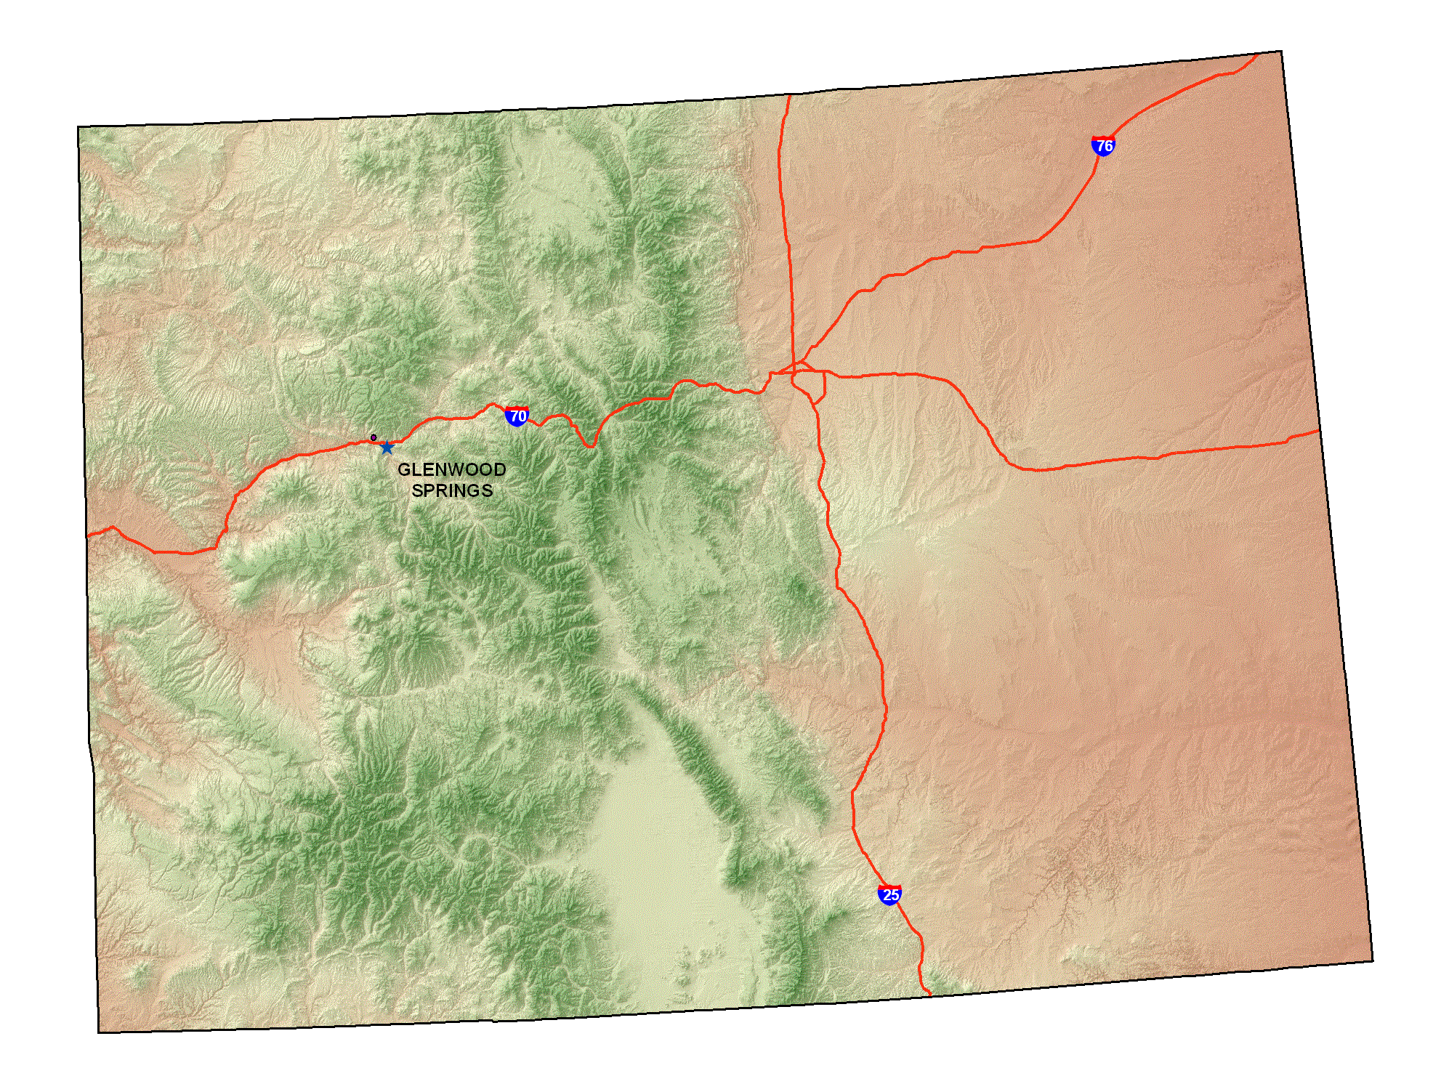

Conditions on
July 6, 1994
Colorado
BLM Grand Junction District
South Canyon
  Severe drought
  Precipitation: Less Than 60% Of Normal
  Live FM: Less Than 125%
  Temperature: Record High
  BI: Record High
Notes:
Slide # 8
South Canyon Fire (14 Fatalities)
July 6, 1994
BACKGROUND INFORMATION:
On July 6, 1994, the South Canyon Fire resulted in the deaths of 14 firefighters in Colorado. Following issuance of the South Canyon Investigation Report (1994), the Director of the Bureau of Land Management and the Chief of the Forest Service established an Interagency Management Review Team (IMRT). Among the team’s tasks was to identify significant issues and concerns related to interagency wildland fire management programs and recommend ways to address these issues and concerns. The recommendations in the IMRT report included application of NFDRS to “improve the way agencies predict fire danger by making the danger rating systems more understandable and easier to use, and then train people in how to use these systems and interpret the results.”
Conditions when the fire started:
Western Colorado was experiencing severe drought; Precipitation levels at Glenwood Springs from October 1, 1993, through July 6, 1994, were 58 percent of normal.
Foliar moisture in under-burned Gambel oak was about 60 percent while that in green unburned Gambel oak was 125 percent.
Colorado experienced record high temperatures during June of 1994.
The burning index in early July was at the highest level ever recorded for those days in the 21 years of weather records at the Colorado National Monument.

Slide 9
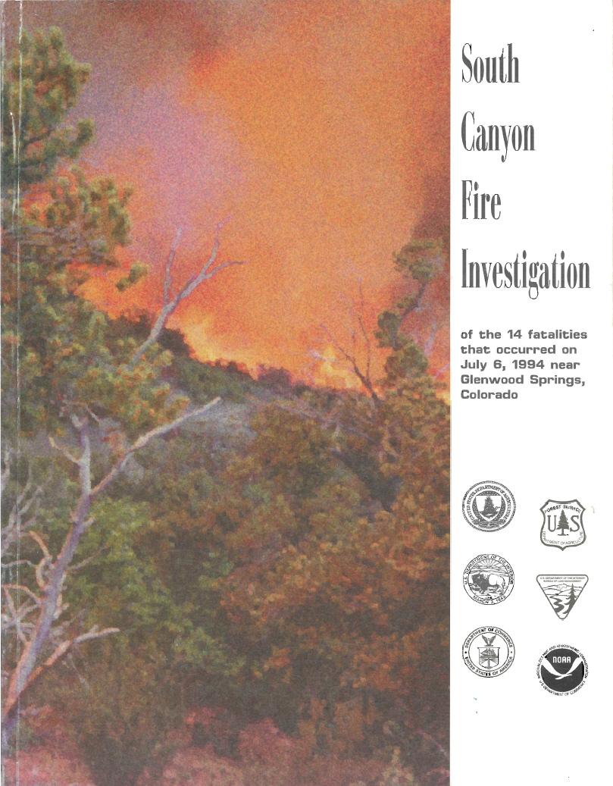
Action Items
South Canyon (1994)
14 Fatalities
Improve fire danger prediction
Make fire danger understandable and easier to use
Train people how to use these systems and interpret the results
Notes:
Slide # 9
South Canyon Fire (14 Fatalities)
July 6, 1994
BACKGROUND INFORMATION:
On July 6, 1994, the South Canyon Fire resulted in the deaths of 14 firefighters in Colorado. Following issuance of the South Canyon Investigation Report (1994), the Director of the Bureau of Land Management and the Chief of the Forest Service established an Interagency Management Review Team (IMRT). Among the team’s tasks was to identify significant issues and concerns related to interagency wildland fire management programs and recommend ways to address these issues and concerns. The recommendations in the IMRT report included application of NFDRS to “improve the way agencies predict fire danger by making the danger rating systems more understandable and easier to use, and then train people in how to use these systems and interpret the results.”
Conditions when the fire started:
Western Colorado was experiencing severe drought; Precipitation levels at Glenwood Springs from October 1, 1993, through July 6, 1994, were 58 percent of normal.
Foliar moisture in under-burned Gambel oak was about 60 percent while that in green unburned Gambel oak was 125 percent.
Colorado experienced record high temperatures during June of 1994.
The burning index in early July was at the highest level ever recorded for those days in the 21 years of weather records at the Colorado National Monument.

Slide 10
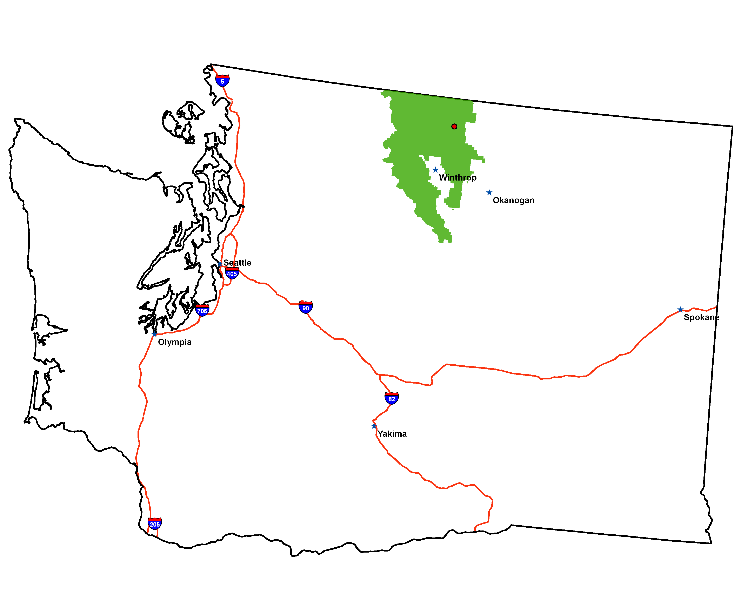
Conditions on
July 10, 2001
Washington
Okanogan-Wenatchee N.F.
Chewuch River Drainage
  Prolonged drought
  Historic low Dead FM
  1,000-hour FM at 10%
  Live FM less than 100%
  ERC near the historic high
Notes:
Slide # 10
Thirtymile Fire (4 Fatalities, 16 Entrapments)
July 10, 2001
BACKGROUND INFORMATION:
On July 10, 2001, four firefighters lost their lives on the Thirtymile Fire in Washington. The Thirtymile tragedy prompted an Accident Prevention Plan which contained specific actions to enhance firefighter safety, including the need to identify thresholds for critical fuels and weather conditions that lead to extreme burning conditions and publishing these on pocket cards for use by firefighters.
Conditions when the fire started:
The Okanogan-Wenatchee National Forest was experiencing prolonged drought
Fuel moisture levels were at or approaching historic lows
1,000-hour fuel moisture was 10%
Live fuel moisture was less than 100%
The energy release component (ERC) was near the historic high for early July

Slide 11
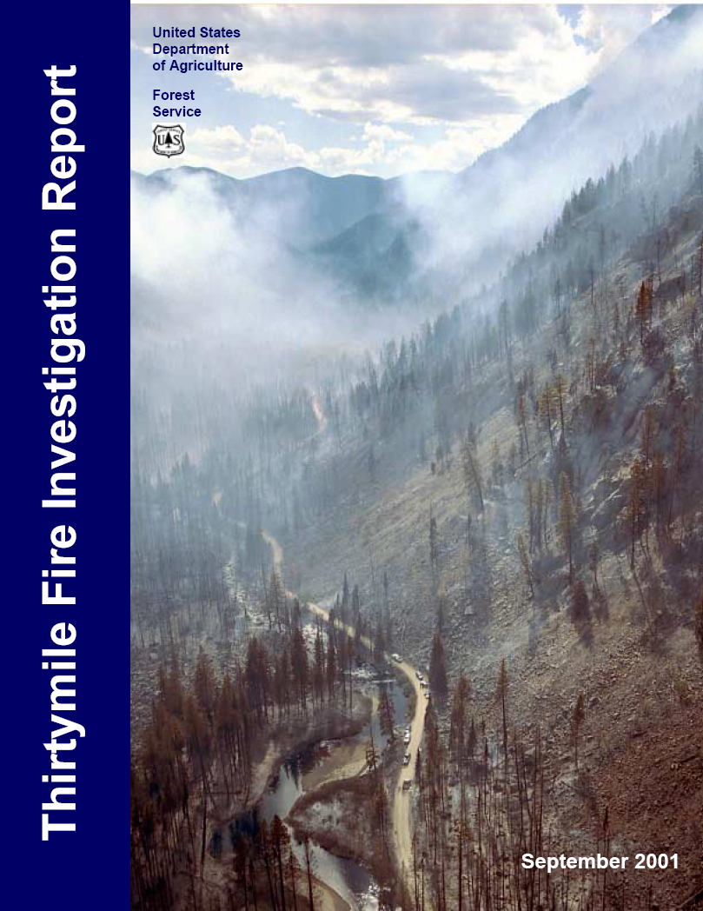
Action Items
Thirtymile (2001)
4 Fatalities
16 Entrapments
Need to identify fire danger thresholds
Convey fire danger indices and their meaning to firefighters (e.g. PocketCards)
Notes:
Slide # 11
Thirtymile Fire (4 Fatalities, 16 Entrapments)
July 10, 2001
BACKGROUND INFORMATION:
On July 10, 2001, four firefighters lost their lives on the Thirtymile Fire in Washington. The Thirtymile tragedy prompted an Accident Prevention Plan which contained specific actions to enhance firefighter safety, including the need to identify thresholds for critical fuels and weather conditions that lead to extreme burning conditions and publishing these on pocket cards for use by firefighters.
Conditions when the fire started:
The Okanogan-Wenatchee National Forest was experiencing prolonged drought
Fuel moisture levels were at or approaching historic lows
1,000-hour fuel moisture was 10%
Live fuel moisture was less than 100%
The energy release component (ERC) was near the historic high for early July

Slide 12
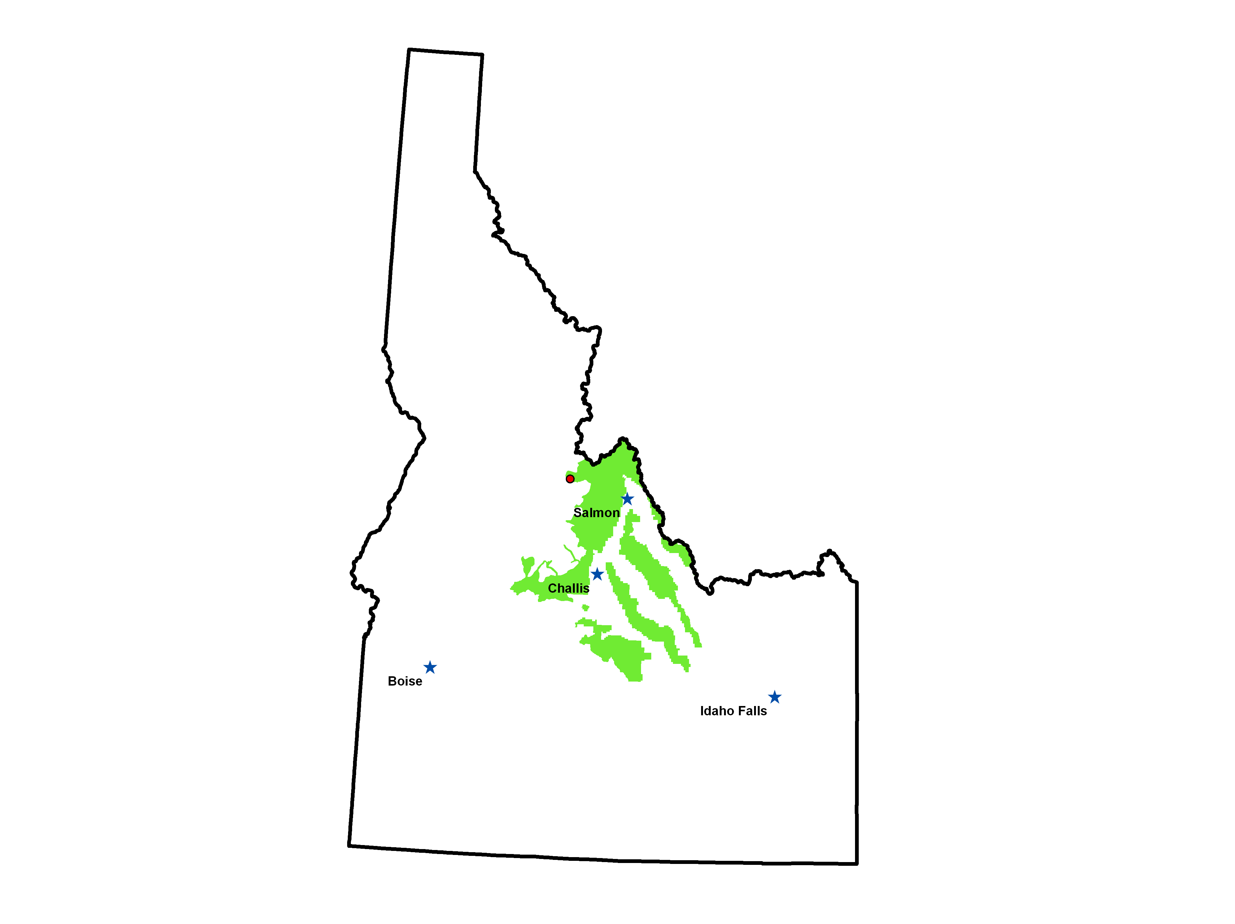
Conditions on
July 22, 2003
Idaho
Salmon-Challis National Forest
Salmon River Drainage
  Prolonged drought
  Temp near 100°F
  RH at 10-12%
  Extreme BI and ERC
  Pocket Card indicated conditions similar to the Clear Creek Fire in 2000 that burned 217,000 acres
Notes:
Slide # 12
Cramer Fire (2 Fatalities)
July 22, 2003
BACKGROUND INFORMATION:
The action items listed on the slide were taken from the Accident Review Board Action Plan, Cramer Fire, Region 4, North Fork Ranger District, Salmon-Challis National Forest, July 22, 2003
On July 22, 2003, two firefighters lost their lives in the Cramer Fire in central Idaho. OSHA levied serious violations which included the failure to recognize fire danger thresholds for large fires and respond accordingly. In addition, a remote automated weather station (RAWS) near the fire had not received maintenance and calibration before the start of the fire season.
NFDRS weather stations must comply with the NWCG standards identified in the Interagency Wildland Fire Weather Station Standards and Guidelines (PMS 426-3). A program of annual (+/- 45 days from installation or previous year’s maintenance date) RAWS maintenance/calibration is required. Every NFDRS RAWS must receive, at a minimum, one annual onsite maintenance visit by either the local user or contracted personnel to ensure sensors are within calibration standards, and verify site and station conditions.
Conditions when the fire started:
The Skull Gulch RAWS site is the most representative of the Cramer Fire area, but weather data from this site was inaccurate and unusable due to a temperature and relative humidity sensor that was not functioning properly as well as other weather data being reported erroneously.
The BIs and ERCs were near the high-end — the Forest BI was well above the 90th percentile and the ERC was at the 96th percentile-indicating dangerous conditions.
The burning index (BI), energy release components (ERC), and percent live fuel moisture were all comparable to the severe levels experienced during the 1988 Yellowstone Fires as well as the 2000 Clear Creek Fire in the Salmon-Challis Forest which made a 23,000 acre run in one day.
A crew on the Cramer Fire had reviewed their Pocket Cards a few days prior to the Cramer Fire and recognized that they were at conditions comparable to those on the Clear Creek Fire in 2000 that burned 217,000 acres

Slide 13
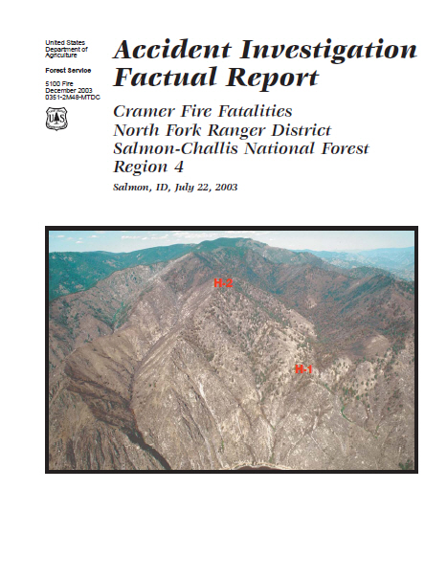
Action Items
Recognize fire danger thresholds and respond accordingly
Annual RAWS maintenance
Cramer (2003)
2 Fatalities
Notes:
Slide # 13
Cramer Fire (2 Fatalities)
July 22, 2003
BACKGROUND INFORMATION:
The action items listed on the slide were taken from the Accident Review Board Action Plan, Cramer Fire, Region 4, North Fork Ranger District, Salmon-Challis National Forest, July 22, 2003
On July 22, 2003, two firefighters lost their lives in the Cramer Fire in central Idaho. OSHA levied serious violations which included the failure to recognize fire danger thresholds for large fires and respond accordingly. In addition, a remote automated weather station (RAWS) near the fire had not received maintenance and calibration before the start of the fire season.
NFDRS weather stations must comply with the NWCG standards identified in the Interagency Wildland Fire Weather Station Standards and Guidelines (PMS 426-3). A program of annual (+/- 45 days from installation or previous year’s maintenance date) RAWS maintenance/calibration is required. Every NFDRS RAWS must receive, at a minimum, one annual onsite maintenance visit by either the local user or contracted personnel to ensure sensors are within calibration standards, and verify site and station conditions.
Conditions when the fire started:
The Skull Gulch RAWS site is the most representative of the Cramer Fire area, but weather data from this site was inaccurate and unusable due to a temperature and relative humidity sensor that was not functioning properly as well as other weather data being reported erroneously.
The BIs and ERCs were near the high-end — the Forest BI was well above the 90th percentile and the ERC was at the 96th percentile-indicating dangerous conditions.
The burning index (BI), energy release components (ERC), and percent live fuel moisture were all comparable to the severe levels experienced during the 1988 Yellowstone Fires as well as the 2000 Clear Creek Fire in the Salmon-Challis Forest which made a 23,000 acre run in one day.
A crew on the Cramer Fire had reviewed their Pocket Cards a few days prior to the Cramer Fire and recognized that they were at conditions comparable to those on the Clear Creek Fire in 2000 that burned 217,000 acres

Slide 14
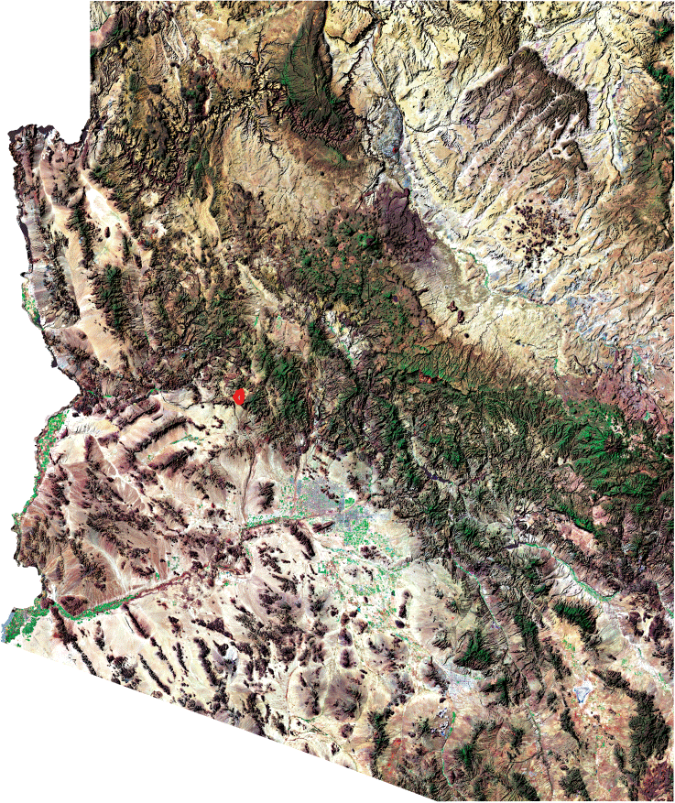
Conditions on
June 30, 2013
Arizona
Arizona State Lands
Yarnell Hill
  Extreme drought
  Below normal live fuel moisture (Ceanothus less than 60%)
  ERC above the 90th percentile
Notes:
Slide # 14
Yarnell Hill Fire (19 Fatalities), June 30, 2013
BACKGROUND INFORMATION:
Nineteen firefighters died on the Yarnell Hill Fire in central Arizona on June 30, 2013 after deploying fire shelters. They were members of the Granite Mountain Interagency Hotshot Crew (IHC), hosted by the Prescott Fire Department.
Conditions leading up to the Yarnell Hill Fire consisted of very high to extreme fire danger and extreme drought during a transition to the Southwest’s summer monsoon season. During this seasonal transition, temperatures are typically very hot. Relative humidity values remain low but fluctuate as storms become more numerous and cloud cover more prevalent. Winds are highly variable with the highest wind speeds occurring during thunderstorms. These storms can generate strong downdrafts, micro-bursts, outflows, and gust fronts, all of which can affect fire behavior.
The Southwest Coordination Center’s Predictive Services issued a Fire Behavior Advisory on June 16, 2013 that discussed critically low fuel moistures and increased fuel loading. On June 25, the National Weather Service (NWS) office in Flagstaff issued an excessive heat watch for Yavapai and northern Gila counties below 4000 feet.

Slide 15
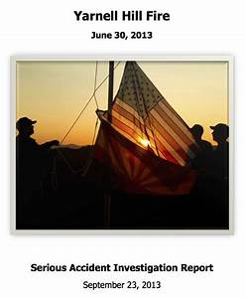

Action Items
Yarnell (2013)
19 Fatalities
Notes:
Slide # 15
Yarnell Hill Fire (19 Fatalities), June 30, 2013
BACKGROUND INFORMATION:
Nineteen firefighters died on the Yarnell Hill Fire in central Arizona on June 30, 2013 after deploying fire shelters. They were members of the Granite Mountain Interagency Hotshot Crew (IHC), hosted by the Prescott Fire Department.
Conditions leading up to the Yarnell Hill Fire consisted of very high to extreme fire danger and extreme drought during a transition to the Southwest’s summer monsoon season. During this seasonal transition, temperatures are typically very hot. Relative humidity values remain low but fluctuate as storms become more numerous and cloud cover more prevalent. Winds are highly variable with the highest wind speeds occurring during thunderstorms. These storms can generate strong downdrafts, micro-bursts, outflows, and gust fronts, all of which can affect fire behavior.
The Southwest Coordination Center’s Predictive Services issued a Fire Behavior Advisory on June 16, 2013 that discussed critically low fuel moistures and increased fuel loading. On June 25, the National Weather Service (NWS) office in Flagstaff issued an excessive heat watch for Yavapai and northern Gila counties below 4000 feet.

Slide 16
Decisions: Conscious or Subconscious?
Humans make around 35,000 decisions a day
  A few decisions are deliberate
  Vast majority of decisions are subconscious
Notes:
Slide # 16
Decisions: Conscious or Subconscious?
Many, if not the majority, of these everyday decisions are made subconsciously. Some estimate that while humans make up to 35,000 decisions a day, some decisions are deliberate and thoughtful, but the vast majority are made at varying levels of sub-consciousness.

Slide 17

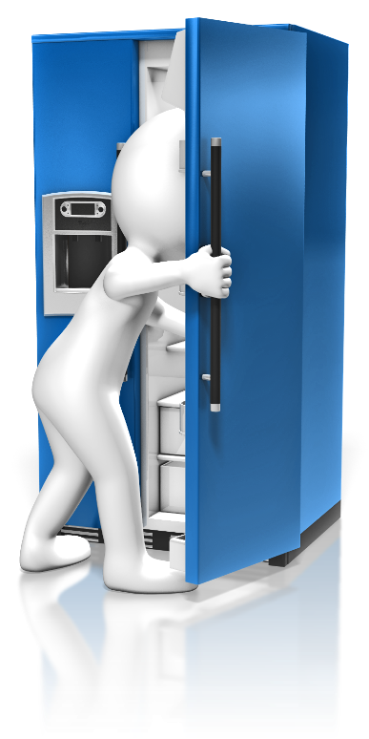
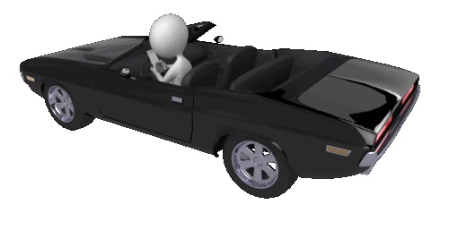
Unconscious Decisions
Word Choices
Food Choices
Driving Decisions
16,000
words / day
221
choices / day
200
decisions / mile
Notes:
Words
University of Texas researchers found that we use an average of 16,000 words a day (Swaminathan, 2007). Most of these words are selected subconsciously (Mehl, Vazire, Ramírez-Esparza, Slatcher, & Pennebaker, 2007).
Driving
The U.S. Occupational Safety and Health Administration (OSHA) reports that “drivers make more than 200 decisions during every mile traveled,” so simply driving 20 miles a day (4000 decisions / day) adds considerably to the number of decisions made each day (OSHA, 2016).
Food
Researchers found that adults make 221 decisions just on their food intake each day, and concluded, “First, we are aware of only a fraction of the food decisions we make. Second, we are either unaware of how our environment influences these decisions or we are unwilling to acknowledge it.” (Wansink & Sobal, 2007).
The sum of just these three activities is over 20,221 decisions each day. Decisions about physical movement, work, social relations, all add to this number, making Daum’s estimate of 35,000 decisions a day conceivable.

Slide 18

Decision-Making Cycle
Perception
Recognition
Option Selection
Decision Point
Action
Change
Assess Outcome
Notes:
Slide # 18
ANIMATED SLIDE (This slide may require extra time, depending upon the discussion)
DECISION-MAKING CYCLE:
We don’t have many answers or mitigation measures from the Yarnell Fire investigation reports; however, we have many questions.
Knowing that the Yarnell Hill Fire escalated rapidly during the course of the day on June 30th, who were the decision-makers (by function, not by name) affecting the outcome(s) at the incident?
Did all of these decision-makers (at every level) have a good sense of the fire potential at Yarnell Hill to make an informed decision?
When we consider the people who are in the decision-making chain, we can break down the categories this way: Real-time, Operational, Strategic
CLICK #1 => (1) Real-time
Who were the real-time decision-makers on the Yarnell Hill Fire?
Possible answers include –
Granite Mountain IHC (Follow-up: 1 unified decision or 19 individual decisions??)
Division Supervisor
CLICK #2 => (2) Operational
Who were the operational decision-makers on the Yarnell Hill Fire?
Possible answers include –
Incident Commander
Operations Section Chief, Air Attack
Dispatcher
CLICK #3 => (3) Strategic
Who were the strategic decision-makers on the Yarnell Hill Fire?
Possible answers include –
Fire Management Officer / Duty Officer
Agency Administrator
GACC
National Weather Service
Consider these questions (rhetorically) as they relate to the components of the Decision-Making Cycle:
CLICK #4 => PERCEPTION:
(Recall, if one’s situation awareness is high, he or she has an accurate perception of reality.
How well perception matches reality is called Situational Awareness)
Real-time
Did everyone on the crew have an accurate perception of the day’s fire danger?
Operational
What was the operational perspective of the local fire management staff and Incident Management Organization?
Did the local unit have a systemic process to communicate relative fire danger for the day?
Strategic
What was the Geographic Area Preparedness Level on June 30th (It was a PL4)
What was the National Preparedness Level on June 30th? (It was a PL3)
CLICK #5 => RECOGNITION:
(Recognition means that a person determines that something needs to be done, that the environment must be changed in some way. )
Real-time
Who recognized that something wasn’t right? Was something said? If so, did it change a course of action?
Operational
Was the suppression response adequate for the fire danger condition?
Strategic
Were systemic systems in place to account for different levels of fire danger to provide an effective initial attack response?
CLICK #6 => OPTION SELECTION
(Option Selection involves understanding the factors and risks associated with various courses of action.)
Real-time:
As the fire intensity and complexity increased, the overall tempo of the incident was escalating. Did that effect the ability of real-time decision-makers to select the best option?
When the crew was faced with the option to leave their safety zone (or stay), was fire danger an important factor in the decision?
Operational:
Strategic:
CLICK #7 => DECISION POINT
(At the Decision Point, the best option is selected.)
With respect to fire danger, what initial response/attack options were identified and discussed with suppression resources, dispatch, and duty officer/fire managers?
Did suppression resources, dispatch, and duty officers/fire managers understand why the preferred course of action was decided on?
What fire danger information might have influenced the crew’s decision on June 30th ?
Were options – other than the option selected – identified?
CLICK #8 => ACTION
(Action means acting on the selected option then returning to the situation awareness cycle—perceiving and gathering information— to assess the results of the action.)
Were the initial attack actions based on an identified, preferred option that encouraged a persistent assessment of situational awareness?
Did selected action(s) consider the complexities associated with a changing fire danger environment (i.e. consider changes in various weather and fuels factors as the day progresses from early burn period to peak burn period).
Was fire danger associated with potential fire behavior considerations?
The action taken by the Granite Mountain Hotshots during the afternoon of June 30th ended with the deaths of 19 firefighters. Unfortunately, they didn’t have the opportunity to return to the situation awareness cycle—perceiving and gathering information. They didn’t get the chance to assess the outcome of their decisions.
Is there anything with respect to fire danger rating that might have influenced the decisions and subsequent course of action?
CLICK #9 => CHANGE
CLICK #10 => ASSESS OUTCOME
The outcome is assessed and modifications are made to the decision (as needed). Decision-makers do not simply terminate the decision process once an outcome is reached; they either consciously or (most often) sub-consciously learn from the process by associating the decision they selected with the outcome they experienced (positive or negative). These decision-making experiences become the “slides” we remember either consciously or (most often) sub-consciously when we encounter similar experiences in the future. The decision-making cycle repeats with our previous experiences (“slides”) affecting our perception and recognition of the situation.
Graphic Adapted From: Leading in the Wildland Fire Service (PMS 494-2), Prepared by National Wildfire Coordinating Group Training Working Team Leadership Committee

Slide 19
Organizational Decision Bias
ENTERPRISE
STRATEGIC
  NLT, Chief, Secretary, Congress NIFC / N-MAC
  Regional Fire Director, State FMO, GACC / Geo-MAC
OPERATIONAL
REAL-TIME
  Agency Administrator, Incident Commander
  Individual (Crew?)
Notes:
Slide # 19
The Influence of Decisions at Multiple Levels
Key Point:
A decision made at any level of the fire management organization can influence another decision at any other level. Enterprise and Strategic decision-makers must understand that their communication to ground-level fire suppression personnel (directly or indirectly) can influence their decisions either positively or negatively. The outcome of real-time decisions made at the ground-level has the potential to influence the decisions at higher levels.
Enterprise -
Decision-Makers: NLT, Chief, Secretary, Congress NIFC / N-MAC
Goal: Define mission and ensure doctrine, strategy and governance are aligned. ERM recognizes systemic nature of risks and adjusts policy / doctrine.
Tools: Policy, trust, FLAs, Life First, budget allocation
Strategic -
Decision-Makers: AA, GACC / Geo-MAC
Goal: Thorough analysis to enhance the certainty of meeting objectives over the life of a long-term project, season, or incident.
Tools: RM professionals, Environmental Assessments, WFDSS
Operational -
Decision-Makers: AA, IC with levels of approval
Goal: Project level RM with time taken to discuss and form comparative options based on given objectives. ORM is typically documented. Results are qualitative, quantitative, and relative.
Tools: JHA, RA matrix, ICS-215a
Real-time -
Decision-Makers: Individual / Crew vote, project leader, usually, no additional level of approval needed
Goal: Real-time decision-making. Cut tree? Retardant? Hike / Fly?
Tools: Safety rules, protocols, standards, RM guidelines

Slide 20
DECISION-MAKERS?
OPERATIONAL DECISIONS
OPS, ATGS, IC
Center Manager
Others?
REAL-TIME
IHC
DIVS
Others?
ENTERPRISE DECISIONS
Washington, National Office
NICC / Predictive Services
STRATEGIC DECISIONS
FMO, Duty Officer, AA
GACC / Predictive Services
Notes:
Slide # 20
ANIMATED SLIDE (This slide may require extra time, depending upon the discussion)
DECISION-MAKING CYCLE:
We don’t have many answers or mitigation measures from the Yarnell Fire investigation reports; however, we have many questions.
Knowing that the Yarnell Hill Fire escalated rapidly during the course of the day on June 30th, who were the decision-makers (by function, not by name) affecting the outcome(s) at the incident?
Did all of these decision-makers (at every level) have a good sense of the fire potential at Yarnell Hill to make an informed decision?
When we consider the people who are in the decision-making chain, we can break down the categories this way: Real-time, Operational, Strategic
CLICK #1 => (1) Real-time
Who were the real-time decision-makers on the Yarnell Hill Fire?
Possible answers include –
Granite Mountain IHC (Follow-up: 1 unified decision or 19 individual decisions??)
Division Supervisor
CLICK #2 => (2) Operational
Who were the operational decision-makers on the Yarnell Hill Fire?
Possible answers include –
Incident Commander
Operations Section Chief, Air Attack
Dispatcher
CLICK #3 => (3) Strategic
Who were the strategic decision-makers on the Yarnell Hill Fire?
Possible answers include –
Fire Management Officer / Duty Officer
Agency Administrator
GACC
National Weather Service
Consider these questions (rhetorically) as they relate to the components of the Decision-Making Cycle:
CLICK #4 => PERCEPTION:
(Recall, if one’s situation awareness is high, he or she has an accurate perception of reality.
How well perception matches reality is called Situational Awareness)
Real-time
Did everyone on the crew have an accurate perception of the day’s fire danger?
Operational
What was the operational perspective of the local fire management staff and Incident Management Organization?
Did the local unit have a systemic process to communicate relative fire danger for the day?
Strategic
What was the Geographic Area Preparedness Level on June 30th (It was a PL4)
What was the National Preparedness Level on June 30th? (It was a PL3)
CLICK #5 => RECOGNITION:
(Recognition means that a person determines that something needs to be done, that the environment must be changed in some way. )
Real-time
Who recognized that something wasn’t right? Was something said? If so, did it change a course of action?
Operational
Was the suppression response adequate for the fire danger condition?
Strategic
Were systemic systems in place to account for different levels of fire danger to provide an effective initial attack response?
CLICK #6 => OPTION SELECTION
(Option Selection involves understanding the factors and risks associated with various courses of action.)
Real-time:
As the fire intensity and complexity increased, the overall tempo of the incident was escalating. Did that effect the ability of real-time decision-makers to select the best option?
When the crew was faced with the option to leave their safety zone (or stay), was fire danger an important factor in the decision?
Operational:
Strategic:
CLICK #7 => DECISION POINT
(At the Decision Point, the best option is selected.)
With respect to fire danger, what initial response/attack options were identified and discussed with suppression resources, dispatch, and duty officer/fire managers?
Did suppression resources, dispatch, and duty officers/fire managers understand why the preferred course of action was decided on?
What fire danger information might have influenced the crew’s decision on June 30th ?
Were options – other than the option selected – identified?
CLICK #8 => ACTION
(Action means acting on the selected option then returning to the situation awareness cycle—perceiving and gathering information— to assess the results of the action.)
Were the initial attack actions based on an identified, preferred option that encouraged a persistent assessment of situational awareness?
Did selected action(s) consider the complexities associated with a changing fire danger environment (i.e. consider changes in various weather and fuels factors as the day progresses from early burn period to peak burn period).
Was fire danger associated with potential fire behavior considerations?
The action taken by the Granite Mountain Hotshots during the afternoon of June 30th ended with the deaths of 19 firefighters. Unfortunately, they didn’t have the opportunity to return to the situation awareness cycle—perceiving and gathering information. They didn’t get the chance to assess the outcome of their decisions.
Is there anything with respect to fire danger rating that might have influenced the decisions and subsequent course of action?
CLICK #9 => CHANGE
CLICK #10 => ASSESS OUTCOME
The outcome is assessed and modifications are made to the decision (as needed). Decision-makers do not simply terminate the decision process once an outcome is reached; they either consciously or (most often) sub-consciously learn from the process by associating the decision they selected with the outcome they experienced (positive or negative). These decision-making experiences become the “slides” we remember either consciously or (most often) sub-consciously when we encounter similar experiences in the future. The decision-making cycle repeats with our previous experiences (“slides”) affecting our perception and recognition of the situation.
Graphic Adapted From: Leading in the Wildland Fire Service (PMS 494-2), Prepared by National Wildfire Coordinating Group Training Working Team Leadership Committee

Slide 21

.
INFORMATION BIAS: The tendency to seek information even when it cannot affect action.
CONFIRMING EVIDENCE BIAS: The tendency to search for, interpret, focus on and remember information in a way that confirms one's preconceptions.
SUNK-COST BIAS: The tendency to stay with a decision because an investment of resources has already been incurred and cannot be recovered.
ANCHORING BIAS: The tendency to rely too heavily, or "anchor", on one trait or piece of information when making decisions (usually the first piece of information acquired on that subject).
OMISSION BIAS: The tendency to judge harmful actions (commissions) as worse, or less moral, than equally harmful inactions (omissions).
HINDSIGHT BIAS: Sometimes called the "I-knew-it-all-along" effect, the tendency to see past events as being predictable at the time those events happened.
OVERCONFIDENCE BIAS: Excessive confidence in one's own answers to questions.
FRAMING EFFECT: Drawing different conclusions from the same information, depending on how that information is presented.
EGOCENTRIC BIAS: Occurs when people claim more responsibility for themselves for the results of a joint action than an outside observer would credit them with.
STATUS QUO BIAS: The tendency to like things to stay relatively the same (see also loss aversion, endowment effect, and system justification).
AUTHORITY BIAS: The tendency to attribute greater accuracy to the opinion of an authority figure (unrelated to its content) and be more influenced by that opinion.
OPTIMISM BIAS: The tendency to be over-optimistic, overestimating favorable and pleasing outcomes
OUTCOME BIAS: The tendency to judge a decision by its eventual outcome instead of based on the quality of the decision at the time it was made.
FUNCTIONAL FIXEDNESS: Limits a person to using an object only in the way it is traditionally used.
Notes:
Slide # 21
Animated Slide
“Cognitive Bias” is important to understand as it relates to fire danger-based influencing effective decision-making.
A cognitive bias is a type of error in thinking that occurs when people are processing and interpreting information in the world around them. Cognitive biases are often a result of our brain’s attempt to simplify the processing of information. They are rules of thumb that help us make sense of the world and reach decisions with relative speed.
Search “Cognitive Bias” in Wikipedia will bring up over 100 different cognitive biases with associated links to each.

Slide 22
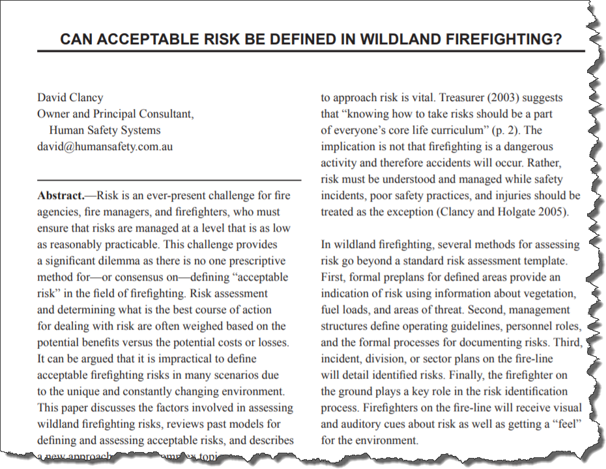
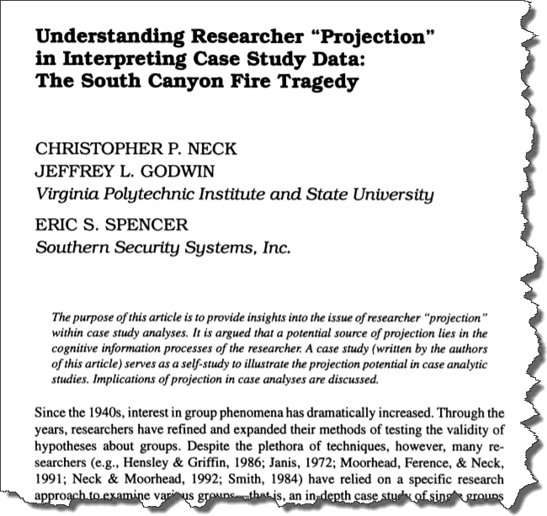

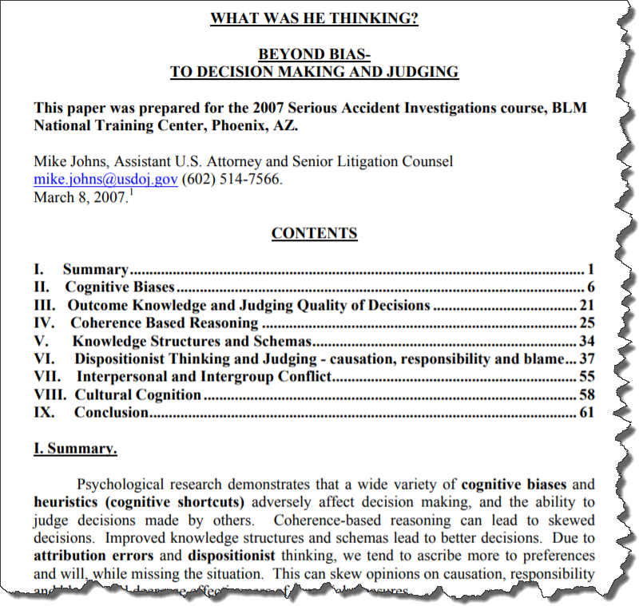
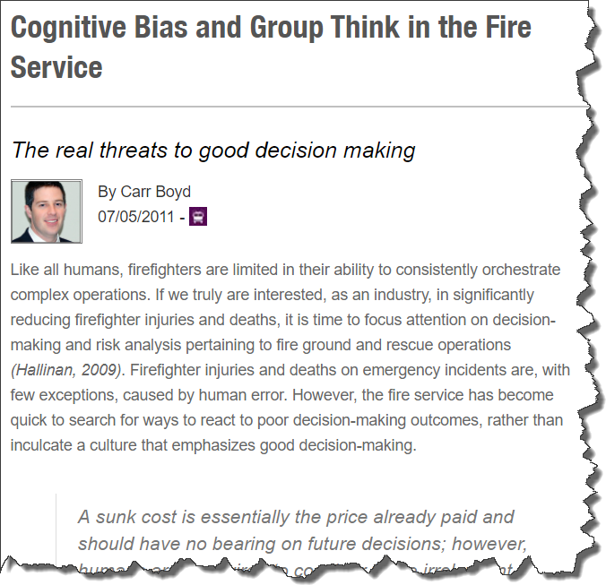
.
Notes:
Slide # 22
Animated Slide:
Human factors, specifically cognitive bias, has the potential to influence decision-making – especially during fast tempo, high stress situations where we rely more on cognitive “short-cuts”.
Further research in the topic is strongly encouraged.

Slide 23
We are Irrational Decision-Makers
Confirmation Bias is, perhaps, the mother of all biases. It’s our tendency to bury our heads in the sand and selectively interpret information that confirms our prior beliefs.
Notes:
Slide # 23
INTRODUCTION:
While we might all like to believe that we are rational and logical, the sad fact is that we are constantly under the influence of cognitive biases that distort our thinking, influence our beliefs, and sway the decisions and judgments we make each and every day.
KEY POINTS:
Cognitive Psychology:
Often our attention is a limited resource in Fire Management positions. It would be impossible for us to evaluate every possible detail and event ​in forming our thoughts and opinions. This is where our brains are wired to take shortcuts (heuristics) which represent biases entering our thought process and affecting our decisions. Nobody is immune.
Cognitive Bias:
A cognitive bias is a mistake in reasoning, evaluating, remembering, or other cognitive process, often occurring as a result of holding onto one's preferences and beliefs regardless of contrary information.
Debiasing (Mitigation):
Research on the topic shows that debiasing can certainly be effective in many scenarios, but that there are also situations where conventional debiasing techniques fail to work. Simply being aware of a person’s cognitive bias (including our own biases) is not enough to avoid or mitigate them.

Slide 24
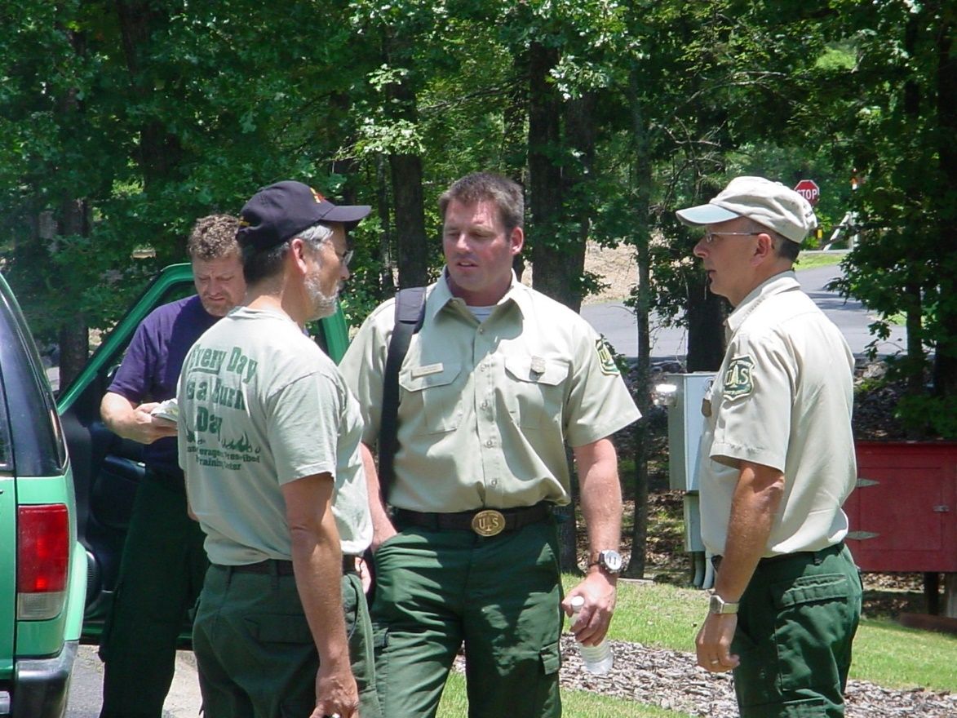
Fire Danger Management Tools
Notes:
Slide # 24
Standardized Fire Danger Management Tools also offer an effective and systematic method to improve decisions.

Slide 25

Fire Management Decisions & Risk
How can we manage risk using Fire Danger Rating?
Notes:
Slide # 25
Fire Danger Rating to Manage Risk –
Provides a basis for an appropriate response commensurate with the level of risk
The Fire Danger Management Tools which area available provide an analytical methodology which quantifies “risk”
Risk Perception -
Assessing/evaluating the amount of risk, and how acceptable this risk is—this involves human judgment. There is no way to avoid this. This is present at all levels, from Line Officers, Incident Commanders, to crew leaders to crewmembers.
Everyone perceives risk through their own “lens,” based on their own “world.” These lenses are not good or bad, they are just different lenses. Seeing risk differently is not about integrity or intelligence, it can be just a matter of perspective.
There are factors that influence how humans perceive risk and acceptability. These factors may include:
individual differences,
role in the organization,
personal experiences,
agency culture, training, and mission,
local history, including
past fires,
the fire you just came from,
who you are currently talking to and hearing from,
social and political factors (this is sometimes ignored, but agencies serve a public mission),
stakeholders (our actions affect others, and we can’t pretend this doesn’t matter or affect decisions. There is a sense of consideration/obligation/responsibility to stakeholders—a felt need to at least consider threats to their values).

Slide 26
Fire Danger Management Tools
Staffing levels
Dispatch levels
Preparedness levels
Adjective fire danger rating
Fire restrictions
Notes:
Slide # 26
Fire Danger Management Tools
Staffing levels
Dispatch levels
Preparedness levels
Adjective fire danger rating
Fire restrictions

Slide 27
Staffing Levels
Staffing Level Examples
  OT Authorizations
  Do I need extra staffing tomorrow?
  Should I extend resources past their normal 8-hour duty-day?
  Do I have sufficient resources to send to new fires based upon the current Dispatch Level?
Notes:
Slide # 27
Staffing Levels
Staffing Levels form a basis of short-term (daily) decisions regarding the “degree of readiness” at the local unit for initial attack.
Staffing Level Examples:
How many people should I have work tomorrow?
Should I extend the fire suppression resources beyond their normal work hours this afternoon? How many people? Which resources? How long?
Staffing Level Decision Traps:
Funding Issues: If we haven’t accounted for day-to-day (short-term) needs, the ability to implement Staffing Level decisions is compromised. Assuming that this cannot be resolved is a status quo decision trap.

Slide 28
Response Levels
Response Level Examples
  At what level is there an automatic dispatch for air tankers?
  How do we factor in staffing level?
  What response level requires multiple resources (dozers, engines, etc.)?
Notes:
Slide # 28
Response Levels
Response (Dispatch) Levels are preplanned actions which identify the number and type of resources (engines, crews, aircraft, etc.) initially dispatched to a reported wildland fire based upon fire danger criteria.
Response (Dispatch) Level Examples:
At what level is there an automatic dispatch for air tankers
How do we factor in staffing level
What response level requires multiple resources (dozers, engines, etc.)
Response (Dispatch) Level Decision Traps:
Many times units set up dispatch levels based on current/full time staffed resources. However, fire managers know additional resources can be ordered to support field units during periods of high initial attack activity. Assuming one can only set up dispatch levels based on current budgeted resources is an example of a framing problem.

Slide 29
Preparedness Levels
Preparedness Level Examples
  At what point (when) do I feel comfortable letting resources go off-unit to fire or detail assignments? Draw-down Levels?
  When is the Duty Officer required to be on site in the dispatch office?
Notes:
Slide # 29
Preparedness Levels
Preparedness Level Examples:
At what level should MAC groups be activated
When should additional decision support resources be ordered such as a decision support center, SOPL, etc.
At what point (when) do I feel comfortable letting resources go off-unit to fire or detail assignments? Draw-down Levels?
When is the Duty Officer required to be on site in the dispatch office?
Preparedness Level Decision Traps:
It is not uncommon for units to make determinations of preparedness levels based on limited criteria or lack of understanding of appropriate criteria. This would be an example of a shooting from the hip decision trap.

Slide 30
Adjective Fire Danger Rating
Adjective Fire Danger Rating Examples
  How often should Smokey’s arm change?
  When should public service announcements start?
  What other decision tools should be tied to this?
Notes:
Slide # 30
Adjective Fire Danger Rating Levels
Adjective Fire Danger Rating Levels are five standard adjective descriptions intended to be used for public information and signing.
Adjective Fire Danger Rating Level Examples:
How often should Smokey’s arm change
When should public service announcements start
What other decision tools should be tied to this
Adjective Fire Danger Rating Level Decision Traps:
A common practice to determine adjective fire danger rating is to standard product out of WIMS. This could easily produce some inconsistencies with some other decisions such as restrictions. This would be an example of a status quo decision trap or an anchoring trap.

Slide 31
Fire Restrictions
Fire Restriction Examples
  When should local/state agencies stop issuing burn permits?
  When should the Forest close access?
  When is firewood cutting allowed?
Notes:
Slide # 31
Fire Restrictions
Restrictions Examples:
When should local/state agencies stop issuing burn permits
When should the Forest close access
When is firewood cutting allowed
When are contractors restricted from harvest operations
Public Use Restrictions Decision Traps:
Units which do not have any clear criteria for establishing public or industrial restrictions maybe experiencing an overconfidence in judgment decision trap. Individuals functioning under this trap fail to collect key factual information.

Slide 32
Debiasing Tools and Methods
Education => Recognition
Embrace diverse input from those with expertise
Decision-support Tools (models)
Actions based upon predetermined criteria (Decision points)
Notes:
Slide # 32
Fire Restrictions
Restrictions Examples:
When should local/state agencies stop issuing burn permits
When should the Forest close access
When is firewood cutting allowed
When are contractors restricted from harvest operations
Public Use Restrictions Decision Traps:
Units which do not have any clear criteria for establishing public or industrial restrictions maybe experiencing an overconfidence in judgment decision trap. Individuals functioning under this trap fail to collect key factual information.

Slide 33
Summary
Rational & informed decisions are hampered by cognitive psychology.
Extreme fire danger conditions are predictable with NFDRS.
When used appropriately, NFDRS management tools will increase the odds for the “right” decision
Notes:
Slide # 33
Summary
Our ability to make rational and informed decisions is hampered by our cognitive biases and time constraints.
Several tragic incidents have demonstrated the predictability of extreme fire danger
The implementation of fire danger Management Tools and High Reliability Organizing (HRO) can optimize the outcome of a decision by minimizing the associated risk.

Slide 34
Review Objectives
Understand basic principles of decision-making and risk.
Provide examples of how the fire danger Management Tools can optimize the potential outcome of a decision by minimizing the associated risk.
Describe how the fire danger management tools support risk management.
Notes:
Slide # 34
Review Lesson Objectives:
Understand basic principles of decision-making and risk.
.
Provide examples of how the fire danger Management Tools can optimize the potential outcome of a decision by minimizing the associated risk.
.
Describe how the fire danger management tools support risk management.
.

Slide 35

Questions?
Notes:
Slide # 35
Questions?

