Slide 1
Intent, Policy, and Guidance for Fire Danger Rating and Implementing NFDRS2016
Lesson #1
Notes:
Slide # 1
Lesson #1: Intent, Policy, and Guidance for Fire Danger Rating and Implementing NFDRS2016
Lesson Time: 60 minutes (followed by a 15-minute break)
Facilitator Notes:
Don’t forget to fill in the “Workshop Dates” and “Workshop Location” on the bottom right of this title slide.
This opening presentation is intended to provide the participant an overview of the next few days.
DO NOT get “into the weeds” with the topics in this lesson (or you’ll never finish on time).

Slide 2
Objectives
Outline the expectations for workshop participants, instructors and coaches.
Provide an overview of the NFDRS2016 Rollout
Notes:
Slide # 2
Lesson Objectives:
Outline the expectations for workshop participants, instructors and coaches.
As instructors, facilitators, and coaches, we have some expectations for this workshop. Not only will we disclose our expectations, but we want to hear yours as well.
Provide an overview of the NFDRS 2016 Rollout
We’ll mention briefly how this workshop is part of a much larger plan to disseminate information for implementation of the NFDRS2016 my 2020.
Objectives 3 & 4 are continued on the next slide.

Slide 3
Objectives (cont’d)
Identify sources for specific agency guidance related to fire danger planning and associated weather station networks.
Introduce the interagency Fire Danger Operating Plan Template.
Notes:
Slide # 3
Lesson Objectives (cont’d):
Identify sources for specific agency guidance related to fire danger planning and associated weather station networks.
Nearly every agency with wildland fire management responsibilities has some kind of guidance or policy as it relates to preparedness planning using the National Fire Danger Rating System. We’ll identify those specific agency sources, or the lack thereof.
Introduce the interagency Fire Danger Operating Plan Template.
In order for landscape-scale preparedness planning to be effective, all affected parties must be engaged to the extent commensurate with their respective fire management workload. A Fire Danger Operating Plan template will be introduced to facilitate the interagency

Slide 4

NFDRS2016 Rollout Workshop Structure
Science & Technology Update
Decision Framing
Fire Business Analyses
Decision Support
Evaluation & Feedback
1 Agencies Direction
7 FDRAs
10 Weather Network
14 Decision Points
2 Managing Risk
8 AGOL
11 Statistics
15 Preparedness Plans
3 Best Practices
Desired End-State
9 Framing Fire Occurrence
12 Target Group Analysis
4 NFDRS2016
16 Case Study
5 Case Study
6 Implement & Evaluate
13 Case Study
DAY 1
Monday
DAY 2
Tuesday
DAY 3
Wednesday
DAY 4
Thursday
DAY 5
Friday
Target Groups
Matching Outputs to Fire Business
Preparedness Plans
Workshop
Evaluation
& Closeout
Task 3
FDRAs
Task 5
Task 7
Task 2
Wx Station Network
Decision Points
Veg/Topo/Climate
Task 1
Task 4
Task 6
Notes:
Slide # 4
ANIMATED SLIDE
Allow Day1 through Day5 boxes to animate across the screen . . . Then for each day, Click to animate the Lesson & Task pins
Rollout Workshop Structure & Process
This workshop is intended to be a series of 16 short presentations (or Lessons) which address general topics that precede 7 group exercises (which we will call Tasks).
The information gleaned from the lessons is intended to provide broad, but consistent, guidance to interagency units as they complete the next task in the development of their Fire Danger Operating Plan. Each of the seven tasks build upon each other sequentially.
Lessons: The lessons are intended to be short facilitative discussions which provide essential information and collaborative dialog for all workshop participants.
Case Studies – Three examples of fire danger applications compare past/current NFDRS with NFDRS2016. Lessons 5, 13, and 16 are intended to be decisional and analytical case studies which challenge participants to move to higher orders of learning by prompting them to ask “how” the issues are related to one another and “why” things happen the way they do.
Tasks: The information gleaned from the lessons is intended to provide broad, but consistent, guidance to interagency units as they complete the next task in the development of their Fire Danger Operating Plan. Each of the seven tasks build upon each other sequentially to reach the desired end-state (as defined at the end of this lesson).

Slide 5
Expectation for Instructors & Coaches
Instructors
Coaches
Start / end presentation(s) on time
Keep focused on the lesson intent; avoid “chasing rabbits”
Encourage questions, but answer with brevity; defer detailed explanations to the coaches when with their groups
Mentor, coach, motivate and facilitate
Be the group’s personal subject-matter expert
Keep the group focused and on-schedule
Be available; be approachable
Notes:
Slide # 5
Roles of the Instructors & Coaches
Key Points:
Instructors will be delivering the big picture material to deliver a consistent message to all groups within the Geographic Area. The intent is to leave the detailed discussions for the breakout sessions (where the coaches will become the facilitative instructors). Otherwise, instructors will likely go over their allotted lesson time because they will get “side-tracked” by “chasing rabbits”.
The workshop is intended to be driven by the coaches in small group breakouts. Coaches will be the primary “go-to” person for detailed questions and discussion regarding the specifics of the respective FDOP. Mentor, coach, motivate, and facilitate.
The goal is to spend more time in the smaller groups (where the work is getting done); less time listening to an instructor.

Slide 6

Expectations for Participants
  Teamwork
  Stay engaged
  Be respectful
  Use the coaches
  Become aware of your biases; maintain an open mind
Notes:
Slide # 6
Roles of the Participants
Key Points:
Participants are expected to participate and fully engage as a team member with their respective group
Participants should be respectful of other participants, instructors, and coaches.
Participants should address questions, comments, and concerns with their respective coach(es)
Become aware disclose your cognitive biases; keep an open mind; be receptive to new concepts and procedures
Emphasize . . . Participants should not be working on laptop computers or mobile devices while a facilitator is making a presentation. Lids to laptops should be closed; mobile devices should be turned off or set to silent mode.

Slide 7
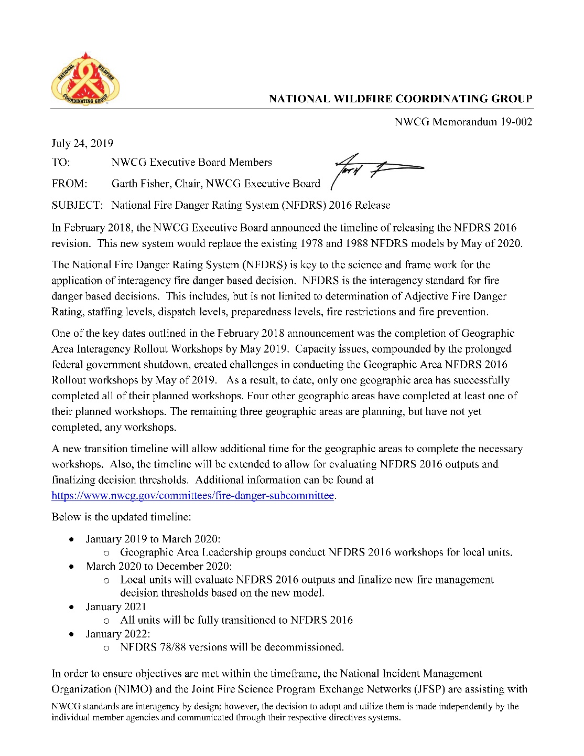
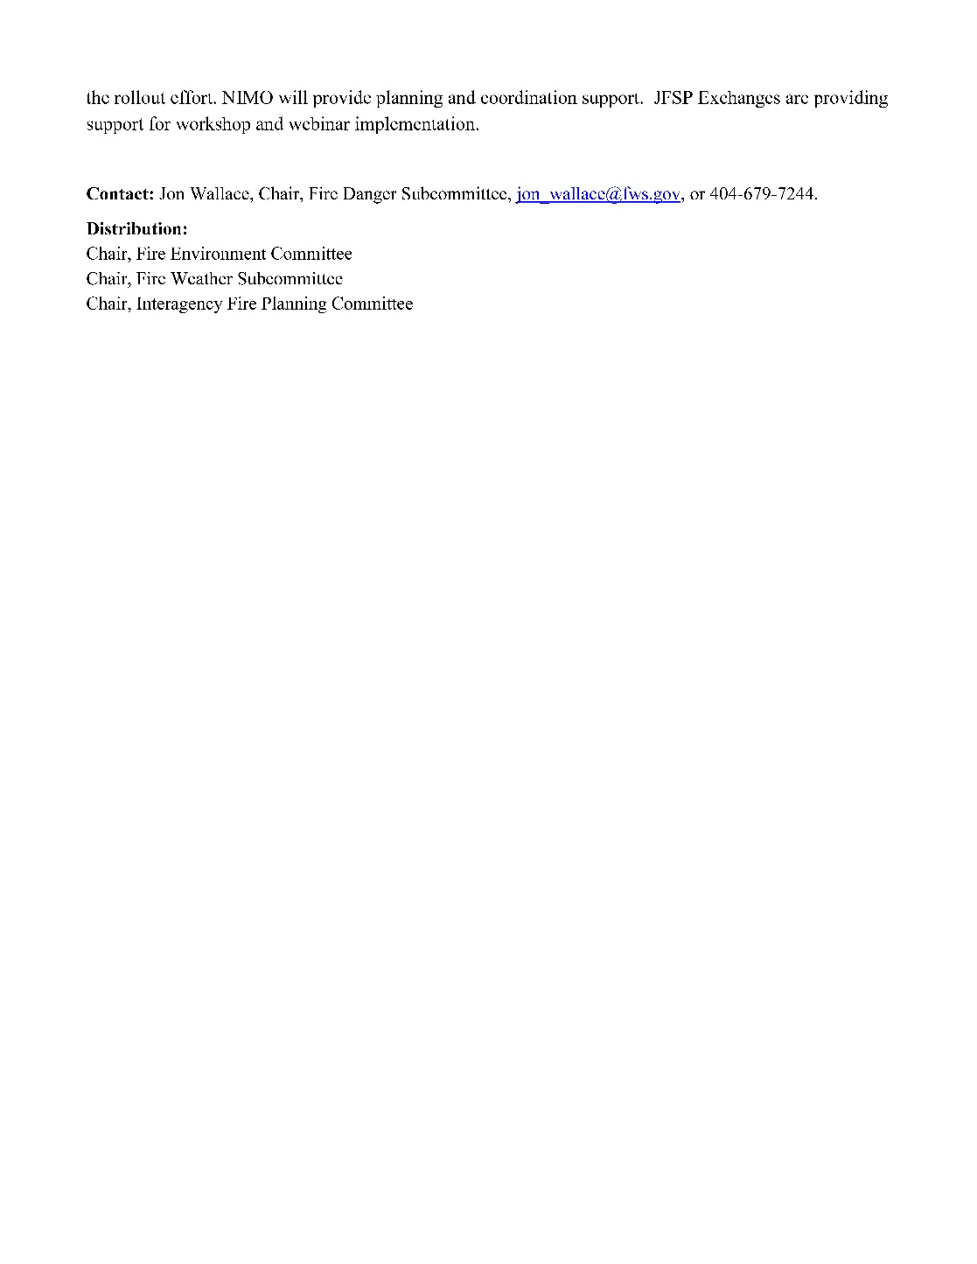

National Wildfire Coordinating Group
“The National Fire Danger Rating System (NFDRS) is key to the science and frame work for the application of interagency fire danger based decision. NFDRS is the interagency standard for fire danger based decisions.”
NWCG Memorandum 19-002 established a NEW deadline of January 2021 for complete transition to NFDRS2016
NWCG Memorandum 19-002
Notes:
Slide # 7
NWCG Memorandum (19-002)
Capacity issues, compounded by the prolonged federal government shutdown, created challenges in conducting the Geographic Area NFDRS 2016 Rollout workshops by May of 2019.
Geographic areas needed additional time to complete the necessary workshops.
Additional time was needed to evaluate NFDRS2016 outputs and finalize decision thresholds.
The IM established a NEW deadline of January 2021 for complete transition to NFDRS2016.
This is the updated timeline:
January 2019 to March 2020:
Geographic Area Leadership groups conduct NFDRS 2016 workshops for local units.
March 2020 to December 2020:
Local units will evaluate NFDRS 2016 outputs and finalize new fire management decision thresholds based on the new model.
January 2021
All units will be fully transitioned to NFDRS 2016
January 2022:
NFDRS 78/88 versions will be decommissioned.

Slide 8
Updated NFDRS2016 Rollout Plan Timeline
Notes:
Slide # 8
NWCG’s NFDRS2016 Rollout Plan Timeline
January 2018 - December 2018:
GA leadership groups will be formed.
April 2018, GA leadership groups will attend a NFDRS2016 workshop at NAFRI to prepare for GA rollout workshops.
April 2018, NFDRS2016 will be widely available for use. WIMS and FireFamilyPlus updates will be complete.
Four online and/or instructor-led NFDRS2016 lessons will be available for previous S-491students (Fire Danger Subcommittee recommends all previous S-491 students take these lessons).
September 2018– May 2019:
GA leadership groups will conduct NFDRS2016 workshops geared toward field level practitioners.
The Alpha version of the updated S-491 course will include instruction of the NFDRS2016 model.
June 2020 – December 2020:
Local units will evaluate NFDRS2016 outputs and finalize new decision thresholds based on the new model.
May 2020:
May 1st 2020 is the deadline for complete transition to the NFDRS2016 system.
After the NFDRS2016 rollout workshop is completed, local units will have a working draft of a Fire Danger Operating Plan. It is expected that local units will evaluate their updated fire danger‐based decisions to gain familiarization with the new NFDRS2016 model components, outputs and implementing the best practices for interagency, fire danger-based decisions. In order to gain a better understanding of the effects of the new model, local units are encouraged to evaluate several common elements which will be posted with the webinar material on the NFDRS2016 rollout website.

Slide 9

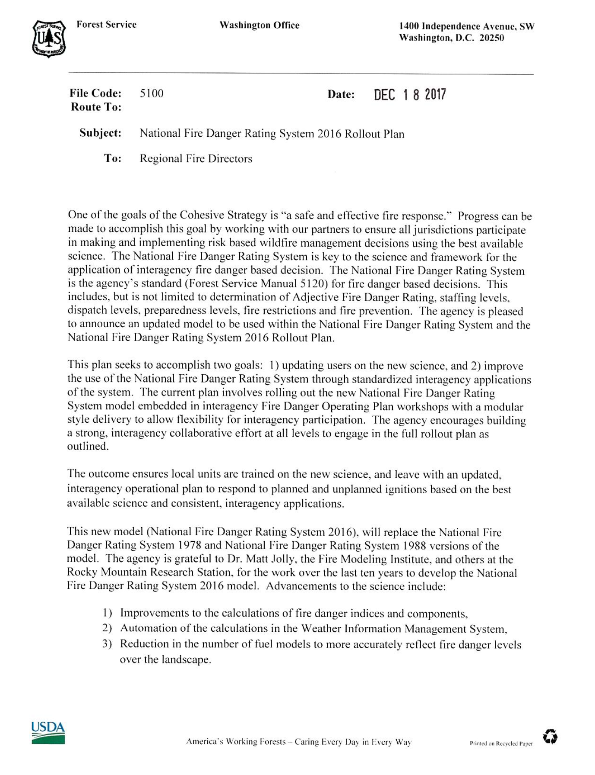
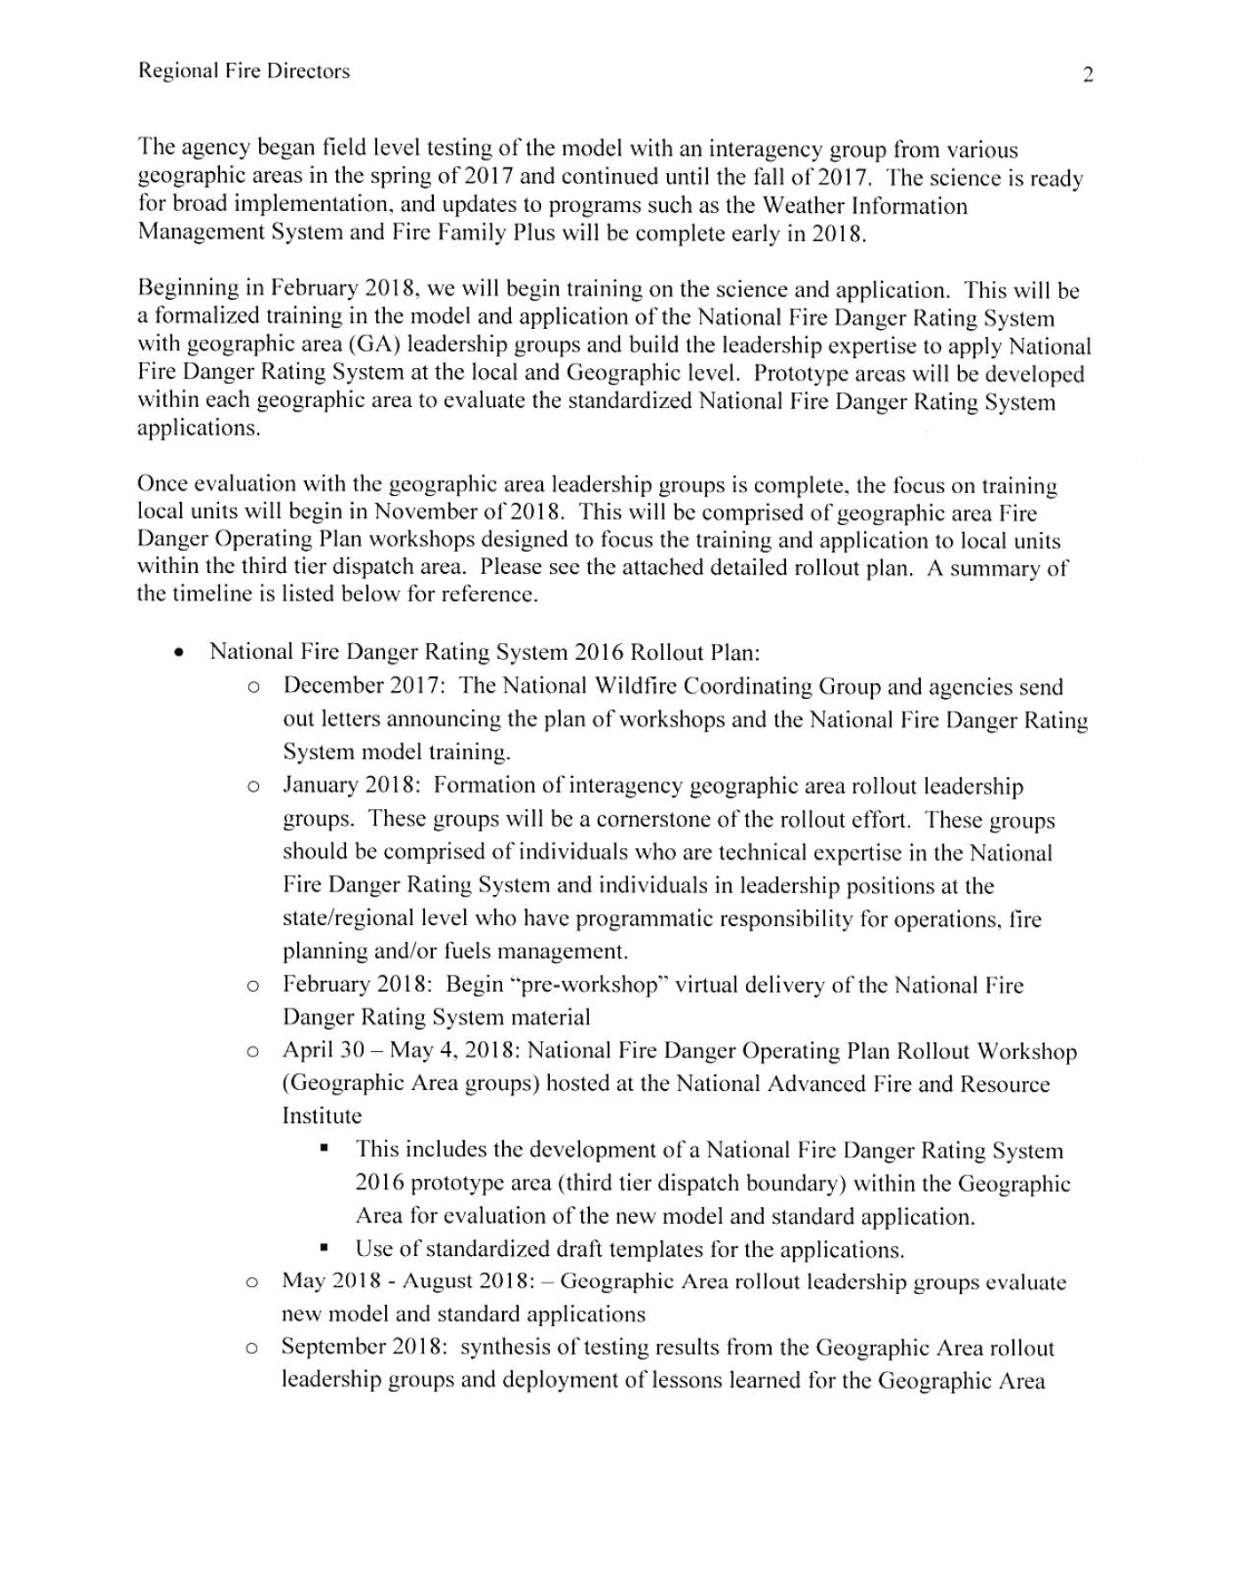
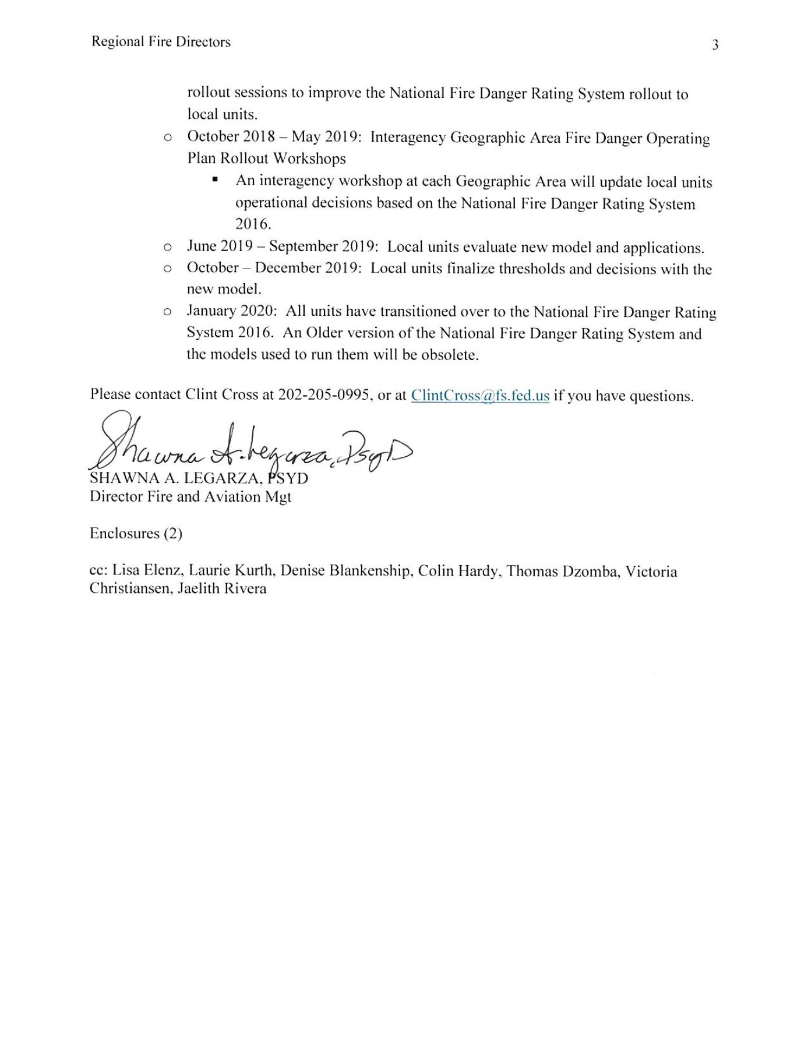
U.S. Forest Service
The NFDRS2016 Rollout Plan seeks to accomplish two goals:
updating users on the new science
improve the use of the National Fire Danger Rating System through standardized interagency applications of the system
Notes:
Slide # 9
U.S. Forest Service Rollout Plan
In December 2017, the Forest Service Fire Director issued guidance and direction to Regional Fire Directors regarding the initial implementation (or “rollout”) plan in preparation for the transition to NFDRS2016.
In December, three documents were issued by the Forest Service:
Letter from the Forest Service Fire Director (KEY POINTS):
The National Fire Danger Rating System is the agency's standard (Forest Service Manual 5120) for fire danger-based decisions.
The Forest Service NFDRS2016 Rollout Plan (attached to the letter) seeks to accomplish two goals:
updating users on the new science, and
improve the use of the NFDRS through standardized interagency applications of the system.
NFDRS2016 Initial Rollout Plan (KEY POINTS):
Provided a detailed initial plan for the phased rollout of the NFDRS 2016 model and applications
Outlined roles for the Fire Danger Sub-Committee, GA Leadership Groups, and General Users
Included objectives and critical needs to achieve expected outcomes.
Briefing Paper to State and Private Forestry (KEY POINTS):
Summarized the previous key points and timeline
Recommended that the USFS lead the overall effort, “collaborating closely with interagency partners”
Point out to participants that these documents are posted under the NWCG Fire Danger Subcommittee Home Page: https://www.nwcg.gov/committees/fire-danger-subcommittee

Slide 10
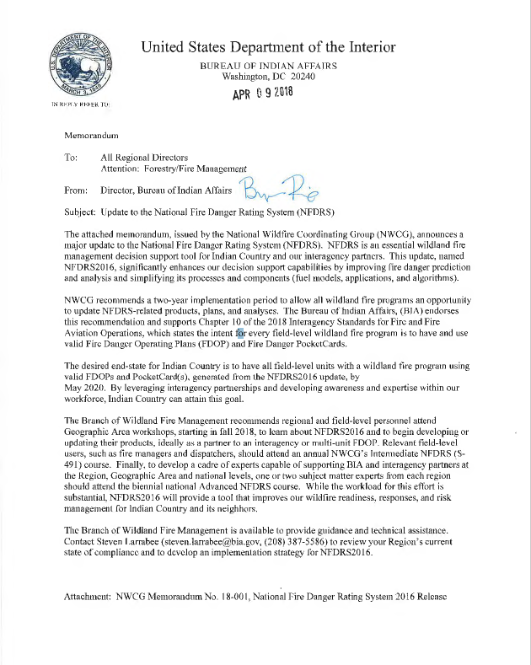

Bureau of Indian Affairs
“The desired end-state for Indian Country is to have all Field-level units with a wildland fire program using valid FDOPs and PocketCard(s), generated from the NFDRS2016 update…”
Notes:
Slide # 10
BIA Endorsement --

Slide 11
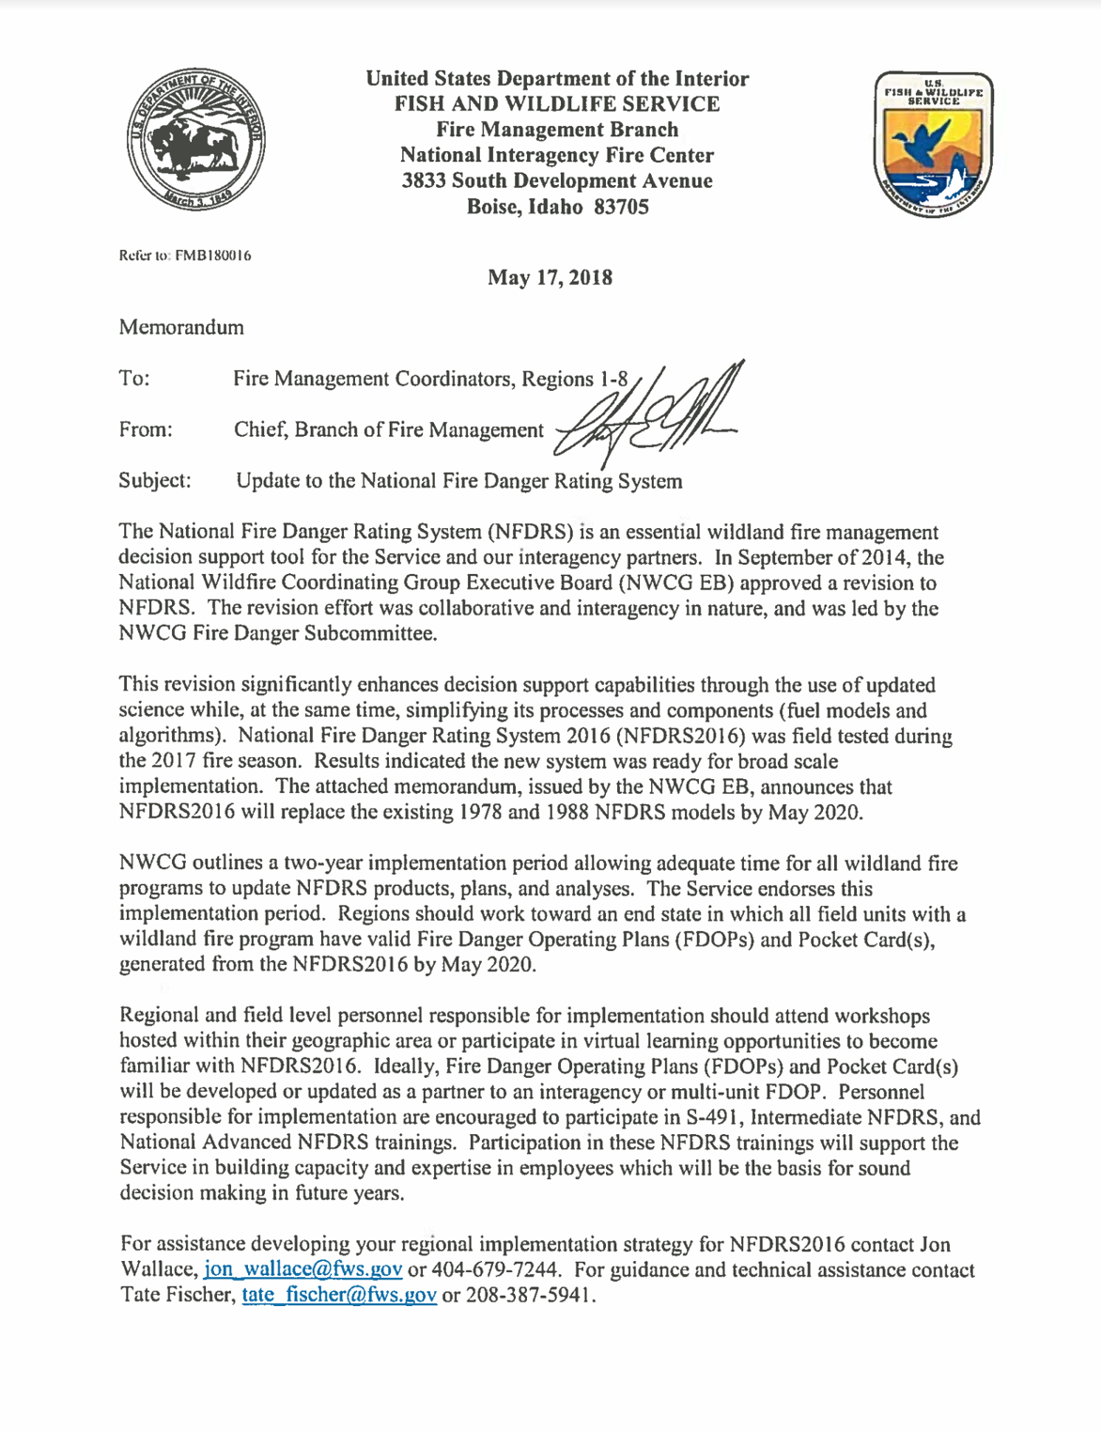

U.S. Fish & Wildlife Service
“Regions should work toward an end state in which all field units with a wildland fire program have valid Fire Danger Operating Plans (FDOPs) and Pocket Card(s), generated from the NFDRS2016 by May 2020.”
Notes:
Slide # 11
US F&WS Endorsement --

Slide 12
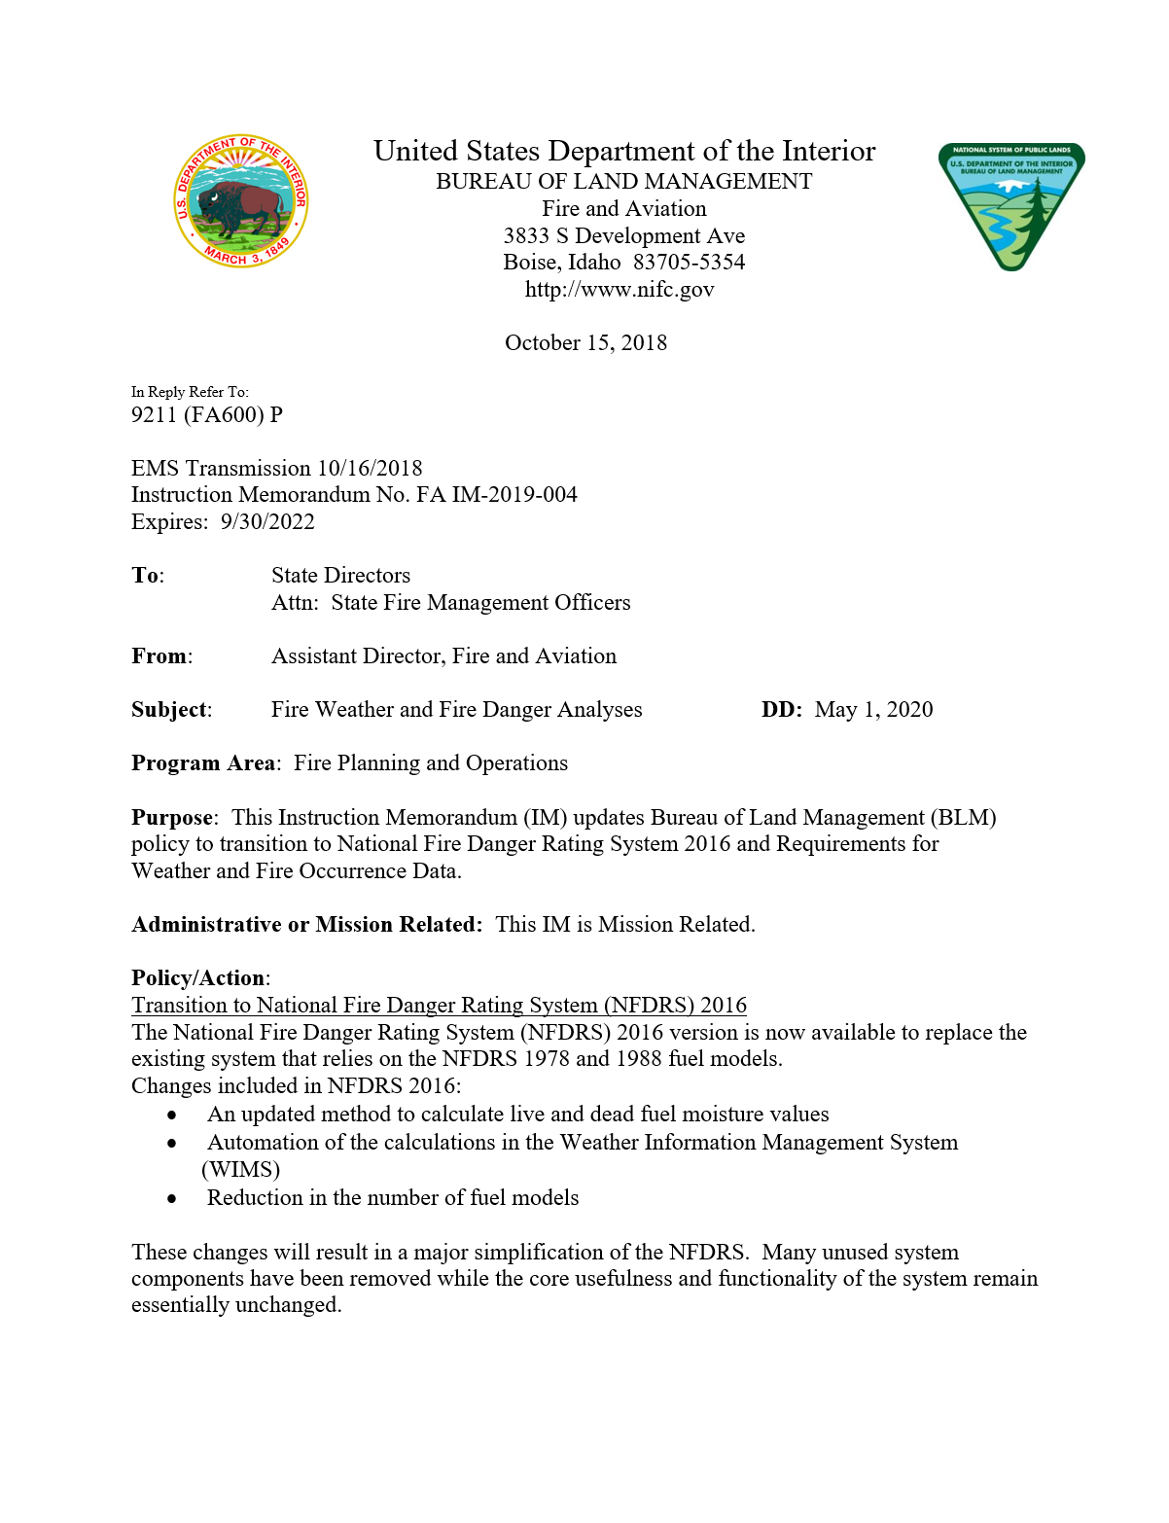

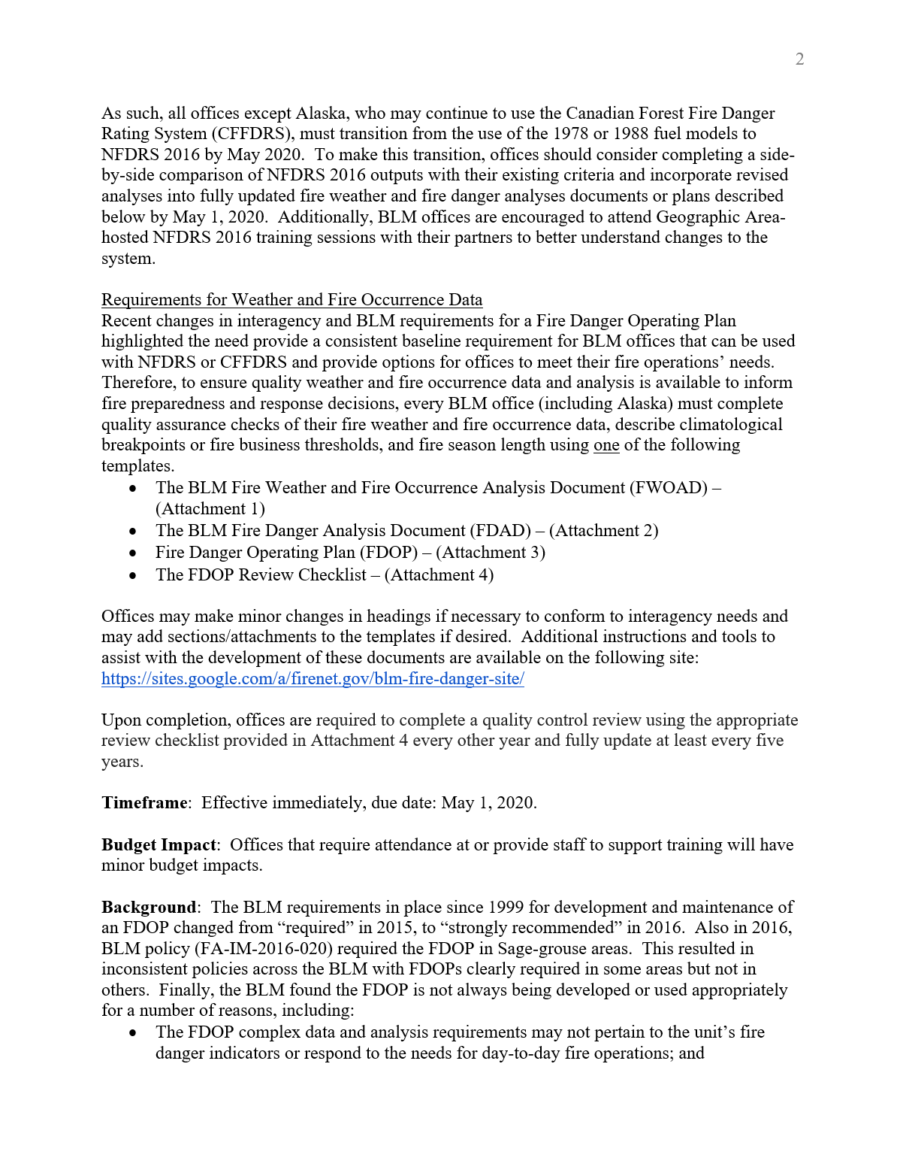
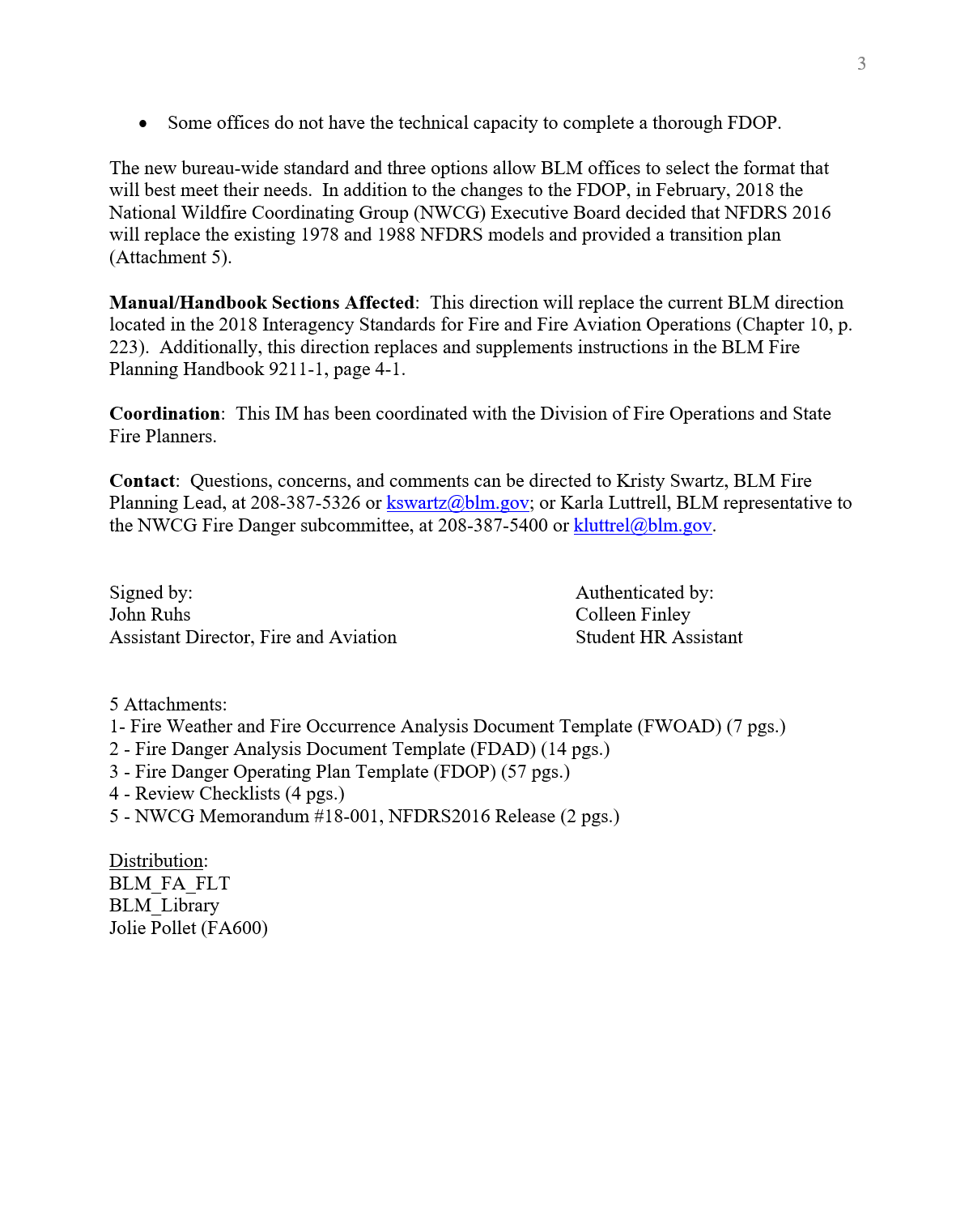
Bureau of Land Management
“ . . . all offices except Alaska . . . must transition from the use of the 1978 or 1988 fuel models to NFDRS 2016 by May 2020. Additionally, BLM offices are encouraged to attend Geographic Area-hosted NFDRS 2016 training sessions with their partners to better understand changes to the system.”
Notes:
Slide # 12
BLM Endorsement

Slide 13
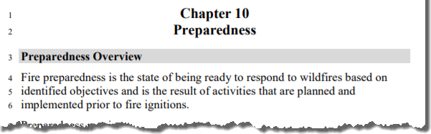
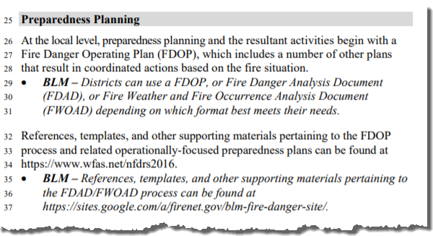
Interagency Standards for Fire and Fire Aviation Operations
(Red Book, Chapter 10 – Preparedness)
“At the local level, preparedness planning and the resultant activities begin with a Fire Danger Operating Plan (FDOP), which includes a number of other plans that result in coordinated actions based on the fire situation.”
Notes:
Slide # 13
Animated Slide
Interagency Standards for Fire and Fire Aviation Operations (Chapter 10 – Preparedness)
This language refers to the FDOP as the focal point for preparedness planning. In addition, the FDOP will include several other plans that have been coordinated to result in actions based on fire danger levels.
Other background information:
For the USDI - Bureau of Land Management the Red Book is supplemental policy. . . Except for Fire Danger Preparedness Planning.
BLM IM FA-IM-2019-004 replaces Red Book language pertaining to the FDOP for the BLM.
For the USDA Forest Service the Red Book is referenced in Forest Service Manual 5108.
For the USDI - Fish and Wildlife Service the Red Book is supplemental policy.
For the USDI - National Park Service the Red Book is supplemental policy, in addition to Reference Manual 18.
For the USDI – Bureau of Indian Affairs the Red Book is supplemental policy.

Slide 14
Workshop Road Map
NFDRS2016 Rollout Workshop
Notes:
Slide # 14
*Note: the next 10 slides are animated. With the exception of this slide, Click to advance to the next slide.
The next 10 slides take the participant on a journey which previews the major elements of the NFDRS2016 Rollout Workshop. The journey follows a “Road Map” to the destination – the Fire Danger Operating Plan.`

Slide 15
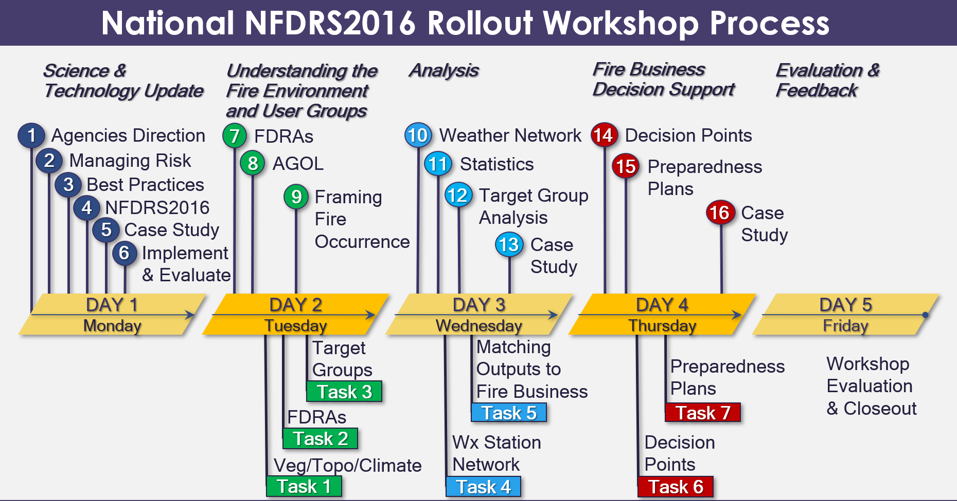

Workshop Structure & Process
NFDRS 2016
Science & Technology Update
Notes:
Slide # 15
Workshop Structure & Process:
Science & Technology Update:
Click to advance to the next slide.

Slide 16
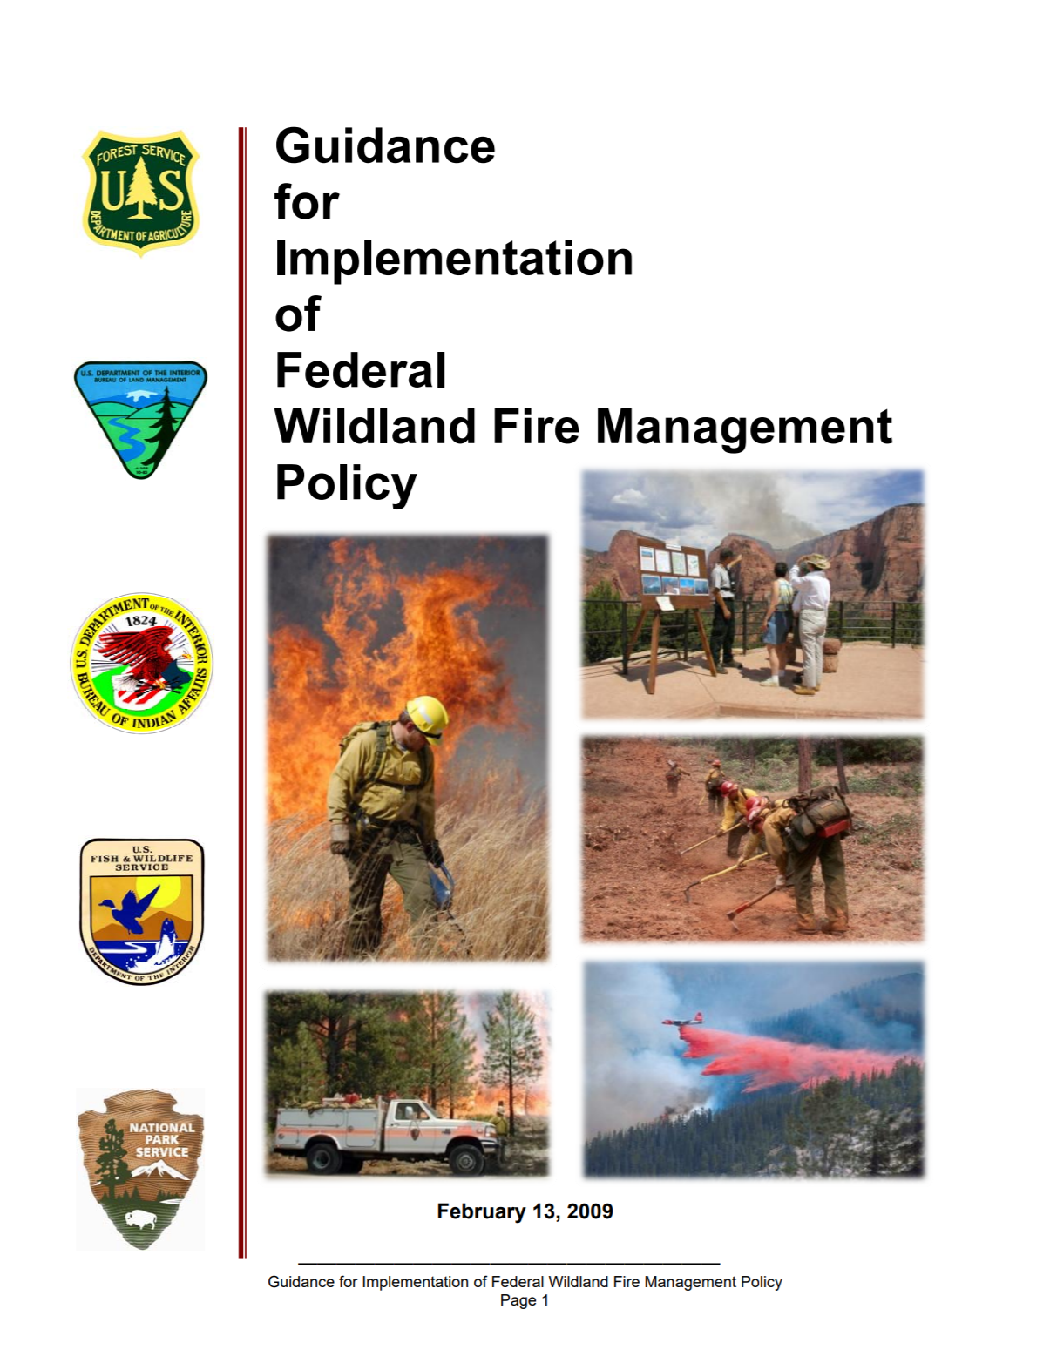
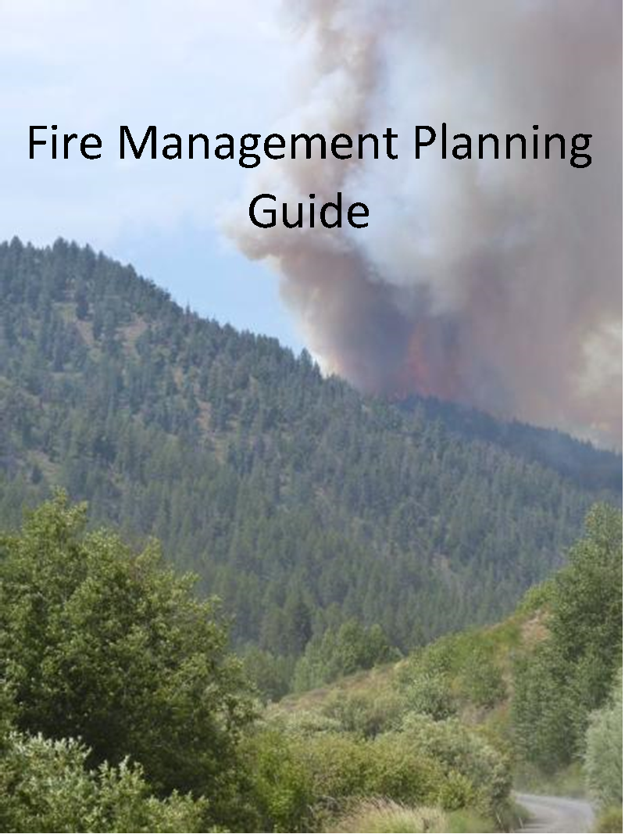
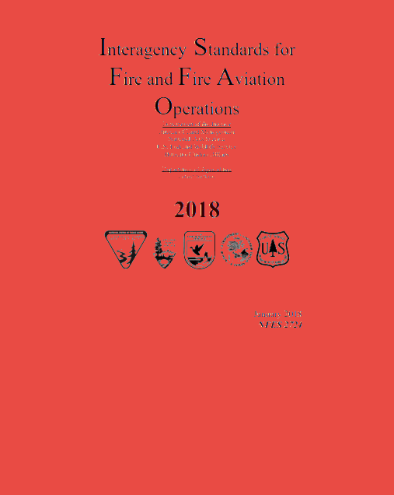
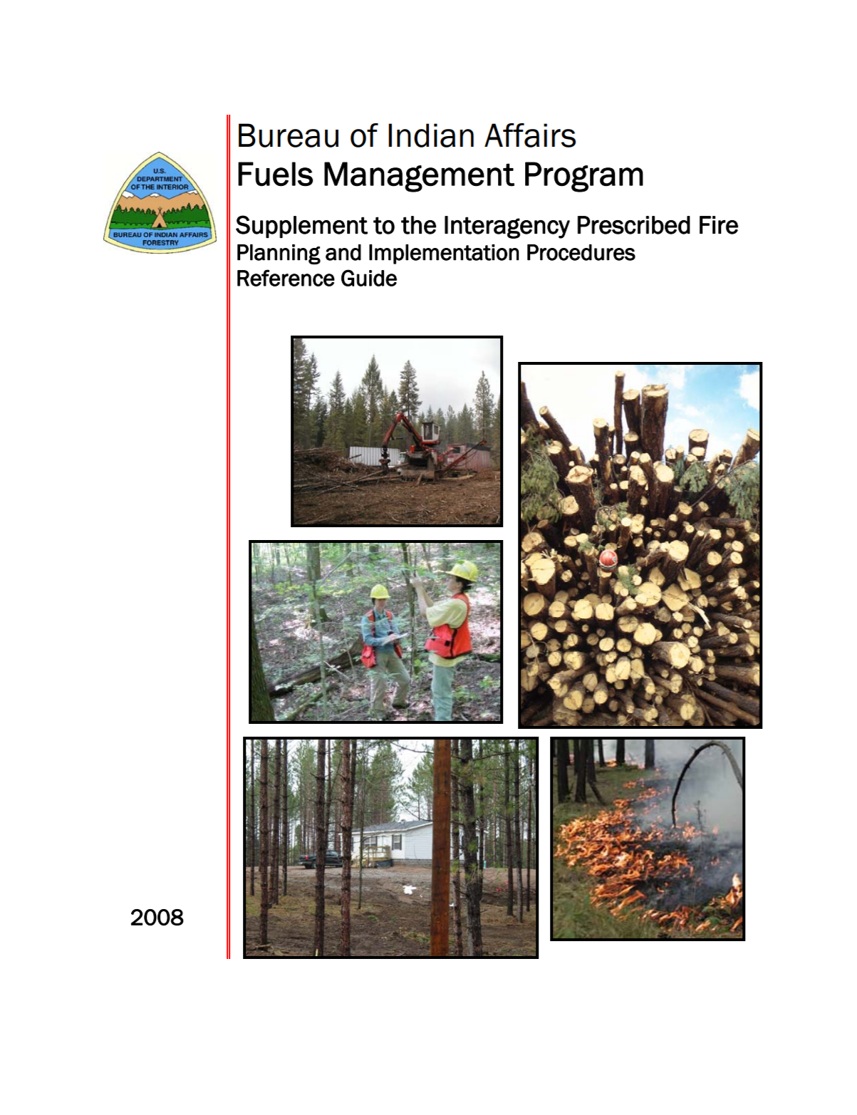
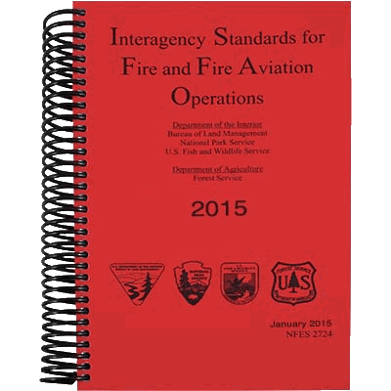
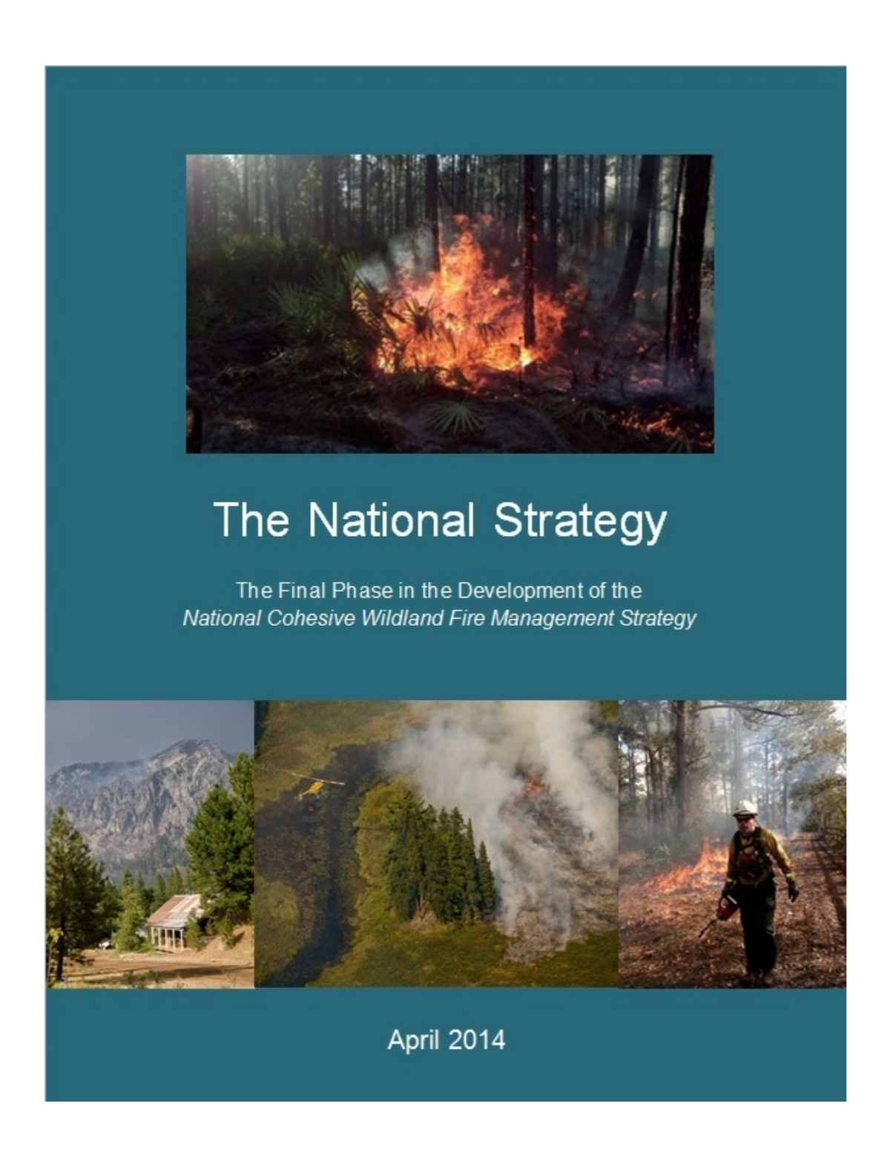
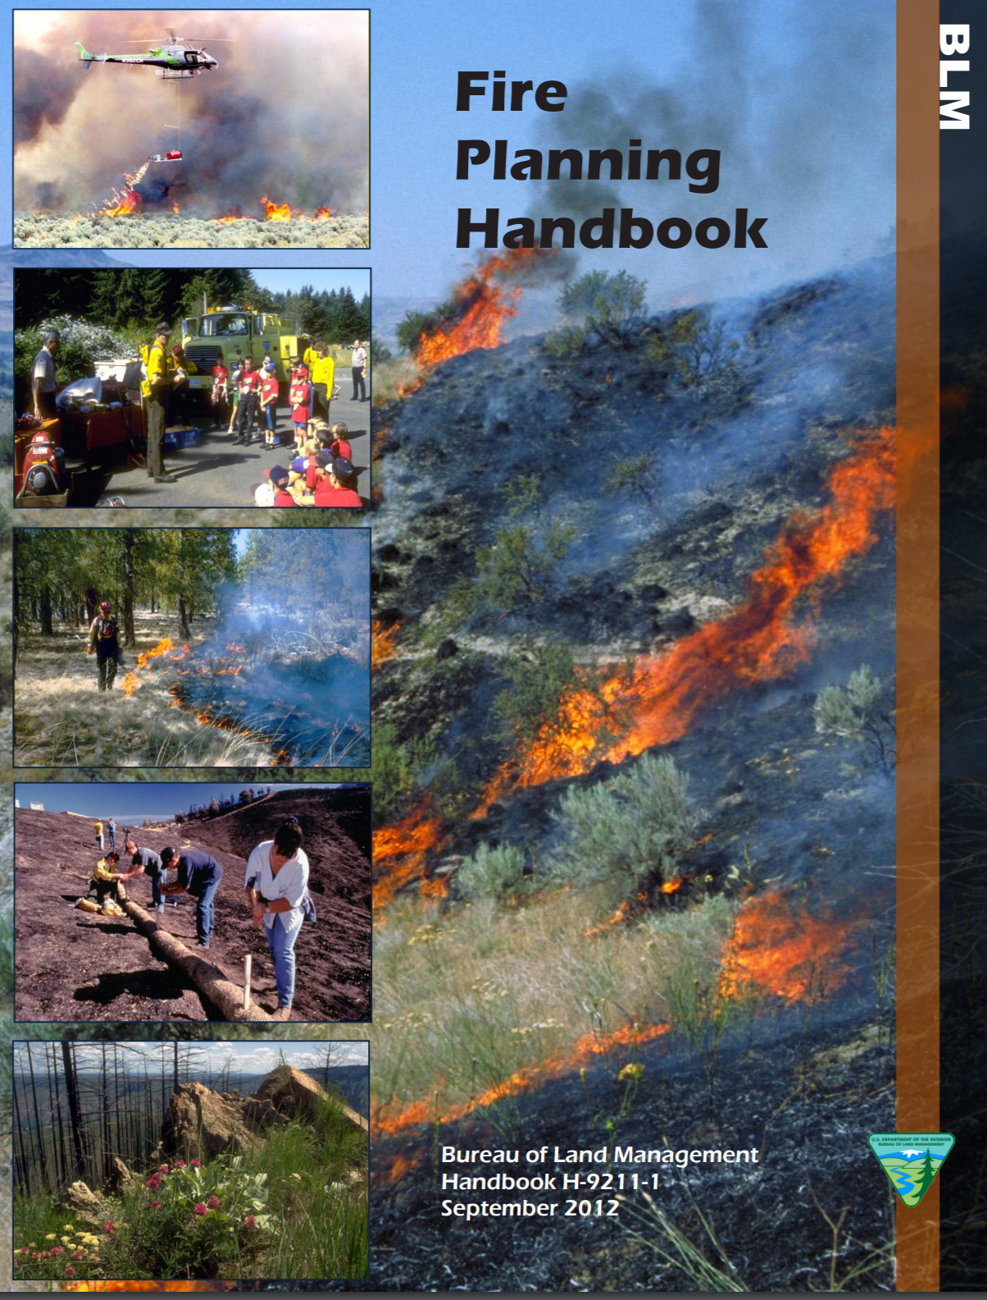
Agency Policy & Guidance
Notes:
Slide # 16
Ball rolls to mid-screen
Agency Policy & Guidance:
Multiple agency policy documents fall onto screen
Ball rolls off screen
Click => Transition to Next Slide

Slide 17

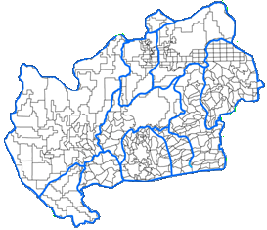
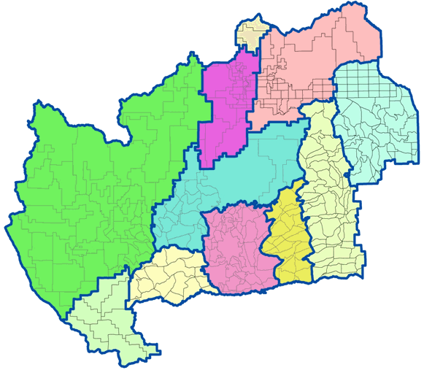

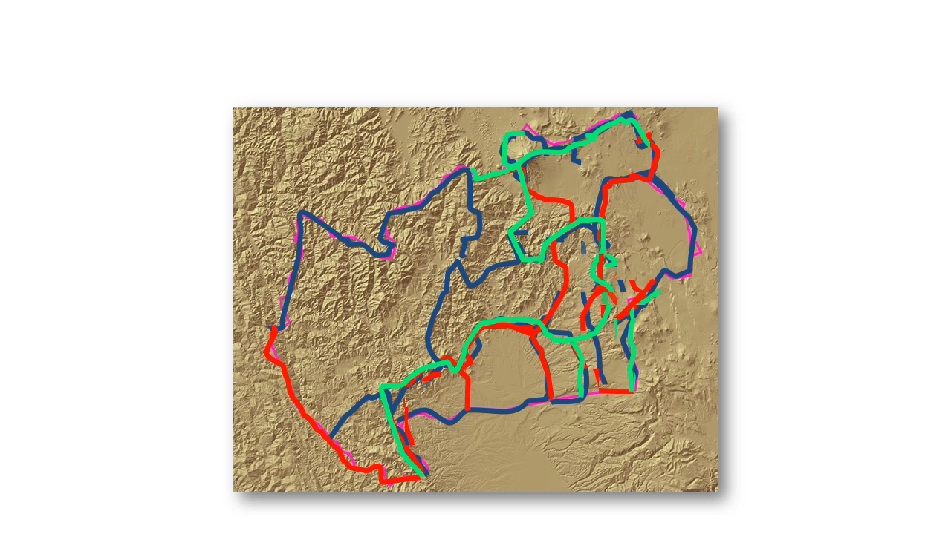
Classification of the Fire Environment
Vegetation
Topography
Climate
Response Areas
Fire Danger Rating Areas
Notes:
Slide # 17

Slide 18


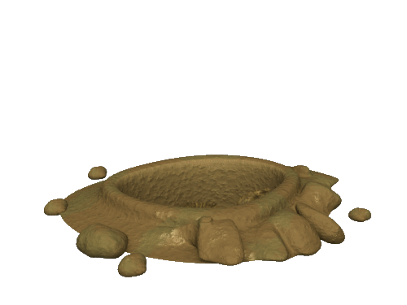





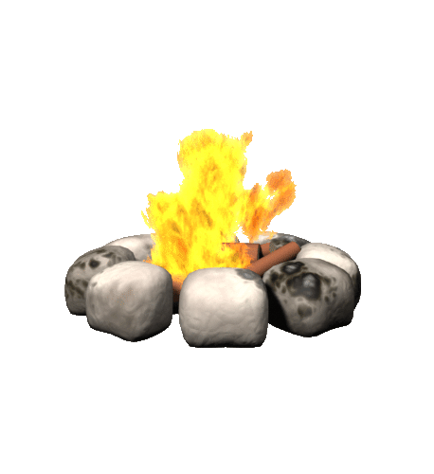
Decision Framing
Fire Occurrence
Target Groups
Notes:
Slide # 18

Slide 19

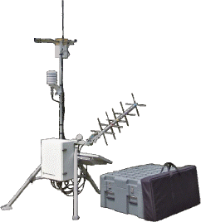

Weather Station Network
Reliability
Data Quality
RAWS
Notes:
Slide # 19

Slide 20
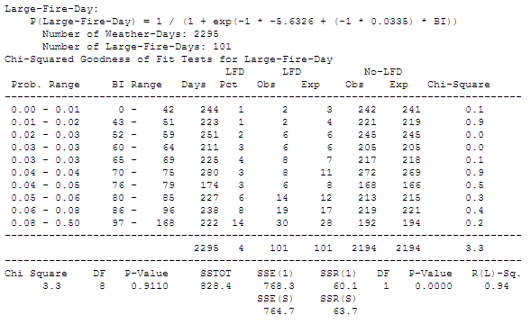
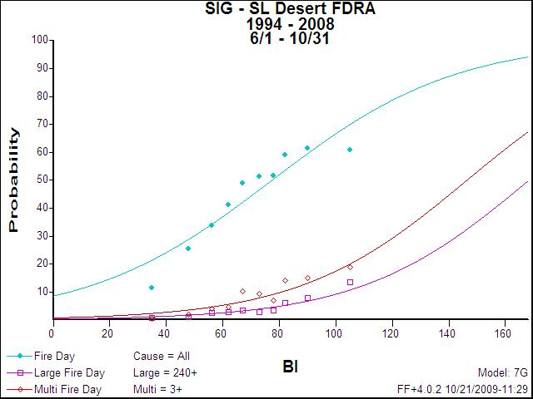
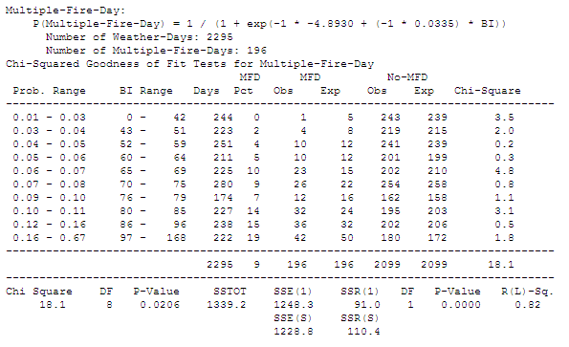
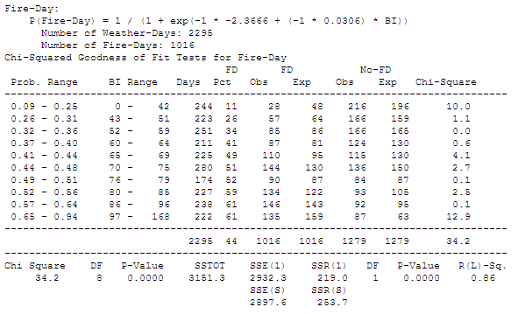

Applied Statistics
Using
FireFamilyPlus
Notes:
Slide # 20

Slide 21

Fire Preparedness Plans
Preparedness Plan
Response Plan
Staffing Plan
Prevention Plan
Notes:
Slide # 21

Slide 22
Decision Support
PocketCards
WFDSS
WIMS
Target Groups
Thresholds
Operational Considerations
Breakpoints
Notes:
Slide # 22

Slide 23
Fire Danger Operating Plan
The “Desired End-State”
Notes:
Slide # 23
So . . . What does the “desired end-state” look like?
** Next Slide **

Slide 24
The “Desired End-State”
Fire Danger Operating Plan
Appendices:
    Preparedness Levels (5)
    Staffing Levels (5)
    Response Levels (3-5)
    Adjective Fire Danger Rating Levels (5)
Preparedness Plan
Staffing Plan
Response Plan
Notes:
Slide # 24
Interagency Fire Danger Operating Plan (FDOP) Template
Desired End-State: The expectation at the end of the workshop is that each group has developed the following:
Fire Danger Operating Plan (FDOP) – an interagency FDOP which describes, for each Fire Danger Rating Area (FDRA), an analysis of historical fire occurrence and weather observations with rationale to support decision points determined from either climatological breakpoints or fire business thresholds. Minimally, each group will determine the following fire danger levels (reference Lesson 3 and FDOP Template):
Preparedness Levels (5)
Staffing Levels (5)
Response Levels (3-5)
Adjective Fire Danger Rating Levels (5)
Appendices – Minimally, the following plans will be incorporated as action plans tiered from the FDOP (Lesson 3 and FDOP Template):
Preparedness Plan
Staffing Plan
Response Plan
Prevention Plan (Optional) Using Adjective Fire Danger Rating Levels determined in the FDOP, include (at a minimum) those sections that pertain to fire danger-based decisions affecting the public, such as changing fire danger signs. Refer to each agency-specific guidance/policy regarding the incorporation of other fire danger-related decisions, such as restrictions and closures.

Slide 25
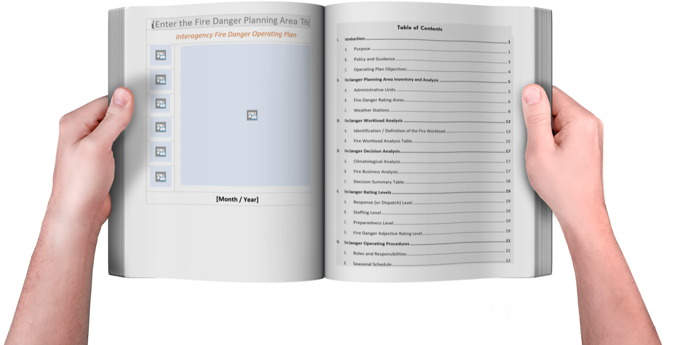
Fire Danger Operating Plan Template
Notes:
Slide # 25
Everyone should have access to an electronic copy of the Fire Danger Operating Plan Template.
More will be discussed about the Fire Danger Operating Plan template and the desired end state of this workshop as we progress.

Slide 26
Review Objectives:
Outline the expectations for workshop participants, instructors and coaches.
Provide an overview of the NFDRS 2016 Rollout
Notes:
Slide # 26
Review Lesson Objectives:
Outline the expectations for workshop participants, instructors and coaches.
Provide an overview of the NFDRS 2016 Rollout

Slide 27
Review Objectives (cont’d):
Identify sources for specific agency guidance related to fire danger planning and associated weather station networks.
Introduce the interagency Fire Danger Operating Plan template.
Notes:
Slide # 27
Review Lesson Objectives:
Identify sources for specific agency guidance related to fire danger planning and associated weather station networks.
Introduce the interagency Fire Danger Operating Plan template.

Slide 28


Questions?
Notes:
Slide # 28
Questions?

